Slide 1
Dialog Driven Wayfinding
MTech-Thesis
Arbaz Khan
Prof. Harish Karnick, Prof. Bharat Lohani

Slide 2


Dialog Driven Wayfinding
Goal
Cross-lingual wayfinding service compatible and accessible
to even low-end feature phones.
Challenge
To build a dialog driven wayfinding tool specifically targeting
maps and people of India.
To resolve contexts of the user.
To help deal with “Reorientation” of the lost.

Slide 3
Wayfinding Properties
DOs
  Use of landmarks to
    identify turns
    confirm orientations
  Description of route passage
DON'Ts
  Use of distance metrics or cardinal directions
  Naive turn by turn instructions (“turn left”, “go straight”)

Slide 4
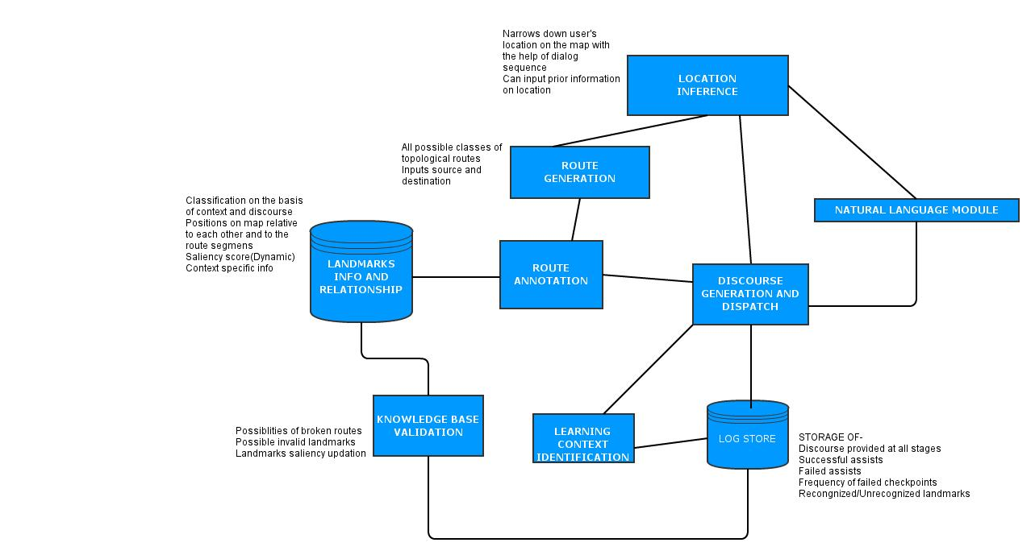
System Architecture

Slide 5
Route Generation
For two given points, compute a sequence of edges on the
shortest path
Cost features
  Distance (cost=edge length)
  Number of turns (cost=number of end-connections)
Edge features
  Id, name, length, type, geometry
  no. of end-connections
  absolute angles {(startpoint, startpoint+1),
                (endpoint, endpoint-1)}

Slide 6
Route Annotation
via Landmarks Info
Annotating each route with sufficient information for discourse generation
  - Static time complexity
1. Edge relation
  varying neighborhood threshholds
Edge | Academic Area Buildings | Hostel Buildings | Playgrounds | Parks | P.O.I

Slide 7
Route Annotation
via Landmarks Info
2. Landmark Saliency
Each category can take values based on the layering of the map
e.g. academic area, hostel Building
Visual feature attributes may not be always available
Semantic feature index may be contributed by popularity of the landmark
e.g. Retrieved from google's prominence index, web mining, crowd-sourcing
or inherent in the map
Landmark | Category | Name | Geometry | Visual | Semantic

Slide 8
Route Annotation
via Landmarks Info
Annotate the route with all possible
salient landmarks present in the region
Store the annotations in the form of
a triplet (edge, landmark, pairedRelation)
pairedRelations={Pass through, Pass with @left, Pass with @right,
Turn left @, Turn right@, ...... }

Slide 9
Route Annotation
via Landmarks Info
Compute the saliency scores for each landmark
Select the salient landmarks
Pass the corresponding triplets to the to the discourse module

Slide 10

Design Ahead
Discourse Generator
Cross-lingual discourse generation platform is set
Given the triplet (edge, landmark,pairedRelation), generate a discourse
Context Identification
On the basis of incremental dialog response,
resolve the context of the user
Log Store
Setting up the data requirements for performance
enhancements (like dialog,response, context)
Incorporating the log store
Reorientation Algorithm
Given the last waypoint checked, retain the location of
disoriented user.

Slide 11
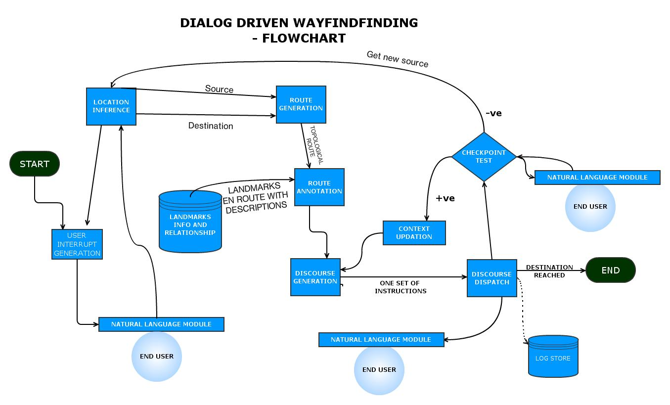

Slide 12
Location Inference
Automated extraction of triplets from natural language text to
represent spatial relationships e.g. house in alley
To use meta-information in the text to produce informative triplets
which are convenient enough for computational interpretations
Exploits a parser which identifies prepositional clauses(DLE)
for a place name.
Corpuses
1] 1858 place descriptions from a mobile game
2] A set of 4 descriptions of University of Melbourne

Slide 13
Location Inference

