Slide 1
Dialog Driven Wayfinding
MTech Thesis
Arbaz Khan, Prof. H. Karnick, Prof. B. Lohani

Slide 2
Dialog Driven Wayfinding
Goal
a cross-lingual wayfinding service compatible and accessible to even low-end feature phones.
Challenge
To build a dialog driven wayfinding tool specifically targeting maps and people of India
To resolve contexts of the user
To help deal with “Reorientation” of the lost.

Slide 3
Wayfinding Properties
DOs
Use of landmarks to
Identify turns
Confirm orientations
Description of route passage
DON'Ts
Use of distance metrics or cardinal directions
Naive turn by turn instructions (“turn left”,
“go straight”)

Slide 4
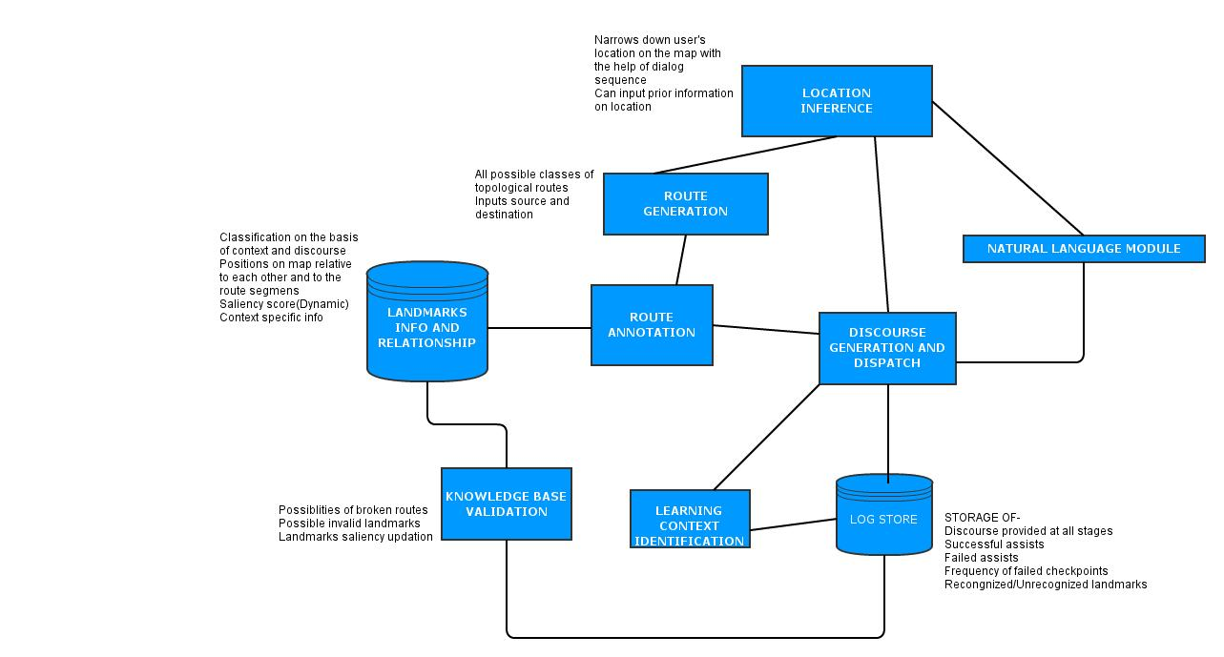
System Architecture

Slide 5
Route Generation
For two given points, compute a sequence of edges on the shortest path
Cost features
Distance (cost=edge length)
Number of turns (cost=number of end-connections)
Edge features
Id, name, length, type, geometry
no. of end-connections
absolute angles {(startpoint, startpoint+1),
(endpoint, endpoint-1)}

Slide 6
Route Annotation via Landmarks Info
Annotating each route with sufficient information for discourse generation
Static time complexity
Edge relation
varying neighborhood threshholds
edge | Academic Area Buildings | Hostel Buildings | Playgrounds | Parks | P.O.I

Slide 7
Route Annotation via Landmarks Info
2. Landmark Saliency
varying neighborhood threshholds
edge | Academic Area Buildings | Hostel Buildings | Playgrounds | Parks | P.O.I

