Slide 1

Git and Github

Slide 2
https://git-scm.com/docs/gittutorial
https://www.geeksforgeeks.org/git-tutorial/
https://www.atlassian.com/git/tutorials
https://www.geeksforgeeks.org/creating-repository-in-github/
https://www.geeksforgeeks.org/how-to-deploy-node-js-app-on-heroku-from-github/
https://www.geeksforgeeks.org/what-is-collaboration-in-git/

Slide 3
doskey /history

Slide 4
1. History of Git
Git is a distributed version control system (DVCS) created to help developers manage source code efficiently.
Timeline
2005: Git was created by Linus Torvalds.
It was developed after the Linux community stopped using the proprietary BitKeeper version control system.
Git was designed to be:
  Fast
  Secure
  Distributed
  Reliable
  Capable of handling large projects like the Linux kernel.
Today, Git is the most widely used version control system in software development.
Before Git, developers often had problems like:
Overwriting each other's code.
Losing previous versions of files.
Difficulty working in teams.
No easy way to undo mistakes.
Benefits of Git
✔ Version History -->Every change is recorded.
✔ Collaboration -->Many developers can work on the same project simultaneously.
✔ Backup
Every developer has a complete copy of the project.
✔ Branching
Developers can create separate branches for new features.
✔ Undo Mistakes
Git lets you restore previous versions if something goes wrong.
✔ Fast
Most Git operations happen locally.
No internet is required for many commands.
What is Version Control?
Version Control is a system that records changes to files over time.

Slide 5
Level 1: Absolute Beginner (The "What" and "Why")
What is Git?
Git is a Version Control System (VCS) or Source Code Manager (SCM) used extensively by developers, Data Scientists, and MLOps engineers.
Why do we need Git?
Version Control & Bug Fixing: Git allows you to take "snapshots" of your project at different stages. If a new piece of code breaks your project, you can easily roll back to a previous, bug-free version.
Collaboration: It enables multiple people (even across different time zones) to work on the exact same project simultaneously by dividing responsibilities.
Non-linear Development: You can create alternate timelines (branches) in your project to experiment with new algorithms or features without risking damage to the main project code.
The 4 Stages of Git Architecture
Understanding how files move is the key to mastering Git:
Workspace: Your local directory/folder where you are currently writing code. Git sees new files here as "untracked".
Staging Area: A preparatory zone (like a shopping bag). You move files here when you are ready for Git to start tracking their changes.
Local Repository: The place on your local machine where your committed "snapshots" or versions are permanently saved.
Remote Repository (GitHub): A cloud platform where you push your local repository. This protects against local data loss (like a laptop crashing) and allows teammates to pull your code.

Slide 6
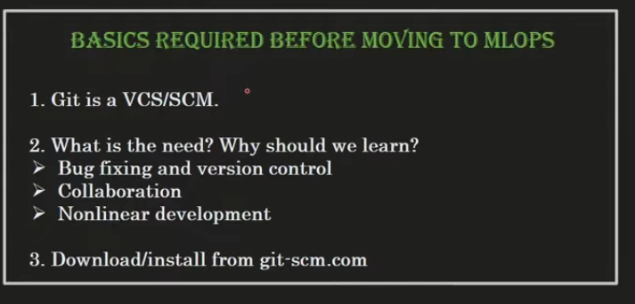
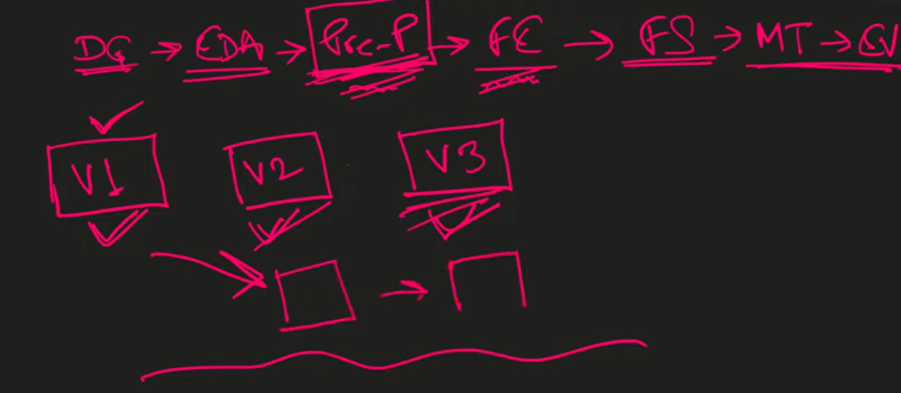
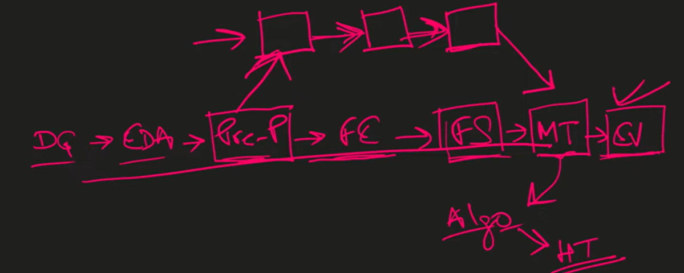
Non Linear Development

Slide 7
5. Important Git Concepts
Push
Uploads your local commits to the remote repository.
Repository (Repo)
A repository stores your project and its history.
Pull
Downloads the latest changes from the remote repository.
Commit
A commit is a saved snapshot of your project
Fetch
Downloads changes from the remote repository without merging them.
Branch
A branch is an independent line of development.
Merge
Merge combines one branch into another.
Remote Repository
A repository hosted on a server (for example, on a Git hosting platform) that multiple developers can access.
Clone
Clone creates a copy of a remote repository on your computer.

Slide 8
Level 2: Basic Operations (Getting Started)
Setup and Configuration
Download Git from git-scm.com and use Git Bash (the command-line interface) to run commands.
Set up your identity globally so Git knows who is making changes:
  git config --global user.name "Your Name"
  git config --global user.email "Your Email"
  git config --list
  note: (above command run only 1st time of git installations)
Core Commands
git init: Initializes a blank Git repository in your folder. It essentially "opens the shop doors" so Git can start monitoring files.
git status: Shows the current state of your project, including untracked files, modified files, and things ready to be committed.
git add <filename>: Moves a specific file from the Workspace to the Staging Area. You can use git add . to stage all changed files at once.
git commit -m "Your Message": Saves the staged files as a permanent version in your Local Repository. The message should clearly describe what work was finished (e.g., "EDA completed").
.gitignore: A special file where you list file names (like passwords, credentials, or rough notes) that you explicitly want Git to ignore and never track

Slide 9
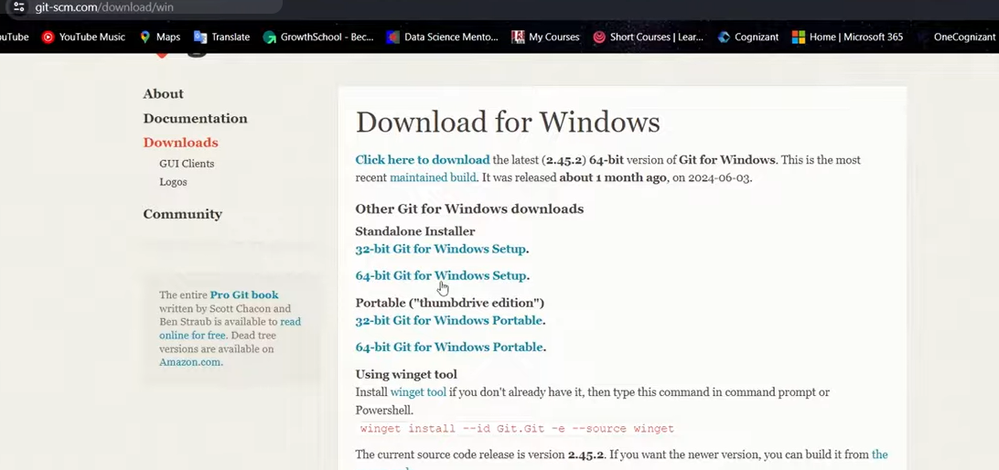

Slide 10
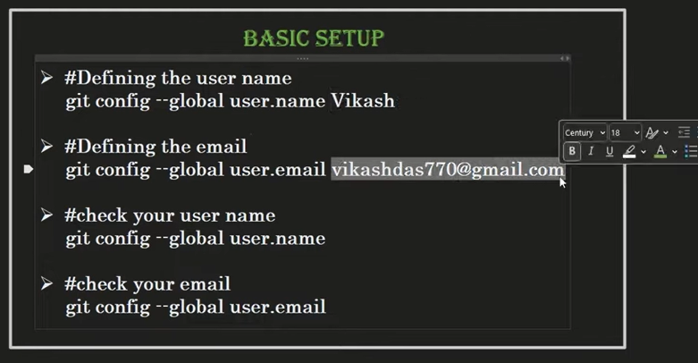
1. Configure Git (First Time)
git config --global user.name "John Doe"
git config --global user.email "john@example.com"
Check configuration:
git config --list

Slide 11
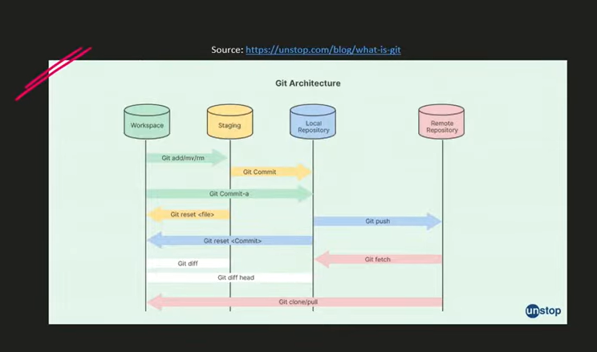

Slide 12
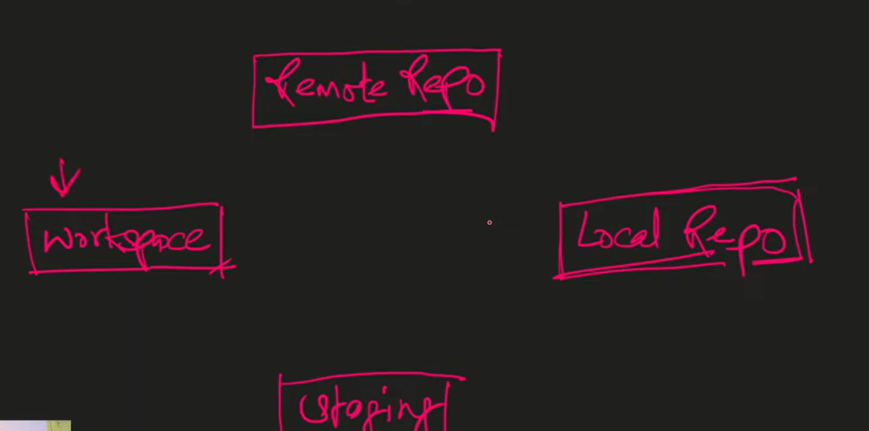

Slide 13
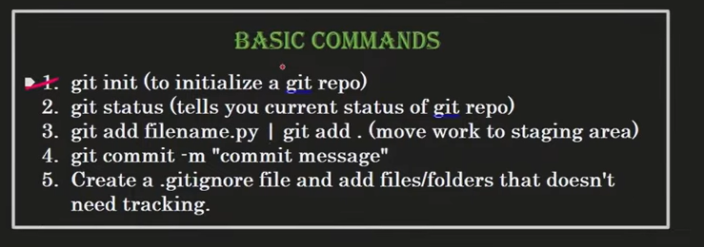
2. Create a Repository
Initialize a new repository
git init
Example:
mkdir myproject
cd myproject
git init

Slide 14
status
* git status
Git Add Commands
1. git add <file> Stages a single, specific file.
2. git add <file1> <file2> Stages multiple specific files simultaneously.
3. git add . Stages all new, modified, and deleted files in the current directory and its subdirectories.
4. git add -A Stages all changes across the entire repository, regardless of your current directory.
5. git add *.txt Stages all files matching a specific extension (e.g., all .txt files)
Git Commit
1. git commit -m "msg"

Slide 15
Level 3: Intermediate (Viewing History and Time Travel)
Viewing Your Project's History
git log: Displays a detailed history of all your commits, including the author, date, message, and a unique identification number called a SHA ID.
git log --oneline: Provides a summarized, cleaner view of your history, showing just the short SHA ID and the commit message.
git diff: Shows you the exact line-by-line code changes you have made in your Workspace before you commit them.
HEAD: A reference marker that points to the most recent commit on your active branch.
Time Travel (Rolling Back)
If you want to jump back to an older version of your code, use git checkout <SHA_ID>. This will instantly revert your files to exactly how they looked at that specific point in time.
To return to the present, simply run git checkout master

Slide 16
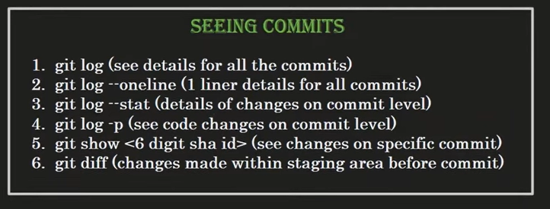

Slide 17
Common Commands
The git diff command is a fundamental tool in Git used to compare variations between different states of your code repository.
git diff: Shows unstaged changes against your index.
git diff --staged: Shows changes staged for your next commit.
git diff HEAD: Shows all changes since your last commit.
git diff <branch1> <branch2>: Compares two different branches.
git diff <commit1> <commit2>: Compares specific historical commits
git diff --statShows a brief summary of altered files and lines.
Common Rules and Syntax
Blank lines or #: Used for readability or to add comments.
Exact file names: Write secret.txt to ignore that specific file anywhere or in a specific folder.
Folder names: Add a trailing slash like build/ to ignore an entire directory.
Wildcards: Use *.log to ignore all files with a specific extension.
Exceptions: Use ! before a pattern (like !important.log) to track a file you would otherwise ignore.
A .gitignore file is a plain text file telling Git which files and folders to ignore in a project, such as node_modules, log files, and secret keys. It keeps your repository clean and prevents sensitive data from being shared.

Slide 18
Ignore a specific folder anywhere in the project:
node_modules/
Ignore a folder and everything inside it explicitly:
text
temp/**
Ignore a folder only at the root level (not its subfolders):
/config/
git rm -r --cached name_of_your_folder/
wildcards (like * or ?) depending on your specific use case.

Slide 19
Level 4: Advanced Local Operations (Branching & Merging)
Branching
By default, your project runs on a single straight timeline called the master or main branch. Branching allows you to diverge from the main timeline.
git branch <branch_name>: Creates a new branch (e.g., a "helper" branch).
git checkout <branch_name>: Switches your workspace to the new branch. Any code you write and commit here will not affect the master branch.
git branch: Lists all existing branches. An asterisk (*) indicates the branch you are currently on.
git checkout -b <branch_name> : create and switch
git switch:
Merging
Once you finish experimenting on a side branch, you can merge that code back into the main project.
Switch back to the main timeline: git checkout master.
Merge the side branch: git merge <branch_name>.
After merging, you can safely delete the experimental branch using git branch -d <branch_name> (use -D to force delete).
Resolving Merge Conflicts
If two developers change the exact same line of code on different branches, Git won't know which one to keep and will trigger a Merge Conflict.
When this happens, open the conflicting file in your code editor (like VS Code). You will see both versions of the code separated by markers.
You must manually select whether to "Accept Current Change", "Accept Incoming Change", or "Accept Both Changes".
Save the file, stage it, and commit it to finalize the conflict resolution

Slide 20
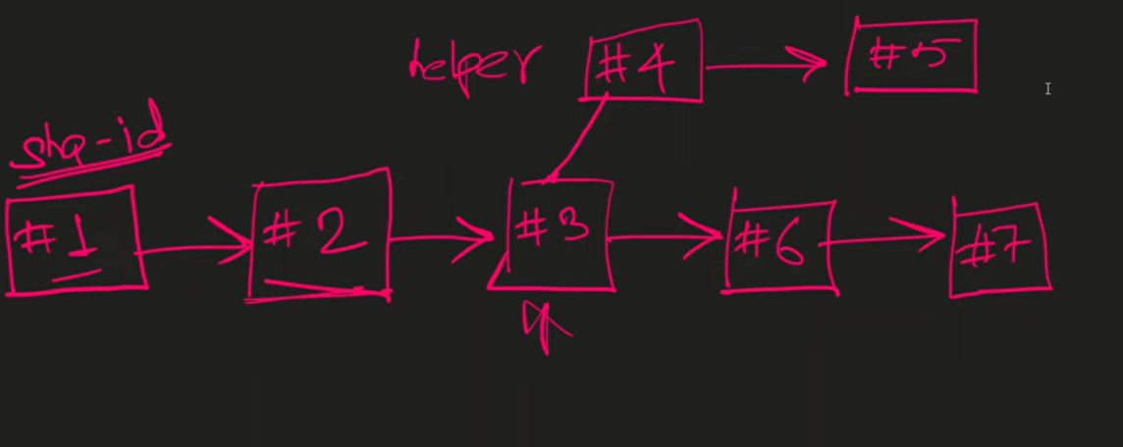
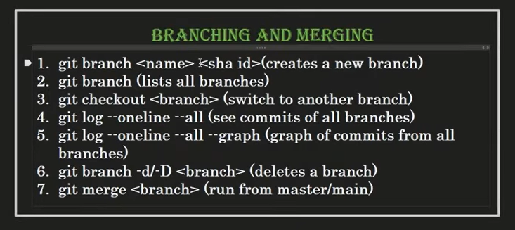

Slide 21
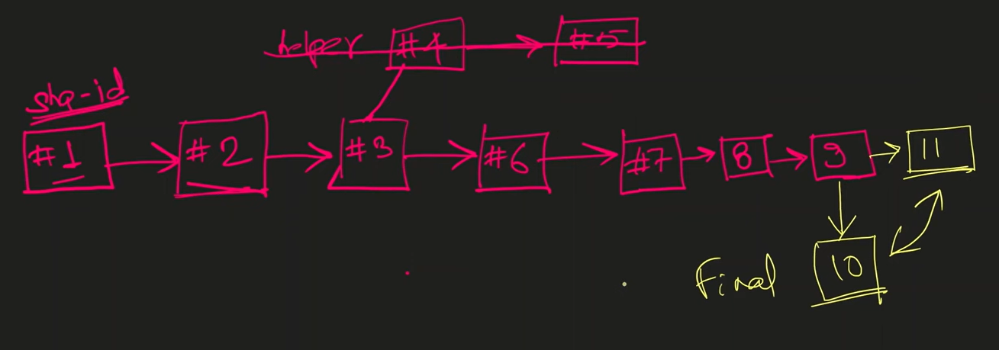
1. Create and Switch (Recommended)
These shortcut commands create the new branch and immediately switch your working directory to it. [1, 2]
git switch -c your-branch-name (Modern syntax available in Git 2.23+)
git checkout -b your-branch-name (Classic syntax) [1, 2]
2. Create Only
If you want to create the branch but stay on your current one, use the git branch command. [1]
git branch your-branch-nam

Slide 22
Level 5: Remote Collaboration (GitHub)
GitHub allows you to host your repositories in the cloud.
Connecting and Pushing Code
Create a New Repository on GitHub (can be Public or Private).
Link your local folder to GitHub using: git remote add origin <HTTPS_URL>.
Upload your local commits to the cloud using: git push origin master (or main).
Cloning and Pulling Code
git clone <HTTPS_URL>: If you want to download an entire existing repository from GitHub to your local machine, use this command.
git pull origin main: If a teammate has pushed new code to GitHub, use this command to fetch those updates and apply them to your local folder.
README.md: A file typically included in GitHub repositories used to describe the project's scope, architecture, and required technologies for recruiters or collaborators to read

Slide 23
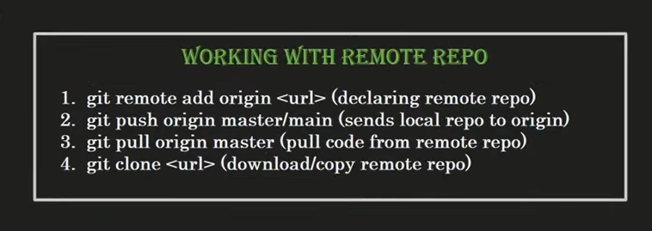

Slide 24
…or create a new repository on the command line
echo "# class-ml_project" >> README.mdgit initgit add README.mdgit commit -m "first commit"git branch -M maingit remote add origin https://github.com/shahil04/class-ml_project.gitgit push -u origin main
…or push an existing repository from the command line
git remote add origin https://github.com/shahil04/class-ml_project.gitgit branch -M maingit push -u origin main
echo "# class-ml_project" >> README.md
git init
git add README.md
git commit -m "first commit"
git branch -M main
git remote add origin https://github.com/shahil04/class-ml_project.git
git push -u origin main
git push -u origin master
git remote add origin https://github.com/shahil04/class-ml_project.git
git branch -M main
git push -u origin main

Slide 25
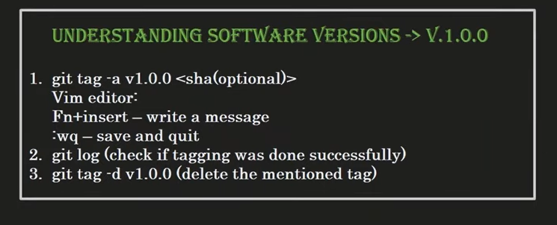
Level 6: Pro Features (Software Versioning)
Developers often tag specific commits to mark major software releases (e.g., v1.0.0 or v1.1.0).
To create a version tag: Use git tag -a <version_number> <SHA_ID>.
This will open the terminal's native Vim Editor. Press Insert to type a release message. Once done, press Esc, type :wq, and hit Enter to save and quit.
To verify the tag, use git log --oneline

Slide 26
Open Source Contribtions in git hub
# Steps for online contributions in github source code
1. do fork --> go to desire github project account
2. click on fork buttion --> basic project name --> create fork
then do to local terminal
git clone https://github.com/shahil04/Global-Early-Alert-System.git
git remote add upstream https://github.com/shubhamkrkarna/Global-Early-Alert-System.git
git remote -v
cd Global-Early-Alert-System
git status
git checkout -b "shahil"
git branch
git status
git add *
git commit -m " add readme contributions by shahil"
git push -u origin shahil
git status
upstream for pull requests
after upload
1. go to your own fork github repo click on pull request
2. creaete new pull request
2. in 1st brach select the mainoriginal fork account(shubhamkrkarna) and in send add your own update repo branch
3. click on create pull request button

Slide 27
Thank You !

