Slide 1
Port Trade Performance and Operational Efficiency Analysis (Nigeria Port Activity Data and Shipment)
A Data Analytics Project Using Power BI
Presented by:
Mohammad Abdulhafeez

Slide 2
Introduction
Ports are critical gateways for international trade and economic growth
Efficient port operations reduce logistics costs and congestion
Data analytics enables evidence-based evaluation of port performance
This study applies Power BI to analyze trade and operational efficiency

Slide 3
Objectives of the Study
Analyze trends in import and export volumes over time
Compare trade performance across ports
Examine cargo composition of trade
Evaluate operational efficiency using port calls and volume
Provide actionable insights and recommendations

Slide 4
Data and Methodology
The data was gotten from Kaggle with 73197 rows and 29 columns
Raw data cleaned and transformed using Power Query
Unpivoting applied to normalize trade and port call data
Star schema model created (Fact and Dimension tables)
DAX measures developed for trade, growth, and efficiency analysis

Slide 5
Visualization Approach
Executive overview using KPI cards and trend charts
Port-level comparison using bar and stacked charts
Cargo composition analyzed using donut and line charts
Operational efficiency evaluated using scatter plots and ratios

Slide 6
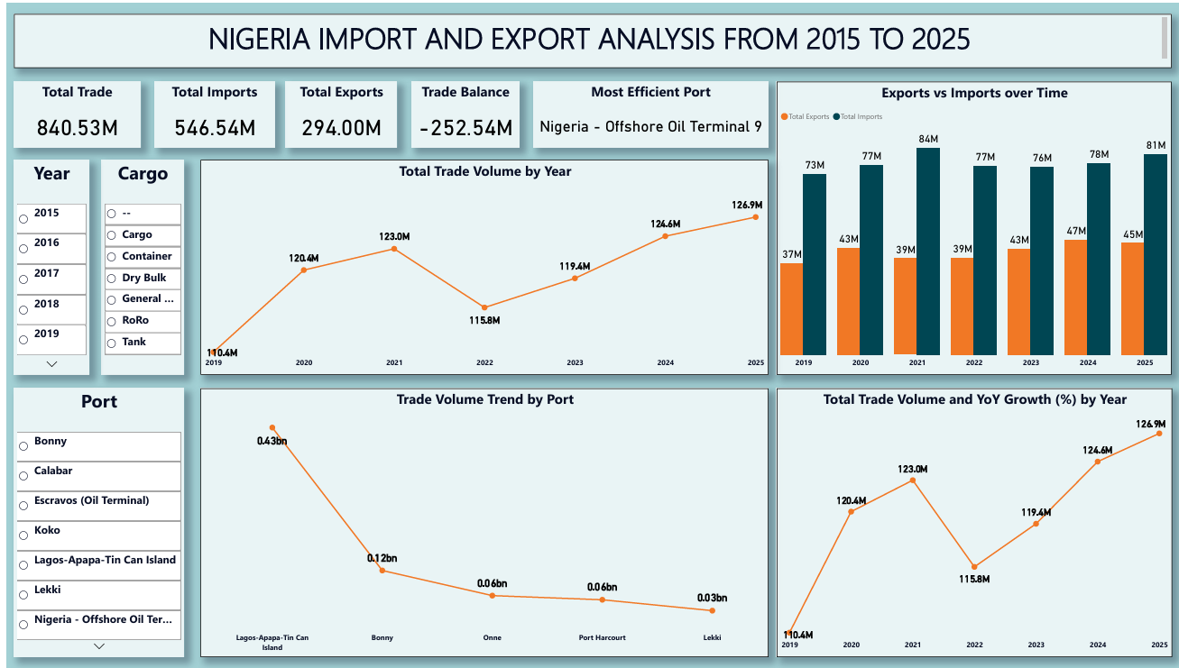
Executive overview using KPI cards and trend charts

Slide 7
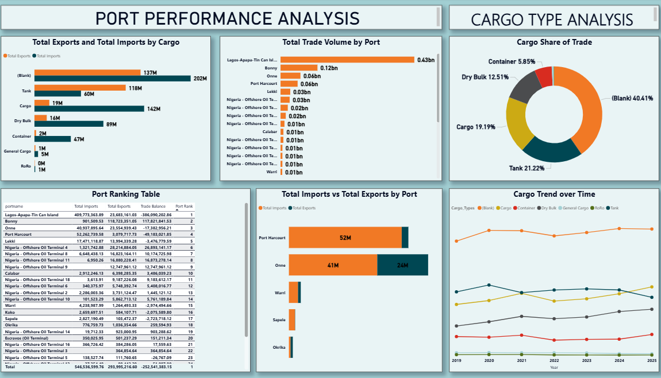
Port-level comparison using bar and stacked charts and cargo analysis

Slide 8
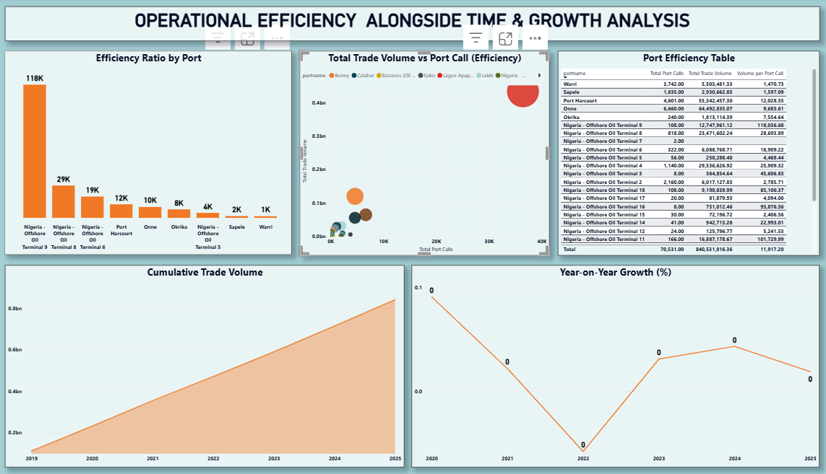
Operational efficiency evaluated using scatter plots and ratios

Slide 9
Key Findings
Sustained growth in total trade volume over time
Imports consistently exceed exports, indicating trade imbalance
Trade activities concentrated in a few major ports
Significant variation in operational efficiency across ports
Containerized and bulk cargo dominate trade structure

Slide 10
Causes of Observed Patterns
Structural dependence on imports
Infrastructure and connectivity advantages in major ports
Underutilization of smaller ports
Inefficiencies in cargo handling and scheduling in some ports

Slide 11
Recommendations
Expand capacity and digital management in high-volume ports
Implement performance benchmarking across ports
Promote export-oriented logistics and policies
Improve utilization of underused ports
Invest in container handling and intermodal connectivity

Slide 12
Areas for Further Research
Incorporate cost and turnaround time data
Conduct comparative studies across countries
Apply predictive analytics for demand forecasting
Assess environmental and sustainability impacts

Slide 13
Thank you!

