Slide 1
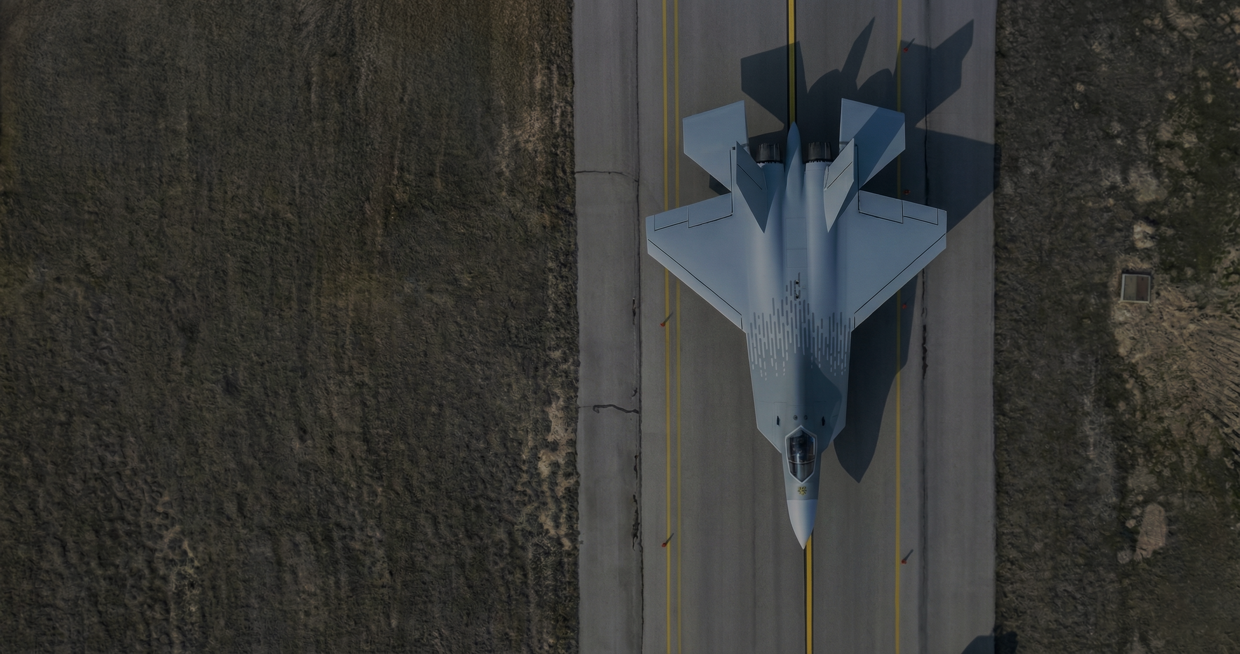

Full Envelope
Airspeed Calibration

Slide 2
Introduction
What is static source position error (SSPE)?
Kinematic relationships for airspeed calibration
Traditional methods for airspeed calibration
The single turning acceleration technique
Numerical results from C-130J simulations
Real flight test results

Slide 3
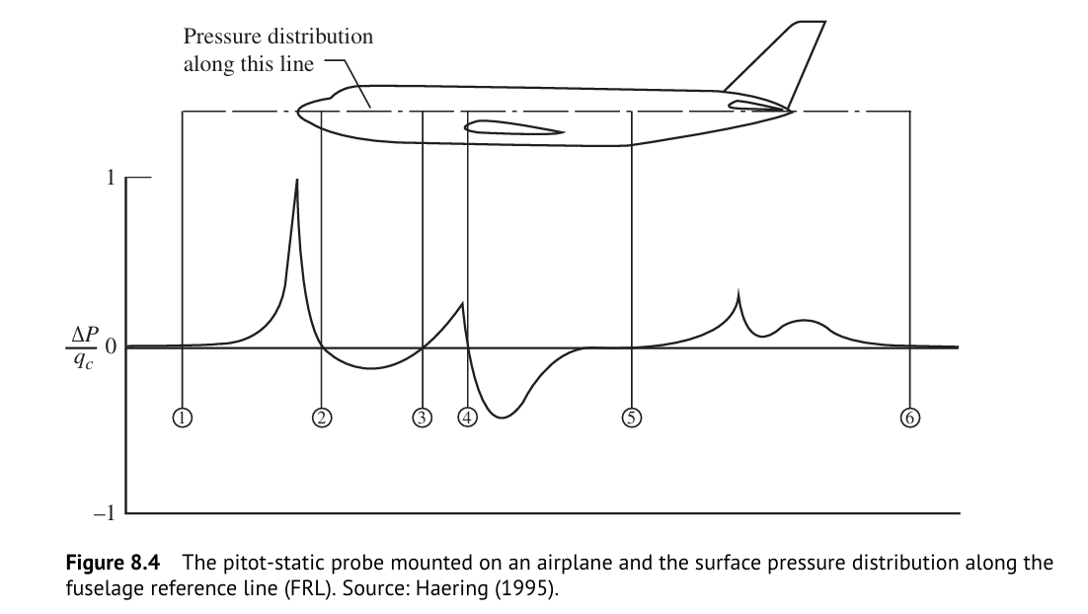
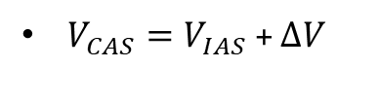
Static Source Position Error (SSPE)
$V_{CAS}=V_{IAS}$ + $∆V$
SSPE is caused by aircraft-induced static pressure distortion
Airspeed errors are also functions of airspeed (and by corollary, a function of Angle of Attack (AOA) and load factor).
1
(Gregory & Liu, Introduction to Flight Testing, 2021)

Slide 4
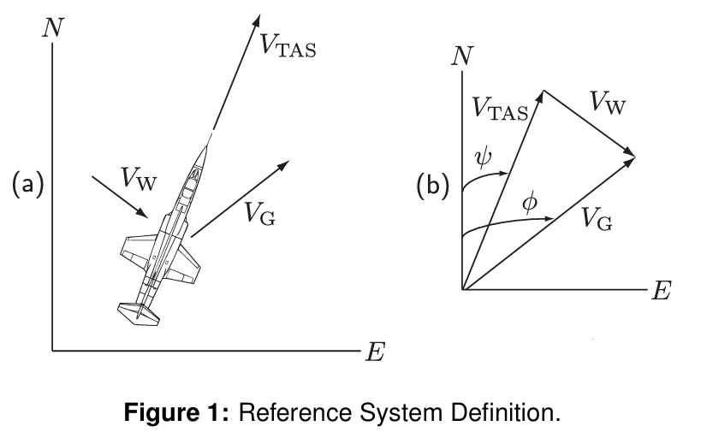
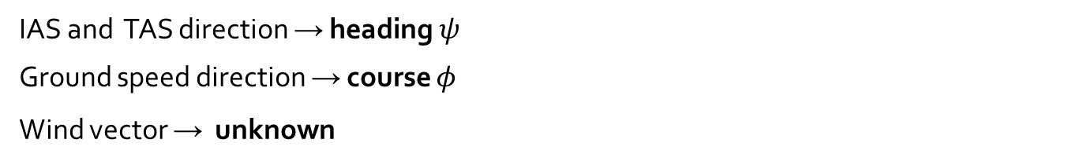
Kinematic Relationships for Airspeed Calibration
IAS and TAS direction → heading $ψ$
Ground speed direction → course $φ$
Wind vector → unknown
2
(SFTE)

Slide 5

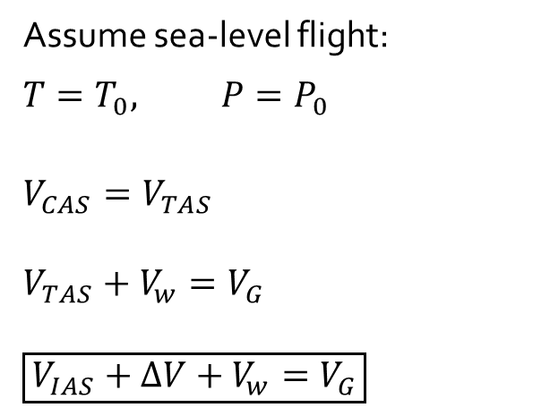
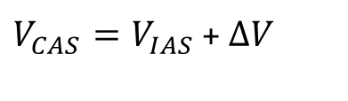
Kinematic Relationships for Airspeed Calibration
$V_{CAS}=V_{IAS}$ + $∆V$
$$V_{CAS}=a_{0}\sqrt{5\left[{\left(\frac{q_{c}}{P_{0}}+1\right)}^{\frac{2}{7}}−1\right]}$$
$$V_{TAS}=a_{0}\sqrt{5\frac{T}{T_{0}}\left[{\left(\frac{q_{c}}{P}+1\right)}^{\frac{2}{7}}−1\right]}$$
Assume sea-level flight:
$$T=T_{0}, P=P_{0}$$
$$V_{CAS}=V_{TAS}$$
$$V_{TAS}+V_{w}=V_{G}$$
$$\boxed{V_{IAS}+ΔV+V_{w}=V_{G}}$$
(SFTE)

Slide 6
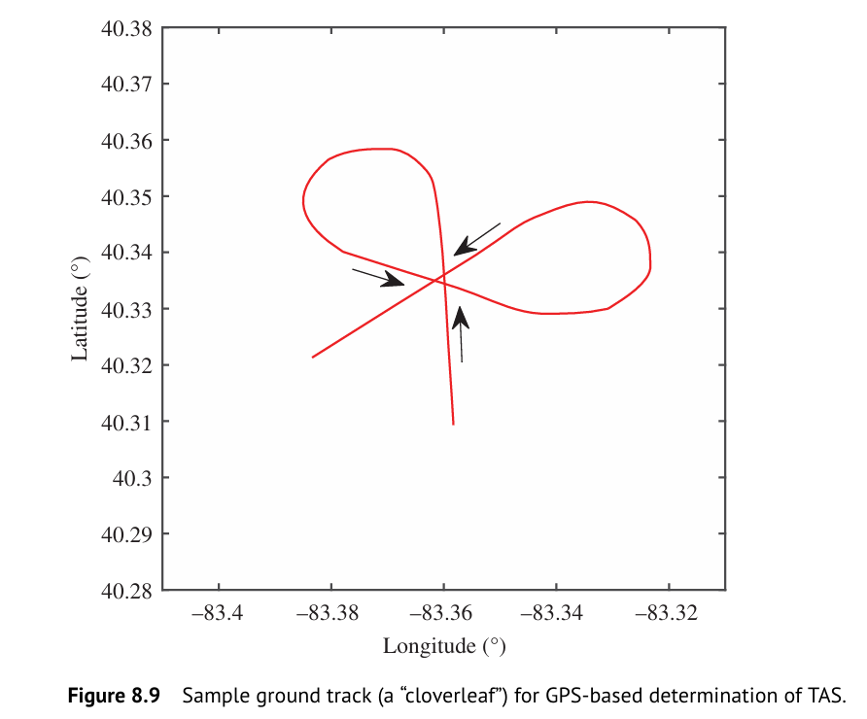
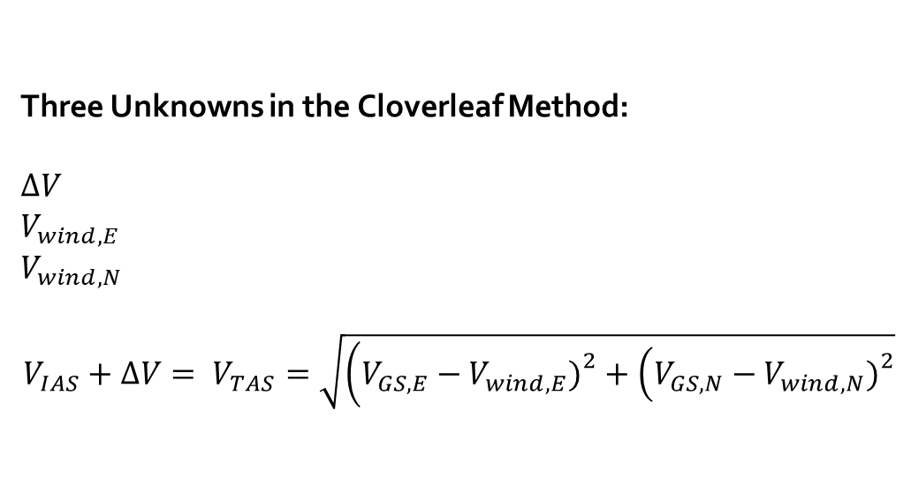
GPS-Based Cloverleaf Calibration Method
Three Unknowns in the Cloverleaf Method:
$$ΔV$$
$$V_{wind,E}$$
$$V_{wind,N}$$
$$V_{IAS}+ΔV= V_{TAS}=\sqrt{\left(V_{GS,E}−V_{wind,E}{\left.)\right.}^{2}+\left(V_{GS,N}−V_{wind,N}{\left.)\right.}^{2}\right.\right.}$$
3
(Gregory & Liu, Introduction to Flight Testing, 2021)

Slide 7
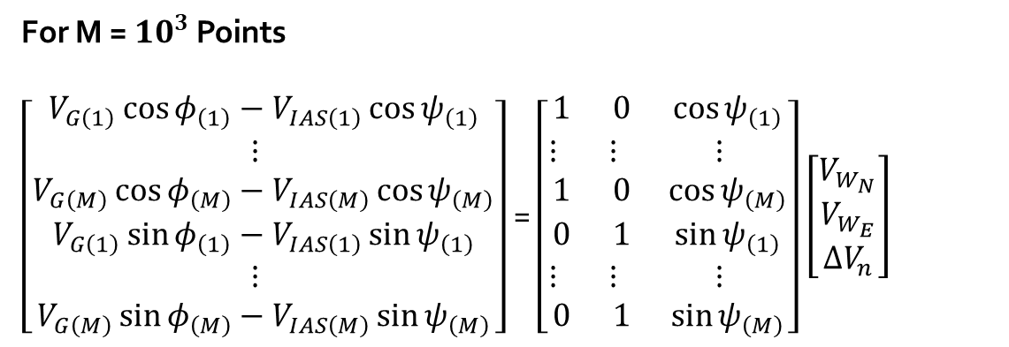
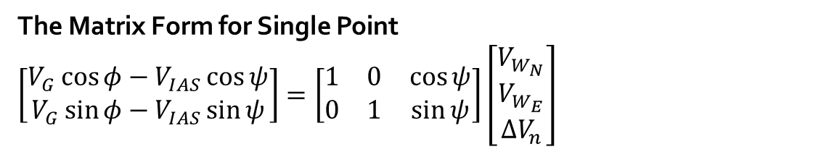
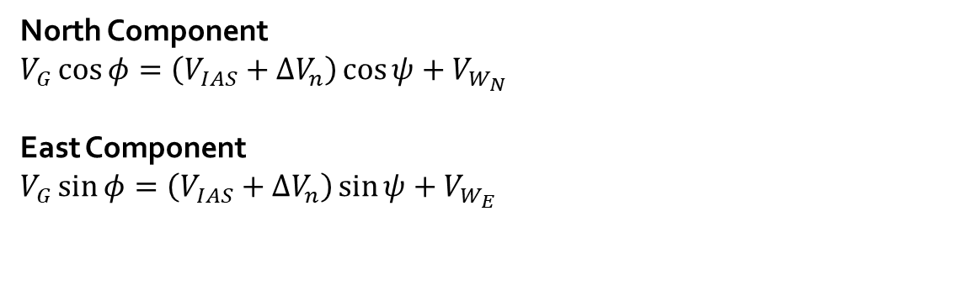
Level Turn Airspeed Calibration Method
North Component
$$V_{G}\cos{φ}=\left(V_{IAS}+ΔV_{n}\right)\cos{ψ}+V_{W_{N}}$$
East Component
$$V_{G}\sin{φ}=\left(V_{IAS}+ΔV_{n}\right)\sin{ψ}+V_{W_{E}}$$
The Matrix Form for Single Point
$$\left[\begin{matrix}V_{G}\cos{φ}−V_{IAS}\cos{ψ} \\ V_{G}\sin{φ}−V_{IAS}\sin{ψ}\end{matrix}\right]=\left[\begin{matrix}1 & 0 & \cos{ψ} \\ 0 & 1 & \sin{ψ}\end{matrix}\right]\left[\begin{matrix}V_{W_{N}} \\ V_{W_{E}} \\ ΔV_{n}\end{matrix}\right]$$
For M = $10^{3}$ Points
$\left[\begin{matrix}V_{G\left(1\right)}\cos{φ_{\left(1\right)}}−V_{IAS\left(1\right)}\cos{ψ_{\left(1\right)}} \\ ⋮ \\ V_{G\left(M\right)}\cos{φ_{\left(M\right)}}−V_{IAS\left(M\right)}\cos{ψ_{\left(M\right)}} \\ V_{G\left(1\right)}\sin{φ_{\left(1\right)}}−V_{IAS\left(1\right)}\sin{ψ_{\left(1\right)}} \\ ⋮ \\ V_{G\left(M\right)}\sin{φ_{\left(M\right)}}−V_{IAS\left(M\right)}\sin{ψ_{\left(M\right)}}\end{matrix}\right]$ = $\left[\begin{matrix}1 & 0 & \cos{ψ_{\left(1\right)}} \\ ⋮ & ⋮ & ⋮ \\ 1 & 0 & \cos{ψ_{\left(M\right)}} \\ 0 & 1 & \sin{ψ_{\left(1\right)}} \\ ⋮ & ⋮ & ⋮ \\ 0 & 1 & \sin{ψ_{\left(M\right)}}\end{matrix}\right]$ $\left[\begin{matrix}V_{W_{N}} \\ V_{W_{E}} \\ ΔV_{n}\end{matrix}\right]$
Overdetermined system
No unique solution → least squares
Wind magnitude and direction are
inferred.
(SFTE)

Slide 8
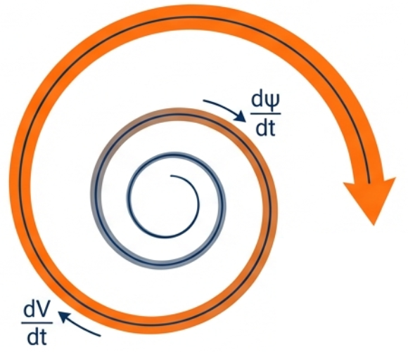
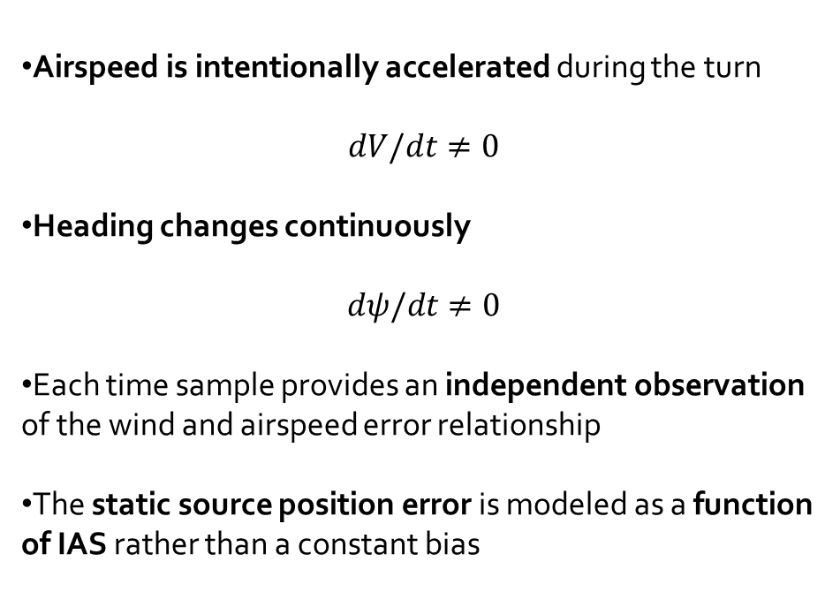
The Single Turning Acceleration Technique
Airspeed is intentionally accelerated during the turn
$$dV/dt≠0$$
Heading changes continuously
$$dψ/dt≠0$$
Each time sample provides an independent observation of the wind and airspeed error relationship
The static source position error is modeled as a function of IAS rather than a constant bias
(SFTE)

Slide 9
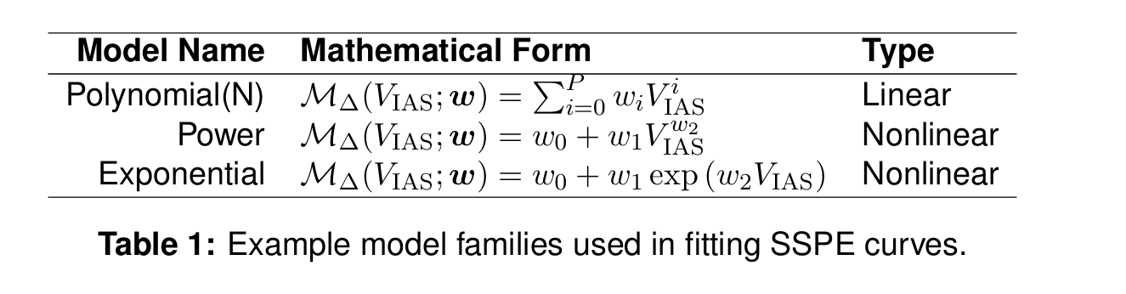
The Single Turning Acceleration Technique
Several candidate error model families are considered:
Polynomial (flexible, linear in parameters)
Power-law (smooth monotonic behavior)
Exponential (rapid nonlinear trends)
Akaike Information Criterion (AIC/AICc) balances goodness of fit against model complexity.
(SFTE)

Slide 10
The Single Turning Acceleration Technique
Angle of Bank Selection:
Angle of bank directly determines turn radius and load factor.
Increasing AOB increases load factor, which in turn increases angle of attack (AoA) for a given airspeed.
Therefore, the lowest practical angle of bank is recommended to best approximate wings-level airspeed calibration
Altitude Selection:
As close as possible to sea level or at higher altitudes with additional computational and instrumentation requirements.
The maneuver tolerance should be ±50 feet to assure a confidence interval of ±0.5 knots.
(SFTE)

Slide 11
The Single Turning Acceleration Technique
Acceleration Profile:
At least one full turn is required to resolve wind magnitude and direction
A wide range of airspeeds is necessary to accurately estimate the SSPE curve
The acceleration profile should remain as constant as possible to minimize wind variability effects
Separate tests are recommended for different airspeed regimes (e.g. subsonic vs transonic)
(SFTE)

Slide 12
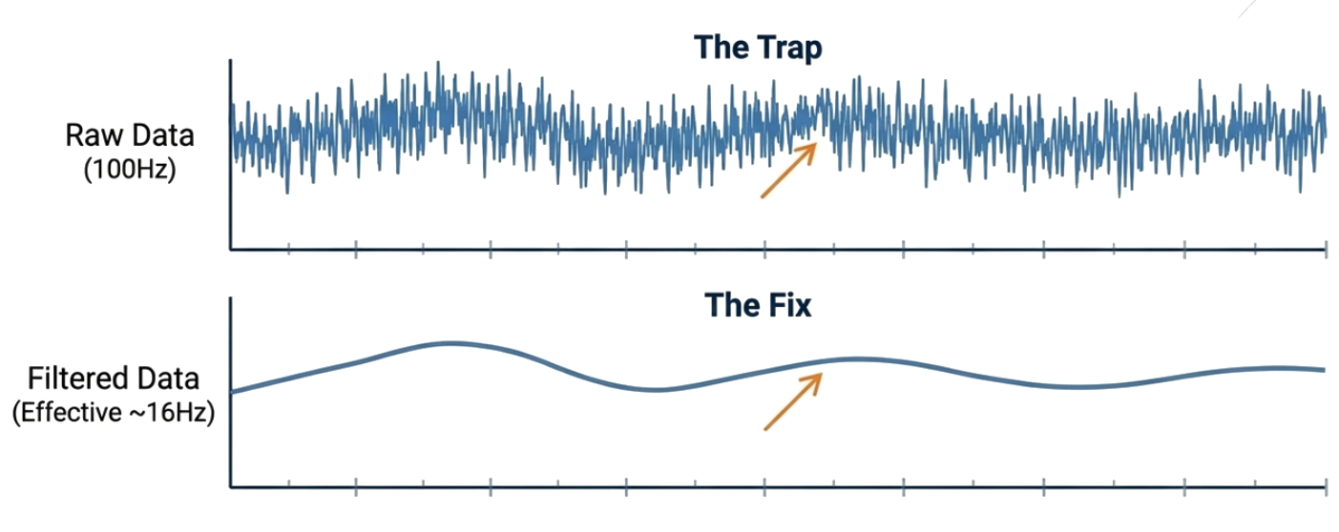
The Single Turning Acceleration Technique
Instrumentation Data Rate
Sampling faster than the pitot system response creates a fake confidence (Artificial CI = 0.35 kts).
Down-sampling ensures statistically independent samples (Realistic CI = 0.88 kts).
More data is not always better. Sequential correlation in high-speed sensors can artificially shrink confidence intervals.
(SFTE)

Slide 13
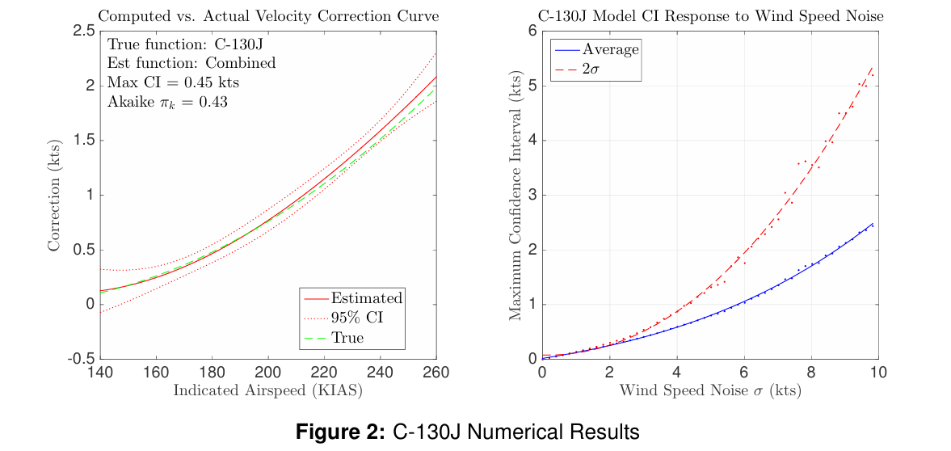
Numerical Results from C-130J Simulations
4
(SFTE)

Slide 14
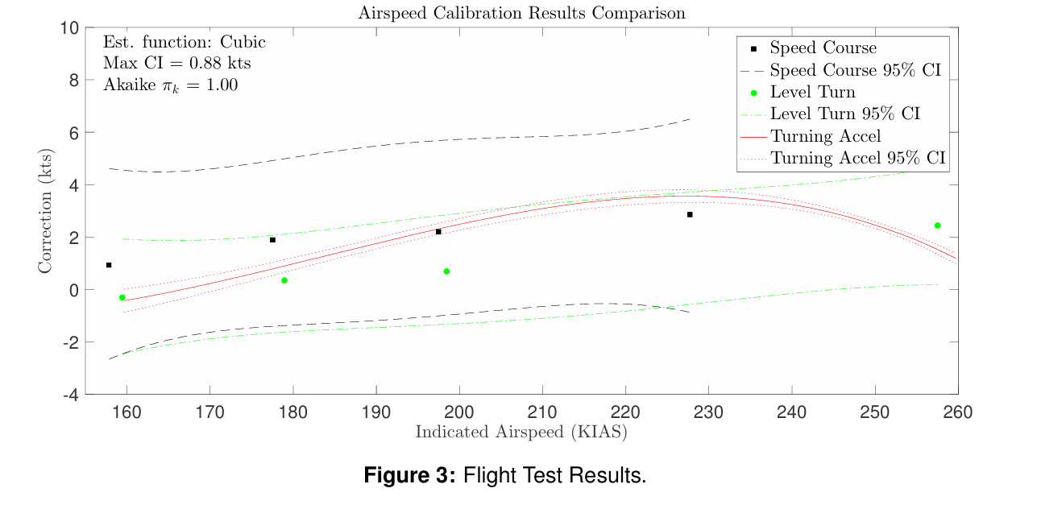
Real Flight Test Results
5
(SFTE)

Slide 15
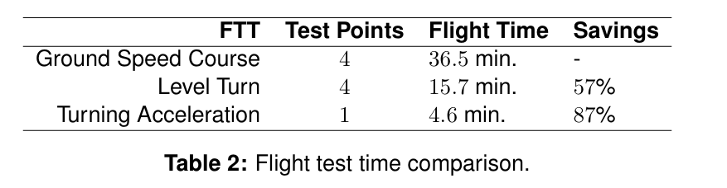
Real Flight Test Results
In the turning acceleration technique, airspeed is intentionally varied.
Gust effects are treated as disturbances.
Their influence is reduced numerically through regression and averaging
Data are down-weighted, not discarded
Because turning acceleration method is quick to execute, it tends to be less affected by wind drifts (not gusts).
In level turn methods, gust-affected data points are relatively easy to identify.
Measurements showing sudden deviations are discarded from the analysis
The results are more accurate for a single IAS value (Assuming no drift in wind).
But flying the whole envelope results in higher costs.
Less tolerant of execution error due to longer flight times.
(SFTE)

Slide 16
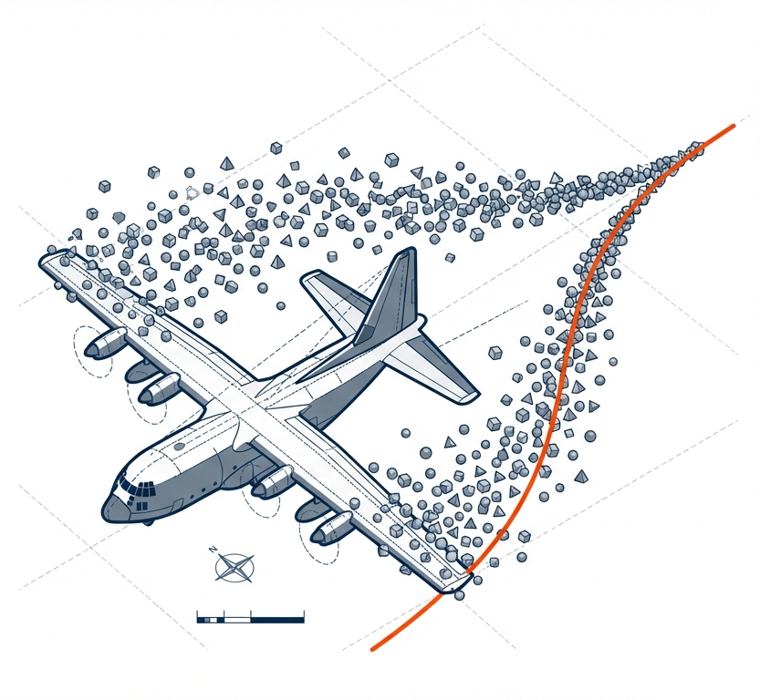
Thank you.

Slide 17
References
[1] J. D. Jurado, C. C. McGehee, and T. R. Jorris, “Full envelope airspeed calibration using a single turning acceleration technique,” in Proceedings of the 47th Annual International Symposium of the Society of Flight Test Engineers (SFTE), Wichita, KS, USA, Aug. 2016.
[2] I. M. Gregory and Y. Liu, Introduction to Flight Testing. Wiley, 2021.
[3] R. E. Erb, Pitot-Statics Textbook. Edwards AFB, CA, USA: USAF Test Pilot School, 2010.
[4] T. R. Jorris, M. M. Ramos, R. E. Erb, and R. K. Woolf, “Statistical pitot-static calibration technique using turns and self-survey method,” in Proceedings of the 42nd International SFTE Symposium, Seattle, WA, USA, 2011.
[5] H. Akaike, “A new look at the statistical model identification,” IEEE Transactions on Automatic Control, vol. 19, no. 6, pp. 716–723, Dec. 1974.

