Slide 1
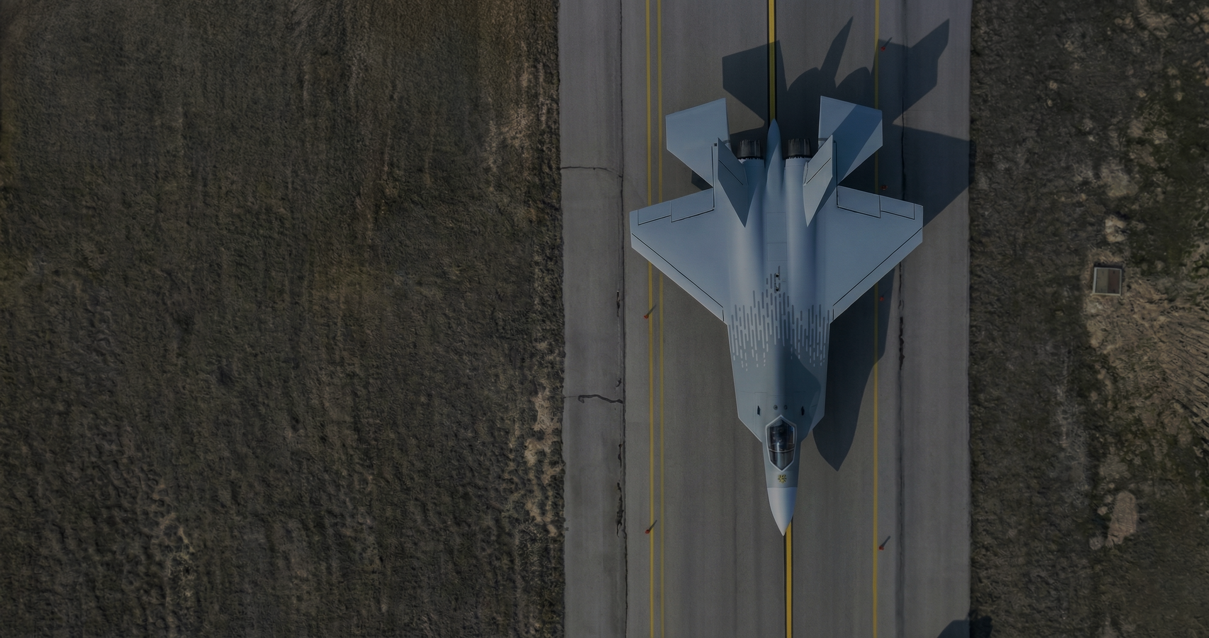

Effects of CG on
Aircraft Flight
Characteristics

Slide 2
Introduction
Definition of the CG
How is the CG of an aircraft calculated?
The effects on flight characteristics
The importance and risk mitigation in flight tests
Midwest Flight 5481 case study

Slide 3
Definition and Calculation
What is center of gravity (CG)?
Why is it important?
It is the point about which an aircraft would balance if it were possible to suspend it at that point (FAA).
An airplane in flight can be manuevered by the pilot using the aerodynamic control surfaces, the elevator, rudder or ailerons.
The force changes on those surface produce rotation around the CG.

Slide 4
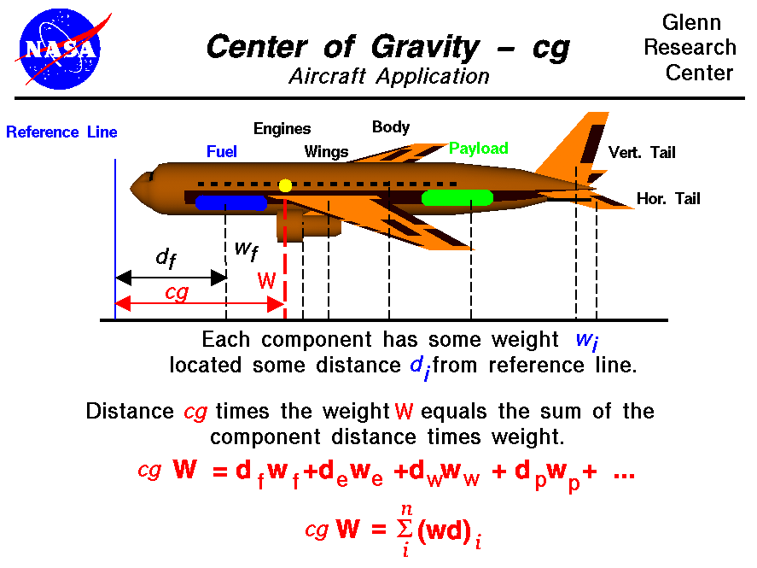

Slide 5


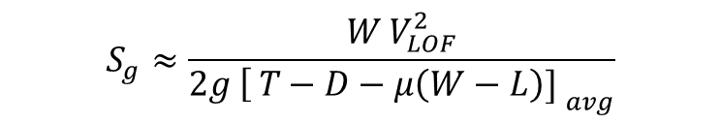
The Effects on Flight Characteristics
Effects of Forward CG:
$$\int_{0}^{S_{g}}{[}T\left(s\right)−D\left(s\right)−μ(W−L\left(s\right))] ds=\frac{W}{2g} V_{LOF}^{2}$$
Longer takeoff distance:
Approximate the bracketed term by an average value over the ground roll:
$$[T−D−μ\left(W−L\right)]_{\text{avg}}$$
$$S_{g}≈\frac{W V_{LOF}^{2}}{{2g \left[ T−D−μ\left(W−L\right)\text{]} \right.}_{avg}}$$
(ITPS)

Slide 6


The Effects on Flight Characteristics
Effects of Forward CG:
At the instant of lift-off, the aircraft just loses contact with the ground, so the normal force is zero:
$$N=0$$
Vertical force equilibrium gives:
$$L−W−L_{t}=0$$
or equivalently,
Longer takeoff distance:
a) Forward CG
b) Aft CG
(ITPS)
$$L=W+L_{t}$$

Slide 7

The Effects on Flight Characteristics
Effects of Forward CG:
Substitute this into the lift-off condition:
$$L=W+L_{t}$$
If $L_{t}$increases while $W$ is constant, then:
$$L↑$$
Longer takeoff distance:
Wing lift is given by:
$$L=\frac{1}{2}ρV^{2}SC_{L}$$
a) Forward CG
b) Aft CG
(ITPS)
$$V_{LOF}↑$$

Slide 8
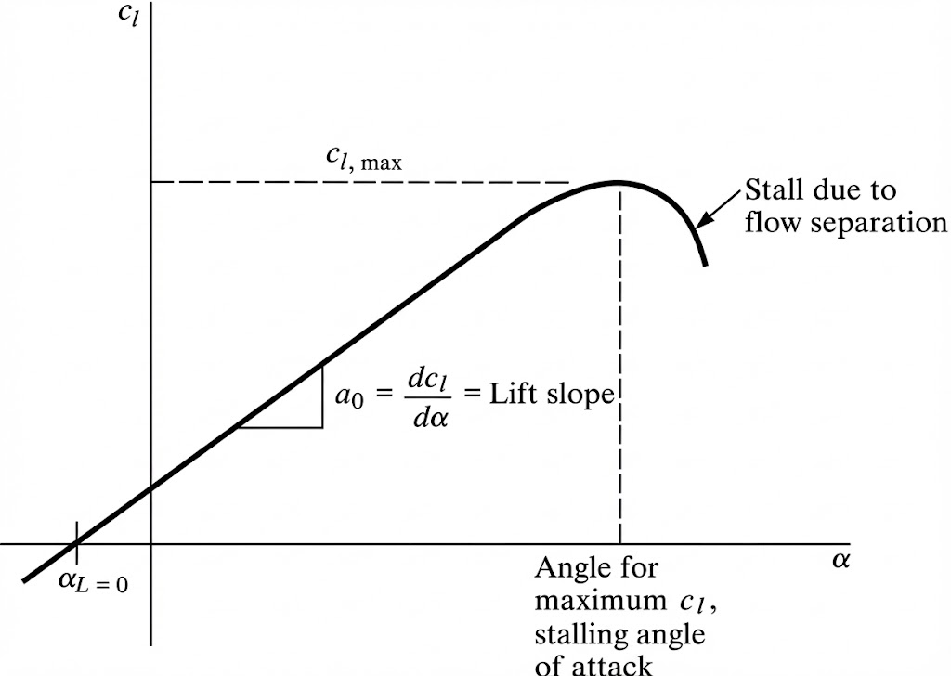



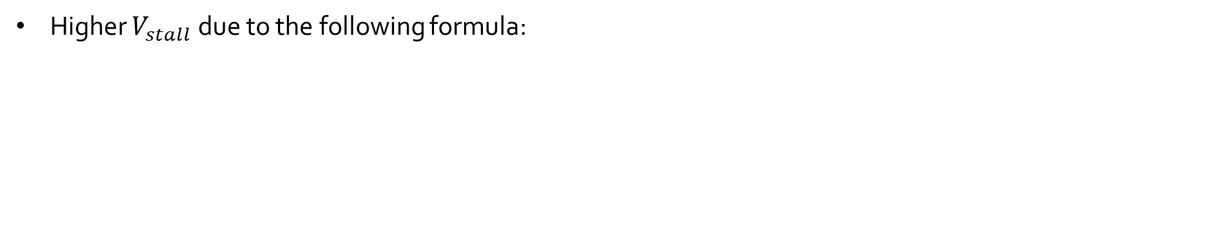
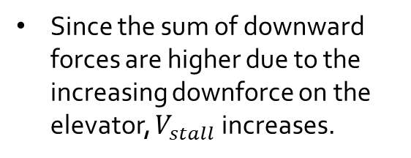
The Effects on Flight Characteristics
Effects of Forward CG:
Higher $V_{stall}$ due to the following formula:
$$V_{stall}=\sqrt{\frac{2L}{ρSC_{Lmax}}}$$
$$C_{L}=C_{L_{max}}$$
$$L=W+L_{t}$$
Since the sum of downward forces are higher due to the increasing downforce on the elevator, $V_{stall}$ increases.

Slide 9

The Effects on Flight Characteristics
Effects of Forward CG:
The cruise efficiency is lower due to the increasing need for lift and resulting increase in the induced drag (Also due to the higher trim drag).
The stall recovery is easier since the nose has a natural tendency to pitch down and the aircraft is more stable.
$$C_{D_{i}}=\frac{C_{L}^{2}}{π e AR}$$

Slide 10
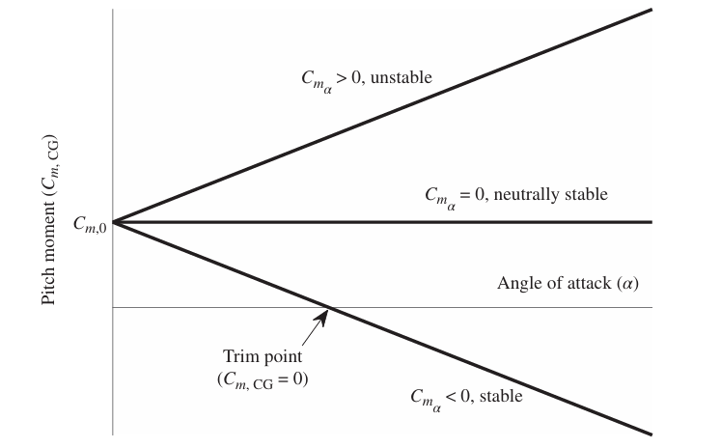
The Effects on Flight Characteristics
Effects of Forward CG:
The aircraft becomes more stable but responds more slowly to pitch commands.
*Stick-fixed static stability is assumed.
(Gregory & Liu, Introduction to Flight Testing, 2021)

Slide 11
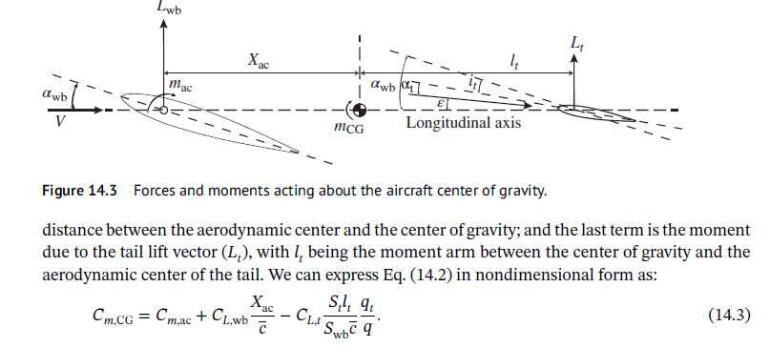
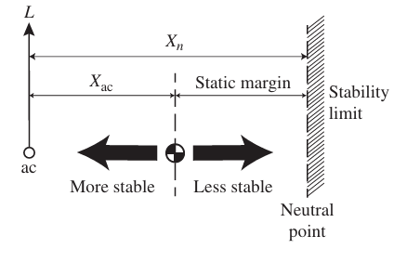
The Effects on Flight Characteristics
Effects of Forward CG:
The aircraft becomes more stable but responds more slowly to pitch commands.
$$\frac{∂C_{m,CG}}{∂α}=\frac{∂C_{L,wb}}{∂α}\left(\frac{X_{ac}−X_{n}}{c}\right)$$
(Gregory & Liu, Introduction to Flight Testing, 2021)

Slide 12

The Effects on Flight Characteristics
Effects of Aft CG:
Shorter takeoff distance.
Lower $V_{stall}$ due to having a lower downforce.
Higher cruise efficiency due to needing a lower lift and having a lower induced drag.
The stall recovery is harder since the stability is low (There is a tendency to diverge).
The aircraft is more responsive to the inputs and more agile while it is less stable.

Slide 13
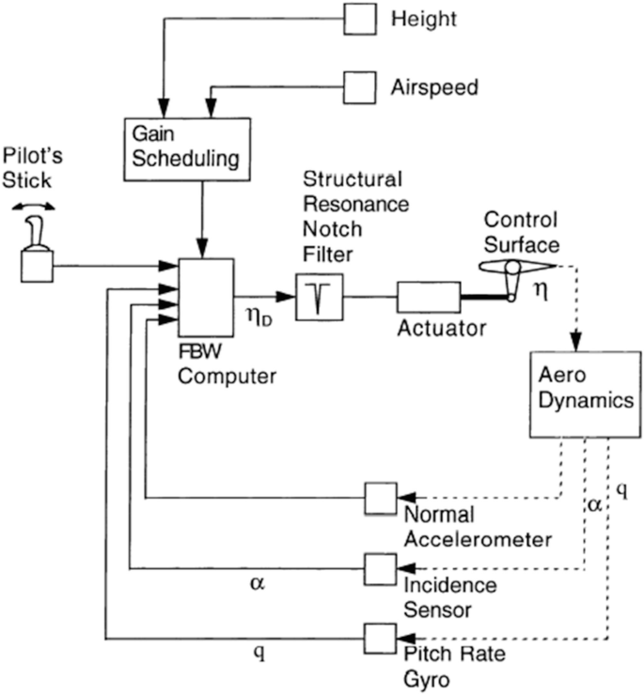
The Effects on Flight Characteristics
Effects of Aft CG:
Irreversible control systems are used to mitigate the risks associated with instability.

Slide 14
Risk Mitigation in Flight Tests
Case Study: Stall Demo of a L-29 Aircraft
Risk assesment:
 | Catastrophic | Major | Moderate | Minor | Negligible
Frequent
Probable
Occasional | X
Remote
Improbable |  | X
*Risk = Severity x Probability
(ITPS)

Slide 15
Risk Mitigation in Flight Tests
Hazard Description:
Causes:
Effects:
Post stall gyration and fail to recover.
Aircraft out of desired conditions (CG).
Incorrect recovery technique after stall.
Aircraft impacting on the ground
Loss of aircraft and death of aircrew.
(ITPS)

Slide 16
Risk Mitigation in Flight Tests
Minimizing Procedures:
Stall testing at minimum 5000ft AGL.
Tests will be done at idle power, wings level.
Forward CG points will precede aft CG.
Lateral fuel will be balanced.
Spin recovery procedures will be reviewed.
A buildup approach can be taken– starting from low-risk flights with known characteristics and carefully advancing to higher-risk flights, where the flight characteristics were unknown and potentially hazardous.
Corrective Actions:
Bailout if aircraft is not controlled at 1,500 ft AGL.
(ITPS)

Slide 17

Case Study: Midwest Flight 5481
Key Facts:
Flight : Air Midwest 5481 operating under the provisions of 14 Code of Federal Regulations Part 121 on an instrument flight rules flight plan.
Aircraft : Beechcraft 1900D, N233YV
Date : January 8, 2003
Departure: Charlotte-Douglas International Airport
Event: Loss of pitch control immediatly after takeoff.
Outcome: 21 fatatlites (2 crew, 19 passengers). The aircraft was destroyed.
(NTSB)

Slide 18
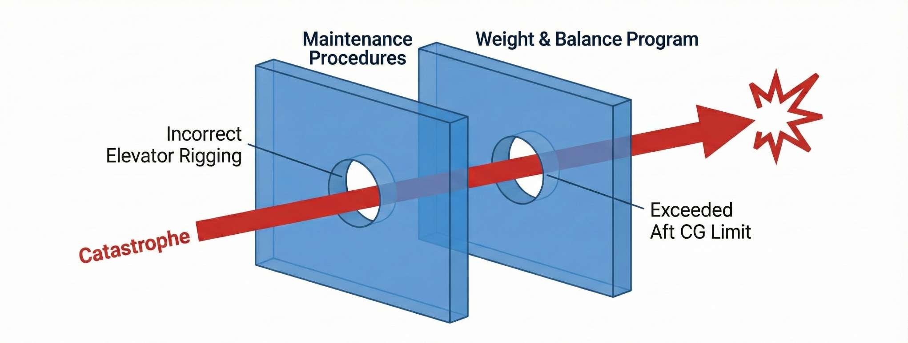
Case Study: Midwest Flight 5481
The accident was the result of two critical, unrelated errors that aligned perfectly. A maintenance error created a hidden limitation in the aircraft’s control system. An operational error placed the aircraft in a condition where that exact limitation became fatal.

Slide 19
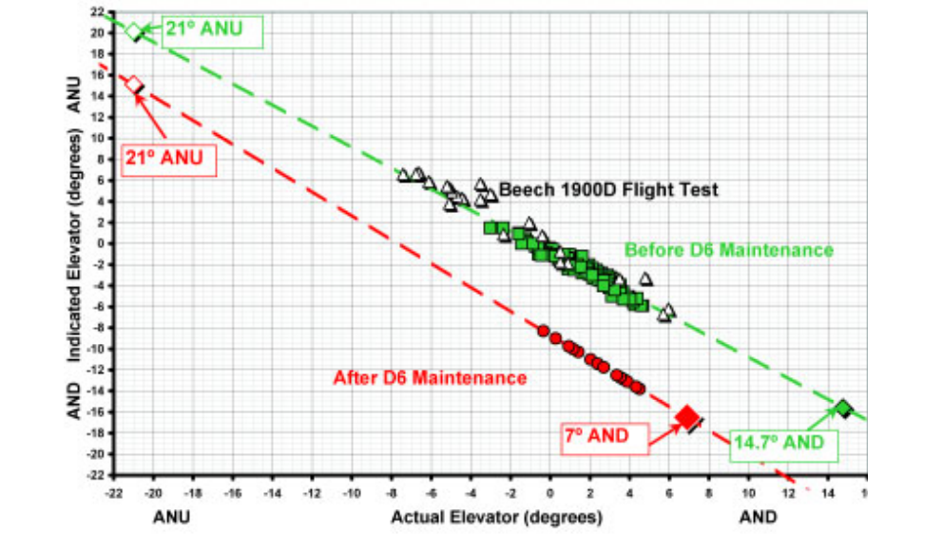
Case Study: Midwest Flight 5481
(NTSB)

Slide 20
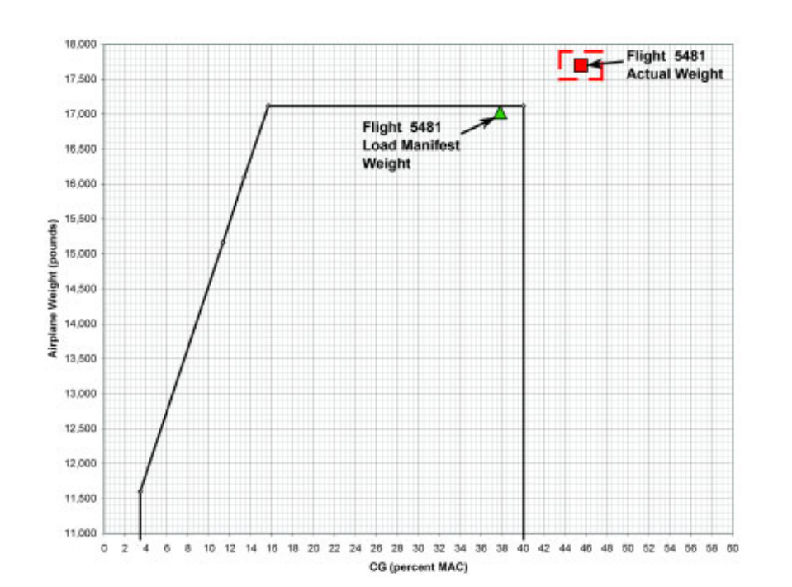

Case Study: Midwest Flight 5481
The operator used outdated FAA standart average weights.
This flight occurred in winter, with passengers wearing heavy clothing and carrying unusually heavy personal bags.
The spare wheel in the aft baggage area was not included on the load sheet.
The baggage compartment on the Beech 1900D is located near the tail.
Passengers were expected to be distributed longitudinally, but most sat in the rear rows.
(NTSB)

Slide 21
Case Study: Midwest Flight 5481
(NTSB)

Slide 22
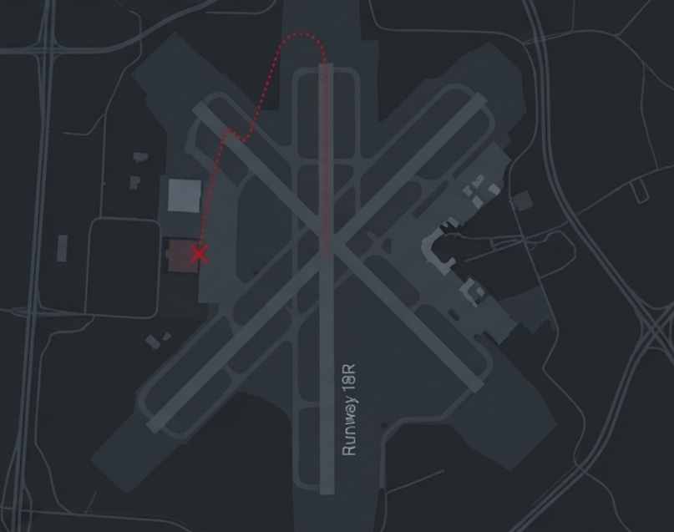
Case Study: Midwest Flight 5481
In simulation, the aircraft required approximately 9° of nose-down elevator to counteract its aft CG condition.
Due to the rigging screw error, the elevator could only generate about 7° of effective nose-down travel, making the aircraft unrecoverable.
(NTSB)

Slide 23
Thank you.

Slide 24
References
[1] Federal Aviation Administration, Pilot’s Handbook of Aeronautical Knowledge, Ch. 10, “Weight and Balance,” FAA-H-8083-25B, 2016. [Online]. Available: https://www.faa.gov/sites/faa.gov/files/12_phak_ch10.pdf
[2] NASA Glenn Research Center, “Center of Gravity and Stability,” Virtual Aero – Bottle Rocket. [Online]. Available: https://www.grc.nasa.gov/www/k-12/VirtualAero/BottleRocket/airplane/acg.html
[3] I. M. Gregory and Y. Liu, Introduction to Flight Testing. Wiley, 2021.
[4] J. D. Anderson, Introduction to Flight, 8th ed. New York, NY, USA: McGraw-Hill Education, 2015.
[5] National Transportation Safety Board, Aircraft Accident Report: Loss of Pitch Control on Air Midwest Flight 5481, Report No. AAR-04/01, 2004. [Online]. Available: https://www.ntsb.gov/investigations/AccidentReports/Reports/AAR0401.pdf

