Slide 1



MapReduce TSQR
Austin Benson

Slide 2
Current benchmarking
  Different data types for Hadoop Streaming input records: use a byte sequence instead of an array sequence via python's struct module
  Store multiple rows in one record
  Measuring variability across trials
  Simulating faults (via software) and relating fault rate to performance
  Python vs. C++ for Hadoop Streaming
  Cholesky QR vs. TSQR algorithm
See:
Paul G. Constantine and David F. Gleich. Tall and skinny QR factorizations in MapReduce architectures. In Proceedings of the second international workshop on MapReduce and its applications, MapReduce '11, pages 43-50, New York, NY, USA, 2011. ACM
http://www.cs.purdue.edu/homes/dgleich/publications/Constantine%202011%20-%20TSQR.pdf

Slide 3
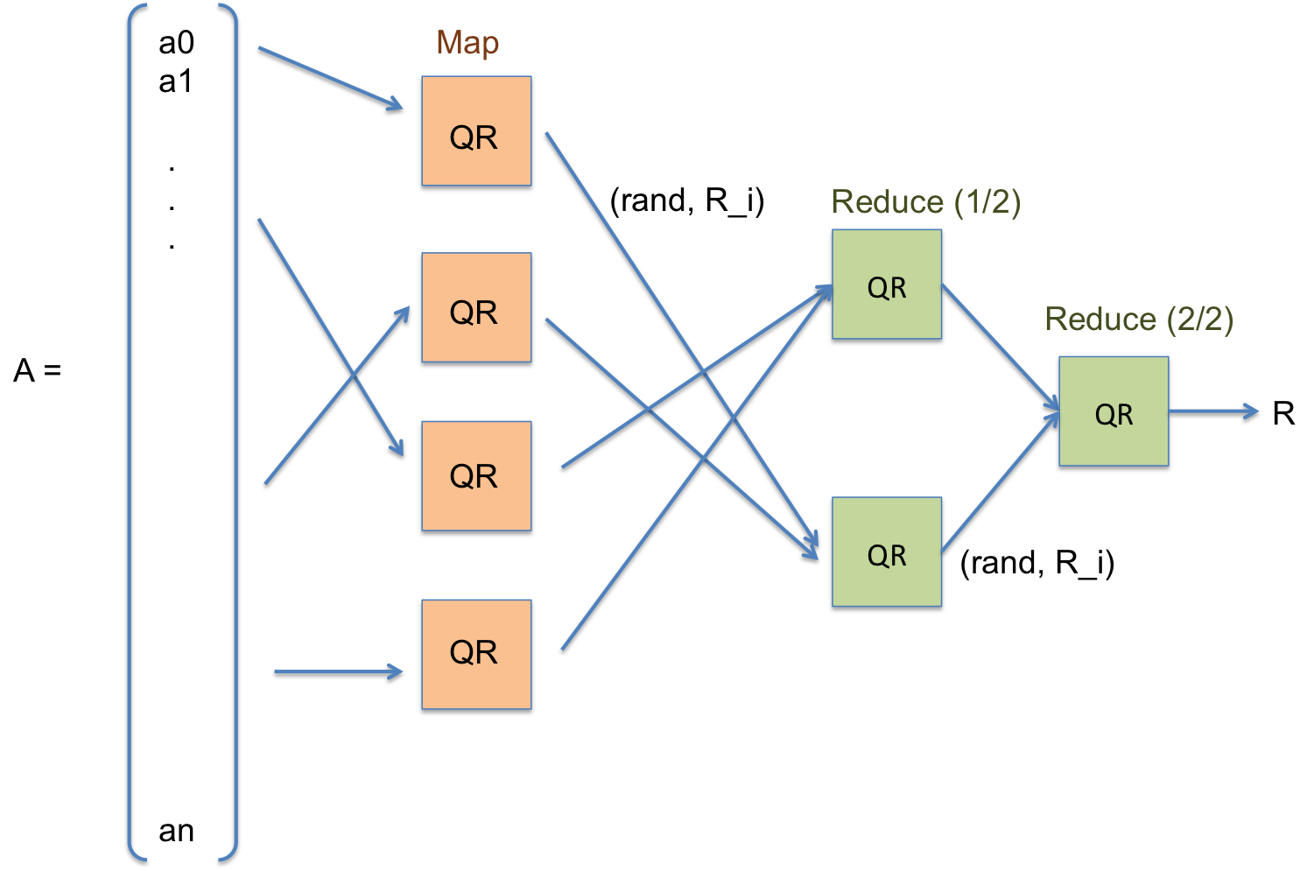
TSQR Scheme

Slide 4
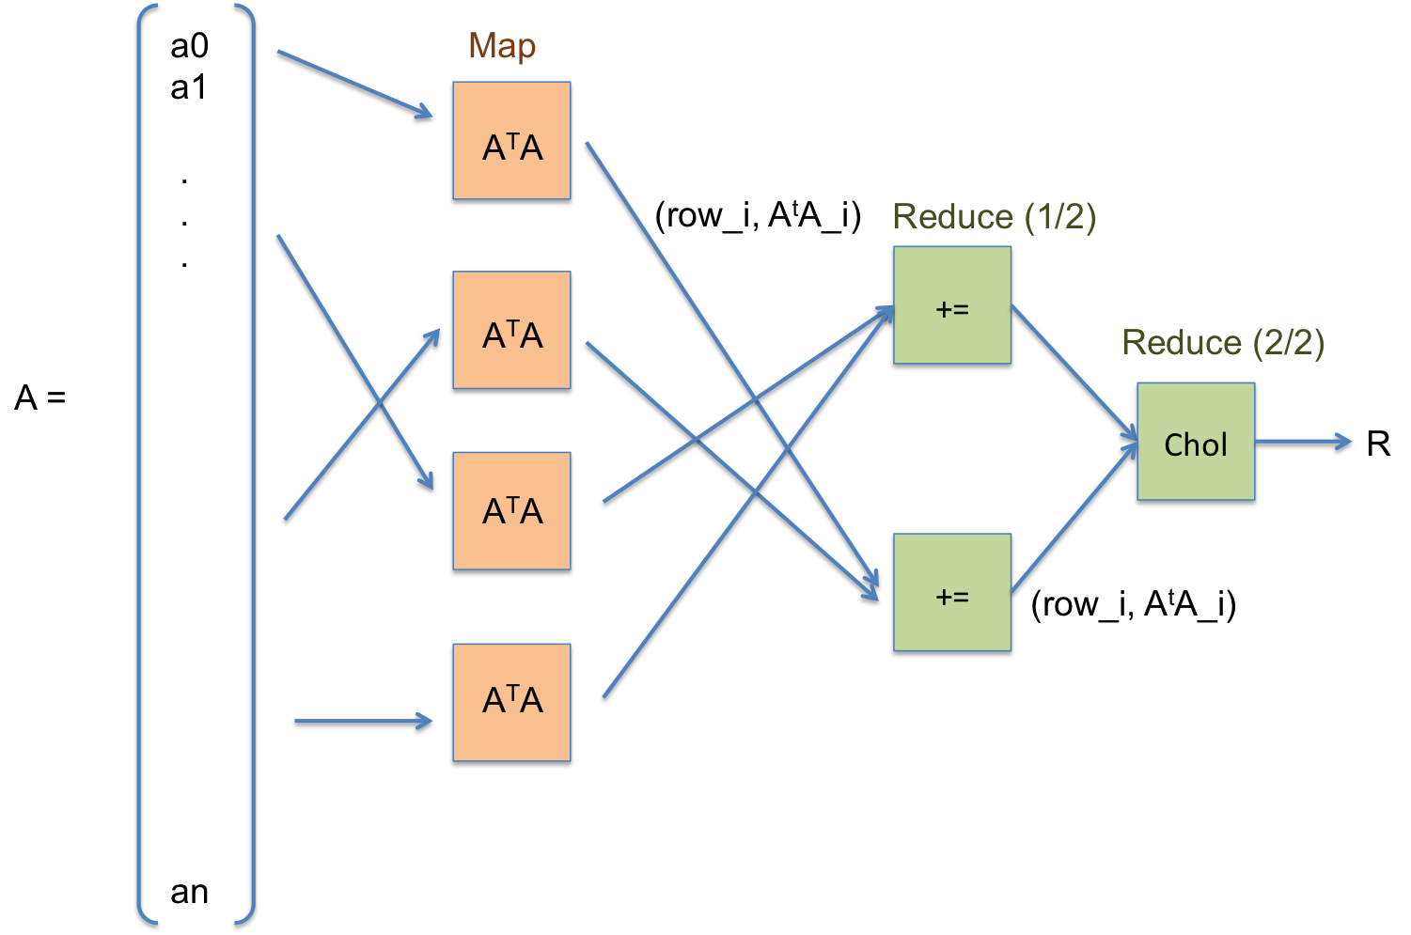
Cholesky QR Scheme

Slide 5
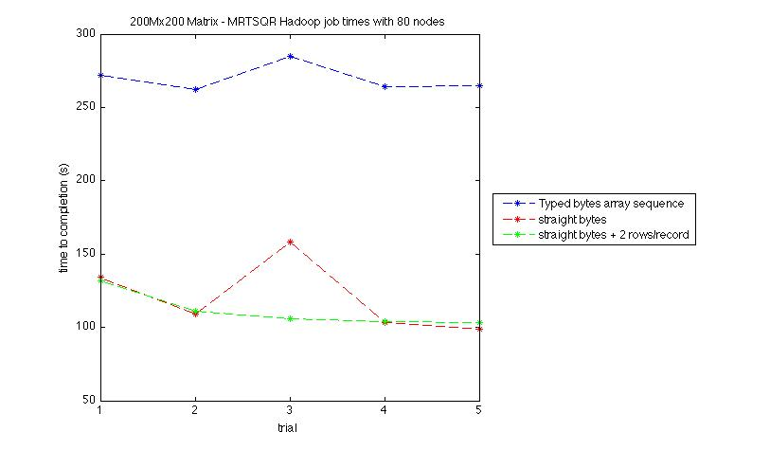
Performance results (200M x 200)

Slide 6
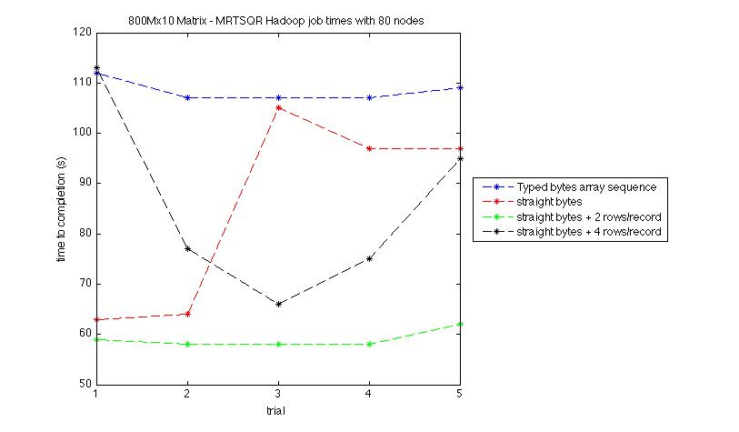
Performance results (800M x 10)

Slide 7
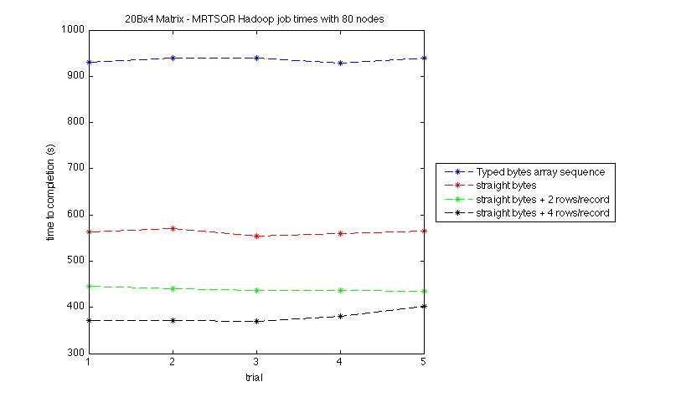
Performance results (20B x 4)

Slide 8
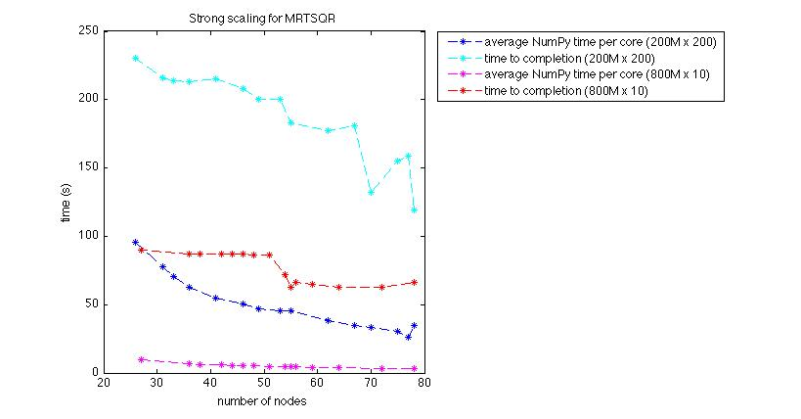
Performance results (strong scaling)
Hard to scale number of nodes in cloud environment--accomplished by tuning the sensitive mapred.min.split.size parameter

Slide 9
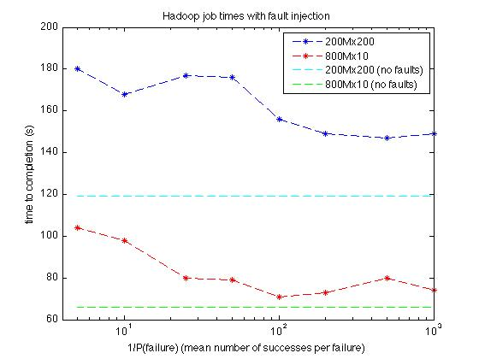
Performance results (simulated faults)
We can still run with P(fault) = 1/5 with only ~50% performance penalty. However, with P(fault) small, we still see a performance hit.

Slide 10
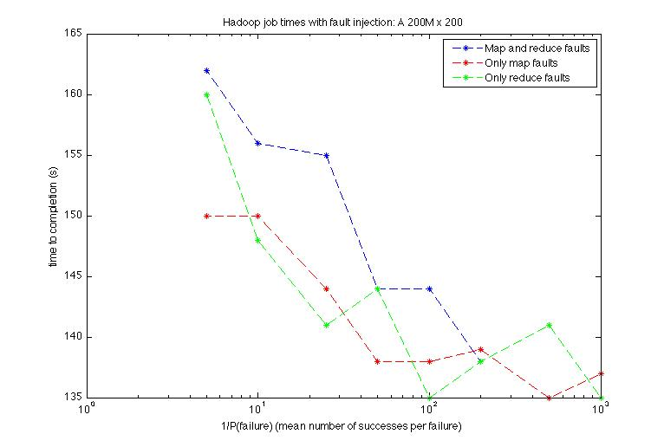
Performance results (simulated faults)

Slide 11
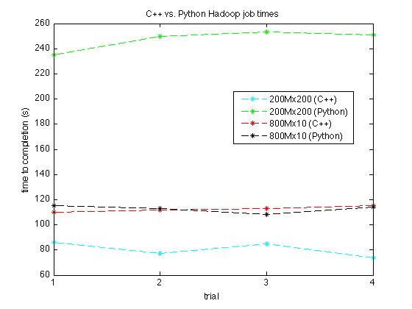
Performance results (C++ vs. Python)

Slide 12
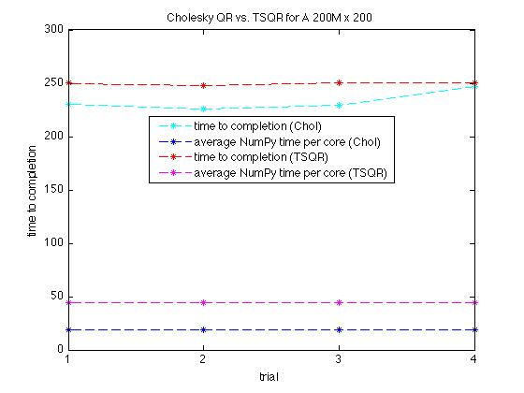
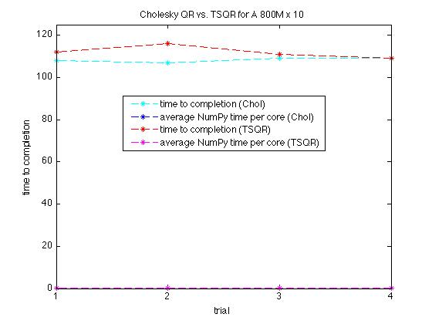
Performance results (CholQR vs. TSQR)*
* This is just measuring map time, due to a bug in the Cholesky code. Reduce time is much smaller and constant.

Slide 13
Future work
  Custom input/output reader/writers
  More C++ implementation performance results
  More Cholesky QR data
  Numerical stability experiments

