Slide 1







Microbits
Introduction
Notes:
This is basically us saying Hi, who we are and what we're going to be doing

Slide 2

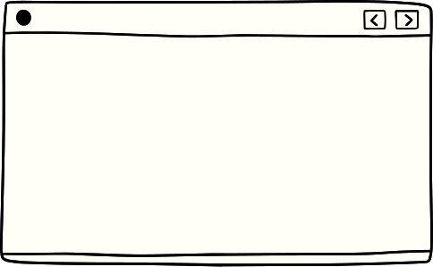



what are we doing today?
01
02
03
What is
is a Microbit
Make a smiley! :)
Variables and Condition
04
05
06
Rock Paper Scissors
Microchat
Tidy Up
Notes:
Explain each activity, and give an overview, i.e. Make a smiley will consist of you guys creating a smiley face using the microbit

Slide 3
Learning outcomes
I know what a microbit is and I know how to code it
01
I know what a variable is and I can give an example
02
I know what a condition is and what they are used for
03
Notes:
Specify the learning outcomes and that we will revisit them later on in the class

Slide 4
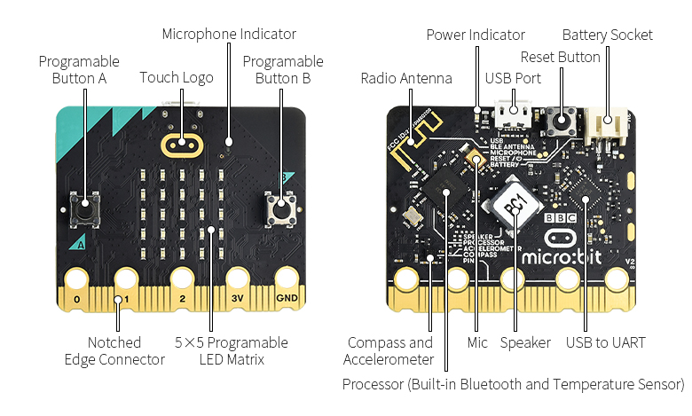
what is a microbit
Notes:
we need to mention:
- usb port - this connects the microbit to the computer
- LED screen - allows us to display images
- Accelerometer - lets the microbit know if it is being tilted
- Power indicator - lets us know if the microbit is properly connected
- Battery socket - we use this when we don't want the microbit to be connected to the computer, but we still want it to work

Slide 5

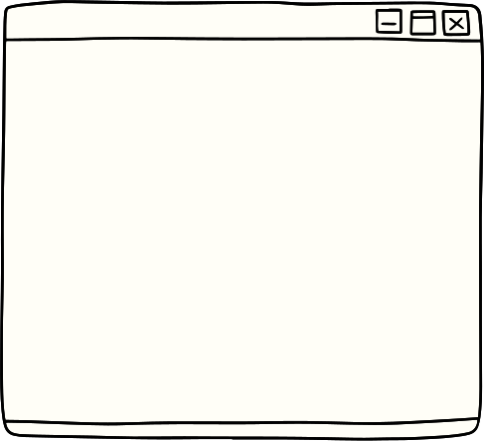


Make a smiley face
We will be using the Microbit to create a smiley face
Notes:
Quick explanation of the project

Slide 6

How to get started
We need to go to the Microbit Website
https://makecode.microbit.org/
Create a new project
Connect your Microbit to the computer
Notes:
This will be the most complicated part, just ensure the students are connected to the computer and are following along what we need them to do.

Slide 7
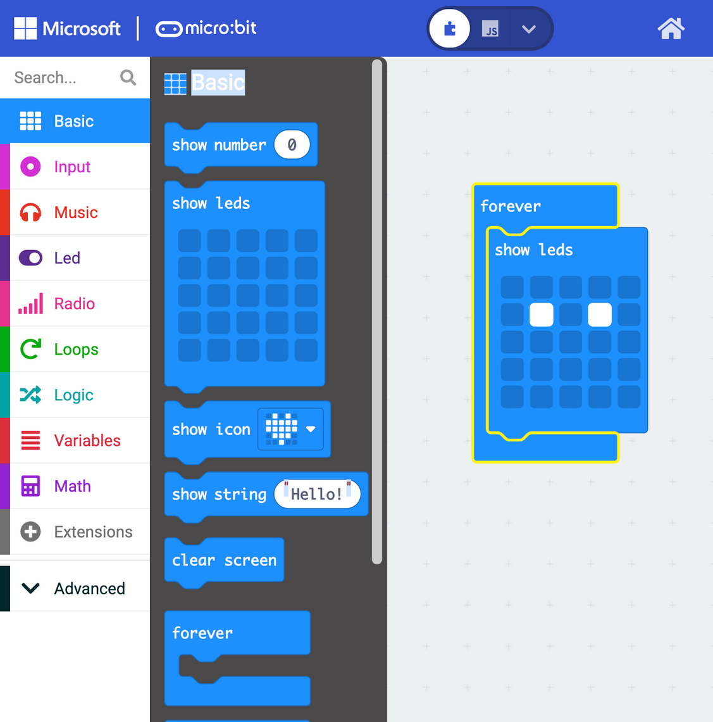
Notes:
This is AFTER everyone has set it up. we can allow them to experiment but say we will be giving you a hint!!! We can ask if they want one and if they don't we can just skip this slide.

Slide 8
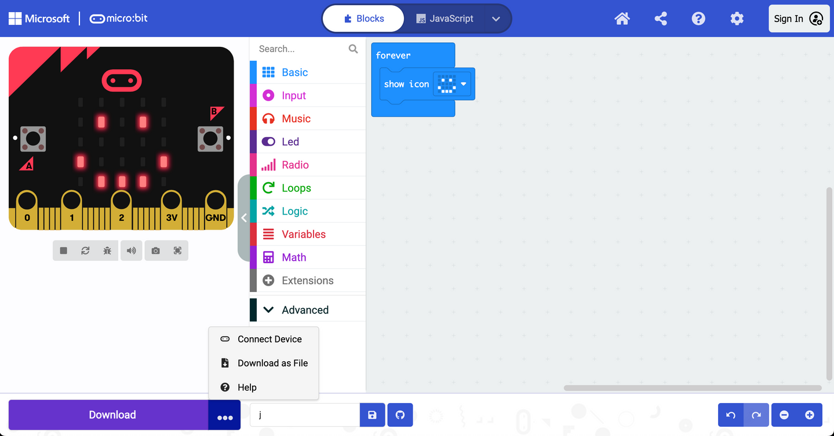
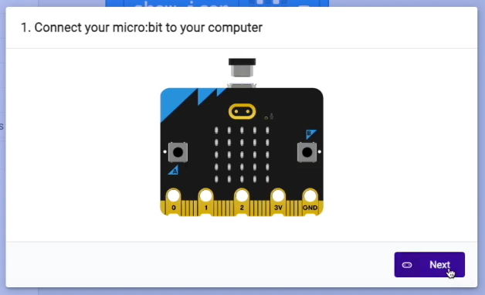


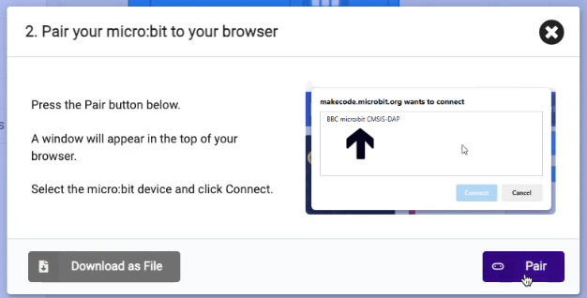
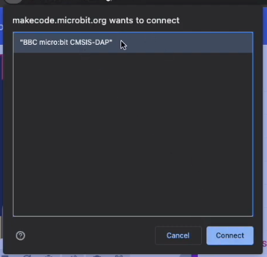
Notes:
This is where we expect them to have most issues. Just keep calm and try to fix it one step at a time making sure the student knows what's happening and why. make sure that they are ON CHROME!!!!! THIS DOESN'T WORK ON FIREFOX. Once it's set up, easier for them to download the program.

Slide 9
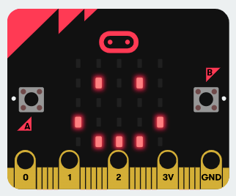
It should look like this
Notes:
nothing to say just remember to keep encouraging and complimenting students

Slide 10
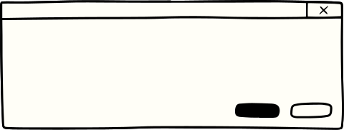



Concepts
Variable
Condition
A container that holds information, such as numbers or words, and you can change what's inside whenever you want.
A condition helps us make decisions by checking if something is true or false
Notes:
Give an example, teach back, and then ask the class if they know of any examples of variables.
teach back steps:
- hide defs
- in pairs, one person describe a variable to the other in their own words
- second person corrects any misunderstandings
- second person describes a condition
-first person corrects
- we will ask 2 pairs for their collective definition

Slide 11
Concepts
Variables
Conditions
Notes:
Have the students teach back to us these two concepts.

Slide 12
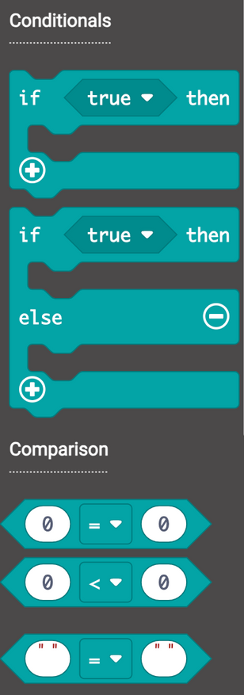
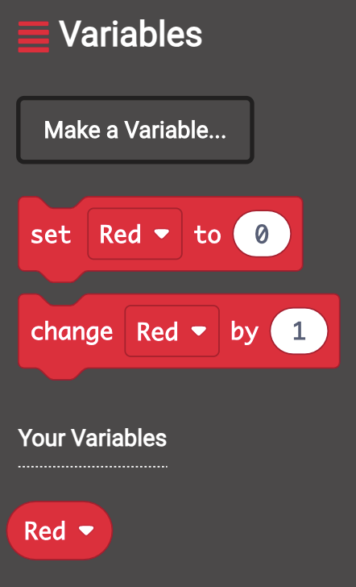
Conditions
how it looks
Variables
Notes:
Explain that these are how they look NOT WHEN CODED just in the bar.

Slide 13
Rock, Paper,
Scissors
Notes:
HYPE THEM KIDS UP WE'RE PLAYING ROCK PAPER SCISSORS

Slide 14
Open the Rock, Paper Scissors Project
Go back to https://makecode.microbit.org/ and open the Rock Paper Scissors project.
(It is in the games section of the web page)
Work through it and raise your hand if you have any questions
If you finish let us know and we’ll give you an extra challenge
Notes:
Common consensus is that this is easier than us showing them step by step. Be alert in case a student has troubles or has questions.
Expansion points:
Have them have different ideas for rock paper scissors.
Can they invent a new hierarchy? Rock paper scissors lizard spock?
Can they add a little bit of code that plays music depending on what kind of variable they get?

Slide 15



Can someone point out the accelerometer?
Can someone explain what variables were used in rock paper scissors?
Check Point
Can someone explain were we used conditions in our code?
Notes:
Throwback to the learning objectives. These measure if the students have learnt anything

Slide 16
Micro-chat
Using radio
Notes:
ONLY IF WE HAVE TIME!!
We ourselves should also program one microbit with the code because there will be 11 pairs and we don't want anyone to feel left out

Slide 17
Open the Micro-chat
Go back to https://makecode.microbit.org/ and open the Micro-chat project.
(It is at the end of the tutorials activities)
Work through it and raise your hand if you have any questions
If you finish let us know and we’ll give you an extra challenge
Notes:
Common consensus is that this is easier than us showing them step by step. Be alert in case a student has troubles or has questions.
Expansion points:
Have them have different ideas for rock paper scissors.
Can they invent a new hierarchy? Rock paper scissors lizard spock?
Can they add a little bit of code that plays music depending on what kind of variable they get?

Slide 18


Let’s tidy up!
Thank you for having us
Notes:
tidy up and feedback

