Slide 1
Platform Excellency
@DocAlly

Slide 2
Objectives
Platform Cost Consciousness
Release/Deployment Optimization
Infrastructure Optimization

Slide 3
Platform Cost Consciousness
Dashboards
Overall Usage Report
Environment Specific Usage Reports (?)
Service Specific Usage Reports
Alarms
Total Billing Threshold
Environment Specific Billing Threshold
Concern: Cloudwatch Cost

Slide 4
Release Optimization
Automated Application Deployment
Application Deployment Pipeline
Cont. Integration and Cont. Deployment

Slide 5
Infrastructure Optimization
On Demand Environment Spin Off and shutdown
Scheduled Downtime for non production environments
Rule based auto scaling up and scaling down

Slide 6
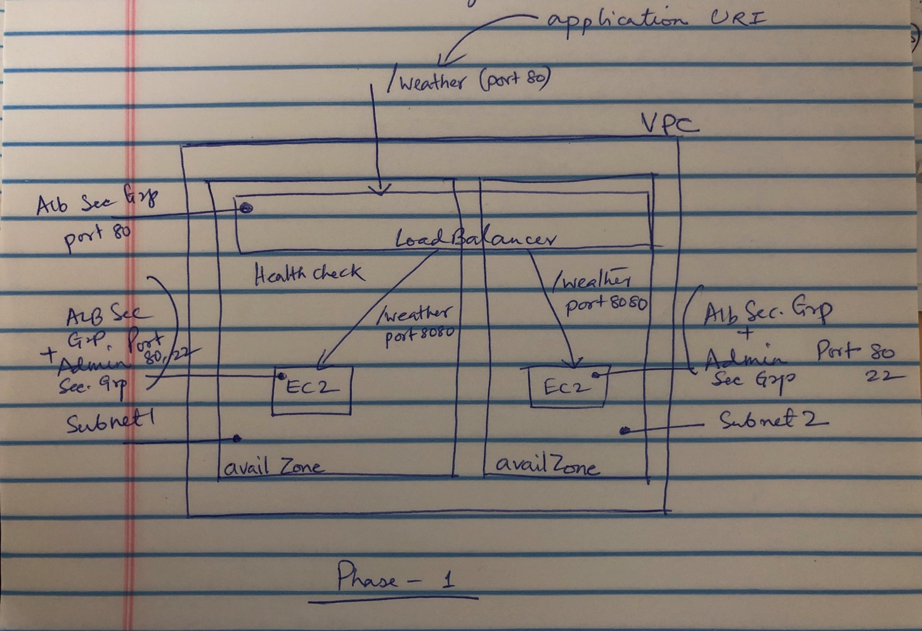
Demo: Dark Sky
Application: Weather Report
Endpoints:
Health: If application is healthy
Weather: Retrieve weather report for a location
Deployment:
Two App Servers in separate AZ
Loadbalancer
Health Check
Firewalls:
Admin activities: SSH/22
Web Traffic : HTTP/80
Web TrafficL HTTP/8080

Slide 7
Planning Chart
Identify Work Items
Prioritize
Schedule next review

