Slide 1

Unicorn
Project G.Memebers: Oshan Mahrajan, Ankur Adhikari, Milan Thapa, Kriti Magar, Shishir Ghorashainee, Arbin Budhathoki, Radip Shrestha

Slide 2
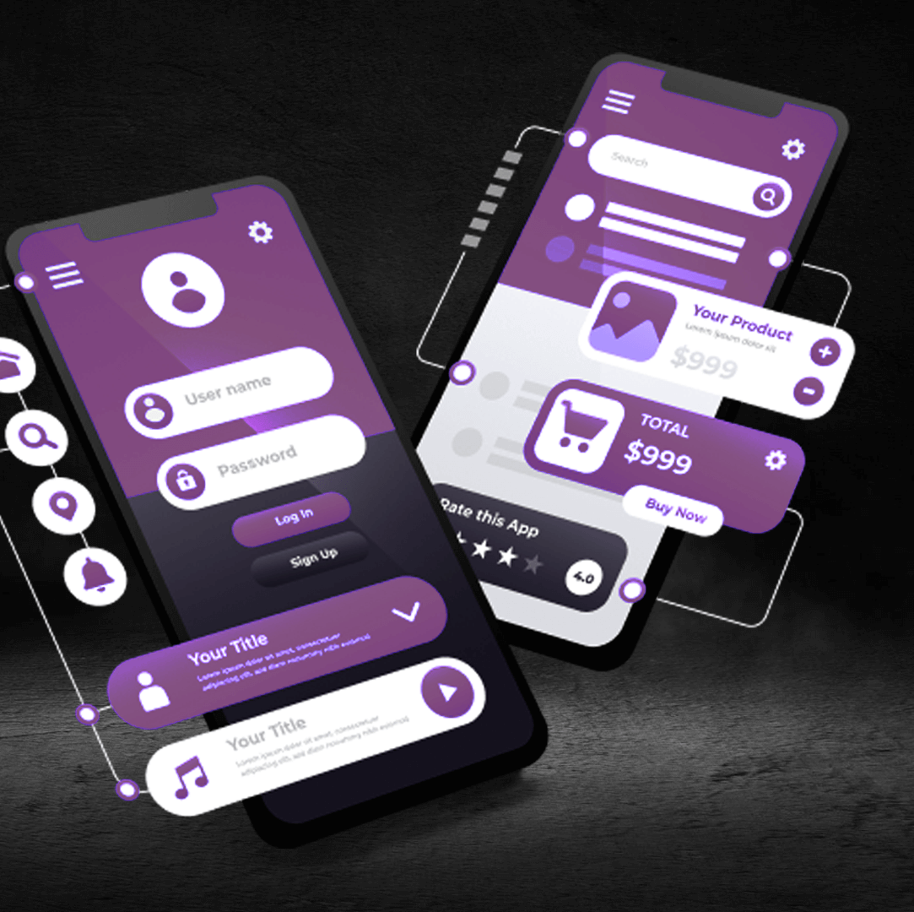
NKU Housing App
The app enhance student living and provides valuable insights into housing options at Northern Kentucky University.

Slide 3

Presntation Team
Oshan leads the NKU Housing Android App project, coordinating team efforts and ensuring project milestones are achieved. With a background in software development, he oversees the technical aspects and user experience design.
Arbin specializes in mobile app development and is responsible for coding the application features. He has experience in Java and Kotlin, contributing to the app's functionality and performance optimization.
Shishir focuses on the user interface and experience design, creating intuitive layouts and visual elements. His expertise in design principles ensures that the app is user-friendly and visually appealing.
Milan is in charge of testing the app for bugs and ensuring it meets quality standards. He conducts user testing and collects feedback to enhance the app's overall performance.
Ankur develops marketing strategies to promote the NKU Housing Android App. His role involves conducting market research and planning outreach initiatives to attract users.
Kriti analyzes user data and feedback to provide insights for app improvements. Her expertise helps the team understand user needs and enhance the app's features accordingly.
Radip assists in managing project timelines and resources. He ensures effective communication within the team and supports various administrative tasks related to the project.

Slide 4

Oshan (Team Leader) Content Creator
The NKU Housing Android app is designed to help NKU students find compatible roommates based on shared interests, habits, and preferences.
It functions similarly to a dating app but focuses on roommate matching.
the purpose of the app and how it works at a high level. They can use a simple analogy to make it relatable.

Slide 5

Ankur Adhikari: Profile Creation
focuses on the first step of the app: creating a profile. They explain what kind of information users need to provide (e.g., hobbies, sleeping habits, cleanliness preferences) and why this is important for finding a good match.
focuses on the first step of the app: creating a profile. They explain what kind of information users need to provide (e.g., hobbies, sleeping habits, cleanliness preferences) and why this is important for finding a good match.

