Slide 1
Messenger Android App
Name: Arbind Saraf
Sec: A
USN:1NH15CS018
6th SEMESTER MINI PROJECT

Slide 2
Contents
1. Introduction
2. Motivation of Project
3. System Requirment Specification
4. Expected Outcomes
5. Flowchart
6. Algorithm
7. Implementation
8. References
Messenger Application Using Firebase
1

Slide 3
Motivation of Project
This project is based chat application where one-to-one person can chat with each other.
Only those will be able to chat who will be registered on the app.
All the data will be organised in Firebase cloud.
Eventually the Authentication, Message, Database every thing is designed on the firebase
Database if managed very efficiently and also the message passing will be done from both the faster end.
1

Slide 4
What is Firebase?
Firebase is a technology that permits you to make web applications with no server-side programming so that development turns out to be quicker and easier.
It is a versatile backend with a lot of good uses.
It is cut down development time and avoids messing with servers and data storage.
It is Scalable. If you want your application to scale well, you can trust that Firebase will handle all your data without missing a single step.
It provides cloud service, so there isn't any setup involved.
Data is stored as native JSON, so what you store is what you see.
It is faster and more efficient than MySql database.
4

Slide 5
INTRODUCTION
Online chat Application
Online chat may refer to any kind of communication over the Internet that offers a real-time transmission of text messages from sender to receiver. Chat messages are generally short in order to enable other participants to respond quickly

Slide 6
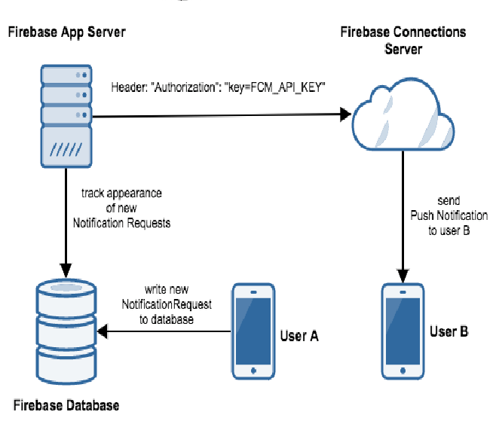
ArchitectureDiagram

Slide 7
Client Requirments
An Android Smart Phone with internet connection
Application Installed
Server Hardware and software requirements
A server with support of Java Complier, XML , Firebase.
1Gb server storage enough for million users

Slide 8
Software:
Android Studio IDE ( for java, XML, kotlin, different plugins, etc )
Firebase Console ( for database management, user Analytics)
Dependencies:
Minimum Configuration to run Android App in System
Internet Connectivity

Slide 9
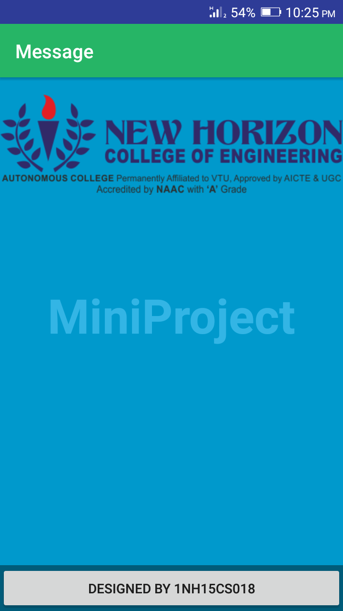
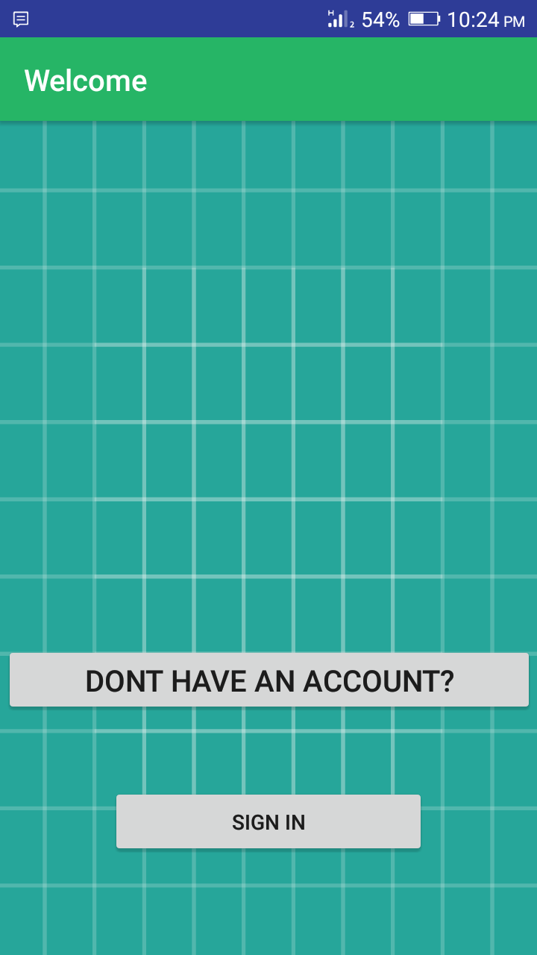

Slide 10
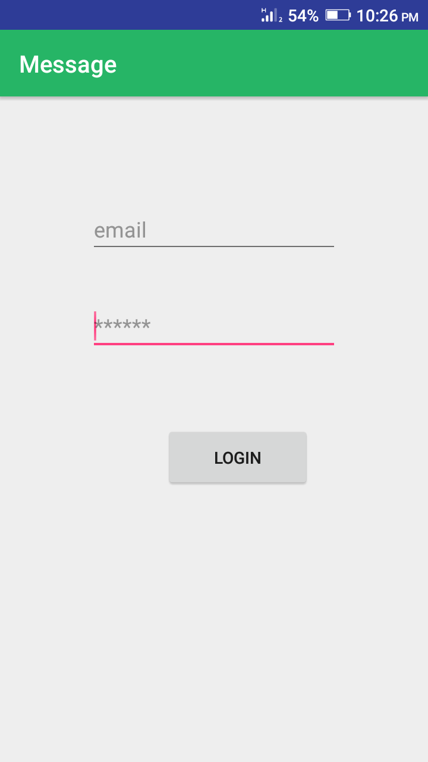

Slide 11
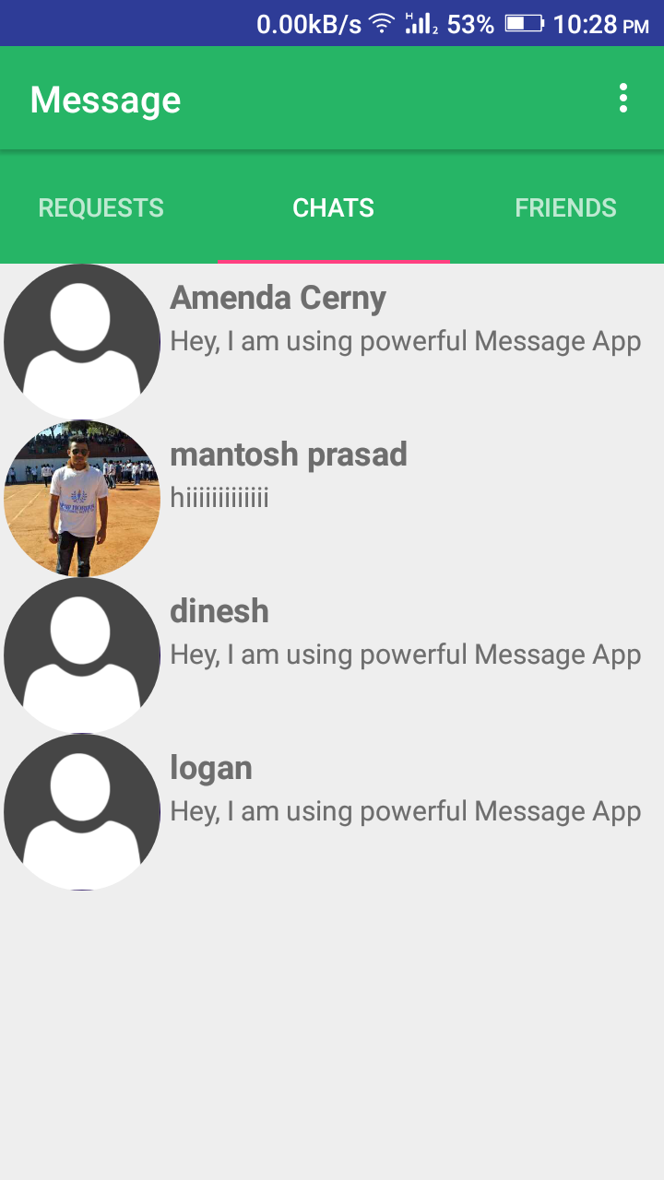

Slide 12
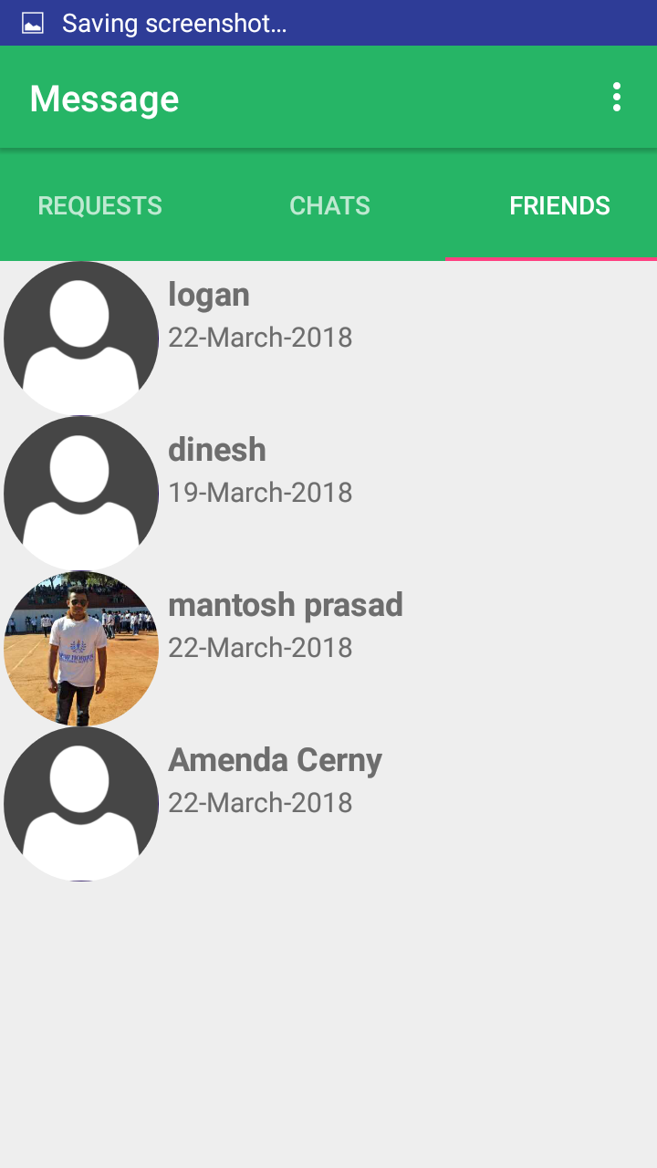

Slide 13
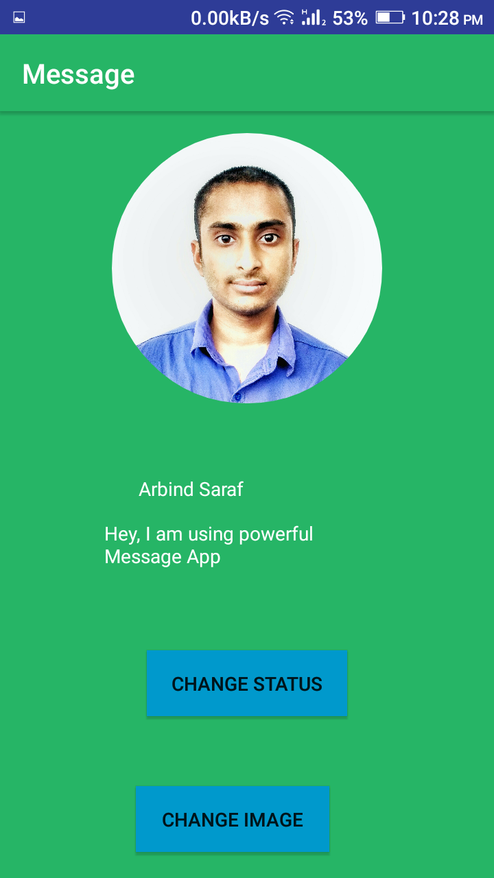

Slide 14
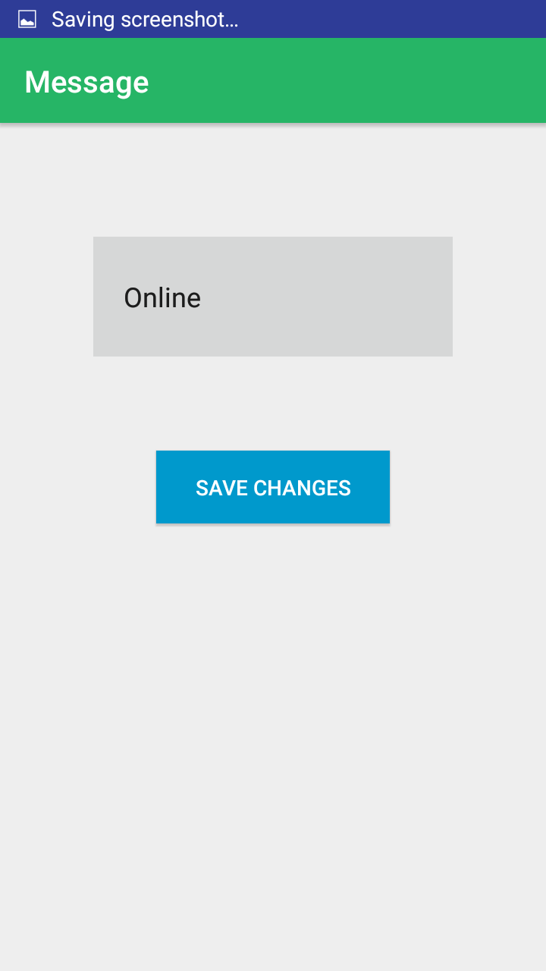

Slide 15
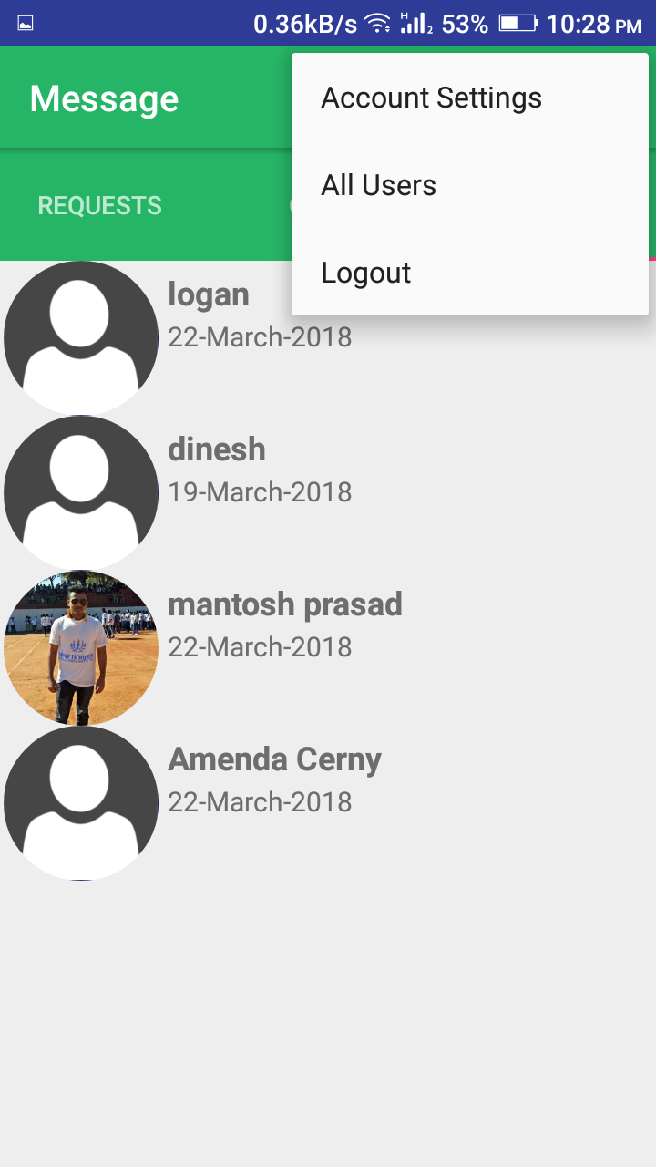

Slide 16
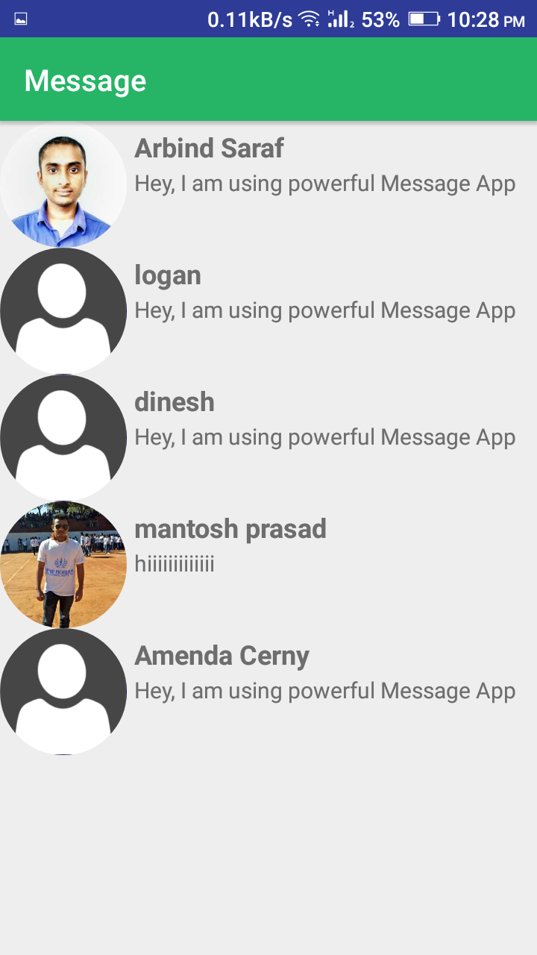

Slide 17
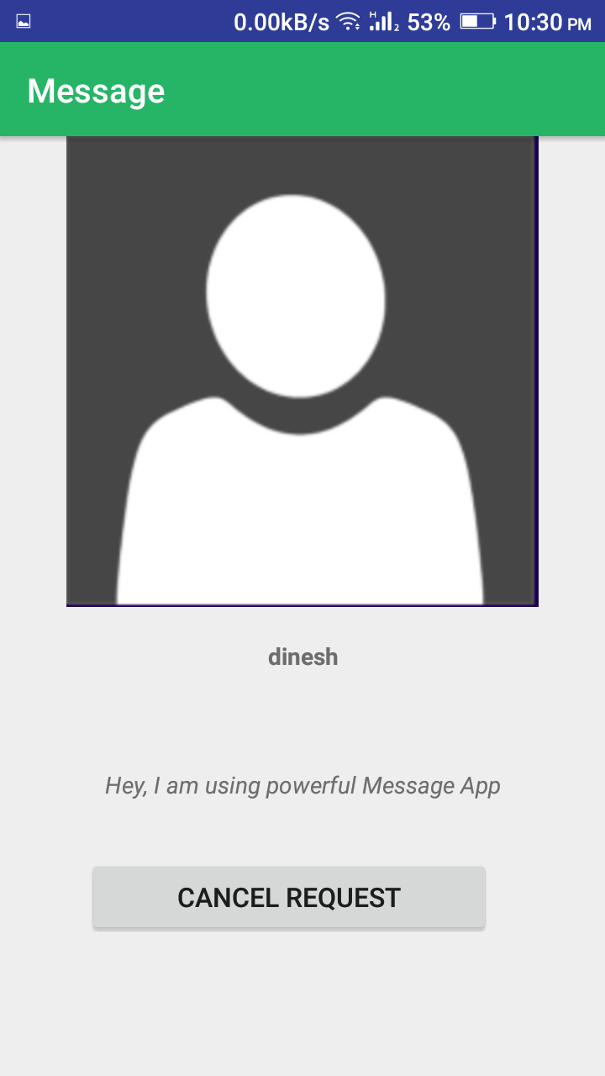

Slide 18
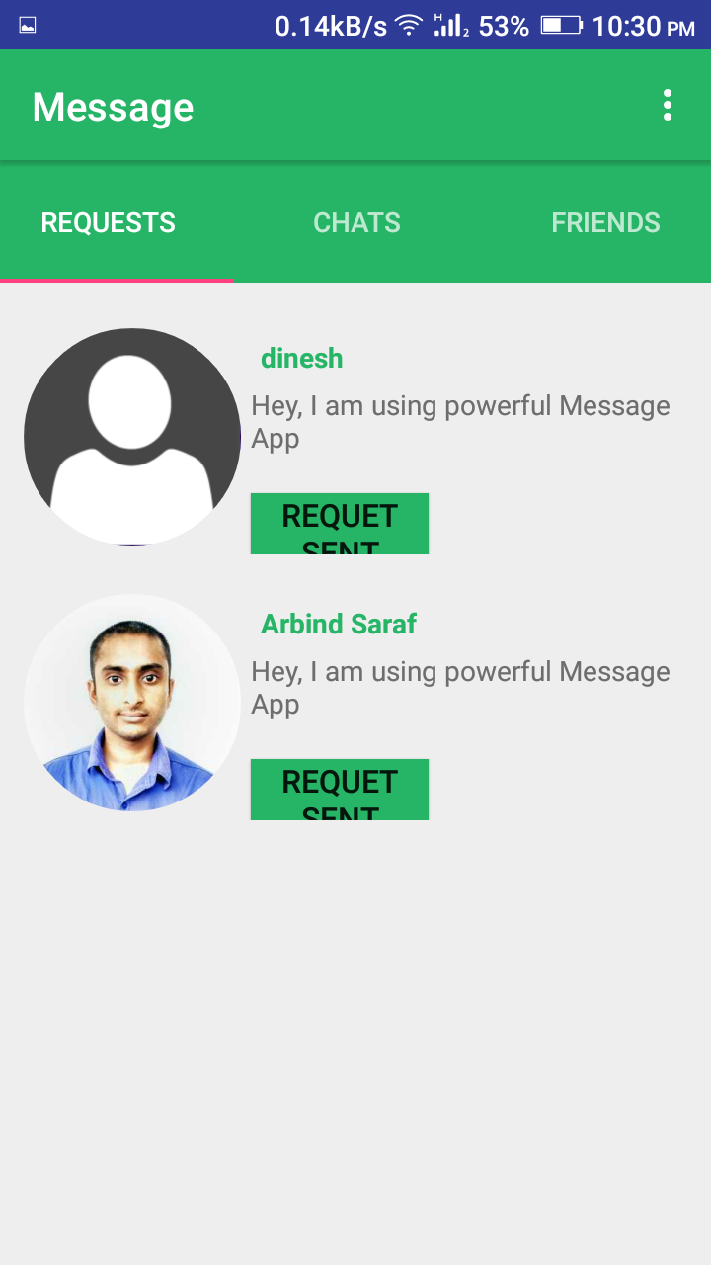

Slide 19
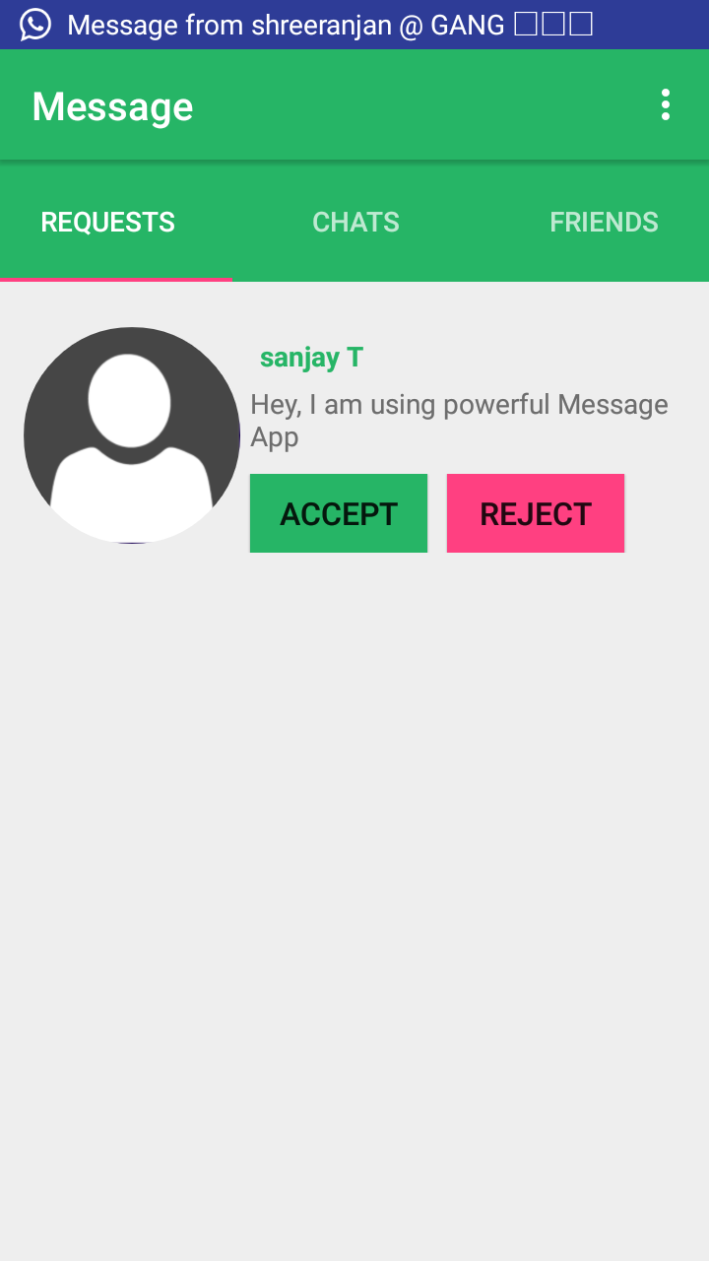

Slide 20
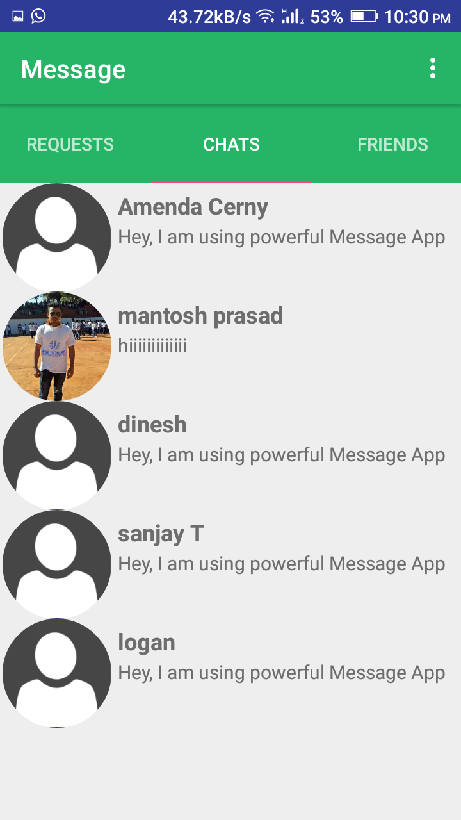

Slide 21
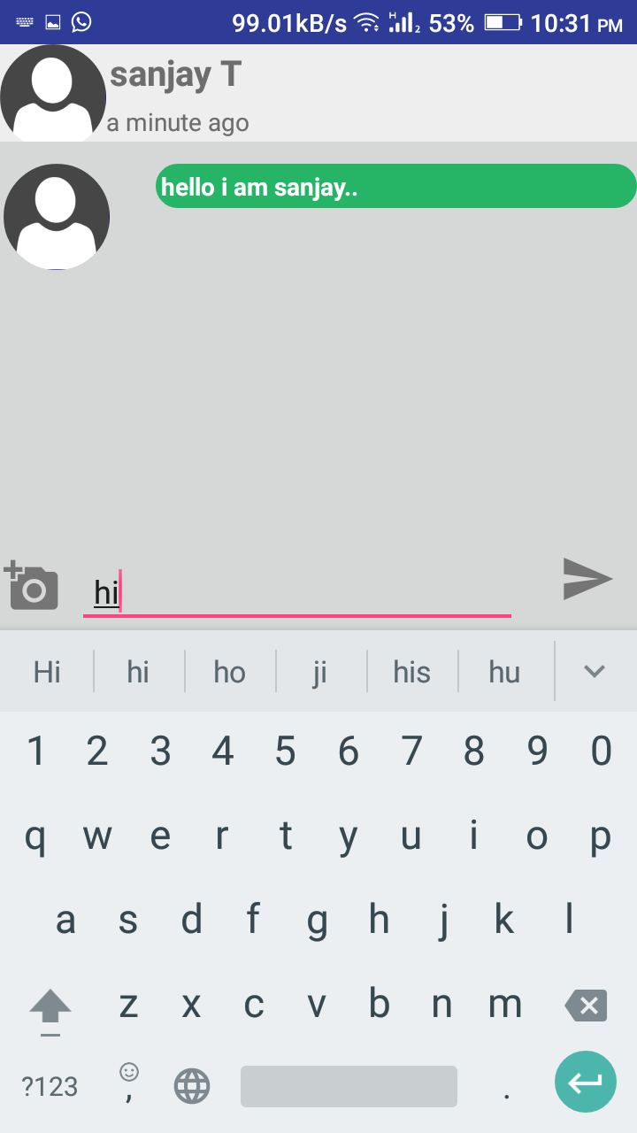

Slide 22
References
The following books have helped me in my project:-
Programming Kotlin by Stephen Samuel, Stefan Bocutiu
Effective Java (2nd edition) by Joshua Bloch
The following websites have been referred to for the project:-
http://www.androidhive.com
www.Udacity.com
22

Slide 23
Thank You!

