Slide 1
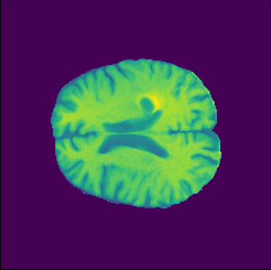
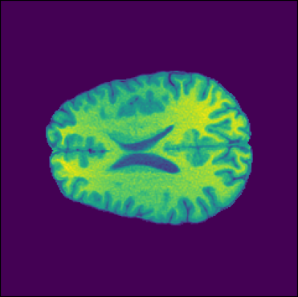
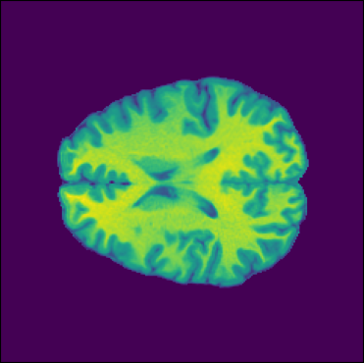
Interdisciplinary Research Computing, Imperial College London
INTRODUCTION
RESULTS
What is an MRI?
Sections:
MRI uses, what it is, population with brain tumours stat
Difficulties of gathering and training with MRI images due to data protection
Our purpose of generating synthetic MRI, briefly what kind of model uses
CONCLUSIONS AND DISCUSSION
OBJECTIVES, MATERIALS, AND METHODS
Our project aims to leverage a Deep Convolutional Generative Adversarial Network (DCGAN) to create clinically accurate glioma images across multiple grades. To train the DCGAN, we utilized cross-sectional MRI scan images from the University of California San Francisco Preoperative Diffuse Glioma MRI (UCSF-PDGM) database [1]. The UCSF-PDGM database includes 501 cases, which encompass 55 (11%) grade II, 42 (9%) grade III, and 403 (80%) grade IV tumours; in each case, 9 cross sectional MRI scans at about the same height were used to train the DCGAN.
Fig. 1. Example cross-sectional brain MRI scans for tumour grade IV (left, case 0004), III (middle, case 0251), and II (right, case 0232), respectively, from the UCSF-PDGM database [1].
In total, 4455 images were used for training the DCGAN. The original images were of 240×240 pixels and were stored in float 64. For the ease of computation using GPUs, we compressed the images to 120×120 pixels in float 32.
REFERENCES
[1] The University of California San Francisco Preoperative Diffuse Glioma MRI (UCSF-PDGM) – The Cancer Imaging Archive (TCIA) Public Access - Cancer Imaging Archive Wiki. Available from: https://wiki.cancerimagingarchive.net/pages/viewpage.action?pageId=119705830/ [Accessed 18th Mar 2023]
ACKNOWLEDGEMENT
We would like to express our sincere gratitude to the invaluable assistance of Ms. Emily Muller for her insightful suggestions and feedback. We are also grateful to University of California San Francisco for providing access to their Glioma MRI database. We would like to express our appreciation to all members of Interdisciplinary Research Computing group at Imperial College London for their constant support and encouragement throughout this research endeavor.

