Slide 1


STREAMS IN JAVA
Presented By:
Arbiya Khanum
07-04-2025

Slide 2
What are Streams in Java?
1
Introduced in Java 8 to support functional-style operations on collections.
A stream is a sequence of elements from a data source that supports aggregate operations.
Streams do not store data, they process it on-the-fly.
Operate in a pipeline (source → intermediate operations → terminal operation).
Enable operations like filtering, mapping, reducing, sorting, collecting, etc.
2
3
4
5
6
7
8
9

Slide 3

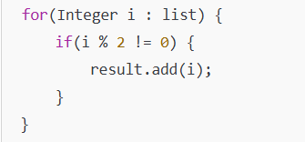
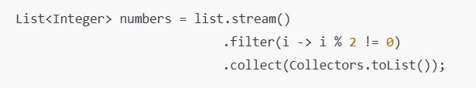
Why Use Streams?
Removes need for external iteration (like loops).
Functional approach: focus on what not how
Promotes clean, readable, and concise code.
Without Streams:
With Streams:

Slide 4
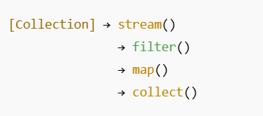
Stream Pipeline Components:
1
2
Source – Collection, array, or generator (e.g., list.stream())
Intermediate Operations – These modify or filter the stream(filter(), map())
Terminal Operations – Triggers processing and ends the stream (collect(), forEach())
3
4
5
6
7
8
9

Slide 5



Creating Streams:
From Collections:
2. From Arrays:
3. Using Static Factory Methods:

Slide 6
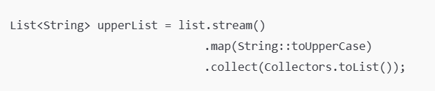
Intermediate Operations:
1
Intermediate operations are lazy and return another stream. They don’t execute until a terminal operation is invoked.
2
3
4
Common Intermediate Methods:
filter(Predicate)
map(Function)
distinct()
sorted()
limit(n)
skip(n)
5
6
7
8
9

Slide 7


Terminal Operations:
Terminal operations trigger the processing of the pipeline and produce a result or side-effect.
Common Terminal Methods:
collect() → gather the result into a collection
forEach() → perform action on each element
count() → returns count
reduce() → combine elements to a single result

Slide 8
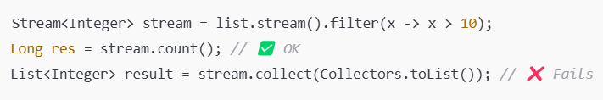
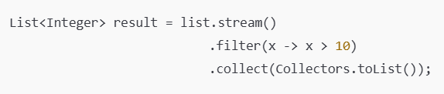
Important: Stream is Single-Use:
1
Once a stream has been operated upon, it cannot be reused.
If you try, Java will throw an IllegalStateException.
2
3
4
Example:
5
6
7
Error:
8
9
Fixed:

Slide 9
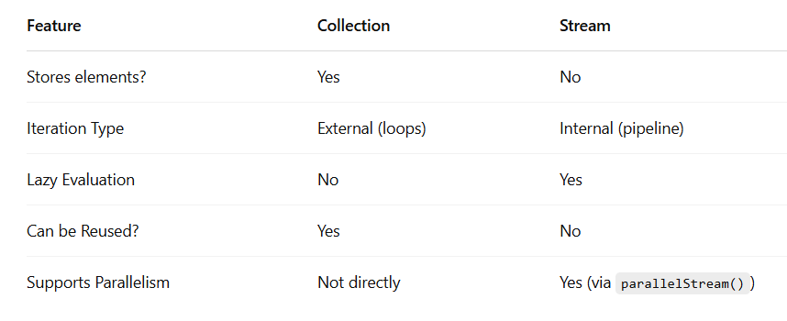
Stream vs Collection:

Slide 10
Thank you

