Slide 1
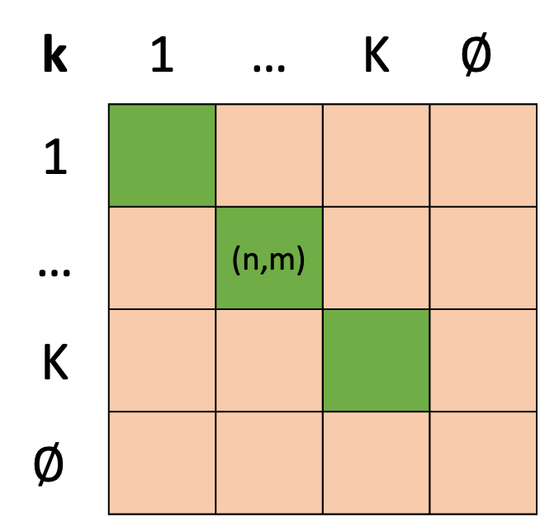
[t,k]
Classification 2
[t,k]
k | 1 | … | K | $$∅$$
1
… |  | (n,m)
K
$$∅$$
Classification 1
[t,k]
[t,k]
Congruent Classifications
Incongruent Classifications

Slide 2
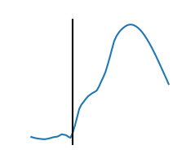
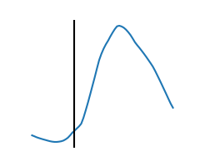
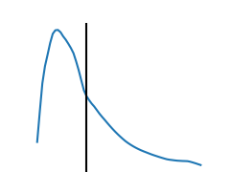
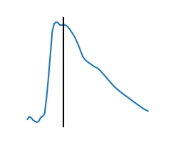
Examples of “Peakless” Spikes
and their Spike Times

Slide 3
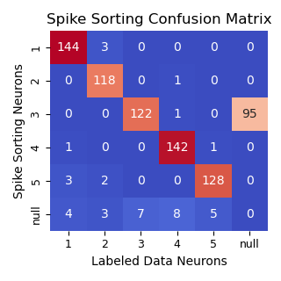

Slide 4
False Positive clips
New Clips
~n
False Positive Rejection
False Positive
Discarded
n
True clips
Neuron Type Classifier
Classified

Slide 5


Training Data
Labeled Clip Creation
Spike Detector
+
-
True clips
False Positives
True
Clip
New Data
New Clips
Classified
SVM Classifier
{1,…,5}
Discarded
False
Positive
{0}

Slide 6
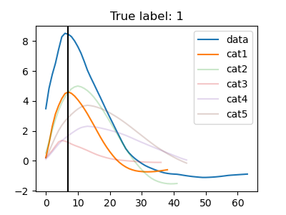
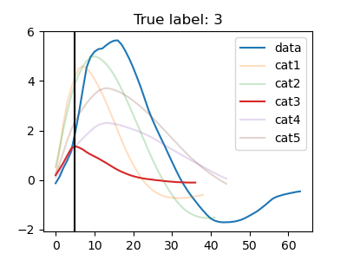
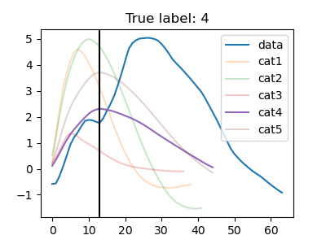
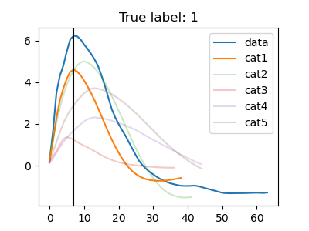
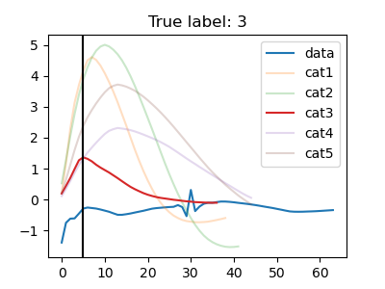
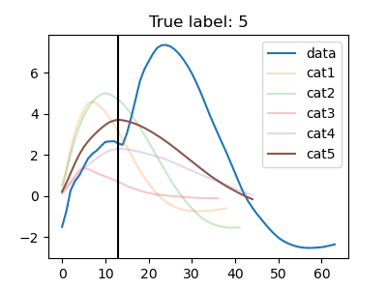
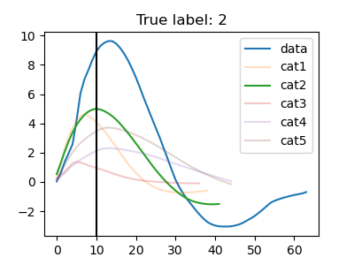
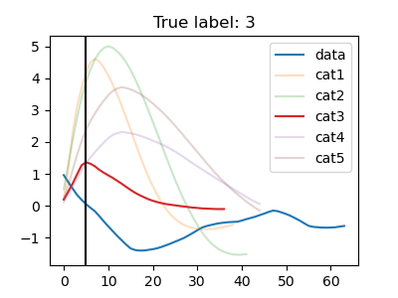
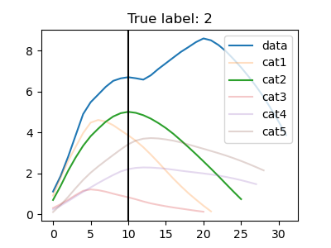
Superposed
n=9/27
Silent
n=10/27
Missed Peak
n=8/27

Slide 7
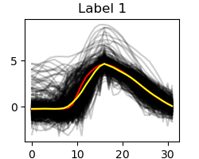
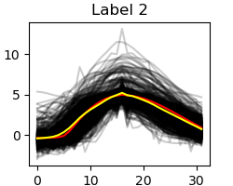
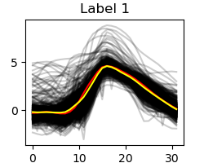
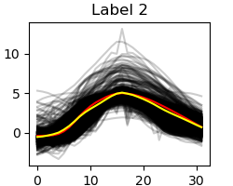
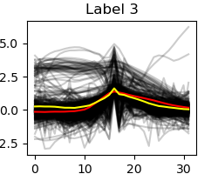
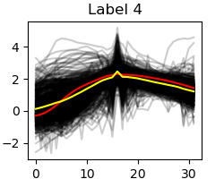
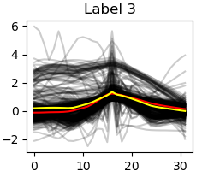
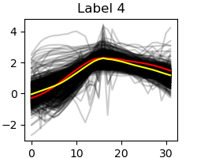
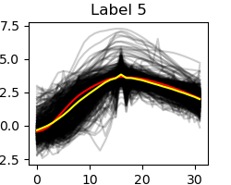
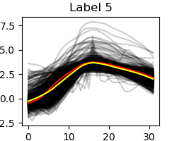
Classified Submission Waveforms With Level 1 Wavelet Denoising
Classified Submission Waveforms With Level 4 Wavelet Denoising
Classified Submission
Waveform
Classified Submission
Waveform
Mean Training
Waveform
Mean Training
Waveform
Mean Submission
Waveform
Mean Submission
Waveform

