Slide 1
Screenshots of a thing I half made.
Eddie Pantrige

Slide 2
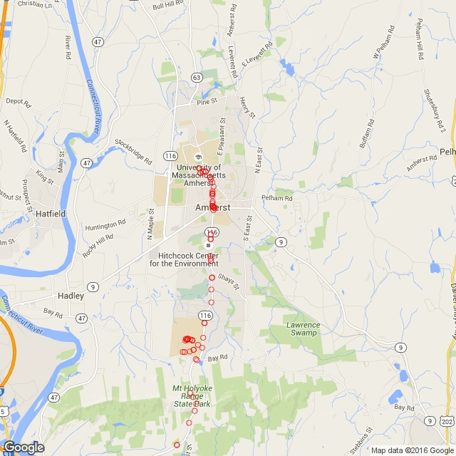
GoogleMaps

Slide 3
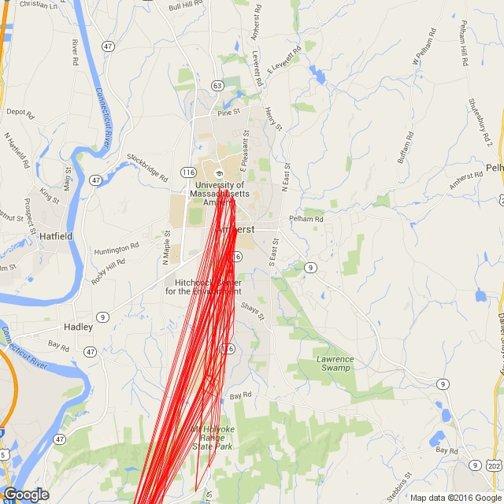
Data Wrangling

Slide 4
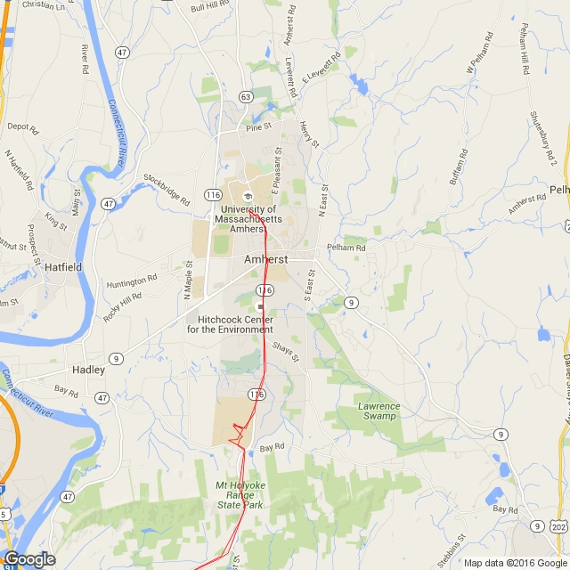
Much Better

Slide 5
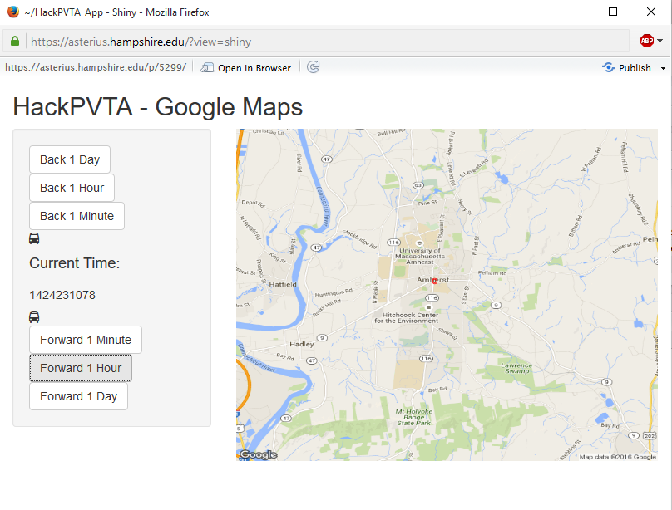
App Prototype

