Slide 1
The Curmudgeon-y Grad Student
By Steele Valenzuela

Slide 2
sorry
overload
This competition is to better PVTA and their service to UMass.
My project is to serve myself [insert evil laugh].
Who likes crowded busses? Not me.

Slide 3
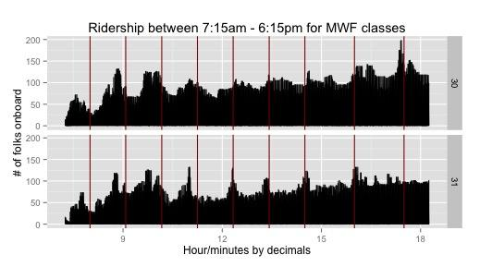
Let’s look at some plots (1 of 2)

Slide 4
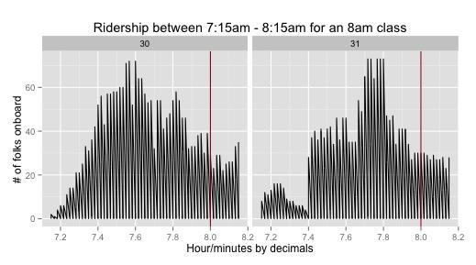
Let’s look at some plots (2 of 2)

Slide 5
100%
of students like a relaxing bus ride.
Here are some recommendations.

