Slide 1
5th HBP Students workshop
A morphologically-detailed neuronal network simulation library for heterogeneous high performance computing architectures
2nd february 2021 I Brent Huisman

Slide 2
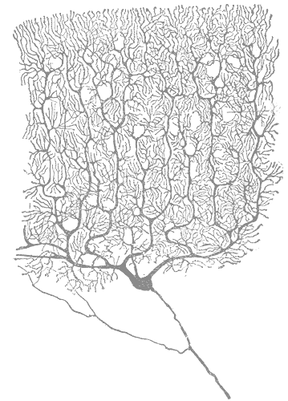
what is arbor?
A morphologically-detailed neuronal network simulation library for heterogeneous HPC architectures
A library for the simulation
of large networks of morphologically-detailed, spiking neurons
for all HPC systems in the HBP
Runs on multiple architectures
GPU systems,
vectorized multicore,
Intel AVX and laptops
Modular design for extensibility to new computer architectures
Purkinje cell by Santiago Ramón y Cajal
Notes:
Purkinje cell
<number>

Slide 3
Core Arbor Team
From different institutions
Ben Cumming
Stuart Yates
Nora Abi Akar
Anne Küsters
Thorsten Hater
Brent Huisman
openly available @ github.com/arbor-sim/arbor
Notes:
<number>

Slide 4

Why arbor?
To solve multi-compartment simulations with large networks on new HPC architectures
Problems and models that are challenging to explore with current software and systems, e.g.
Near real-time multi-compartment simulations
Large networks with long simulations, parameter search, statistical validation
Field potential calculations of large networks with volume visualization
Adapting existing simulators to new HPC architectures is hard, e.g. for
Highly parallel architectures such as Intel Xeon and Intel KNL
Wider vector operations such as AVX, AVX2, AVX512
Specialized accelerator hardware as GPUs
Source of picture: flaticon.com
Notes:
Flaticon.com
<number>

Slide 5
Questions: programming experience?
Languages
Python, C++, Matlab, ...
Operating systems
MacOS, Linux, Windows
Tools
Bash, Git, ...
Hardware
GPU, HPC, ...
Notes:
Flaticon.com
<number>

Slide 6

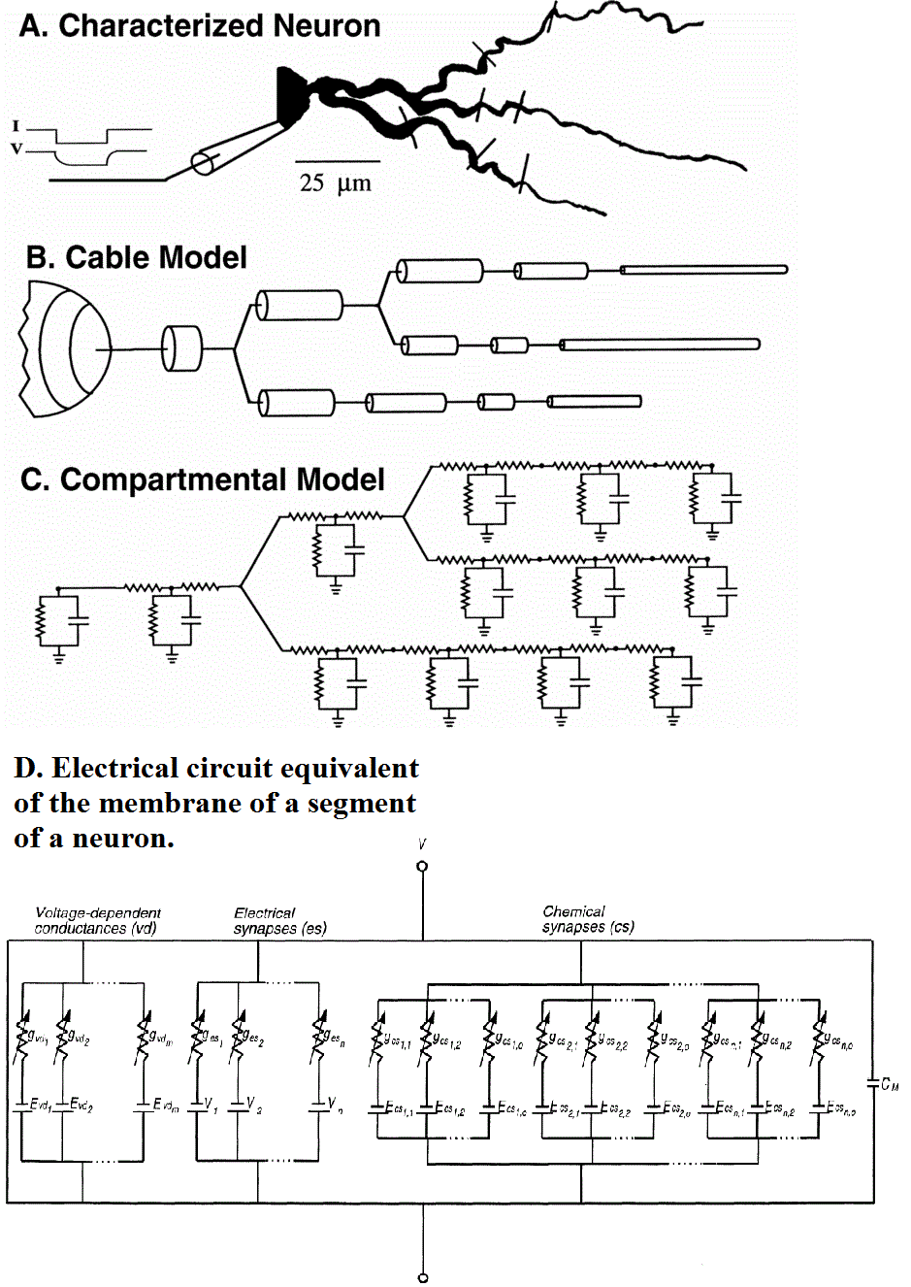
Arbor’s Neuron Model
Arbor simulates networks of multi-compartment neurons
Neurons: approximated by axonal delay, synaptic functions and a set of cables (for dendrites + soma) connected in a tree.
Cables: characterized as 1D electrical compartments (of variable diameter) composed of ion channels, cable resistance and capacitance.
Neurons represented as sparse, close-to-band matrices to be solved (e.g. by Hines solver) against known current states due to synaptic conductance.
Network and spike exchange between neurons at synapses are represented by concatenations of matrices.
Source: Koch, Methods in Neuronal Modeling: From Ions to Networks
Notes:
<number>

Slide 7
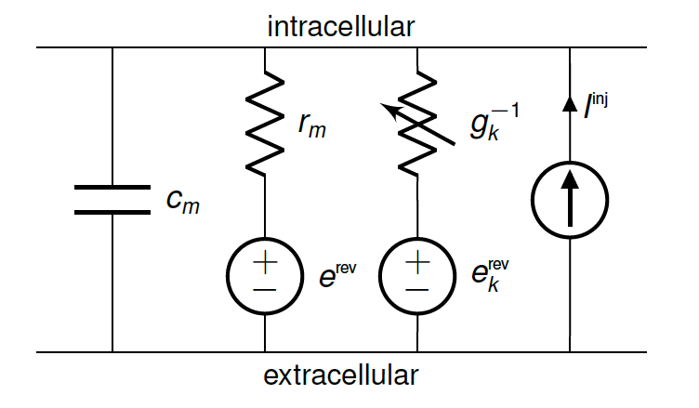
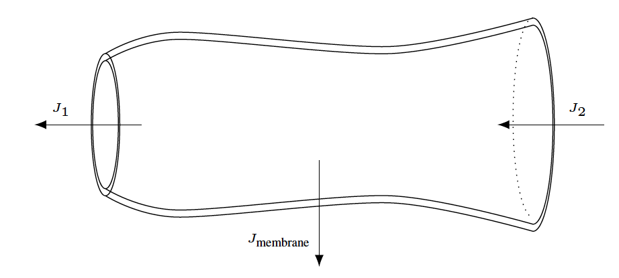
Cable Equation
A cell is modelled as a branching, one-dimensional electrical system
, where
with
Axial conductivity of the intracellular medium
Membrane areal capacitance , areal conductance for an ion channel of type as a function of channel’s state
Corresponding reversal potential
Membrane surface area as a function of axial distance
Current produced by a synapse at position as a function of the synaptic state and local voltage
Injected current at position
Notes:
f_k, f_k^syn biophysical properties of the ion channels and synapses, and will vary from simulation to simulation
<number>

Slide 8
Numerical Model
Cell state evolution is numerically solved with first order methods
Space discretization: Vertex-centered 1D finite volume method using first-order approximation for axial current flux with
Voltage and channel state time evolution split: Lie-Trotter
Time discretization: First-order implicit Euler integration
Channel state ODEs: Integration with updated voltages depending on set of ODEs

Slide 9
Cell simulation
Most time consuming parts on a CPU are updating currents and integrating gating variables

Slide 10
Questions: modelling experience?
Math
(Systems of) (partial) differential equations
Methods
Integration
Discretization
Solvers
Notes:
Flaticon.com
<number>

Slide 11
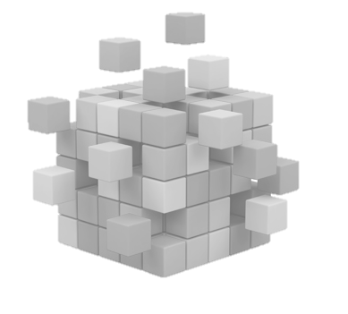
Arbor’s Design model
Describe the neuroscience first ...
Cells
Recipes
A “cell” represents the smallest model to be simulated
A “cell” forms the smallest unit of work distributed across processes
Types:
Specialized leaky integrate-and-fire cells
Artificial spike sources
Multi-compartment cells
A “recipe” describes models in a cell-oriented manner and supplies methods to
Map global cell identifier gid to cell type
Describe cells
List all connections from other cells that terminate on a cell
Advantage: parallel instantiation of cell data
Notes:
<number>

Slide 12
Arbor’s Design model
… then translate it into execution.
Cell groups
Mechanisms
A “cell group” represents a collection of cells of the same type together with implementation of their simulation
Partitioning into cell groups provided by decomposition
A “simulation” manages instantiation of model and scheduling of spike exchange as well as integration for each cell group
In a recipe, mechanisms are specifications of ion channel and synapse dynamics
Implementations of mechanisms:
Hand-coded for CPU/ GPU execution or
A translator (modcc) is used to compile a subset of NEURONs mechanism specification language NMODL to architecture-optimized vectorized C++ or CUDA source
Notes:
<number>

Slide 13
Arbor’s Design model
… then translate it into execution.
Cell groups
Mechanisms
A “cell group” represents a collection of cells of the same type together with implementation of their simulation
Partitioning into cell groups provided by decomposition
A “simulation” manages instantiation of model and scheduling of spike exchange as well as integration for each cell group
In a recipe, mechanisms are specifications of ion channel and synapse dynamics
Implementations of mechanisms:
Hand-coded for CPU/ GPU execution or
A translator (modcc) is used to compile a subset of NEURONs mechanism specification language NMODL to architecture-optimized vectorized C++ or CUDA source
Handled for you (mostly)
Notes:
<number>

Slide 14
Model
Summary
Arbor models:
Multicompartment neurons using a cable model transformed into a sparse matrix
Neurons characterized by axonal delays, synaptic functions and cables connected in a tree
Spike exchanges are global across computer nodes, functionally concatenating matrices
Numerical solutions are discretized in time and space, and channel states are discretized ODEs
Accelerator (GPU) optimization is focused on updating currents and integrating gating variables
Models are composed of:
Cells representing the small unit of computation (LIF, Artificial sources, Multicompartment cells)
Recipes representing a parallelizable set of neuron construction and connections
Cell groups computed together on the GPU or CPU
Mechanism representing ion channel and synapse dynamics

Slide 15
Questions
Notes:
Flaticon.com
<number>

Slide 16
Exercises
Construct a small ring network
1: make a cell!
2: make the network
3: make the simulation
4: show some results
Notes:
Flaticon.com
<number>

Slide 17
Step 0
Go to https://jupyter-jsc.fz-juelich.de and login
Add new Jupyterlab
System: Jusuf
Project: training2103
Open Terminal
Bottom of screen or File > New > Terminal
source /p/project/training2103/arbor/activate
Start ‘python’
import arbor
Notes:
Flaticon.com
<number>

Slide 18
Step 0
Documentation at https://arbor.readthedocs.io
‘Concepts’ for conceptual explanation
Python and C++ pages detail the API for the matching (roughly) conceptual page.
Today: Python section
‘Cable Cells’ page
Various ‘Cell *’ pages
Notes:
Flaticon.com
<number>

Slide 19
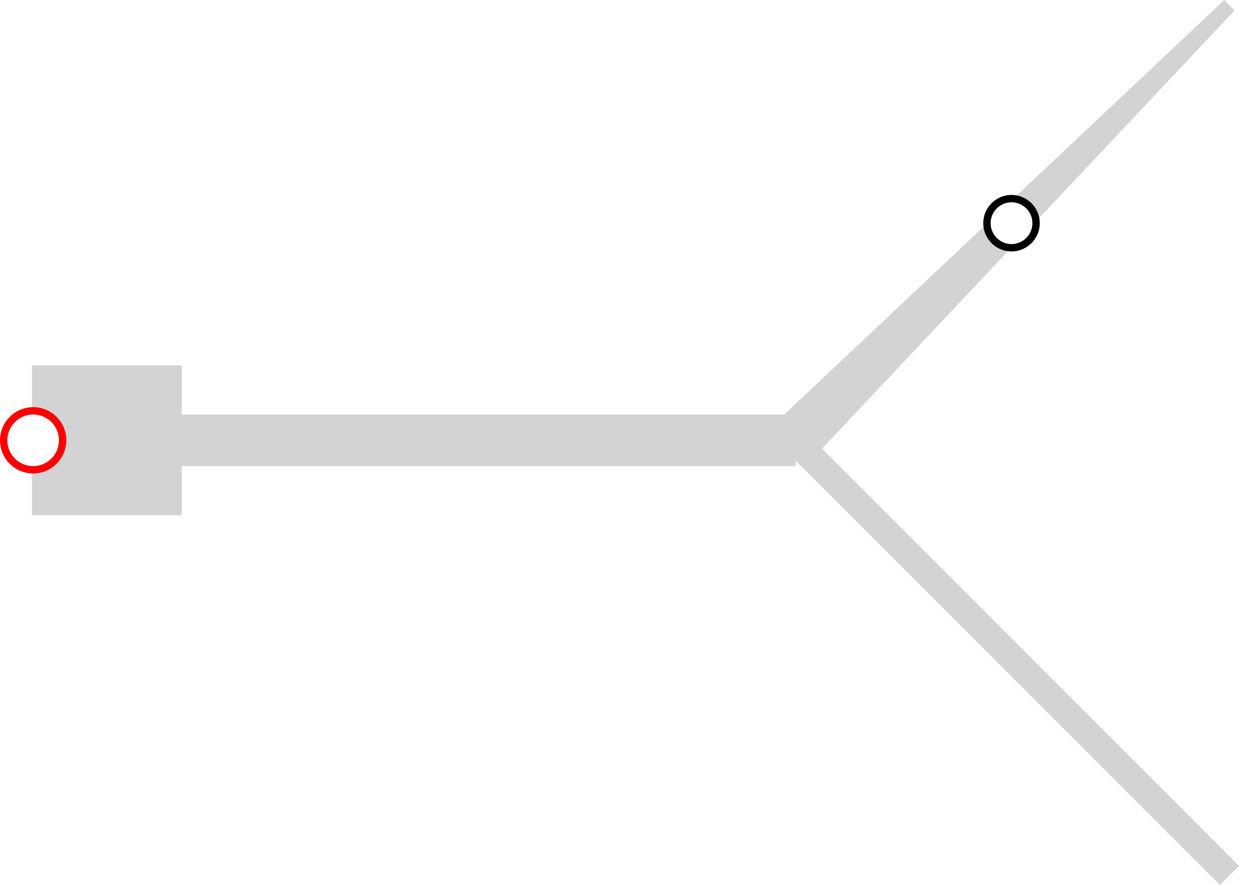
Step 1: Make a cell
Cell with segments (grey), junction site (black)
Use segment_tree
HH dynamics on soma
Passive dendrites
spike_detector at “root”
Notes:
Flaticon.com
<number>

Slide 20
Step 1: MAKE the network
Cells are the basic building blocks in Arbor
Recipes tie them together
Therefore, the network is in the recipe
You’ll make your own recipe by inheriting from arbor.recipe
Some member functions need to be overridden
TODO:
Override all functions
Connect each cell with the previous
Place an event generator on the first cell.
Probe the membrane voltage at "root"
Notes:
Flaticon.com
<number>

Slide 21
Step 3: Make the simulation
Look through the Simulation page, Hardware page
Start with an arbor.simulation object, and see what you need for it.
(defaults are OK)
We need to store handles to the samplers, because later we’ll use arbor.simulation.samples() to retrieve results.
Notes:
Flaticon.com
<number>

Slide 22
Step 4: Show your results!
We can extract results from
arbor.simulation.spikes
arbor.simulation.samples
Print or plot.
Matplotlib, Seaborn (, Pandas?)
Notes:
Flaticon.com
<number>

Slide 23
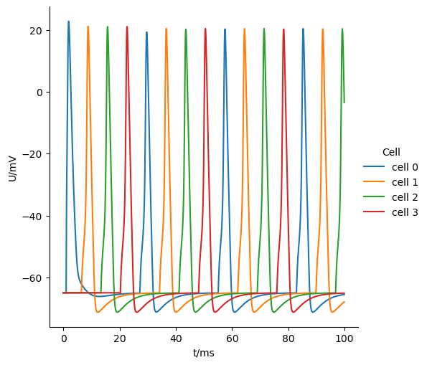
Results
((0, 0), 1.42525561)
((1, 0), 8.32347893)
((2, 0), 15.22188202)
((3, 0), 22.12039976)
((0, 0), 29.08125267)
((1, 0), 36.00941203)
((2, 0), 42.93738402)
((3, 0), 49.86534444)
((0, 0), 56.79361867)
((1, 0), 63.72184675)
((2, 0), 70.65009778)
((3, 0), 77.57832833)
((0, 0), 84.50656887)
((1, 0), 91.43476941)
((2, 0), 98.3629114)
Notes:
Flaticon.com
<number>

Slide 24
Bonus: Arbor on HPC
source /p/project/training2103/arbor/bonus
We’re going big! MPI:
https://en.wikipedia.org/wiki/Message_Passing_Interface
Lookup arbor.mpi_comm and how to use it.
An arbor.simulation will now run distributed
arbor.simulation.samples only knows about local results
You’ll need to save results from the instances yourself!
srun -A training2103 -n N_JOBS python network_ring_bonus.py
Notes:
Flaticon.com
<number>

Slide 25
The end
Get the answers
source /p/project/training2103/arbor/hurray
Leave some feedback
arbor-sim.github.io/feedback
Questions?
Notes:
Flaticon.com
<number>

