Slide 1

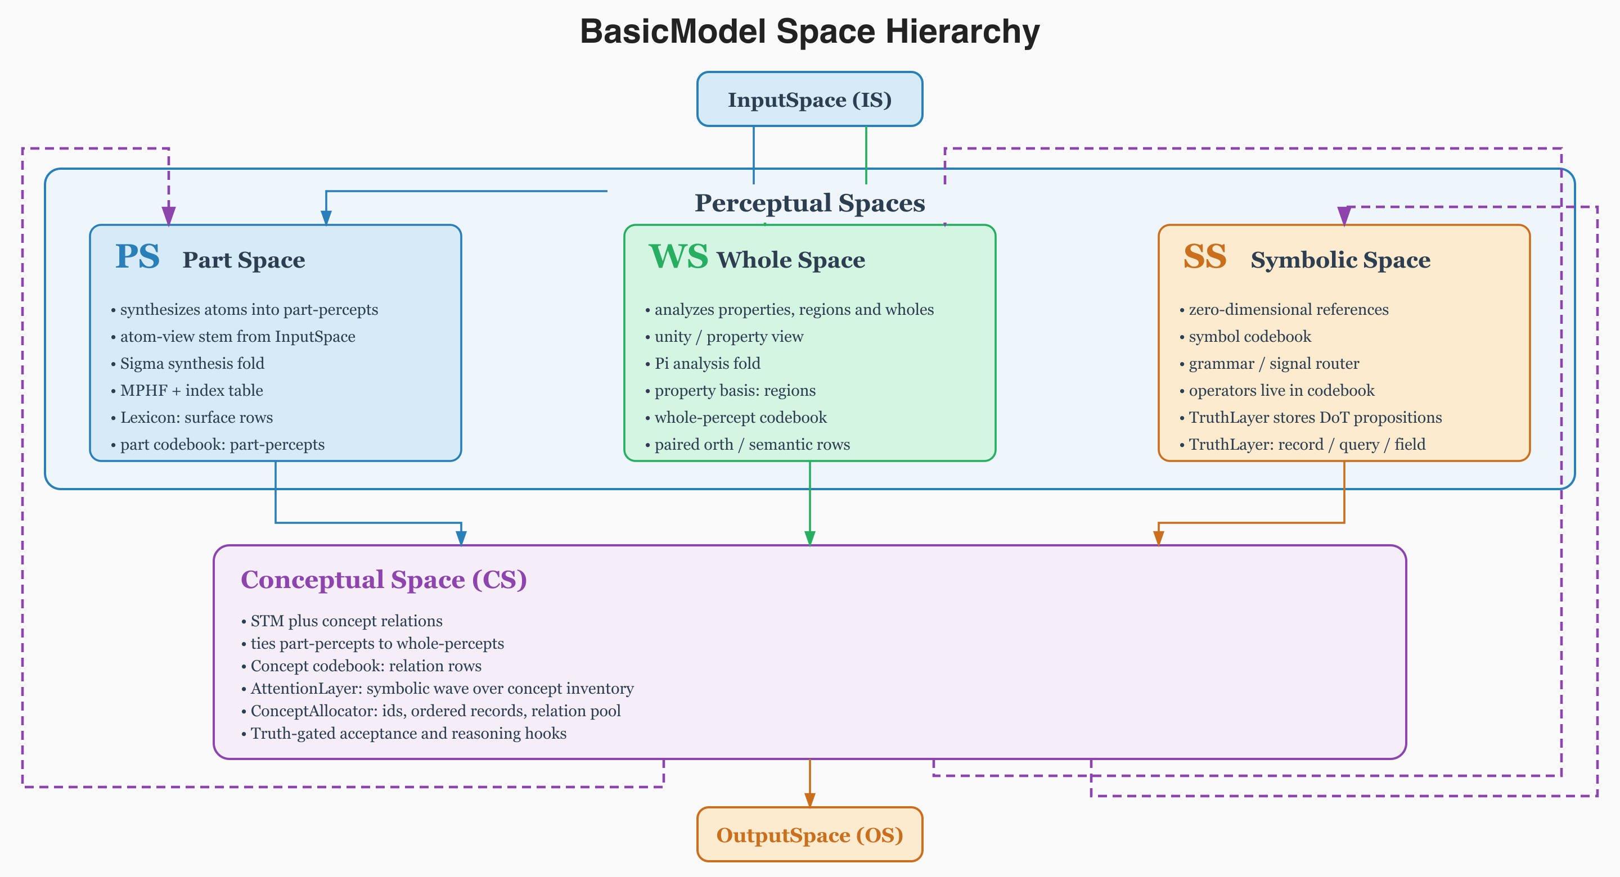
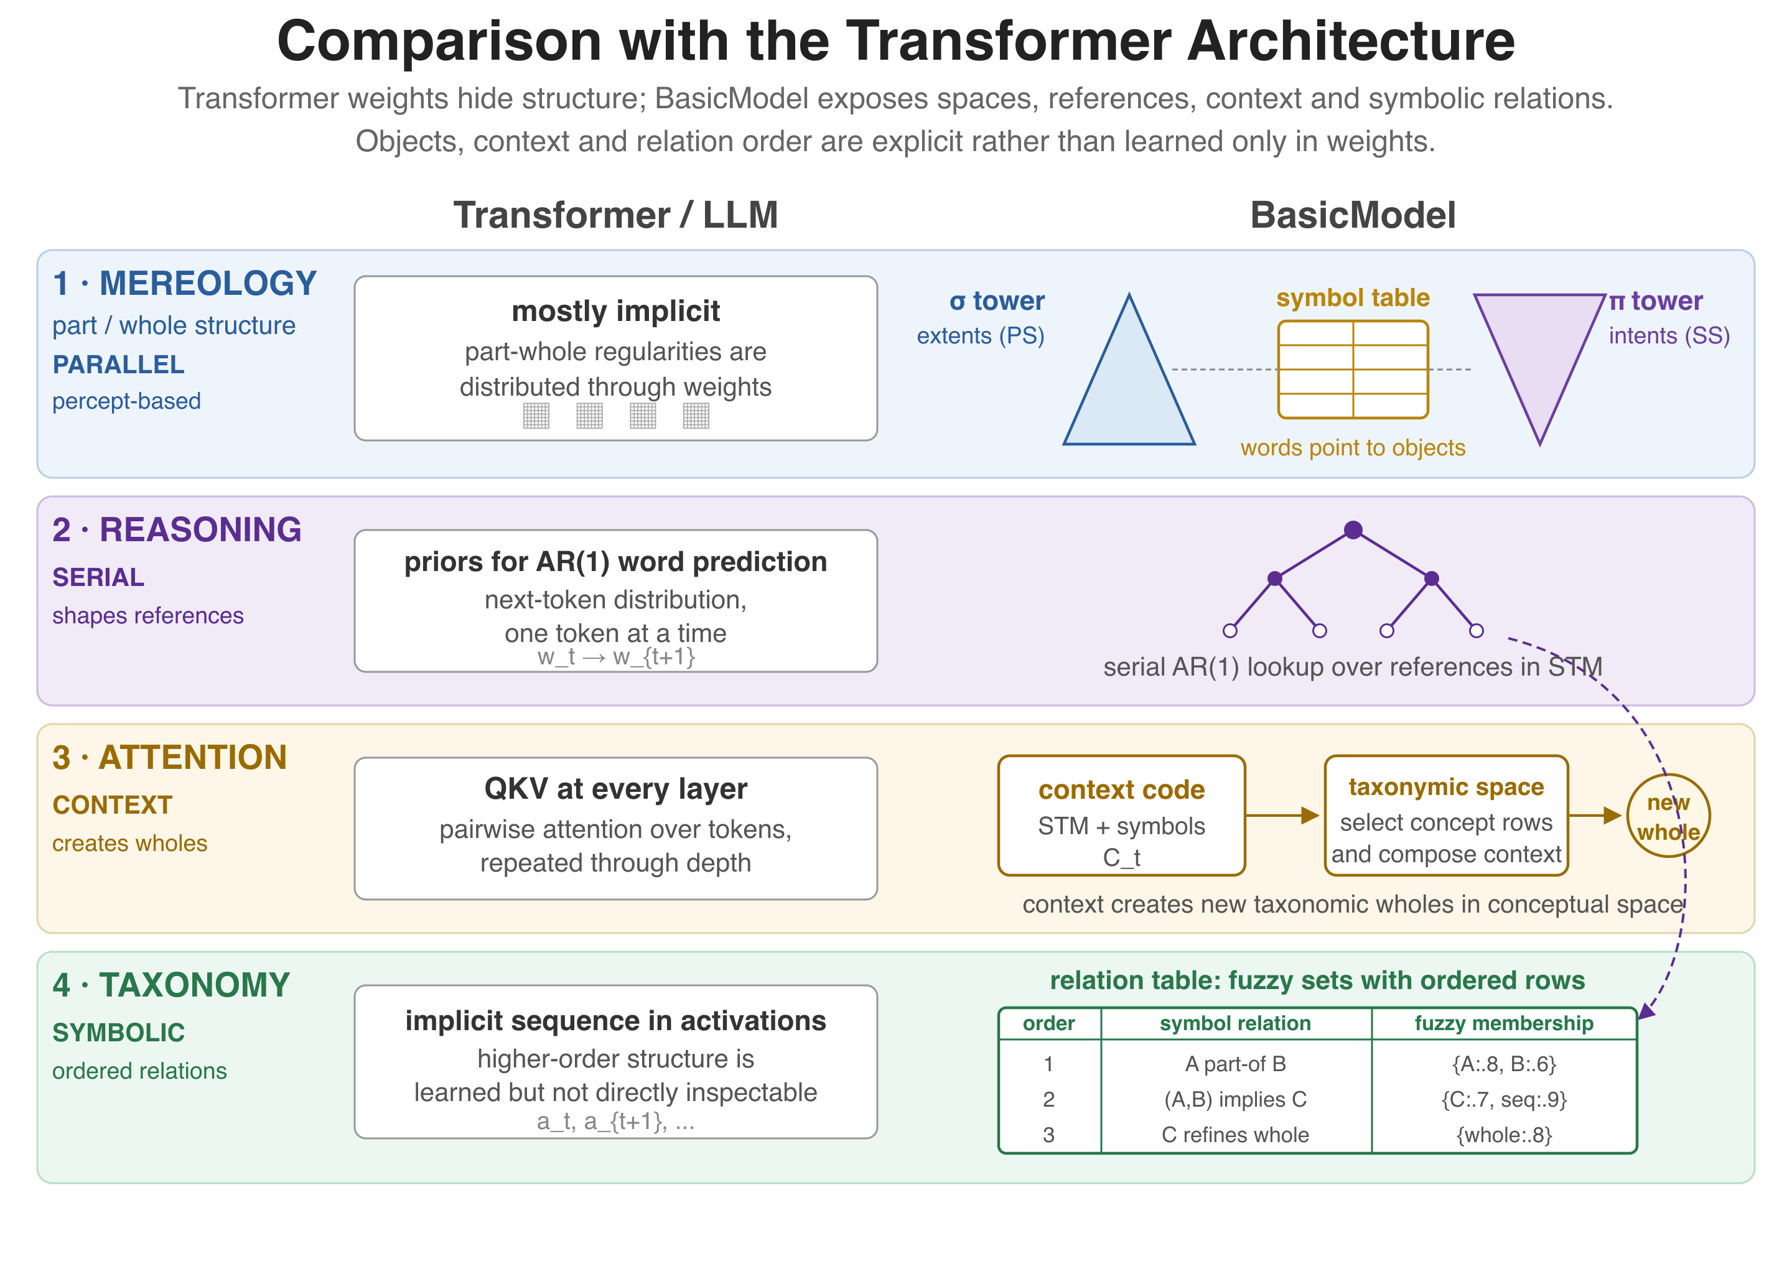
MODELS OF CONSCIOUSNESS 7 - UNIVERSITY OF COPENHAGEN - OCTOBER 12-16, 2026
Alec Rogers
alec@arborrhythms.com
A Truth-based Architecture for Grounded Cognition
A distributed AI system that separates sources of knowledge into a distributed and secure epistemic layer,
and operates on that layer using a cognitive grammar in high-dimensional perceptual and conceptual spaces.
WikiOracle
Overview
BasicModel
WikiOracle is a truthful, explainable LLM system designed as a public good; the Wikipedia model applied to artificial intelligence.
• Truth is preserved and managed explicitly.
• Data is encrypted and stored publically.
• Data, models, and keys can be shared within a network of trust.
• Frames machine cognition as an inspectability problem: if artificial systems are discussed as possible subjects or epistemic agents, their truth boundaries and update rules should be available for mathematical scrutiny.
• Separates truth claims from subjective reports and source authority.
• Defines inspectable confidence, certainty and update gates.
• Provides a more humanistic interface to machine cognition.
• Keeps feelings outside the truth lattice and training set.
• Supports multiple frames of reference.
GitHub.com/ArborRhythms/BasicModel develops the symbolic and syntactic cognition model that WikiOracle can host as one LLM provider. The poster treats it as an inspectible counterpoint to black-box transformer behavior.
Basic Model spaces
Epistemic Model
Truth objects are explicit records that separate verifiable claims, subjective reports, sources, authorities and model providers.
Object
Status
Role
fact
verifiable
Grounds reasoning and can train weights.
LLM comparison
feeling
subjective
Session-only signal; never trains or persists.
reference
source
Grounds claims in external evidence.
authority
remote TruthSet
Imports structured truth with scaled trust.
provider
expert mind
Contributes facts/feelings through voting.
Distributed Architecture
Runtime state stays outside the server and moves between client, encrypted storage and model providers.
Object
Location
Principal Computational Components
Server
Stateless HTTPS service; state is supplied by the client.
Basic Model decomposes cognition into interacting computational components rather than a single opaque weight field.
Client
Web interface for conversation, truth editing and provider selection.
Piece
Basic Model treatment
Storage
Conversations and truth are stored as AES-256 ZIP files on Dropbox.
Mereology
Two towers expose part-percept extents and whole-percept intents instead of leaving structure implicit in weights.
Models
Routes to multiple LLMs, including Basic Model as one provider.
Attention
Typed attention ranges over input, STM, LTM, PartSpace, WholeSpace and SymbolSpace.
Privacy Policy
Hierarchy
Serial referential lookup and grammar composition shape references after parallel perceptual settling.
Privacy policy separates persistent public knowledge from optional personal facts; feelings remain session-only.
STM
A depth-limited concept-space working set tracks serial or whole-slab sentence state.
Channel
TruthSet
Weights
Session
Safety and Interpretability using a Symbolic Firewall
LTM
End-state chains and stored truths support inter-sentence prediction and recall.
Universal facts
yes
yes
yes
The symbolic firewall keeps model state typed, addressable and inspectable so updates can be audited.
Particular facts
optional
yes
yes
Item
Why it matters / discussion hook
Reasoning within Conceptual Space
Feelings
no
no
yes
No anonymous state
Persistent vectors live in addressed codebook rows or STM slots.
Conceptual Space stores and manipulates truth-bearing structures through explicit mechanisms.
Typed units
Percepts, concepts, symbols and operators declare roles and valid operations.
Mechanism
Basic Model content
Auditable mutation
Semantic changes should expose deltas, masks, confidence and provenance.
Truth
Degree-of-Truth scaled propositions are stored, queried and checked for consistency.
Grounding
Can a model expose its path from perception to symbol rather than only output text?
Luminousity
Coverage and consonance guide acceptance, derivation and validity of stored truth.
Cognition
Do symbolic and syntactic constraints give a better mathematical object for machine minds?
Ideas
ConceptualSpace holds sentence-level working states as ideas in STM.
Relations
Concept codebook rows and symbolic graph edges encode part/whole, equality and derived chains.
Sources: WikiOracle.org homepage + README.md; WikiOracle doc/*.md + architecture SVG; basicmodel/doc/*.md + diagrams; AMCS MoC7 2026 and MCS pages; selected speaker profiles; arXiv 1907.03223, 2301.11812, 2308.08708.

