Slide 1

Life Mapper Range and Diversity (LmRAD) platform: a Web Processing Services based GIS architecture for global biogeographic analyses of species distributions
Jeffery Cavner, Aimee Stewart, CJ Grady
jcavner@ku.edu, astewart@ku.edu, cjgrady@ku.edu
Biodiversity Institute Natural History Museum University of Kansas

Slide 2
Species Diversity
Studying biodiversity patterns means to describe, visualize and analyze different aspects of the numbers and abundances of taxa in time and space.
Patterns of species richness are determined by constituent species ranges sizes and spatial locations of those ranges.
Patterns related to species associations, co-occurrence, and species interactions remain central questions against similar patterns that can be expected with non-biological statistical artifacts or distributions due to geometric constraints which requires null hypothesis testing against randomized distributions

Slide 3
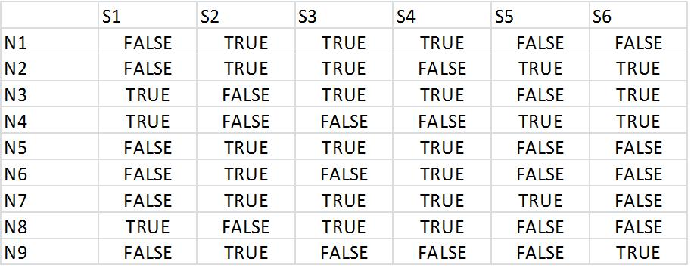
The presence/absence matrix (PAM)
Species richness and species range can be summarized and linked by one basic analytical tool. The PAM is a Boolean data grid of quadrants of equal area covering the extent of a study area not oriented with respect to physio-graphic features or other known zoogeographic features. The presence or absence of each species is noted for each 'cell' or geographic site, where one axis represents species (S) and the orthogonal axis represents geographic sites (N). Each site is coded for the presence (1) or absence (0) of each of hundreds or thousands of species. Stored and manipulated as NumPy arrays.
Row totals represent site richness
Column totals represent species range
Randomization for null hypothesis testing requires keeping range sizes and richness totals constant, bitwise operations on boolean version of the PAM speed these operations

Slide 4
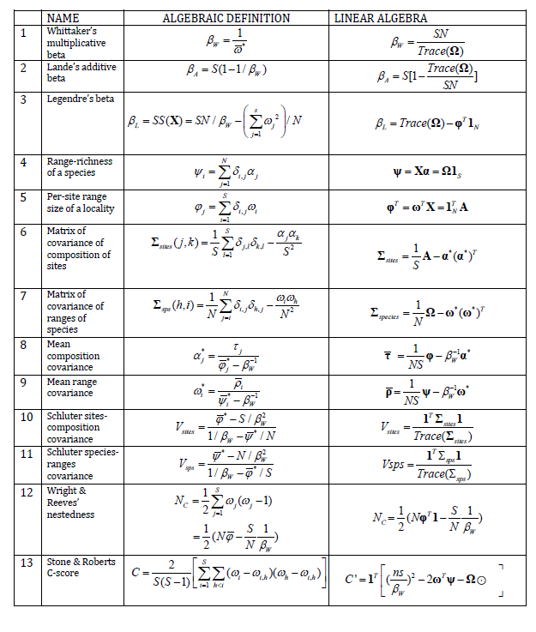
Most existing
indices of biodiversity
pattern are simple
combinations of :
The vector of species richness
The vector of sizes of distributions
The vector of “dispersion fields”
The vector of “diversity fields”
Whitaker’s beta diversity
The dimensions of the PAM

Slide 5
Macroecology is macro in extent but at increasingly high resolutions for sampling sites
Global to continent sized extents with resolution of cells for analysis at 1 kilometer to 10 kilometers
Analyses for biodiversity consider thousands of species at a time
Biogeographical scales significantly increases the size of the PAM when describing whole taxa at high resolutions and leads to computational challenges for constructing, intersecting with species inputs, randomization and linear algebra operations on the PAM
Populating a PAM with species inputs is a labor intensive exercise involving a myriad of different technologies.
With LmRAD hundreds to thousands of species layers can be intersected against the PAM's topology at a time, with thresholds for presence and absence set by the user.
Species layers can be pulled directly from the Lifemapper species distribution archive and used as species inputs in addition to user supplied distribution maps

Slide 6
Lifemapper species distribution modeling
LmRAD is built on top of the the existing Lifemapper Species Distribution Modeling (LmSDM) architecture at the Biodiversity Institute at the University of Kansas. Lifemapper is a robust archival and species distribution modeling platform consisting of a computational pipeline, specimen data archive, predicted species distribution model archive, and an Open Geospatial Consortium (OGC) and Representation State Transfer (REST) based suite of Web Services for on-demand modeling using openModeller. Species distribution models are created by using climate scenario data and aggregated specimen occurrences from the Global Biodiversity Information Facility (GBIF). Existing Lifemapper computational resources provide data through web services for species occurrence, environmental data, and predicted habitat maps for various research and education laboratories.

Slide 7
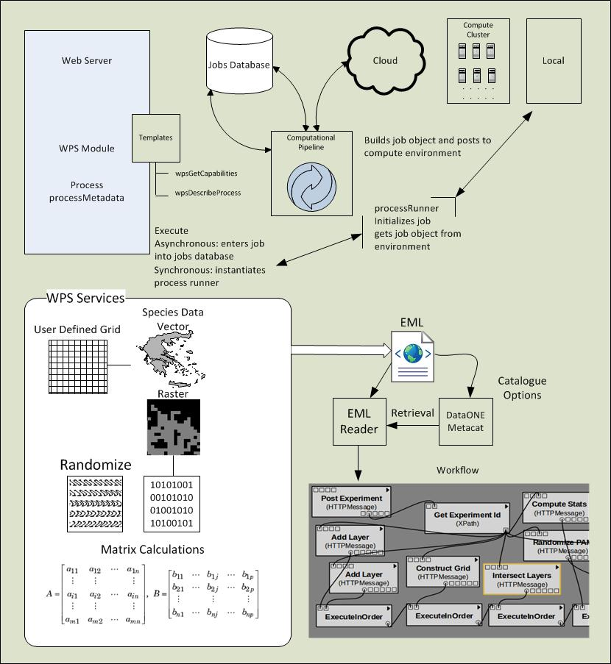


Clients

Slide 8
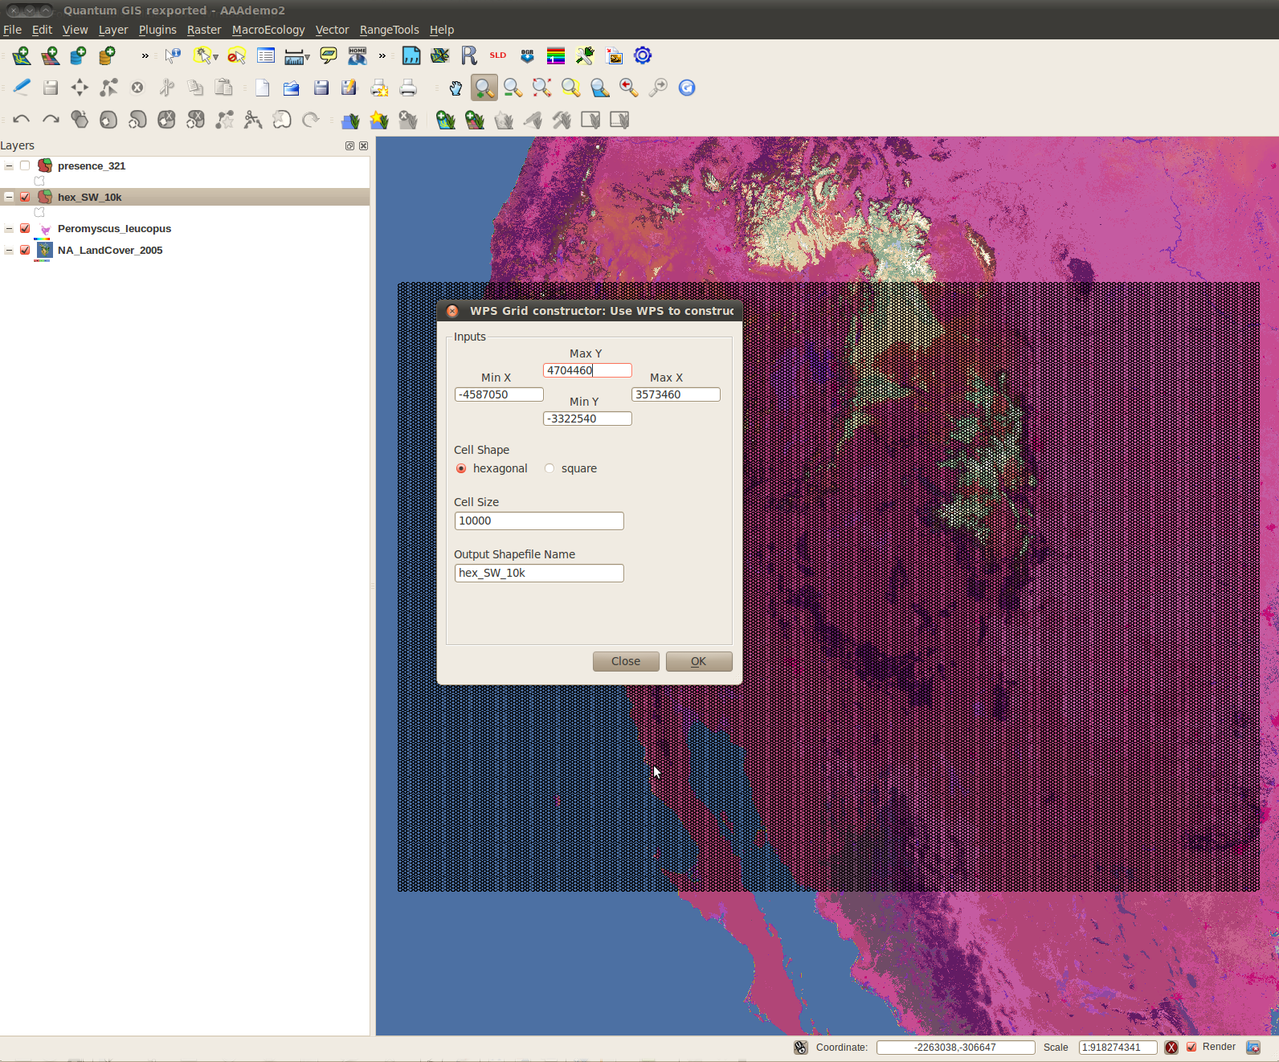
QGIS as a WPS client for building a data grid as the geographical component of the PAM

Slide 9
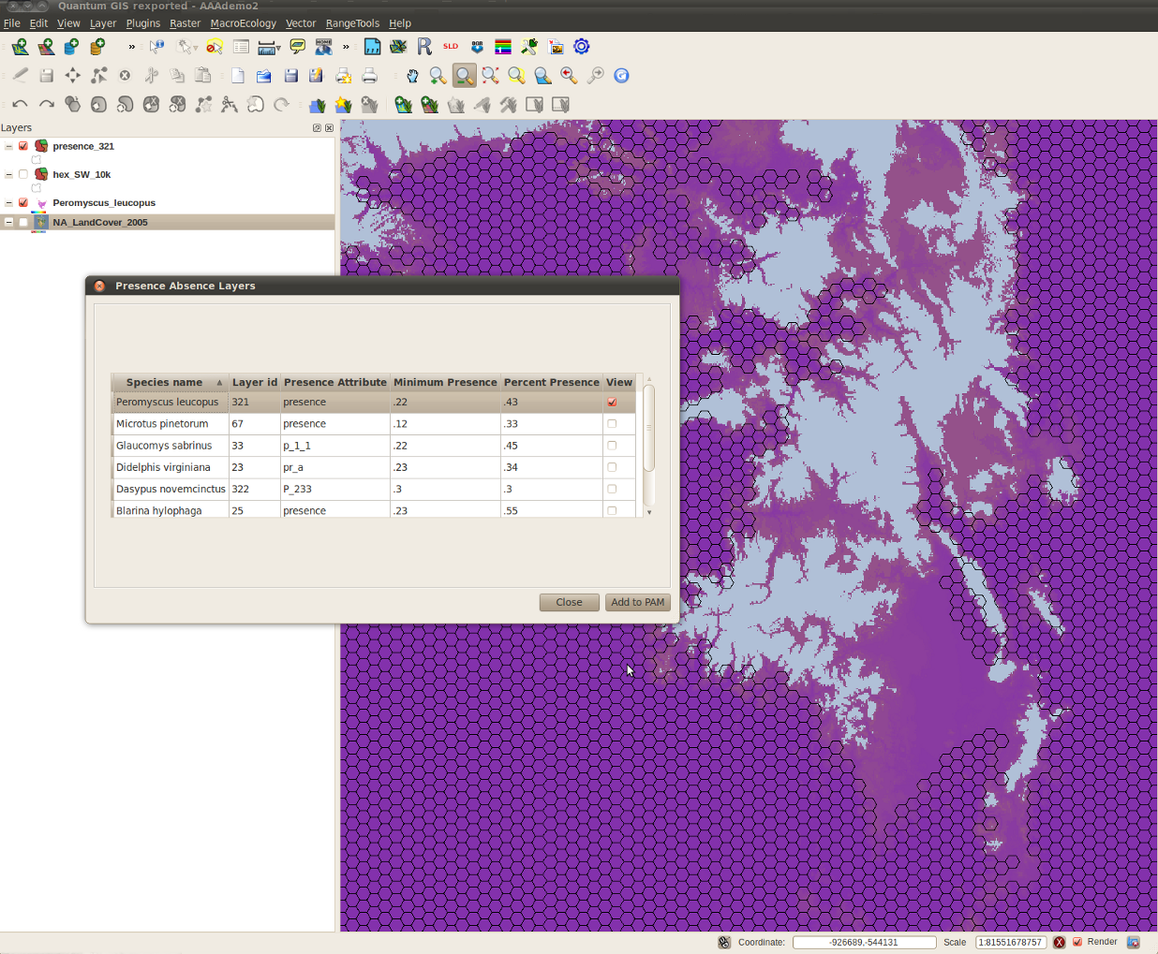
Hexagonal data grid populated with species raster from Lifemapper distribution model

Slide 10
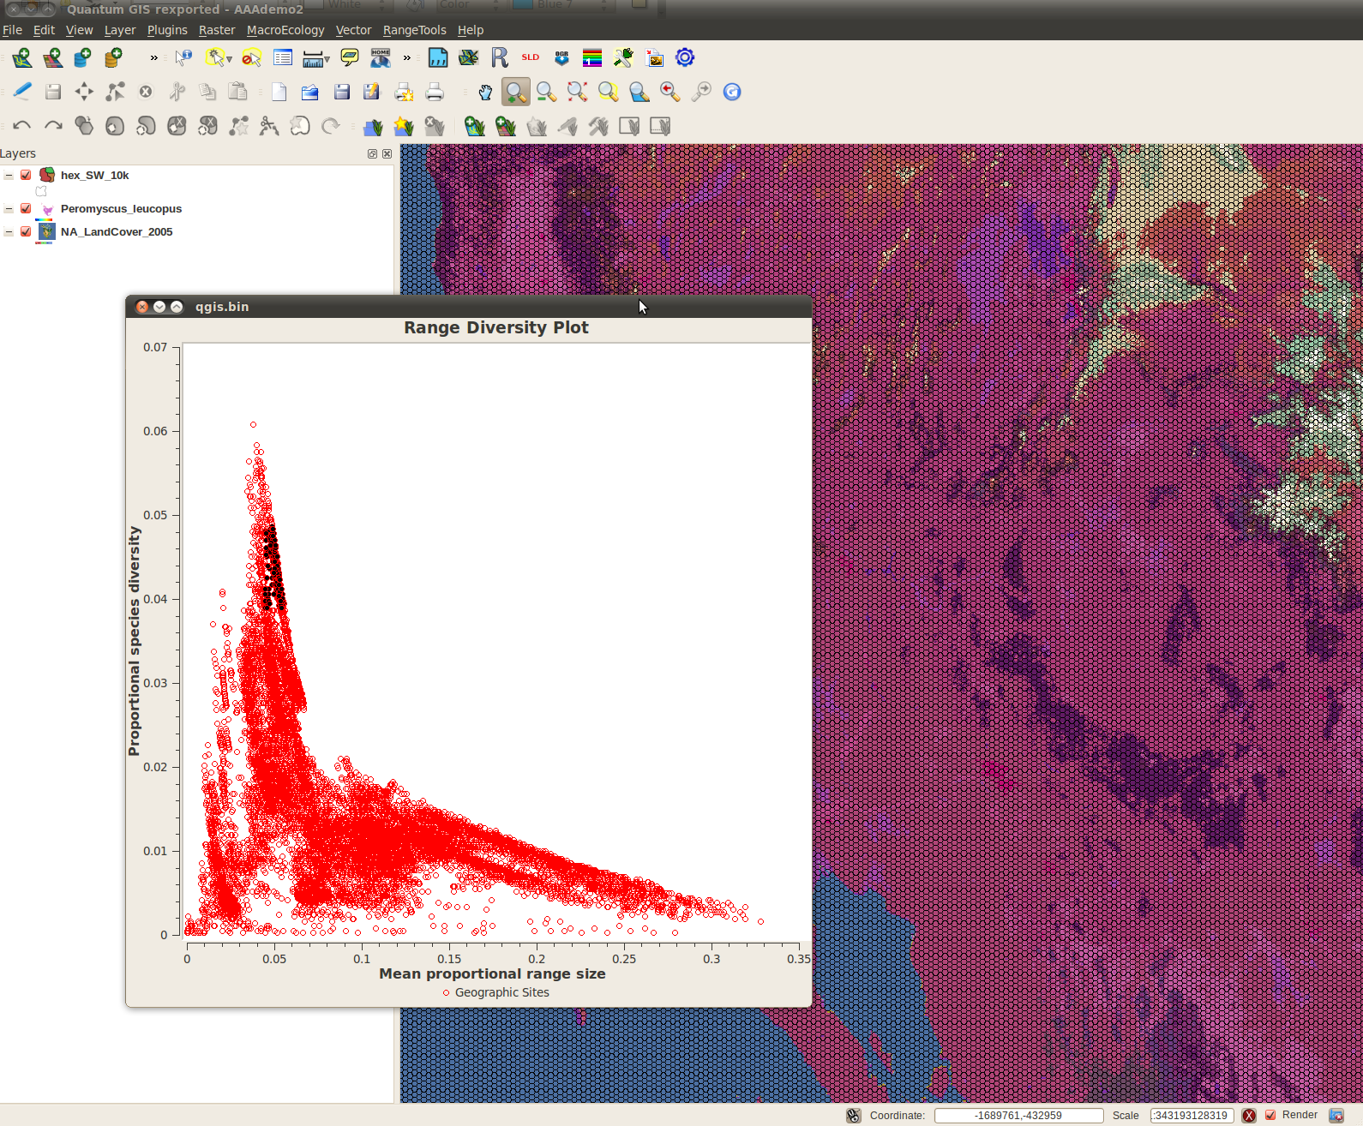
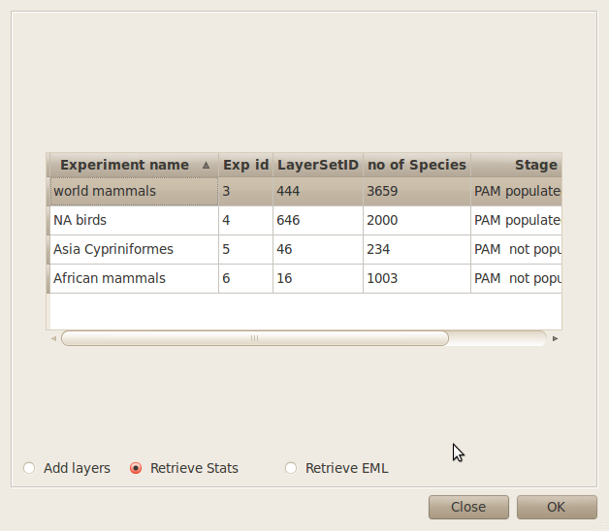
Statistical services provide diversity indices and plots using WPS

Slide 11
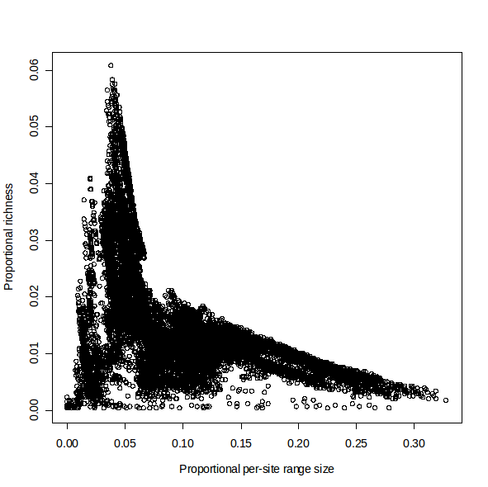
The range-diversity plot
Plot of richness of species
in each cell of the grid as a
fraction of total number of
species,
vs
the average of the ranges
(proportional to total area
Of the grid) of the species
inhabiting each cell
The Proportional per-site
Range size, is, for global plots,
identical to the
Dispersion Field Volume of
Graves and Rahbek, 2005

Slide 12
Dispersion field and Diversity field
The per-site mean proportional range size is a measure of a 'dispersion field' which is the set of geographic ranges of species occurring in a given site. The dispersion field volume of a site, based on the average covariance of a site with all the sites within the extent of the presence-absence matrix, can be interpreted as an index of similarity between sites. Comparing the range size of a species occurring in a site is equivalent to studying the covariance of that site with all sites in the presence-absence matrix. The analogue to that measure but by species is the 'diversity field' which quantifies the species diversity of all sites in which a particular species occurs. Analyzing the diversity field within the range of a species is equivalent to studying its covariance with all the species. These relationships inform a by-species and by-sites view of the fundamental relationships present in the PAM.

Slide 13
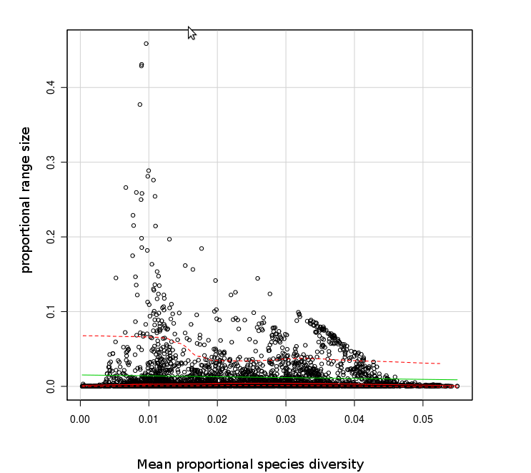
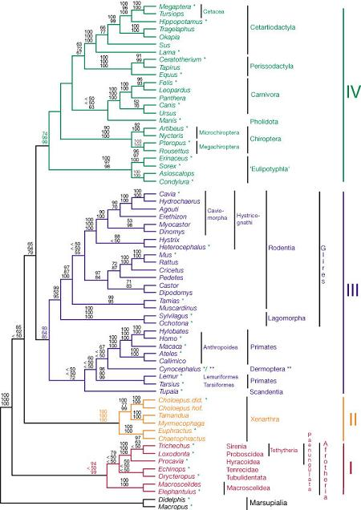
By-species range-diversity plot

Slide 14
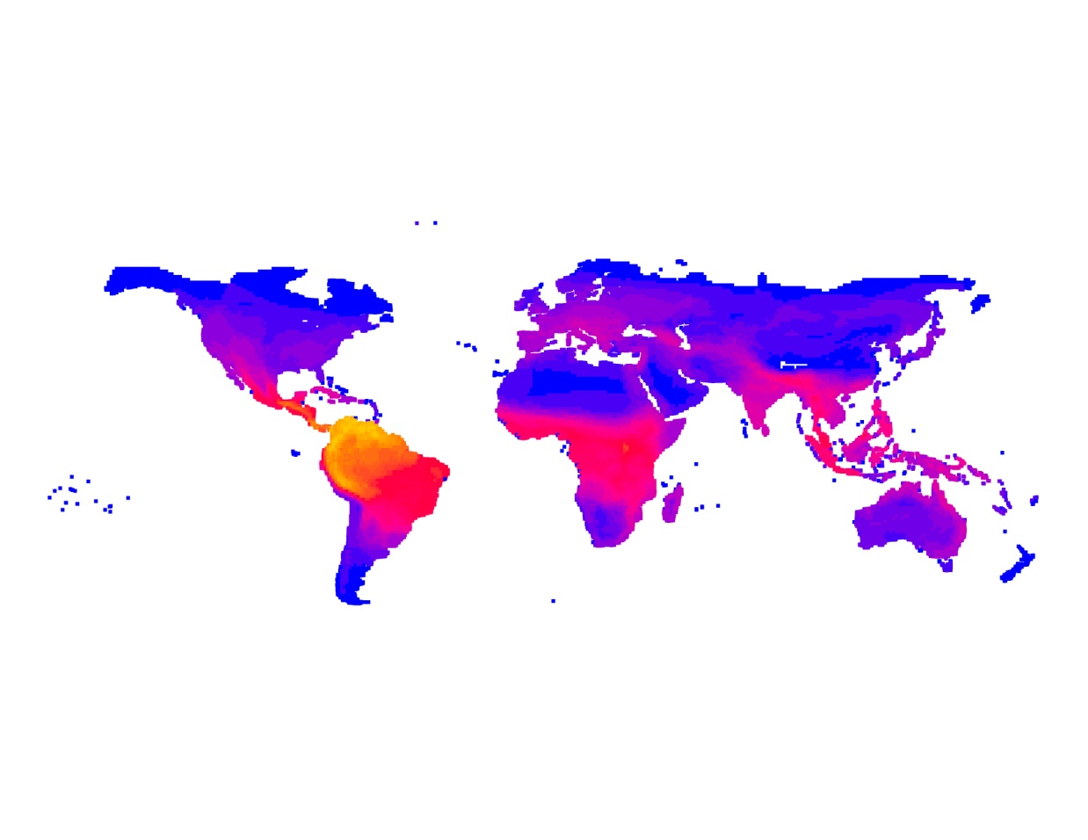
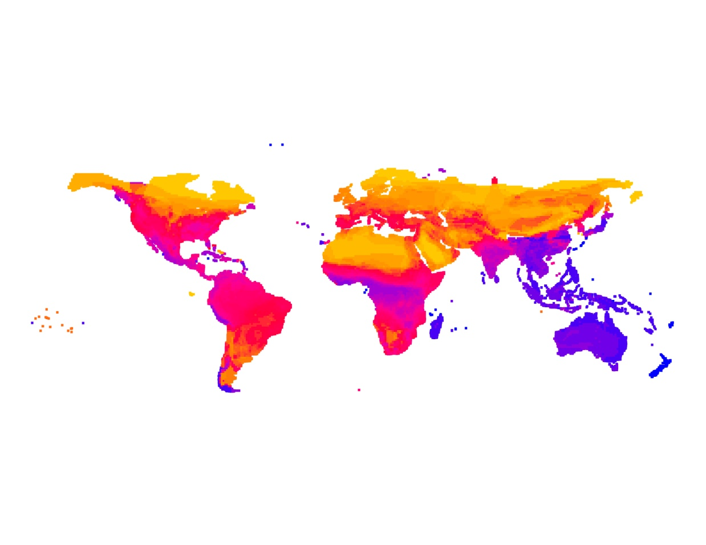
Terrestrial mammals of the
world (3617 species)
Extent: ~ 1.5 10⁸ km2
Resolution: 10⁴ km2
Proportional species richness
Yellow: highest values
Red; intermediate
Blue: lowest values.
Per-site range size

Slide 15
Conclusion
By employing WPS services with an established and extensible open source GIS platform we provide intuitive, efficient and data rich biogeography tools for formulating biogeographical hypotheses and for simultaneously analyzing and visualizing species ranges and geospatial biological diversity patterns through diversity indices calculated from a presence/absence matrix. This distributed web service and thick client architecture will allow current research practices of PAM assembly overcome large computational constraints and advance biodiversity research and education of the global impacts of climate change on biological species and communities.

Slide 16
Jeffery Cavner, Aimee Stewart, CJ Grady
jcavner@ku.edu, astewart@ku.edu, cjgrady@ku.edu
Biodiversity Institute Natural History Museum University of Kansas

