Slide 1
Ruby without Rails
Doing Data Science and Machine Learning
on the Ruby stack

Slide 2
Q: What do I need to learn
to become Data Scientist?

Slide 3
1992: Learn SQL

Slide 4
2001: Learn R

Slide 5
2008: Learn Python

Slide 6
Spark, Julia, Tidyverse...

Slide 7
2019: Try Ruby (and all above)

Slide 8
Q: How do I start doing Data Science?

Slide 9
A: You open a new Jupyter notebook...
in Ruby!

Slide 10
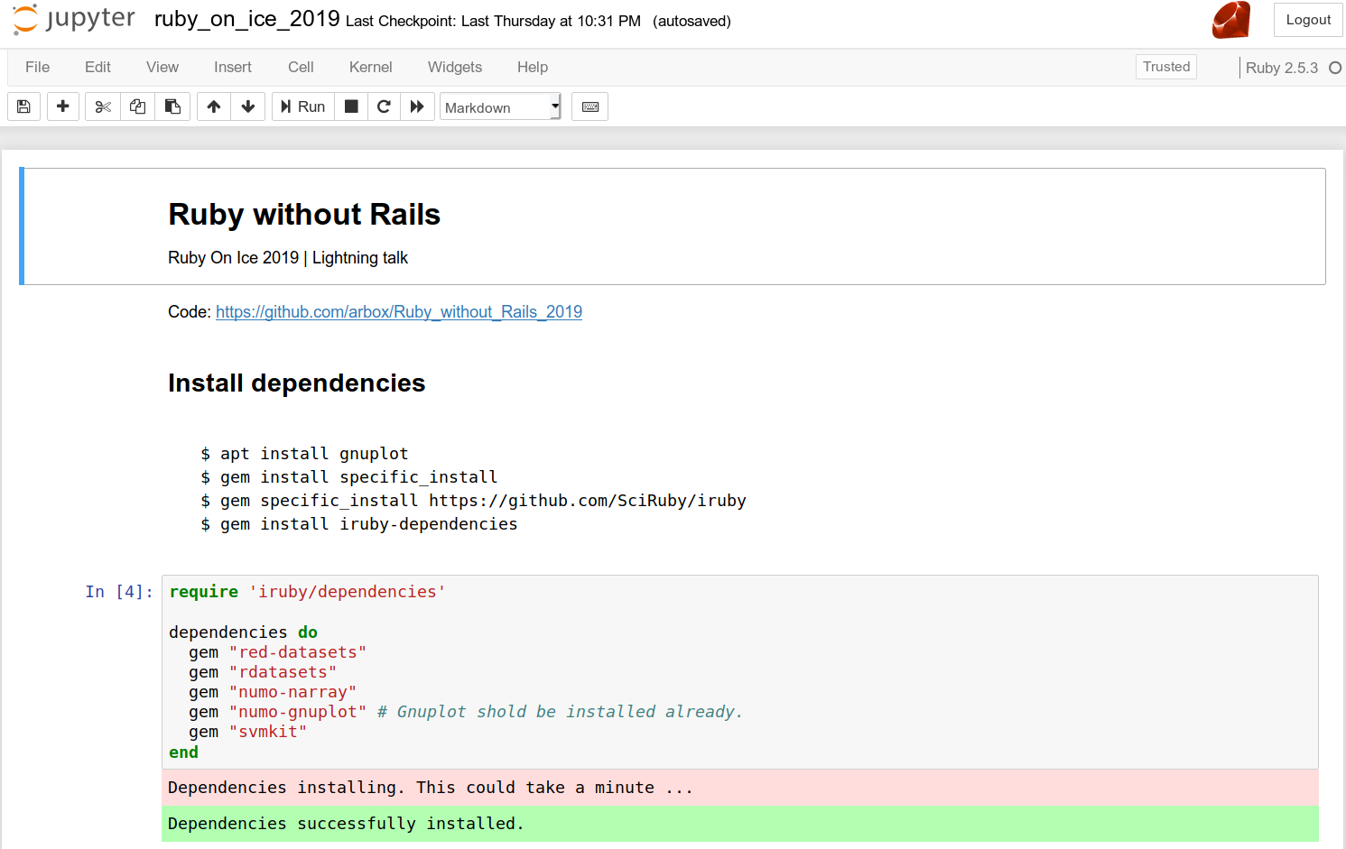

Slide 11
Take a well known dataset…

Slide 12
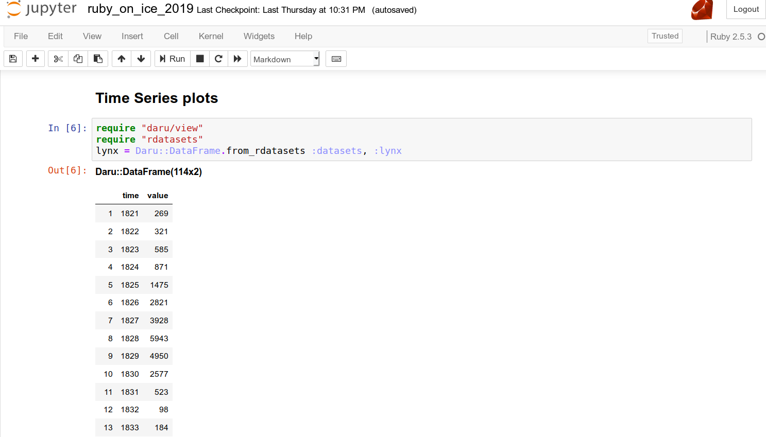

Slide 13
… explore it graphically ...

Slide 14
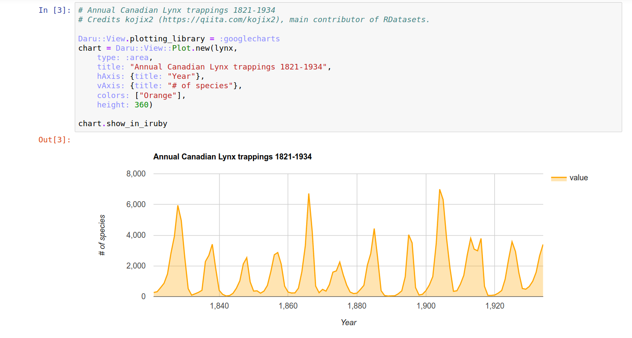

Slide 15
… and train a model!

Slide 16
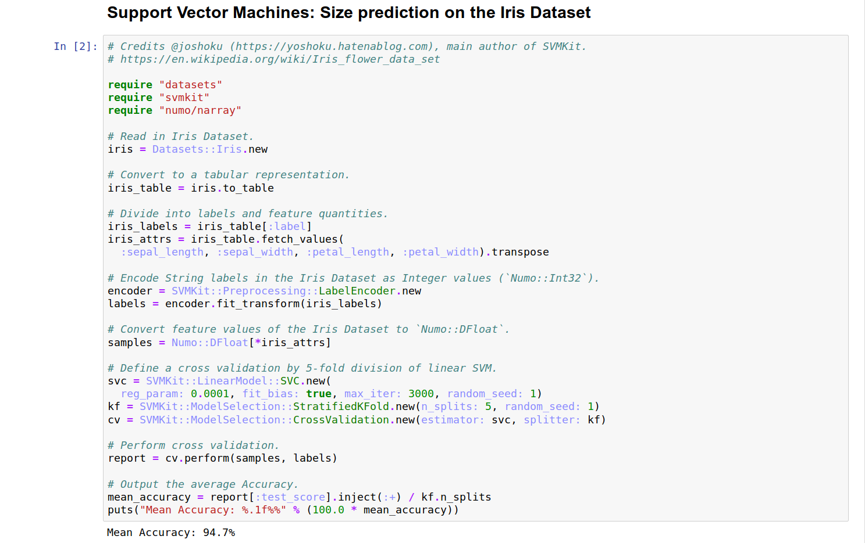

Slide 17
Q: Do you want more?

Slide 18

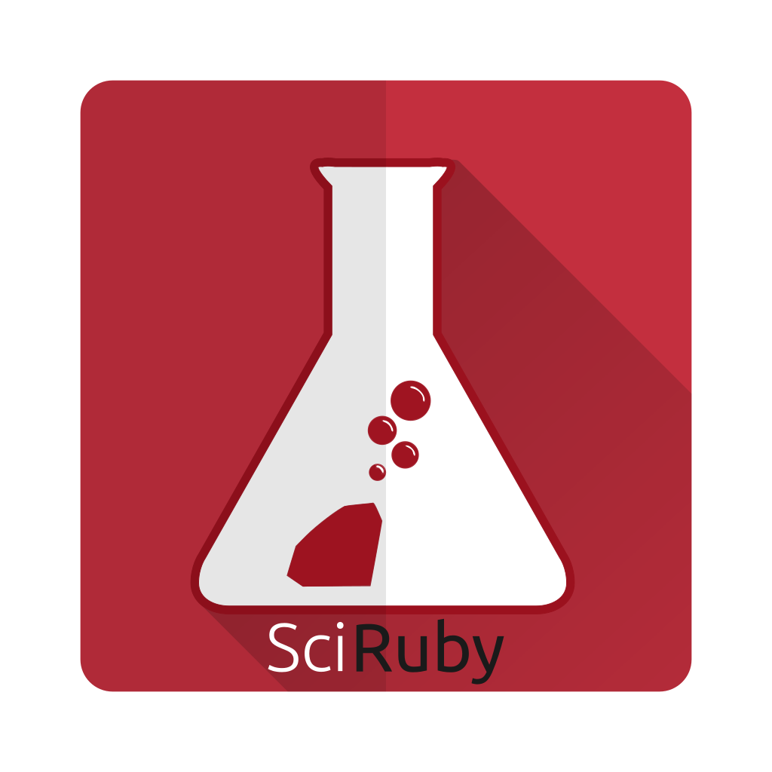
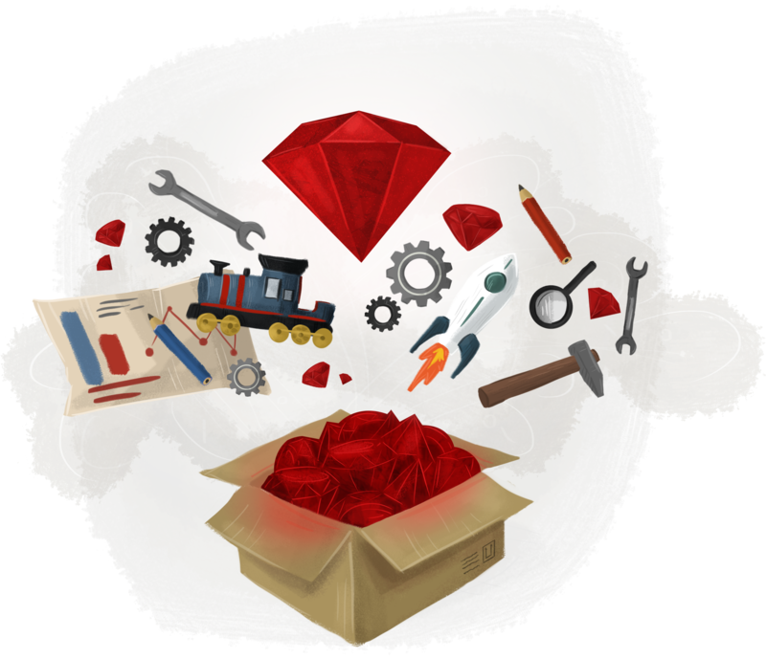

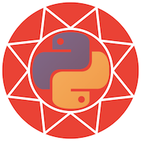
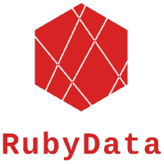

Slide 19
Or just talk to us!
GitHub: @arbox

