Slide 1
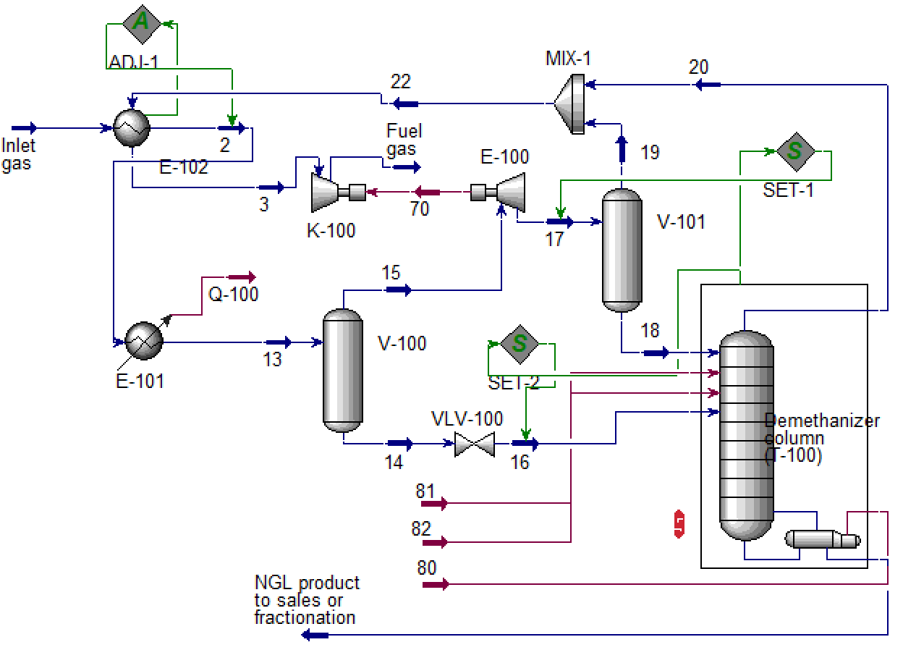

Slide 2
Train n = 3746
Test n = 443
Adj. R² = 0.997
MAD = 26.87 kW
Train n = 3782
Test n = 407
Adj. R² = 0.996
MAD = 22.12 kW
(a)
(b)
Train n = 3779
Test n = 410
Adj. R² = 0.996
MAD = 20.17 kW
Train n = 3785
Test n = 404
Adj. R² = 0.991
MAD = 148.88 kW
(c)
(d)

Slide 3
Train n = 3786
Test n = 403
Adj. R² = 0.962
MAD = 40.31 kW

Slide 4
Train n = 3779
Test n = 410
Adj. R² = 0.96
MAD = 0.0014
Train n = 3730
Test n = 459
Adj. R² = 0.957
MAD = 0.0389
(a)
(b)
Train n = 3759
Test n = 430
Adj. R² = 0.961
MAD = 0.0263
Train n = 3762
Test n = 427
Adj. R² = 0.947
MAD = 0.0150
(c)
(d)

Slide 5
Train n = 3789
Test n = 400
Adj. R² = 0.996
MAD = 0.0032
Train n = 3764
Test n = 425
Adj. R² = 0.965
MAD = 0.0033
(a)
(b)
Train n = 3811
Test n = 378
Adj. R² = 0.965
MAD = 4.1983e-04
Train n = 3774
Test n = 415
Adj. R² = 0.882
MAD = 7.0145e-05
(c)
(d)

Slide 6
Train n = 3799
Test n = 390
Adj. R² = 0.995
MAD = 3.5152

Slide 7
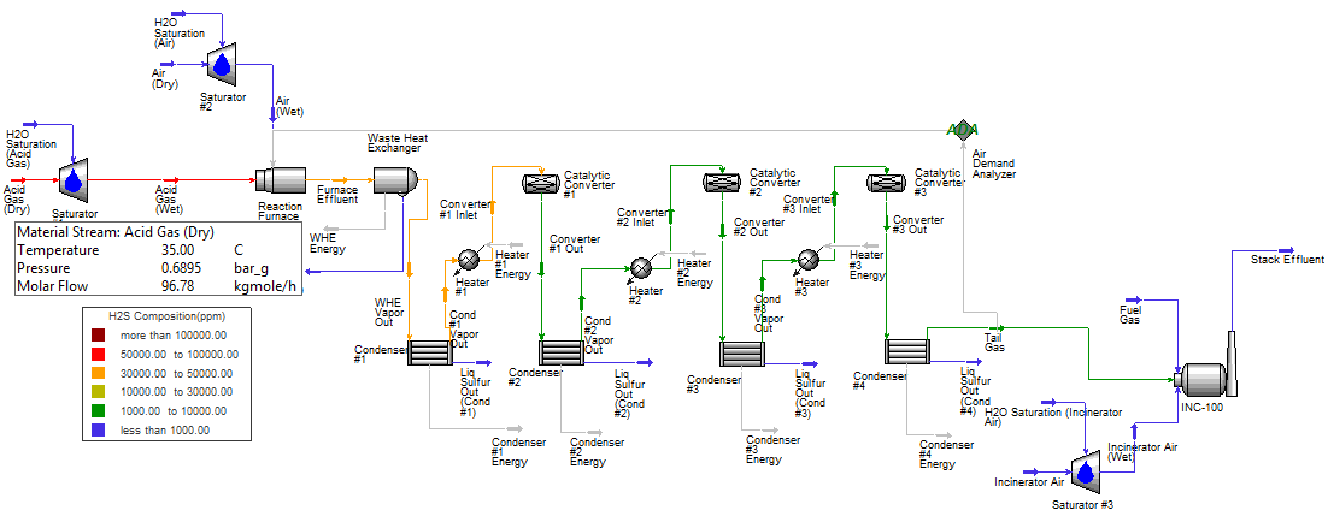

Slide 11
(a)
(b)

