Slide 1
BORN2BEROOT
Tanooki

Slide 2
Apt vs Aptitude – two package manager
Apt → lighter (only command mode)
Apt → native software, aptitude → has to be downloaded
Aptitude → heavier (graphic mode available), but more possibilities to search packages, list & filter (more displays possibilities)

Slide 3
Debian vs Rocky - differences
different package manager (apt vs dnf)
different MAC (AppArmor vs SELinux)
Community vs entreprises

Slide 4
Aptitude – Package Manager
Install/uninstall
sudo aptitude install [package]+ install package
sudo aptitude install [package]- uninstall package
sudo aptitude install [package]_ purge package
Update/upgrade
sudo aptitude update update pckg
sudo aptitude safe-upgrade updt, no purge unused
sudo aptitude full-upgrade updt, purge unused
sudo aptitude hold [software] block updt of the pckg
sudo aptitude unhold [software] unblock updt of the pckg
Search
sudo aptitude search ~I display installed pckg
sudo aptitude search ~b display broken pckg
sudo aptitude search ~ahold display updt blocked pckg
sudo aptitude show [package] display infos about the pckg
sudo aptitude why [package] show reason why pckg didn’t install
sudo aptitude why-not [package] show the conflicts
sudo aptitude clean erase downloaded package files
sudo aptitude auto-clean erase old downloaded package files

Slide 5
UFW – Uncomplicated FireWall
Status
sudo ufw status display status of the ufw
sudo ufw status verbose detailed status & default profile
sudo ufw status numbered same, but numbered
ON/OFF
sudo ufw enable activate ufw also on boot
sudo ufw disable deactivate ufw
sudo ufw reload restart ufw
Change default rules
sudo ufw default [deny/allow] [incoming/outgoing/routed] change the default rule of income/outcome/routed
Ports
sudo ufw allow [port] allow a port
sudo ufw deny [port] deny a port (better for security, don’t send back replies)
sudo ufw reject [port] reject a port (send back replies)
sudo ufw delete [rule_nb] delete the rule nb (back to default rule)
sudo ufw delete [action] [port] delete the port (better) (back to default rule)

Slide 6
AppArmor – limit programs resources accessibility
a program/profile may be in 3 modes:
enforcement = will block the program/profile if it access to non-authorized resources
complain = will not block the program/profile if it access to non-authoriyed resources, but will report policy violation attempts
unconfined = program/profile has no restriction

Slide 7
MAC – Mandatory Access Control
SELinux and AppArmor are both MAC programs.
Only one MAC program can be activate at time.
AppArmor is more adapted for public, SELinux more for companies.
AppArmor is path based, SELinux is global function (context-based)

Slide 8
AppArmor - commands
systemctl status apparmor display apparmor status
sudo aa-status show status of the programs/profiles
sudo aa-enforce [program] set the program in enforced mode
sudo aa-complain [program] set the program in complain mode

Slide 9
User&Group Permissions – change file permissions
change owner/group
sudo chown [new_owner] [file] change owner of the file
sudo chown [new_owner]:[new_group] [file] change owner & group of the file
sudo chgrp [new_group] [file] change group of the file
change permissions
chmod [permissions] [file/directory] change permission
two ways:
sudo chmod 755 [file] 4=read, 2=write, 1=exec
sudo chmod uo+rx,g-w [file] u=user, g=group, o=others
r=read, w=write, x=exec
chmod u/g+s [file] set user id or group id on a file (means you can run a program, that will execute other program with id of the owner or group file)

Slide 10
User&Group Permissions – display infos
display permission of a file
ls –l [filename] display permissions of a file in one line
stat [filename] display details of a file (permissions, size, …)
display about user
who display the users loged-on
whoami display the actual user
users display all the users logged in
groups [user] display all the groups the user is in
id [username] display all the groups the user is in & the uid & gid
getent passwd [username] display all details about the user (also the shell)
display about group
getent group display all the existing groups with members
getent group [group_name] display only the group with members

Slide 11
User&Group Permissions – manage users/groups
users
sudo useradd –m –s /bin/bash [new_usr_name] create new user (-m = create a home dir for user, -s = give a shell to the user) -> best for system/service account
sudo adduser [new_user_name] create new user with home dir, etc. -> best for human user (friendly way)
sudo adduser [user_name] [group_name] add a existing user to a group
sudo passwd [username] add/change passwd of the user
sudo userdel –r [username] delete username (-r = delete also home dir of user)
sudo pkill –u [username] kill all proc of the user
ps –u [username] show the proc of the user
groups
sudo addgroup [new_grp_name] create a new group (friendly way)
sugo groupadd [new_grp_name] create a new group
sudo groupdel [grp_name] delete the group

Slide 12
User&Group Permissions - usermod
sudo usermod -aG [grp_1,grp_2, …] [username] add user to new group(s) (-a for append, necessarly, otw replace all users in group)
sudo usermod -g [new_grp] [username] give a new primary grp to the user
sudo usermod –s /bin/bash [username] change the default login shell to the user
sudo usermod –s /sbin/nologin [username] set no possible login to a shell for the user
sudo usermod –l [new_name] [old_name] change name of the user
sudo usermod –d [new_dir_path] –m [username] move the home dir of a user and move files automatically (with –m)
sudo usermod –L [username] lock a user
sudo usermod -f 0 [username] force to change password to user on next login

Slide 13
Computer specs – display it (1)
GENERAL
uname –a displays details about the machine & linux system (-a for all)
MEMORY
lsblk displays the partitions of the disk (block device)
DISK
df display the free/used/total space on the disk
df –BM same but shows it in megabits
CPU
lscpu display infos about the cpu(s)
vmstat [delay] [nb_of_occurence] displays processes, memory, disk, cpu infos
vmstat 1 2 | tail -1 best usage to have actual usages
→ first line is an average since booting, from 2nd line, its average of last second)
nproc display the actuel number of processing units available (! Not the nb of vCPU(s))
TCP
ss -ta display sockets (-t → tcp socket, -a → all)
IP infos
ip link displays IP infos

Slide 14
Computer specs – display it (2)
hostname displays name of hostname
hostname –i displays ip hostname
hostname [new_temp_hostname] change temporarly the hostname
sudo hostnamectl displays detail about the system hostname (static)
sudo hostnamectl set-hostname [new-hostname] change the hostname (static)
!! also change the /etc/hosts file !!
top display full detailed cmd process, cpu usage
who –b display the last system boot
shasum print/check signatures

Slide 15
awk - filtering & scan datas
Basic Syntax
awk [option] ‘[pattern] {[action]}’ [input_file] > [output_file]
1) print specific columns of datas, with specific separator, from a cmd
[cmd] | awk –F “:” ‘{print $1,“\t”,$4 }’ -F ”[separator]” → set the separator
$[columns_numb] → which column to print
(in action zone) : “[string]” → chars to print
2) add a regex in the awk function
ls –la | awk –F” “ ‘/^d/ {print $NF}’ regex : /[pattern]/
→ filter me all lines starts with “d”
3) filter a file (not a cmd) & add condition
awk –F”:” ‘$3 >= 1000 {print $1}’ /etc/passwd → file at the end
→ do the action if $3 is >= than 1000

Slide 16
awk – example 1
awk 'BEGIN{FS=":";OFS=">>";count=0} $3>=1000{print $1,$6,$7;count++} END{OFS=" ";print "Total =",count}' /etc/passwd
BEGIN{FS=":";OFS=">>";count=0}
Before reading :
1) set the Field Sep as “:” & set the Field Sep Out as “>>”
2) create a variable count and start it at 0
$3>=1000{print $1,$6,$7;count++}
for each line read that has column 3 >= 1000:
1) print column 1,6 & 7
2) increase count
END{OFS=" ";print "Total =",count}
After reading :
1) set the Field Sep Out as “[spacebar]”
2) print the following message : Total = [count]
/etc/passwd
the file to read

Slide 17
awk – example 2
ls -la | awk ‘BEGIN{count=0} $6=="Dez" && $1~/^d/{print NR “/t” $NF;count++} END{print "total =",count}’
BEGIN{count=0}
before reading, initialize count=0
$6=="Dez" && $1~/^d/
two conditions to do the actions on the line :
1) column 6 has to be equal to “Dez”
2) the first column of the line has to match with the following regex : start with “d”
{print NR “/t” $NF;count++}
1) print the current line number & print content of last column
2) increase count
END{print "total =",count}’
print the following message : total = [count]

Slide 18
awk - vocabulary
$0 (print) whole line
$[numb] (print) the numb columns
$NF Number of fields (columns) → if there is 3 columns in the line, NF = 3
NR Current line number at the action
FS Field Separator
OFS Output Field Separator
BEGIN first action, before starting reading
END last action, after reading

Slide 19
patterns - vocabulary
$1 ~ /x/ Field matches (~) regex
$1 !~ /x/ Field does not match (!~) regex
$3 > 1000 Numeric condition
pattern1 && pattern2 AND
pattern1 || pattern2 OR

Slide 20
regex - vocabulary
^ beginning of (colum, line, …)
$ end of (column, line, …)

Slide 21
SSH (and SSHd) – Secure Shell(daemon)
ssh is a client application to remotely access a computer through terminal.
It implement the SSH protocol which defines the authentication methods, key exchange, and data encryption mechanisms.
sshd is a server-side daemon application that listens to a specific port and allow or not a computer using the app-client ssh. Daemon because it’s a background-running app.
The fact sshd is launched and managed by the systemd makes it is a service.

Slide 22
ssh - commands
installation & setup ssh
sudo aptitude install openssh-client openssh-servers Install both ssh-client and ssh-servers
sudo systemctl status sshd check that sshd is managed by the systemd
sudo systemctl active sshd run the sshd now
sudo systemctl enable sshd will open at boot the sshd
connecting to server
ssh-copy-id -i [path_public_key] -p 4242 [username]@[hostname/IP] copy the client public key to the server
ssh [username]@[hostname/IP] –p [port] access a computer through terminal
managing keys
ssh-keygen creates public and private keys for authentification process
ssh-add [private_key] add a private key to the ssh-agent
ssh-add –l list all the private keys that are in the ssh-agent
ssh-add –D or ssh-add –d [private_key] deleta all/specific private key(s) in the ssh-agent

Slide 23
systemd – definition
the first program to be initialized
the program to manage units (include services like sshd, ufw)
steps of booting :
1) BIOS/UEFI
2) bootloader (GRUB)
3) kernel
4) systemd

Slide 24
systemd – commands
On/Off units
sudo systemctl start [unit] launch the unit on the spot
sudo systemctl stop [unit] stops the unit on the spot
sudo systemctl restart [unit] reboot the unit on the spot
sudo systemctl reload [unit] reboot without turning off the unit
sudo systemctl enable [unit] enable the unit to launch at boot
sudo systemctl disable [unit] disable the unit to launch at boot
check status of unit
systemctl status [unit] check if unit is active and enable
systemctl list-units --type=service list of all services active/inactive
systemctl list-units --type=service –state=running list of all active services
systemctl list-unit-files --type=service also list of all services active/inactive
journalctl – historic of system
journalctl display historic of all systemd activity
journalctl –u [unit] display specific unit historic
journalctl _COMM=sudo display all the commands of sudo

Slide 25
CPU – different usages
us: Percentage of CPU time spent running user processes.
sy: Percentage of CPU time spent running kernel (system) processes.
ni: Percentage of CPU time spent running processes with a nice value (priority adjusted).
id: Percentage of CPU time spent idle (no work being done).
wa: Percentage of CPU time spent waiting for I/O operations to complete.
hi: Percentage of CPU time spent servicing hardware interrupts.
si: Percentage of CPU time spent servicing software interrupts.
st: Percentage of CPU time stolen from this virtual machine by the hypervisor (if virtualized).

Slide 26
sudo – editing the sudoers with visudo
sudo visudo edit the sudoers.tmp file
→ define the “bonus” permissions we allow to each user when using sudo
create new user bonus perms
[username_give_perms] [hostname]=([new_users]:[group_user]) [path_cmd] [file_to_be_used]
example
root ALL=(ALL:ALL) ALL
means → the root user, in all machines (hosts), can have the permissions of all users and all groups and do all commands in all files
create new group bonus perms
%[username_give_perms] [hostname]=([new_users]:[group_user]) NOPASSWD:[path_cmd] [file_to_be_used]
NOPASSWD: → not necessarly, he doesn’t have to put the passwd to do the cmd
create user aliases (”user group of permissions”)
#User_Alias [user_cmd_name] = [username1], [username2]
create command aliases (“cmd group would be permitted)
#Cmnd_Alias [cmd_alias_name] = [path_cmd]

Slide 27
sudo - commands
sudo visudo edit the sudoers.tmp file
→ define the “bonus” permissions we allow to each user when using sudo
sudo visudo –c will check the syntax of sudoers and sudo_config files
nano /etc/sudoers.d/sudo_config creating a new sudo config file

Slide 28
sudo – adding specific policies
what to write in it ?
Defaults passwd_tries=[number] set the nb of tries
Defaults badpass_message=“[write_your_own_message] set a message in case of bad passwd
Defaults logfile=”/var/log/sudo/sudo.log set the log historic file for sudo
Defaults log_input, log_output records (log) all input/output commands & writing done
Defaults iolog_dir=‘/var/log/sudo” set where the in/out cmds/writings are saved
Defaults requiretty requires sudo is only available by real terminal (no distance ssh manipulation)
Defaults secure_path=“/usr/local/sbin:/usr/local/bin
:/usr/bin:/sbin:/bin:/snap/bin”

Slide 29
Password Policies – editing log configs
nano /etc/login.defs edit the file login.defs
→ to edit log configs
PASS_MAX_DAYS maximum number of days a password may be user
PASS_MIN_DAYS minimum number of days allowed between password changes
PASS_WARN_AGE number of days warning given before a password expires

Slide 30
crontab – edit contab files for cron daemon
cron → service/daemon
crontab → configuration “interface”
jobs → scheduled commands
systemctl status cron check if daemon cron is active/enable
crontab –e configure the cron service of the user (add the scheduled commands)
crontab –l displays the crontab edit file
mesg n/y (not available) allow receiving message from a wall cmd
cd /var/spool/cron/crontabs/ location of all crontabs file
cd /usr/local/bin my location of monitoring.sh

Slide 31
sudo, crontab, … - why using utilitaries ?
question :
Why using this utilitaries instead of editing directly the files ?
1) will lock the file from other users when editing the file
2) will check the synthax of file there is no mistakes !
→ also, the directories like cron.d, sudoers.d are directories, which can be added new configurations instead of writing in the og files ! called drop-in directories

Slide 32
PAM - Pluggable Authentification Modules
What is the problem ?
→ no “possible-native” passwd global rule possible
→ each “program” should code his own rules policy passwd
PAM solves this problem !
PAM = framework → set rules, libraries & conventions
Goals of PAM :
- centralized authentification logic
- possible to module
- enforce same rule everywhere
- hard to bypass it

Slide 33
PAM - setup
/etc/pam.d/ → folder contains all pam config files
files categories
- individual configs (ssh, sudo, …)
- common-* files → global configs files
Some parameters you can add → if number negative, means “at least n”
minlen=[number] minimum length password
ucredit=[number] uppercase rule
dcredit=[number] digit rule
lcredit=[number] lowercase rule
maxrepeat=[number] max repetition of a char in a row
reject_username not allowed to write username in password (also reverse & no case- sensitive)
difok=[number] minimum different char new password must have (compared to old one)
enforce_for_root apply all rules also to root

Slide 34
LUKS – Linux Unified Key Setup
Standard Linux de chiffrement d’un volume
a disk can have multiple passwords possible
Some cmds :
cryptsetup [action] [volume]
cryptsetup luksAddKey /dev/sda5 add a new passphrase to the encrypted volume
cryptsetup luksRemoveKey /dev/sda5 remove a passphrase of the encrypted volume
cryptsetup luksDump /dev/sda5 show how many password are used
note : the /dev/ folder list all kernel devices (disks, partitions, virtual devices, terminal, …)

Slide 35
Permission and shebang
Important point : if you’re using a shebang, that runs another script, both must have reading permission. Because the shebang has to « read the 1st line » of the documents.

Slide 36
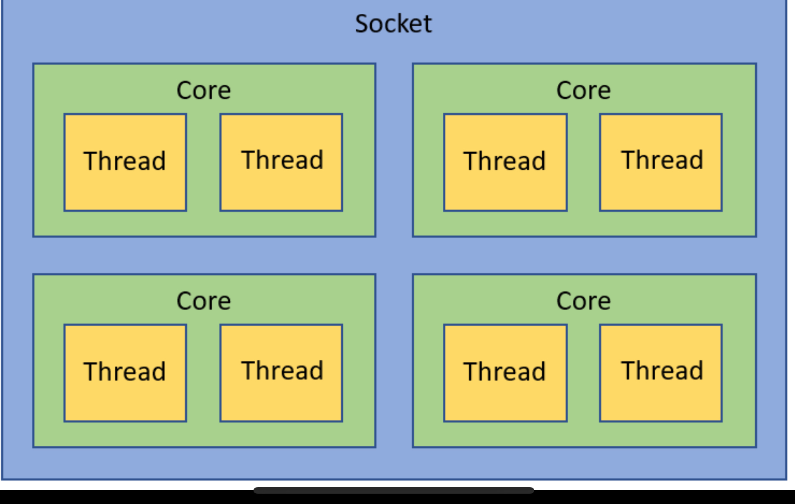
CPU – the rule
Number of virtual CPUs :
Nb of sockets x nb of cores x nb of threads per core
Sockets are actually the « physical » CPU(s)

