Slide 1

[REDACTED_ORG]
[REDACTED_ORG]

Slide 2
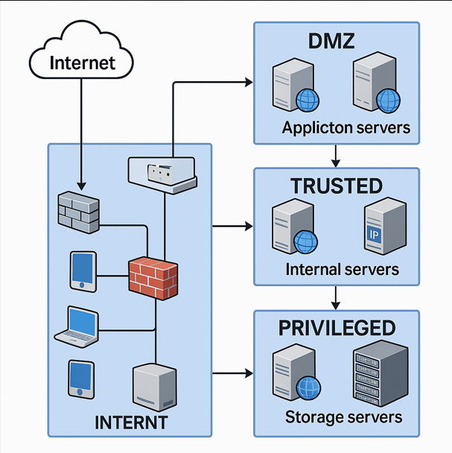

Slide 3
Revision History
Revision | Full Name | [REDACTED_PERSON] | Reviewed Date | Changes Made (If Any)
1.0 | [REDACTED_PERSON] | [REDACTED_EMAIL] | [REDACTED_DATE] | Initial draft of network topology diagram created.
1.1 | [REDACTED_PERSON] | [REDACTED_EMAIL] | [REDACTED_DATE] | Updated IP addressing scheme and [REDACTED_ORG] assignments.
1.2 | [REDACTED_PERSON] | [REDACTED_EMAIL] | [REDACTED_DATE] | No changes. Reviewed and approved existing diagram.
1.3 | [REDACTED_PERSON] | [REDACTED_EMAIL] | [REDACTED_DATE] | No changes. Confirmed compliance with updated security policies.

