Slide 1

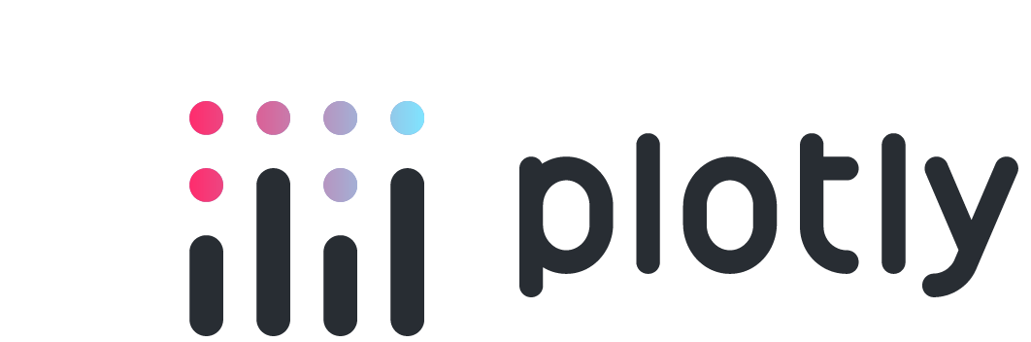
Streamlit vs. Plotly Dash
Lunch & Learn Cage Match
March 4, 2024

Slide 2
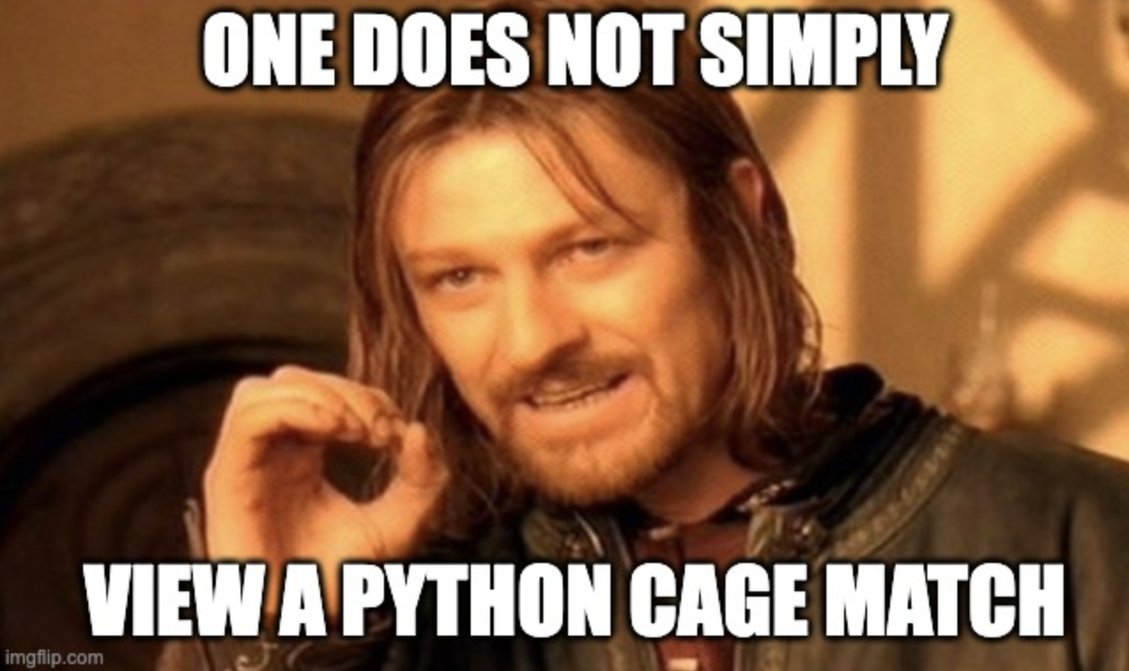

Slide 3
There’s a GitHub!

Slide 4
What’s a framework?

Slide 5
What’s a framework?
Why use Python?

Slide 6
Wright’s Grand Unified Theory of Technology Abstraction

