Slide 1
API Gateway
研發部

Slide 2
Outline
目標
Architecture
API Config Design
Task Flow System Design
ER Model Design
JSON-RPC
Error Handle

Slide 3
目標
1.設計一個痛用型的 api gateway 用於協助super app 串聯資料庫
2.以json-rpc 串聯蘭花 AI api
3.後續逐步擴充各種情境希望能整合入Robot一部分

Slide 4
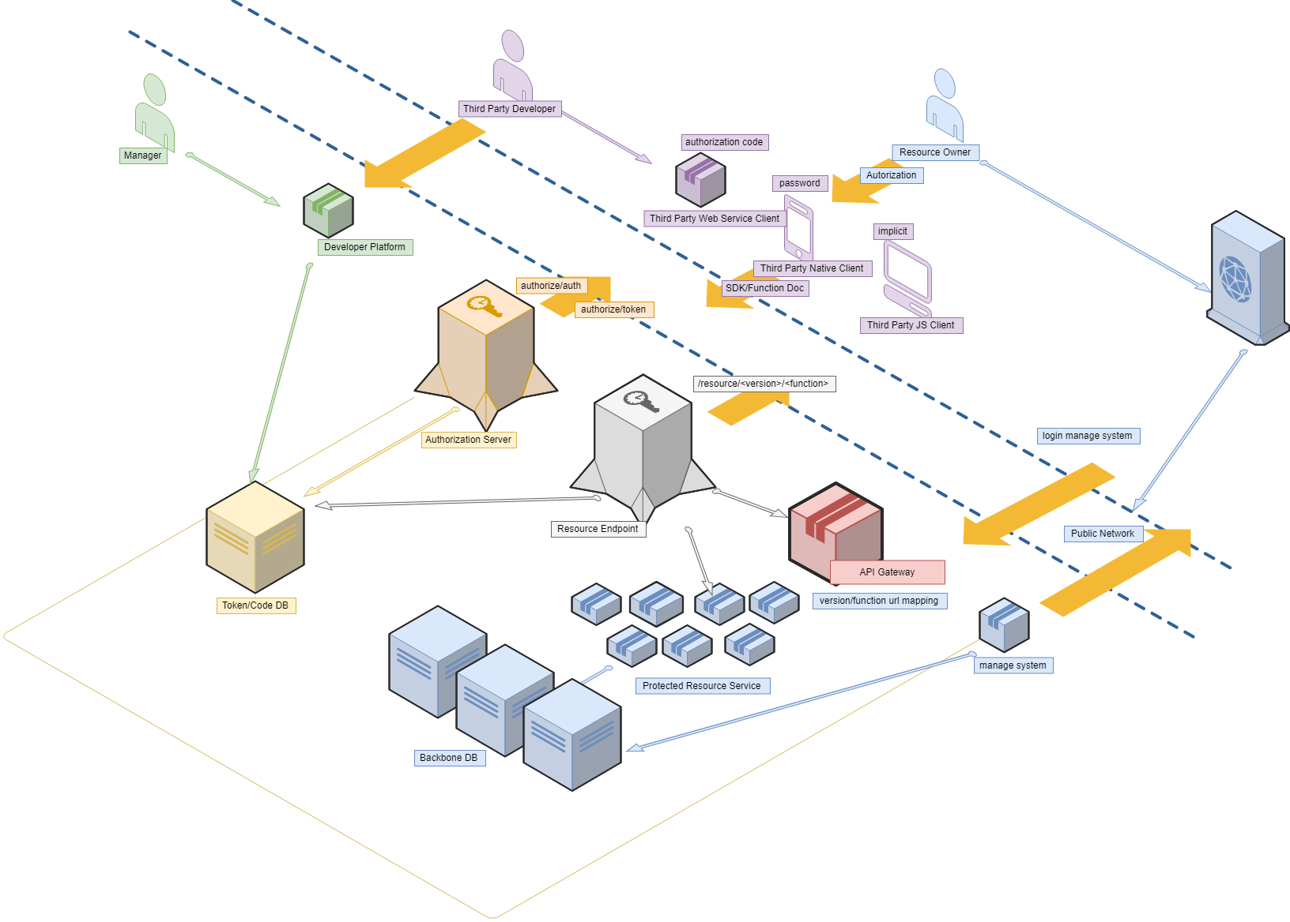
Architecture

Slide 5
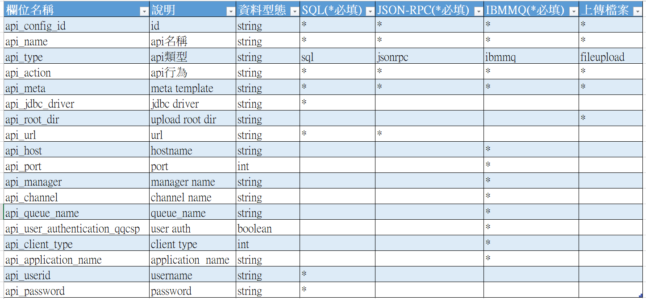
API Config Design

Slide 6
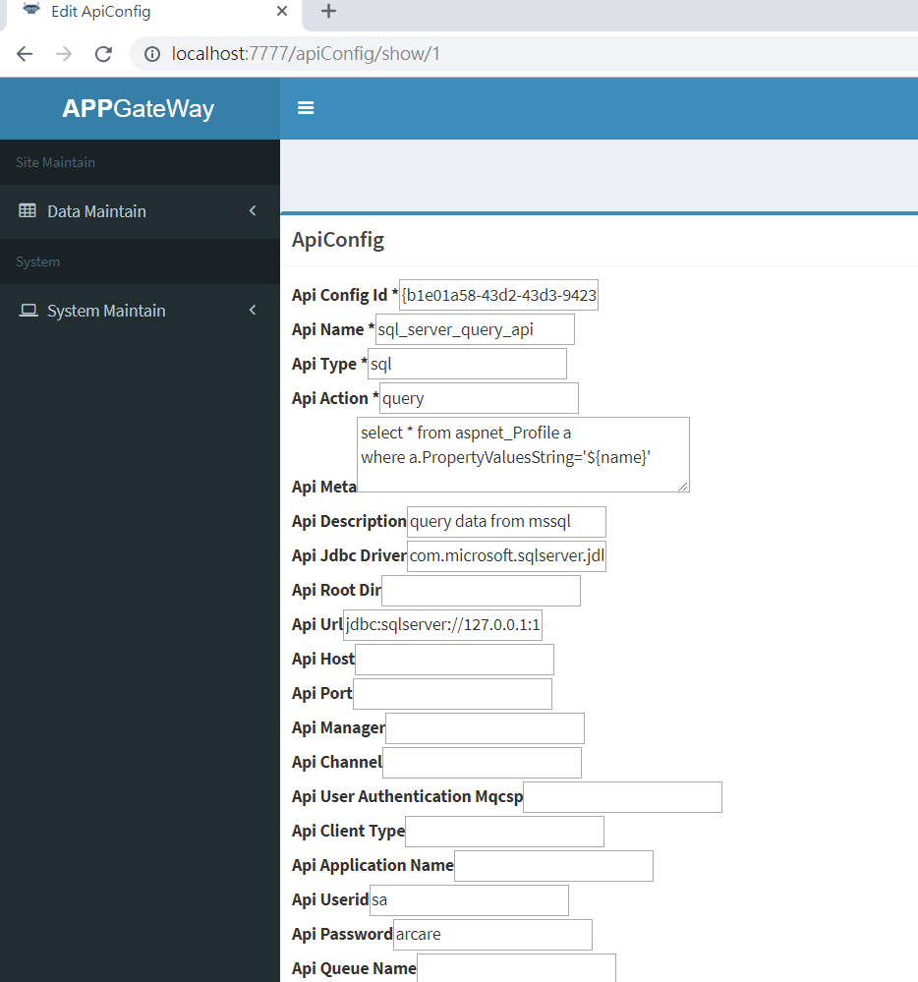

Slide 7
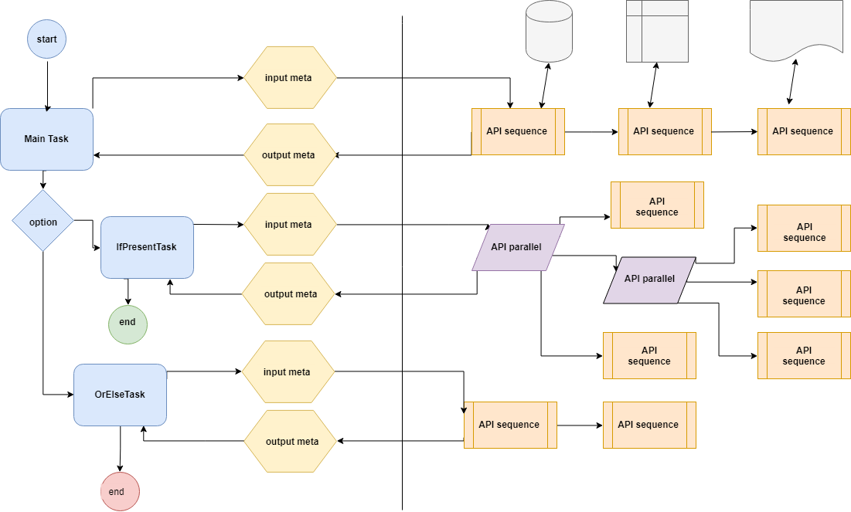
Task Flow System Design

Slide 8
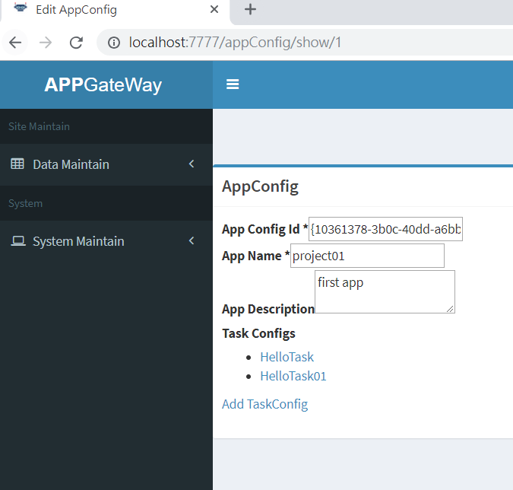

Slide 9
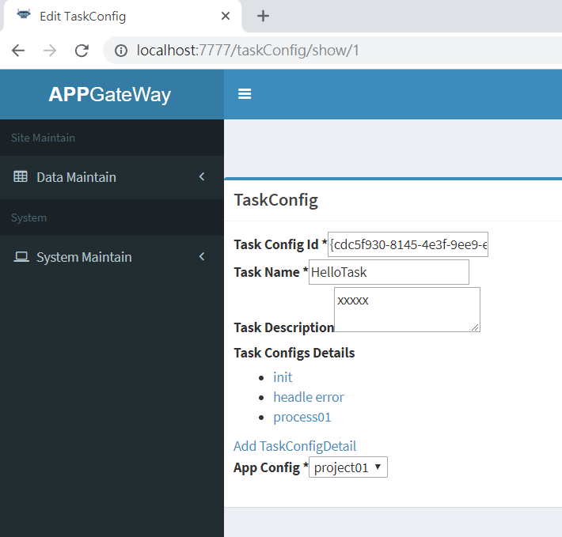

Slide 10
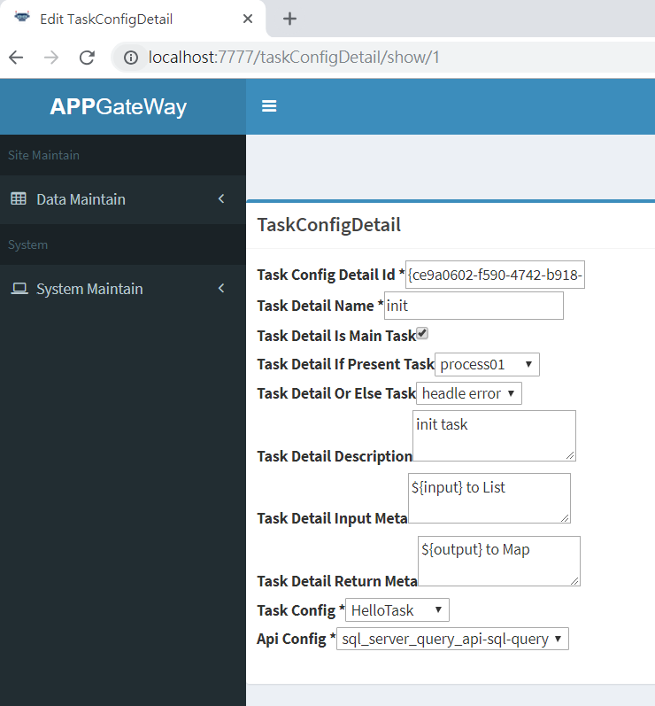
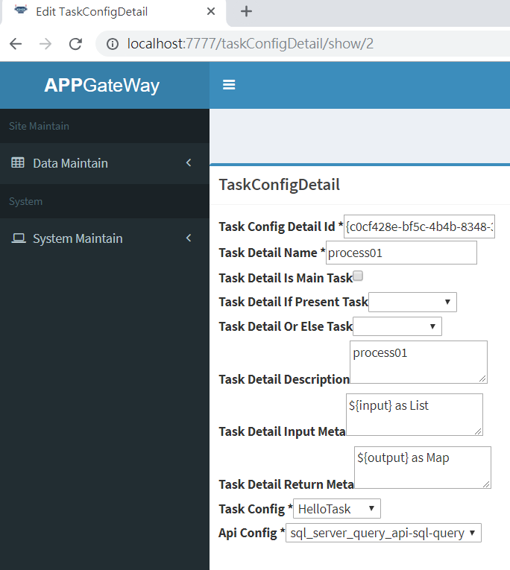
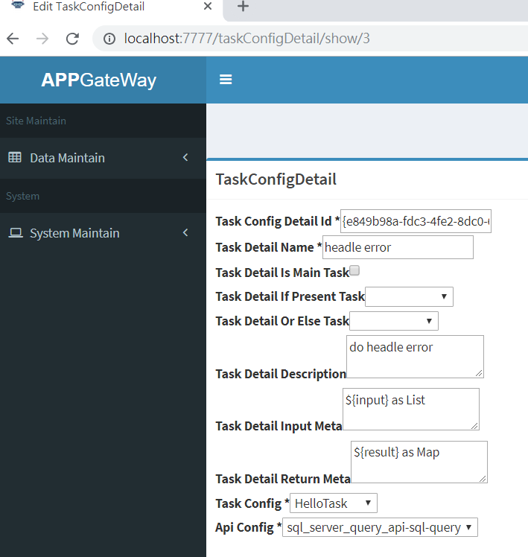

Slide 11
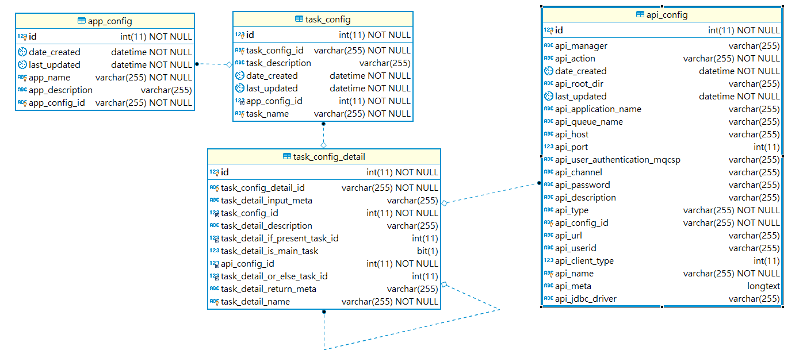
ER Model Design

Slide 12
JSON-RPC
HTTP POST application/json http://<application>/ArcareAPIConverter/json-rpc
POST BODY
單筆POST
{
"jsonrpc":"2.0",
“method”:“<sequence|paralleltask>”,//sequence 循序處理,parallel 平行處理,task 處理任務
"params":{“strAppId”:<api_id|task_id>,
"strApiName":“<api_name>",
"strData":{“key1”,”value1”,….}
},
"id":1
}

Slide 13
多筆一次POST
[
{
“jsonrpc”:“2.0”,“method”:“< sequence|paralleltask>”,// sequence 循序處理,parallel 平行處理,task任務處理
"params":{“intAppId”:<api_id|task_id>,strData":{“key1”:”value1”, “key1”:”value2”,…}},
"id":1
}, {
"jsonrpc":"2.0","method":“< sequence|paralleltask >",
"params":{“intAppId”:<api_id|task_id>,strData":{“key1”:”value1”, “key2”:”value2”,…}},
"id":2
},….
]

Slide 14
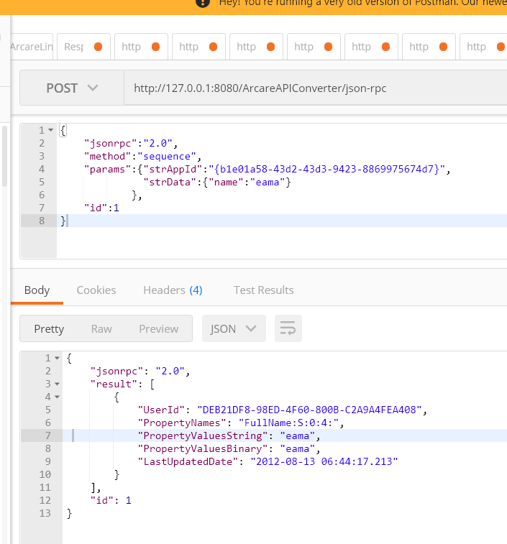

Slide 15
ERROR Hendel
-32001,"not support this api_action"
-32002,"bind error"
-32003,“strAppId is null"
-32004,"strApiName is null"
-32005,"api config not exists"
-32006,"not support this api_type"
-32007,"api_url not exists"
-32600,"Invalid Request"
-32700,"Parse error“
-32701,"JMS error <error message>"

