Slide 1
OAuth2 研究

Slide 2
Outline
整體結構
Authorization Server
  Endpoint
    Authorization endpoint
      authorization code
      Implicate
    Token endpoint
      authorization code
      password
      client credentials
      Refresh_token
  Access Token 產生公式
Resource Server
  Resource endpoint
TokenDB Design
Register Client Platform
Client SDK document

Slide 3
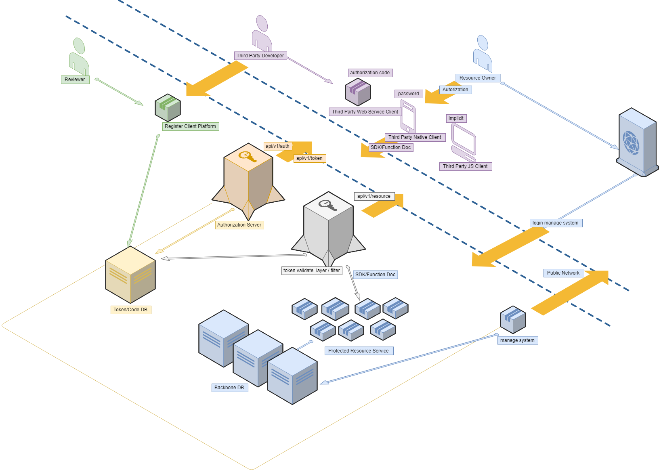
整體結構

Slide 4
Authorization Server
Endpoint
  Authorization endpoint
    https://<hostname>/authorize/auth
    METHOD
      GET
  SUPPORT MODE
    authorization code
    Implicate

Slide 5
Authorization Server
authorization code(step1/2)
  Request ->USER LOGIN CONFIRM -> return 302 get grant_code
Implicit(step1/1)
  Request - >USER LOGIN CONFIRM -> return 302 get access_token

Slide 6
Authorization Server
Endpoint
  Token endpoint
    https://<hostname>/ authorize/token
    METHOD
      POST application/x-www-form-urlencoded
    HEADER
      Authorization: Basic base64(client_id:client_secret)
  SUPPORT MODE
      authorization code
      password
      client credentials
      Refresh_token

Slide 7
Authorization Server
authorization code(step2/2)
  request -> grant_type=authorization_code -> get access_token
password(step1/1)
  request -> grant_type=password -> get access_token
client credentials(step1/1)
  Request -> grant_type=client_credentials -> get access_token
refresh token(step1/1)
  Request -> grant_type=refresh_token -> get new access_token

Slide 8
Authorization Server
Access Token 產生
  sign=HMACSHA256(base64(header)+'.'+base64(payload)+'.'+sign_key)
  Access_token=base64(header)+'.'+base64(payload)+'.'+sign
  header
    {"alg":"HS256","typ":"JWT"}
  payload
    *client_id
    *developer_username
    *username
    *date_created
    *expire_date
    *scope
  sign_key

Slide 9
Resource Server
Endpoint
  Resource endpoint
    https://<hostname>/resource/<version>/<function>
    METHOD
      POST application/x-www-form-urlencoded
    HEADER
      Authorization: Bearer <access_token/JWT>
    BODY
      //TODO
    RESPONSE
      //TODO

Slide 10
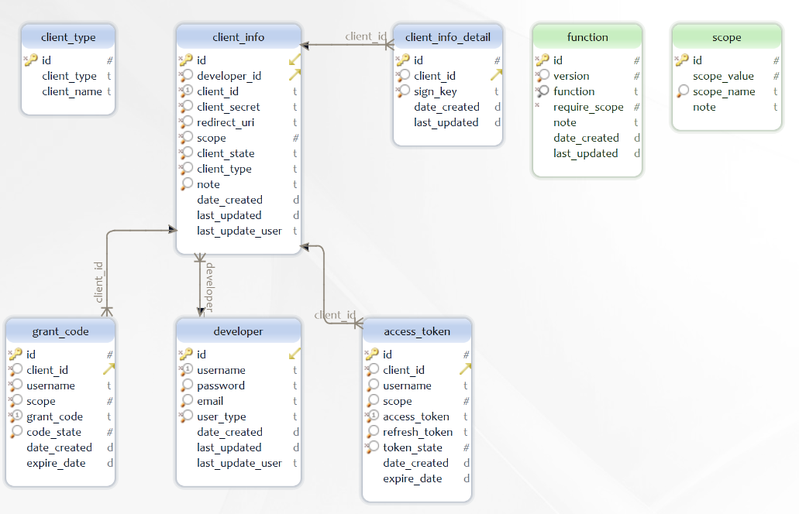
TokenDB Design

Slide 11
Register Client Platform
Third Party Login to Regist Client
  1. Third Party Define callback uri and application info
  2. Application resource scope
  3. Auto generate client_id and client_secret and sign_key
  4. Select Api Version
Allow system manager to review scope application
  1. pass/reject application
  2. destory any client,token,grant_code
Client Type MODE Mapping
  WEB SERVER -> authorization code
  NATIVE APP -> password
  JS APP -> implicit
  SERVER -> client credentials

Slide 12
Client SDK document
WEB SERVER
  //TODO
NATIVE APP
  //TODO
JS APP
  //TODO
SERVER
  //TODO

