Slide 1
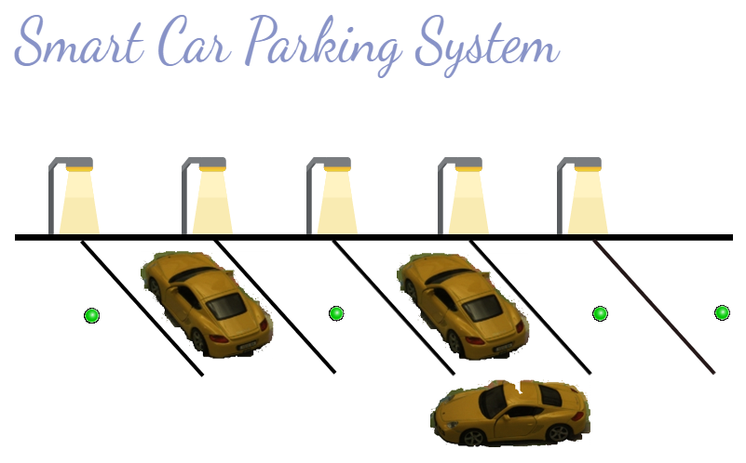
Icy Road Template
Your name

Slide 2
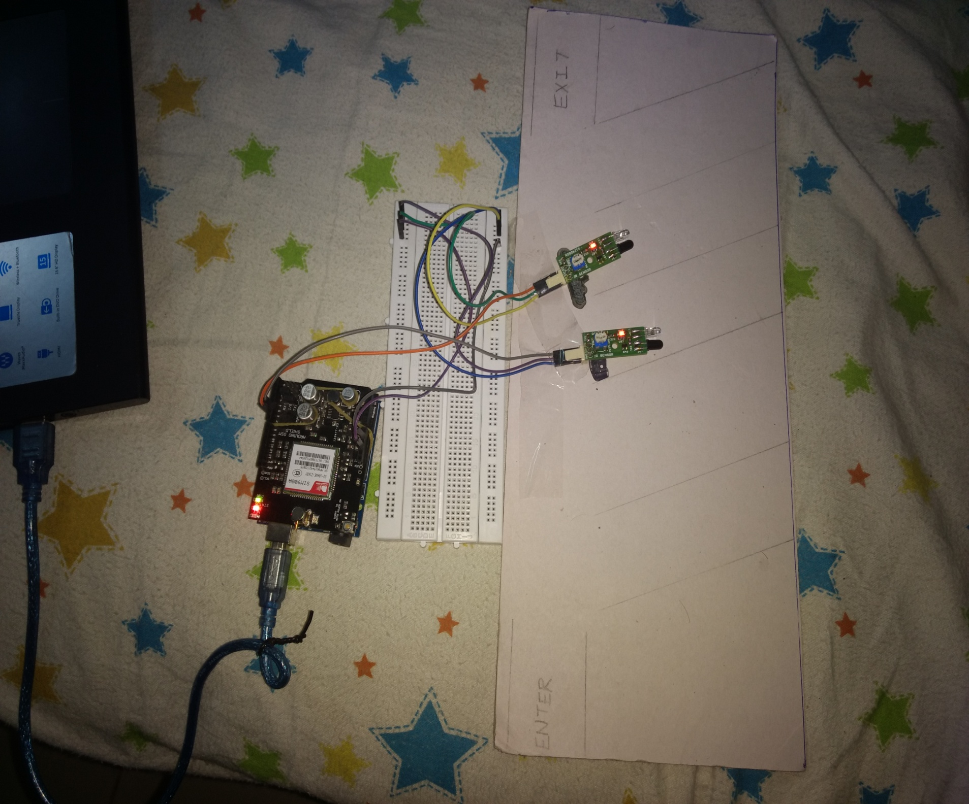

INTRODUCTION
A SMART CAR PARKING SYSTEM TO IMPLEMENT SYSTEMATIC PARKING.
A major problem in day to day life is parking of vehicles especially the car parking at an appropriate place. And this issue indirectly leads to traffic congestion.
This project presents the basic concept of using server or cloud based smart parking services in smart cities as an important application of the Internet of Things (IoT) paradigm.
This system will be accessible through a mobile app or through the webpage provided and can be used to monitor or find the empty slots in that area.

Slide 3
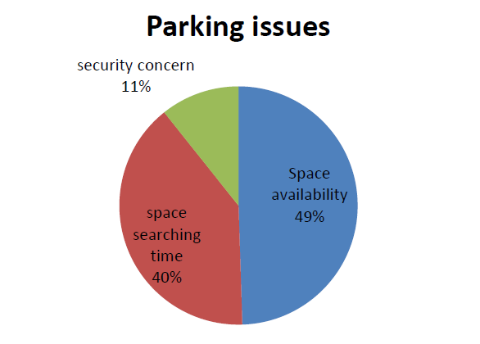
Almost half of the people faced the problem of space availability while parking.
This is a serious problem which can be solved by smart car parking system.

Slide 4
SYSTEM OVERVIEW
--The system basically consist of two parts :- 1)Hardware 2.)Software
--This process is quick and efficient.

Slide 5
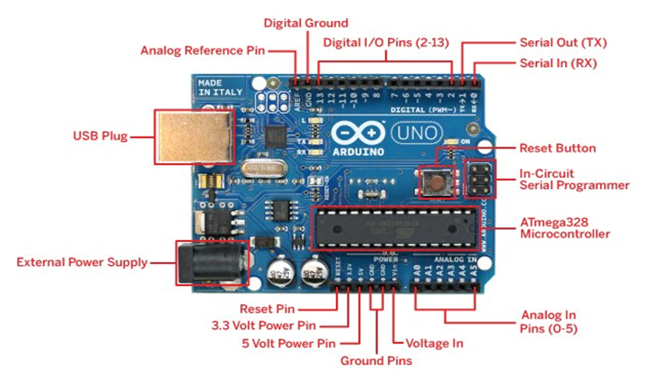
BASIC COMPONENT
ARDUINO-UNO
Arduino is an open-source electronics platform based on easy-to-use hardware and software. Arduino boards are able to read inputs - light on a sensor, a finger on a button, or a Twitter message - and turn it into an output - activating a motor, turning on an LED, publishing something online. You can tell your board what to do by sending a set of instructions to the microcontroller on the board. To do so you use the Arduino programming language (based on Wiring), and the Arduino Software (IDE), based on Processing. Arduino was born at the Ivrea Interaction Design Institute as an easy tool for fast prototyping, aimed at students without a background in electronics and programming.

Slide 6
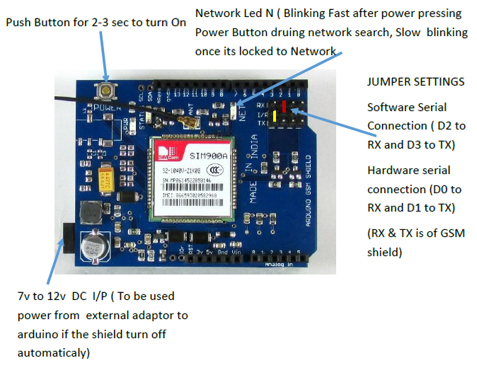
GSM SHIELD
Global System for Mobile communication (GSM) is used for mobile communication in many countries. It features sending and reading short messages (SMS), the management on phonebook of SIM card, sending SMS to group users, moreover, a flexible solution on real-time reading SMS is also proposed. There are different kinds of GSM modules available in market. We are using most popular module based on Arduino Uno & Sim-Com SIM900A for this tutorial. GSM module contains SIM card holder, antenna for receiving and sending signals to the SIM, and RS232 based serial port for connection. AT commands are used to use a GSM modem.

Slide 7
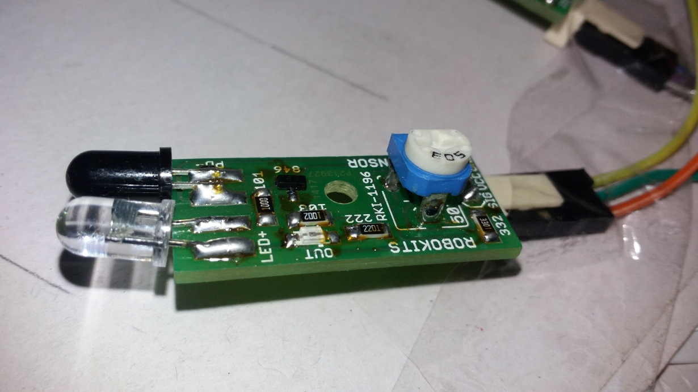
IR OBJECT SENSOR
IR sensor An infrared sensor is an electronic device which is used to sense light wavelength of its surroundings by either emitting or detecting infrared spectrum. It will also capable of measuring the heat being emitted by an object and detecting motion. LED will be glow with respect to the IR sensor detection. Green LED will be glow if no object is detected and Red LED will be glow if object is detected.

Slide 8
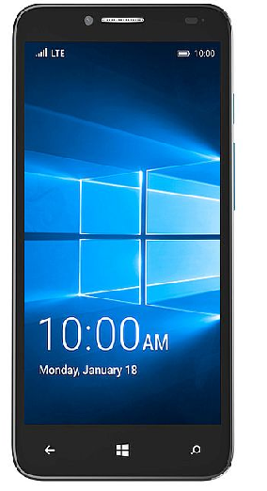
ANDROID
Android is a mobile operating system developed by Google, based on the Linux kernel and designed primarily for touchscreen mobile devices such as smartphones and tablets. Android's user interface is based on direct manipulation, using touch gestures that loosely correspond to real-world actions, such as swiping, tapping and pinching, to manipulate on-screen objects, along with a virtual keyboard for text input .
ANDROID STUDIO: Android Studio is an integrated development environment (IDE) for developing for the Android platform. It was announced on May 16, 2013 at the Google I/O conference by Google's Product Manager, Katherine Chou. Android Studio is freely available under the Apache License 2.0
Android Studio was in early access preview stage starting from version 0.1 in May 2013, then entered beta stage starting from version 0.8 which was released in June 2014.

Slide 9
METHODOLOGY DETAILING
1.Download and Install Arduino IDE 1.6.9 from http://www.filehorse.com/download-arduino/25855.
2.Testing of Arduino UNO
->Connect Arduino UNO with laptop using USB cable.
->Open Arduino IDE.Goto File->Example->Basic->Blink
->If LED of Arduino is blinked then Arduino is working properly.
3.Mount Arduino GSM shield(SIM900) on arduino UNO.
4.Connect IR sensor to digital 5,6,7 pin of Arduino GSM shield.
5.Add Adafruit_FONA library in Arduino IDE
->Download Adafruit_FONA Library from
https://learn.adafruit.com/adafruit-fona-mini-gsm-gprs-cellular-phone-module/arduino-test.

Slide 10
METHODOLOGY DETAILING
6.Connect USB Jack to laptop using USB cable
7.Upload Arduino code in Arduino IDE
8.Open Serial monitor for run the code.
9.See the record in database
->Open Website: carparking.esy.es
->You can see the record of database.
10.Download android app,open and see the result.

Slide 11
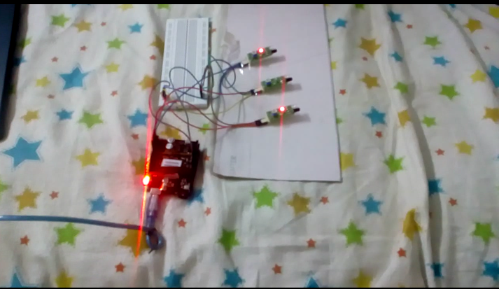
CONNECTION

Slide 12
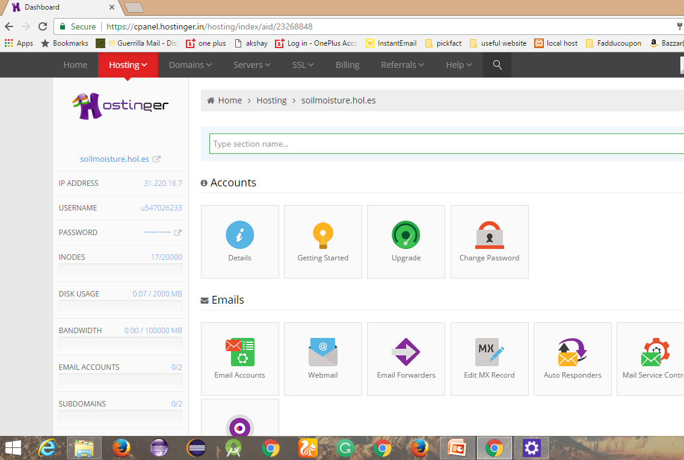
Hostinger(Free hosting website)
The hosting service from Hostinger India gives you the best free web hosting with PHP, MySQL, BW 100GB, unlimited cheap hosting and a free domain.

Slide 13
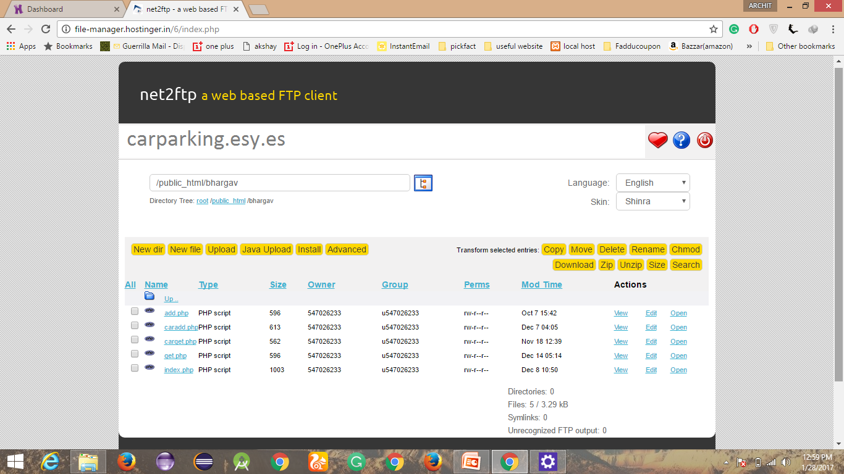

Slide 14
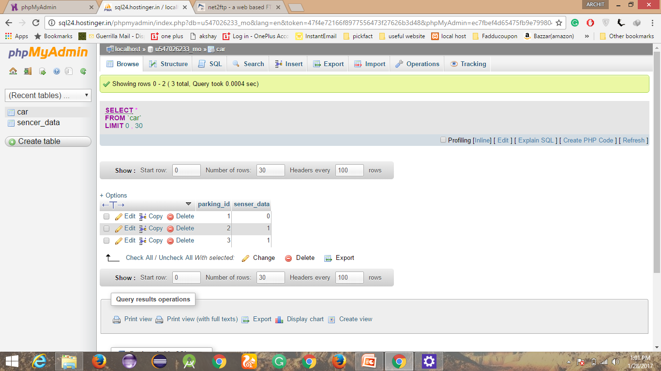
phpMyAdmin(database)
The hosting service from Hostinger India gives you the best free web hosting with PHP, MySQL, BW 100GB, unlimited cheap hosting and a free domain.

Slide 15
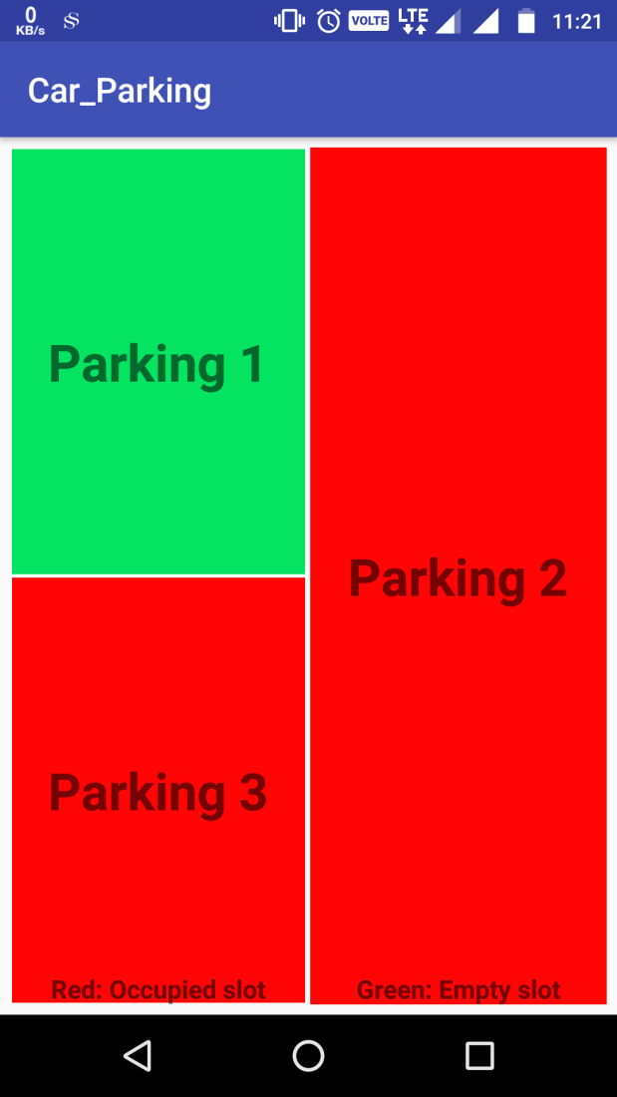
OUTPUT
Green Color shows empty parking slots.
Red color shows occupied parking slots.

Slide 16
ADVANTAGES
Optimized parking – Users find the best spot available, saving time, resources and effort.
Reduced traffic – Traffic flow increases as fewer cars are required to drive around in search of an open parking space.
Reduced pollution – Searching for parking burns around one million barrels of oil a day. An optimal parking solution will significantly decrease driving time, thus lowering the amount of daily vehicle emissions .

Slide 17
Increased Safety – Parking lot employees and security guards contain real-time lot data that can help prevent parking violations and suspicious activity.
Real-Time Data and Trend Insight – Over time, a smart parking solution can produce data that uncovers correlations and trends of users and lots.
Decreased Management Costs – More automation and less manual activity saves on labor cost and resource exhaustion.

Slide 18
DISADVANTAGES
Cost of implementation is high.
GSM feature creates bottlenecks.
Reservation feature is not available for the user.
High cost of implementation.
User will have to inquire for every slot available.

Slide 19
Conclusion
We can conclude that Smart Parking is at a very tender stage in India and people hardly know about the technology. They cannot distinguish between smart parking and automated parking which is already very prevalent in India. However people are willing to accept it as it will solve many problems like space availability, wastage of time, fuel and will also provide security to the vehicle. Hence Smart Parking has got a huge potential as many Smart City projects are coming up in India and a huge investment has already been lined up.

Slide 20
Contact Us
Video tutorial available :-
https://youtu.be/NVHurPKLu9w

