Slide 1









Automated Temperature Control System

Slide 2



TEAM MEMBERS
The team is comprised of four members:
MWESIGA
TEGAMBWAGE
NANCY HIZA
WALIDI KOWERO
CHELSEA GIDEON

Slide 3

PROBLEM STATEMENT
The society is governed by different aspects including affordability, efficiency, convenience and comfort.
Businesses and Home owners want a more convenient temperature regulation system that can cut the trade-off between its performance and price.
A system that can provide customer the convenience and comfort regardless the place and weather condition

Slide 4
PROPOSED SOLUTION
We propose an automated system that maintains the temperature of the room based on user preferences.
System makes sure the right temperature is maintained not only by dealing with disturbances but also by providing a comfortable condition to the users
This solution aims at enhancing convenience and comfortability of home owners while at home.

Slide 5


SDG AREA
The system satisfies both 7th and 11th SDG
Stated as Affordable and Clean Energy as well as Sustainable Cities And Communities
The solution aim at improving human settlements energy efficiency as well as comfortableness performance in temperature cooling

Slide 6

GEOGRAPHICAL AREA
The system aims to focus in Tanzania, precisely in Dar es Salaam.
Being largest city in Tanzania, it faces significant energy demands, particularly for cooling.
Hence, solution aims to show its effectiveness in reducing energy consumption while enhancing indoor comfort.

Slide 7

TARGET AUDIENCE
The system is aimed to be used in all aspects, from home, apartments and even hotels.
But the targeted audience are Home Owners to provide them the comfort they need whenever they are at home
System turns the home into a comfort zone regardless weather conditions.

Slide 8
HUMAN RESOURCES
Mwesiga Tegambwage: Project Manager and Lead System Designer
Nancy Hiza - Lead Electronics and Hardware Engineer
Walidi Kowero - Lead Electronics and Hardware Programming
Chelsea Gideon
System Design | Project Management | IoT and Embedded Systems | Research
Electronics Circuit Design | CAD Software | IoT and Embedded Systems | Maintenance
C, C+ Programming | PCB Design and Assembly | IoT and Embedded Systems | CAD Software
IoT and embedded systems | Project planning and management

Slide 9
TASK DISTRIBUTION

Slide 10
TECHNICAL RESOURCE AND COST ESTIMATIONS
Item Name | Item Description
Power Adapter | 230v ac to 24v/12v dc and power cable
Voltage Regulator | LM317T, 5v and 12v Regulator
Relay | 2 x 12V 30A 250W 2 Channel Relay
Buttons | Push Buttons
Enclosure | PVC or Aluminum
Power MOSFET | IRF540
Peripherals | Diode, Resistors, Electrolytic Capacitor
PCB Designing | PCB Board, Connectors, Power Connectors
LCD Display
Item Name | Item Description
Heating Subsystem:
Nichrome Wire or PTC | Heating element
Cooling Subsystem:
Refrigerant | R22, quantity
Rotary Compressor | Rotary Compressor
Filter | Copper filter ac drier
Capillary Tube | 80 mm diameter
Copper tubes | Quarter inch diameter
Fan | Cooling Axial Ac Fan

Slide 11
SYSTEM REQUIREMENTS
Functional Requirements:
System must be able to monitor indoor temperature in real-time;
System must control a rotary compressor for cooling based on temperature readings;
System must activate either heating or cooling subsystem based on temperature readings;
System must allow users to set desired temperature ranges;
System must store data on temperature variations for analysis and optimization;
System must provide remote monitoring and control capabilities through a connected application or interface.

Slide 12
SYSTEM REQUIREMENTS
Non-Functional Requirements:
System must respond to temperature changes within 30 seconds;
The system must operate continuously with minimal downtime;
System must be secure, protecting data from unauthorized access;
System must be user-friendly, with an intuitive interface and easy-to-understand controls.

Slide 13
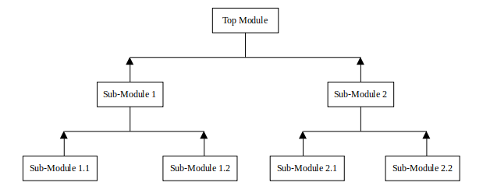
METHODOLOGY
The methodology employed in the implementation is Bottom-up Methodology Approach.
Methodology enhances creativity, improves problem-solving, and increases team engagement.

Slide 14
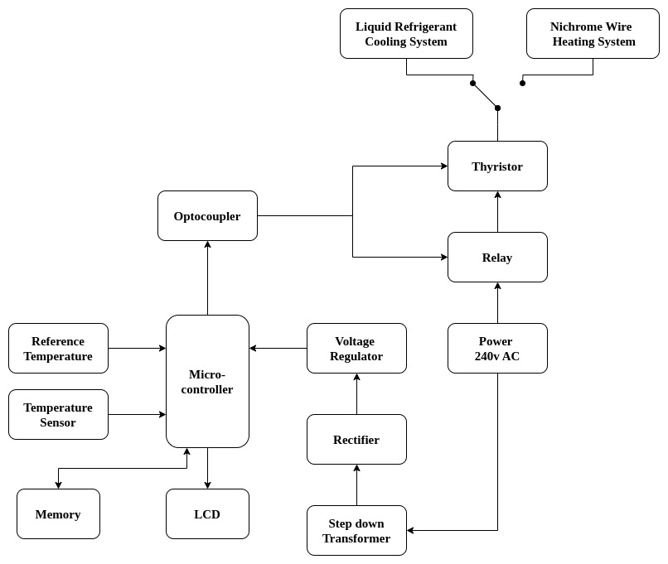
DETAILED SYSTEM BLOCK DIAGRAM
The temperature control system will be comprised of two subsystems activated by micro-controller by threshold temperature factor.
Above the threshold temperature, the cooling system will be activated;
Below the threshold temperature, the heating system will be activated;

Slide 15
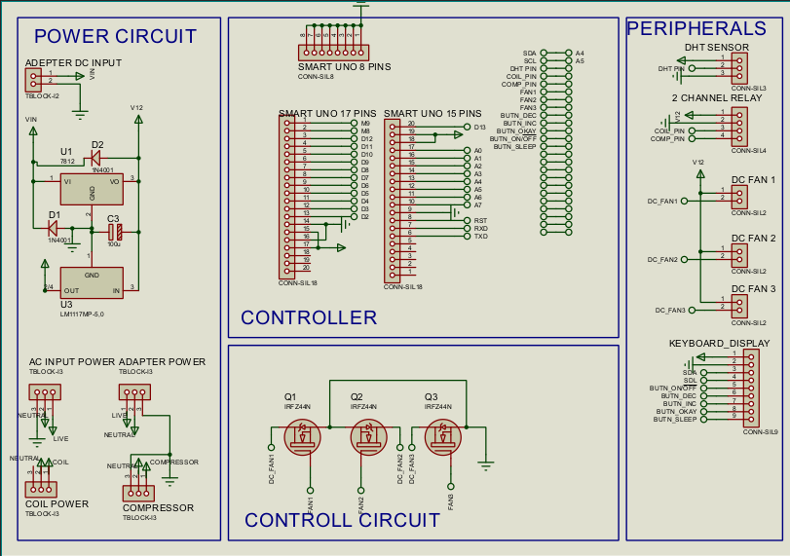
SCHEMATIC DESIGN

Slide 16
COOLING SYSTEM DESIGN
Compressor Type : Rotary compressor suitable for the application.
Refrigerant : Compatible with R22.
Capacity : 1.25kg
Total Surface Area = 0.182m²
Cooling Capacity ≈ 0.137kW ≈ 467.46 BTU/hr
Refrigerant Charge ≈ 182.5g
Length of copper tubes ≈ 4.572m (15ft each)
Capillary tube size ≈ 0.031 inches diameter, 5 feet length

Slide 17
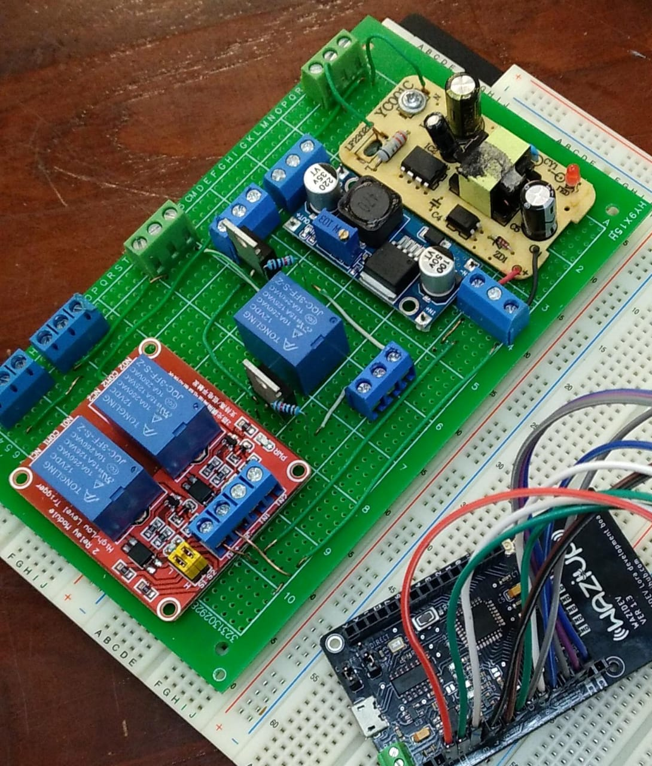
PCB IMPLEMENTATION
Once the design was completed, the control logic for micro-controller task execution was implemented.
Implementation was then followed by carefully soldering electronics components onto the PCB.
Special attention given to the placement and orientation to avoid any potential issues during operation

Slide 18
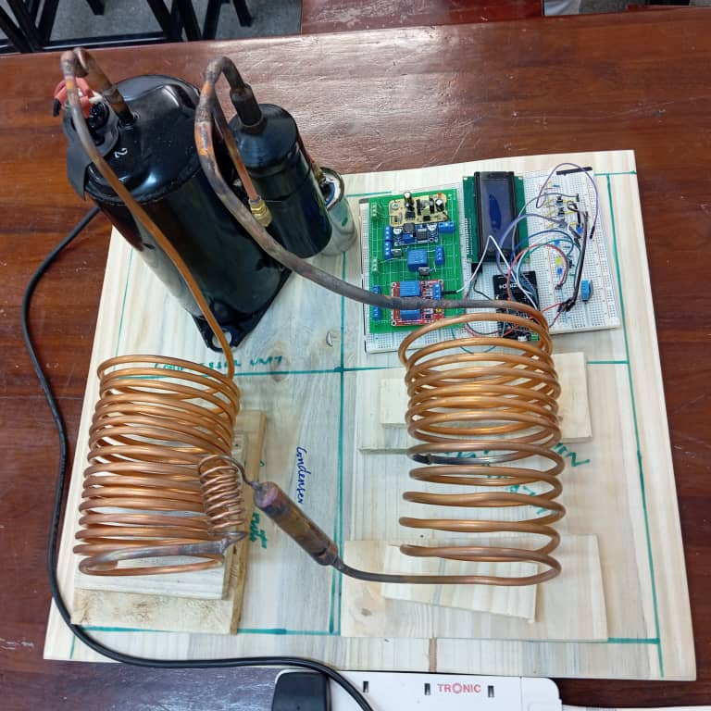
COOLING SUBSYSTEM IMPLEMENTATION
Cooling system components were integrated to create a closed-loop system capable of efficient heat exchange;
Copper tubes were arranged in a helical configuration to maximize surface area and improve heat dissipation;

Slide 19
HOW THE SYSTEM WORKS
Micro-controller checks for user preferred temperature else it uses default temperature values for cooling or heating
Temperature sensor measures the current room temperature;
The micro-controller compares measured temperature to the threshold temperature for initiation of subsystem;
Based on the comparison, micro-controller sends signals to the relay to initiate either cooling subsystem or heating subsystem;
Micro-controller monitor flow of hot and cold air to bring room temperature closer to desired value;
While continuous monitoring, the temperature data are sent to gateway for analysis and informed decisions.

Slide 20
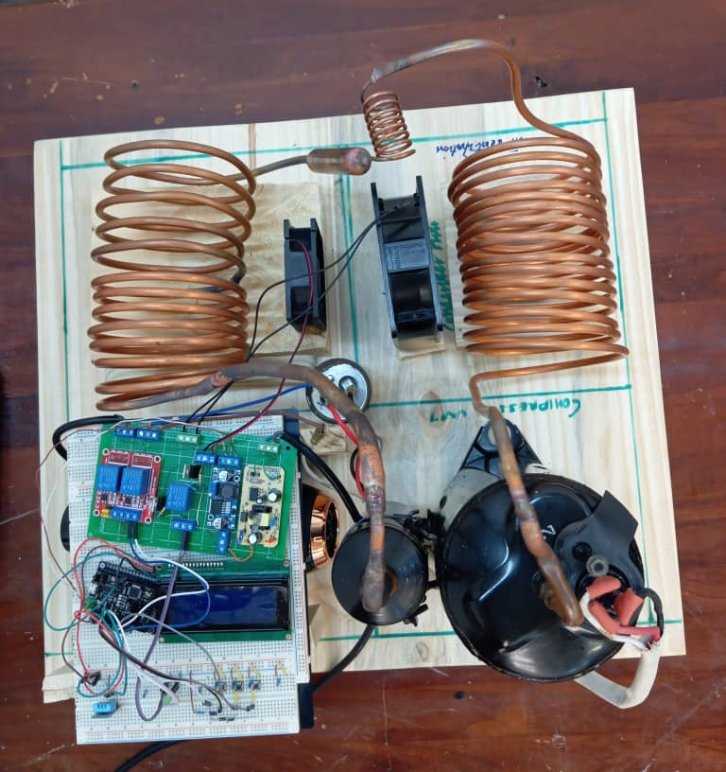
SYSTEM INTEGRATION

Slide 21



WHY THIS SYSTEM
Comfort: maintains a consistent and comfortable temperature in the room.
Energy Efficiency: optimizing heating and cooling to reduce energy consumption.
Convenience: automatic operation eliminates the need for manual adjustments.

Slide 22
Thank you
Consortium partners
By
Mwesiga Tegambwage
Nancy Hiza
Walidi Kowero
Chelsea Gideon

