Slide 1









Automated Temperature Control System

Slide 2



TEAM MEMBERS
The team is comprised of three members:
MWESIGA TEGAMBWAGE
NANCY HIZA
CHELSEA GIDEON

Slide 3

SDG AREA
The system satisfies both 7th and 11th SDG
Stated as Affordable and Clean Energy as well as Sustainable Cities And Communities
The solution aim at improving human settlements energy efficiency as well as comfortableness performance in temperature cooling

Slide 4
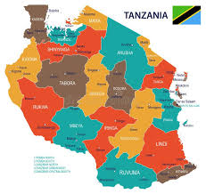
GEOGRAPHICAL AREA
The system aims to focus in Tanzania, serving the Tanzanians.
Region-wise the focus is maintained first in Dar es Salaam region as an Early adopter

Slide 5
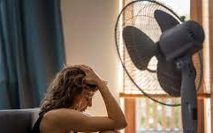
PROBLEM STATEMENT
The society is governed by different aspects including affordability and system efficiency with much convenience and comfort.
Businesses and Home owners want a more convenient temperature regulation system that can cut the trade-off between its performance and price.
A system that can provide customer the convenience and comfort regardless the place and weather condition

Slide 6

PROPOSED SOLUTION
We are aiming at offering an efficient automated temperature control system that can be affordable even to local people.
The system regulates the temperature of the enclosed room based on user preferences.
This solution aims at enhancing convenience and comfortability of home owners while at home.

Slide 7

DATA
Collection of data is via both user preference as well sensors.
Measured, Collected and Data to be analyzed includes temperature data as well as humidity for temperature control precision.
Also temperature range for the early adopter region will also be collected and studied enabling tuning behavior of system for a particular region

Slide 8

TARGET AUDIENCE
The system is aimed to be used in all aspects, from home, apartments and even hotels.
But the targeted audience are Home Owners. This system will give them the comfort they need whenever they are at home.
Makes the home into a comfort zone in whatever the weather conditions are

Slide 9
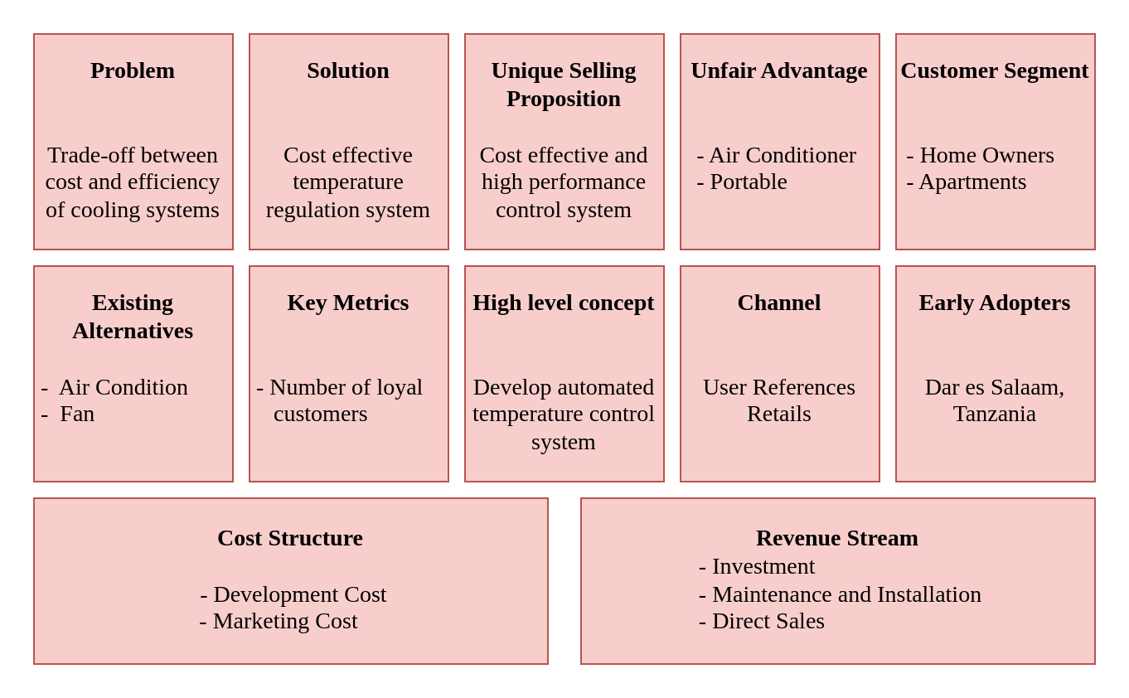
LEAN CANVAS MODEL

Slide 10
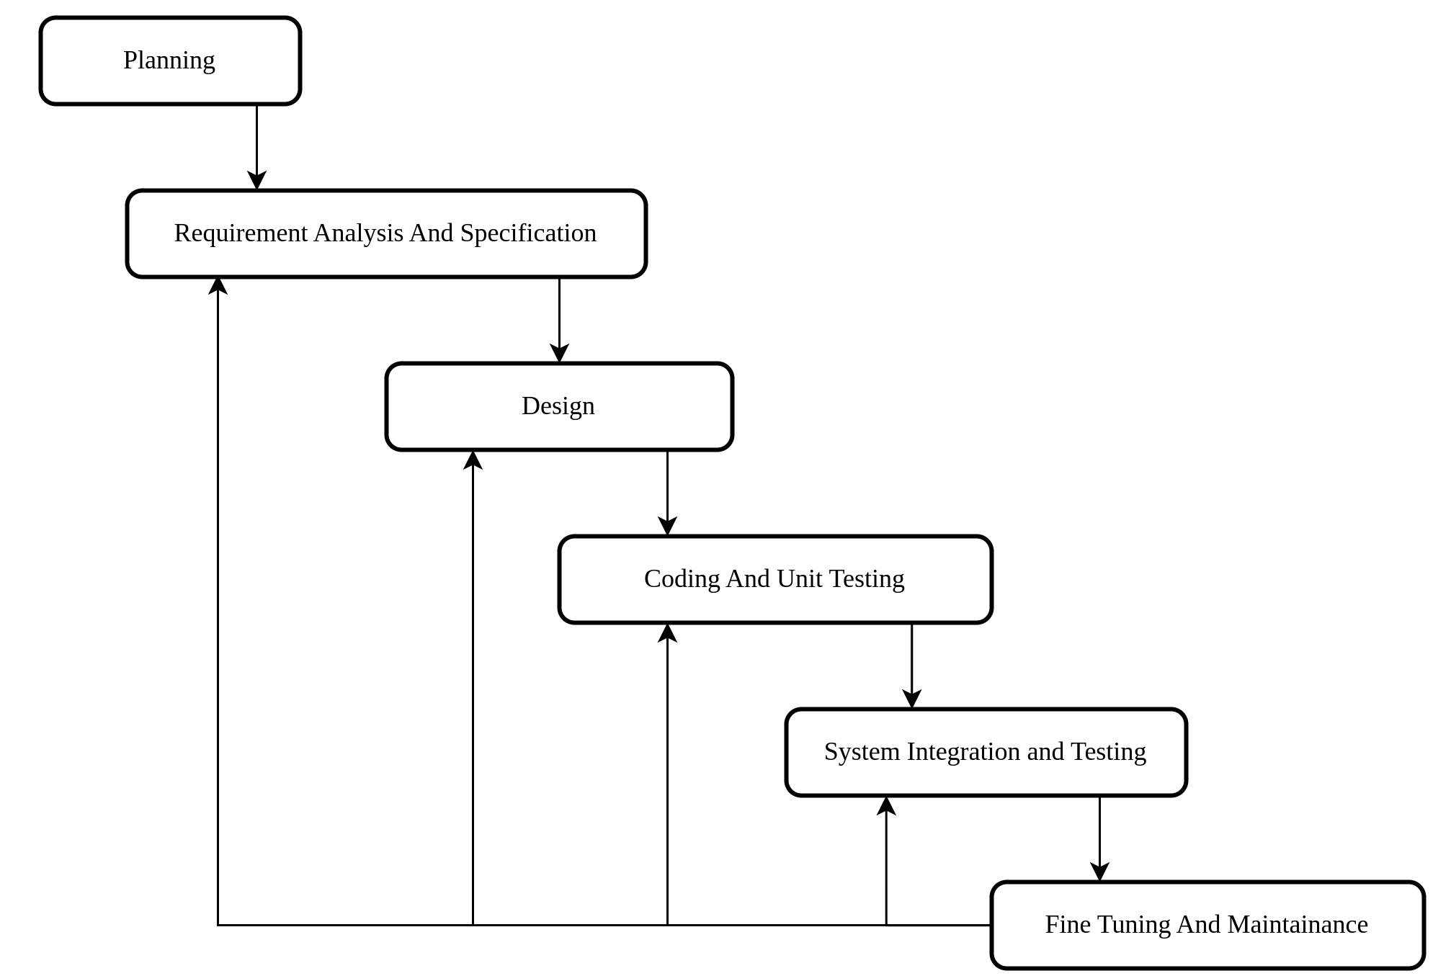
SYSTEM ROAD-MAP
The activities to be involved for the development of this system is illustrated below

Slide 11
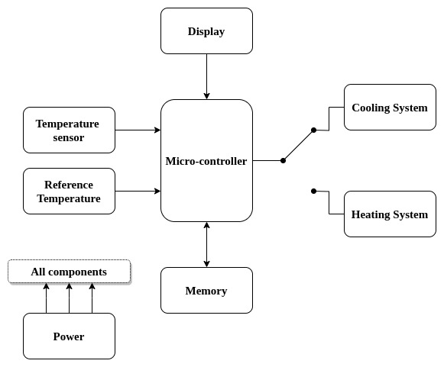
SYSTEM BLOCK DIAGRAM
The system block Diagram is illustrated in the figure below
The temperature control system will be comprised of two subsystems activated by micro-controller by threshold temperature factor.
Above the threshold temperature, the heating system will be activated;
Below the threshold temperature, the cooling system will be activated;

Slide 12
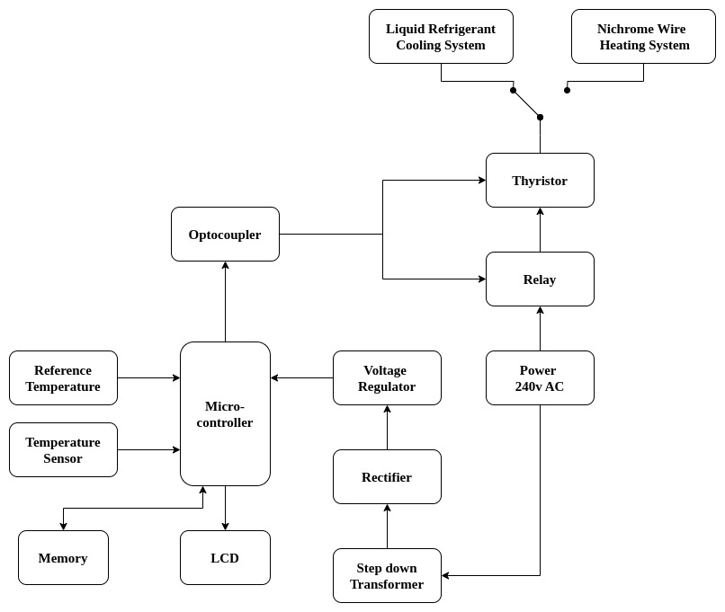
DETAILED SYSTEM BLOCK DIAGRAM

Slide 13

HOW THE SYSTEM WORKS
The temperature sensor measures the current room temperature where as humidity sensor may be added to improve precision.
The micro-controller compares the measured temperature to the desired temperature set by the user.
Based on the temperature difference, the micro-controller sends signals to the relay.
The relay adjusts the flow of hot and cold air to bring the room temperature closer to the desired value from cooling system.
The temperature sensor continuously monitors the temperature and provides feedback to the controller for further adjustments.

Slide 14
SYSTEM REQUIREMENTS
Hardware Requirements
Input
Infrared Thermometer: (contactless)
DHT22: temperature and humidity sensor
Others
Micro-controller:
Voltage Regulator
Rectifier:
Opto-coupler: provide electrical isolation.
Step-Down Transformer
Variable Speed Fan: Adjusts speed to control airflow volume
Relay: switching device used to perform switching action.
Thyristor: perform switching action via pulse generated by micro-controller

Slide 15
SYSTEM REQUIREMENTS
Hardware Requirements
Cooling System
Rotary compressor
Condenser Radiators:
Evaporator Radiators
Filter
Expansion Tube
Suction Copper Tubes
Heating System
Heating Element : made of nichrome wire
Rotating fan:
Radiator
Layout
Boards
Soldering Iron
Soldering Wire
Duct

Slide 16



WHY THIS SYSTEM
Comfort: maintains a consistent and comfortable temperature in the room.
Energy Efficiency: optimizing heating and cooling to reduce energy consumption.
Convenience: automatic operation eliminates the need for manual adjustments.

Slide 17
Thank you
Consortium partners
By
Mwesiga Tegambwage
Nancy Hiza
Chelsea Gideon

