Slide 1
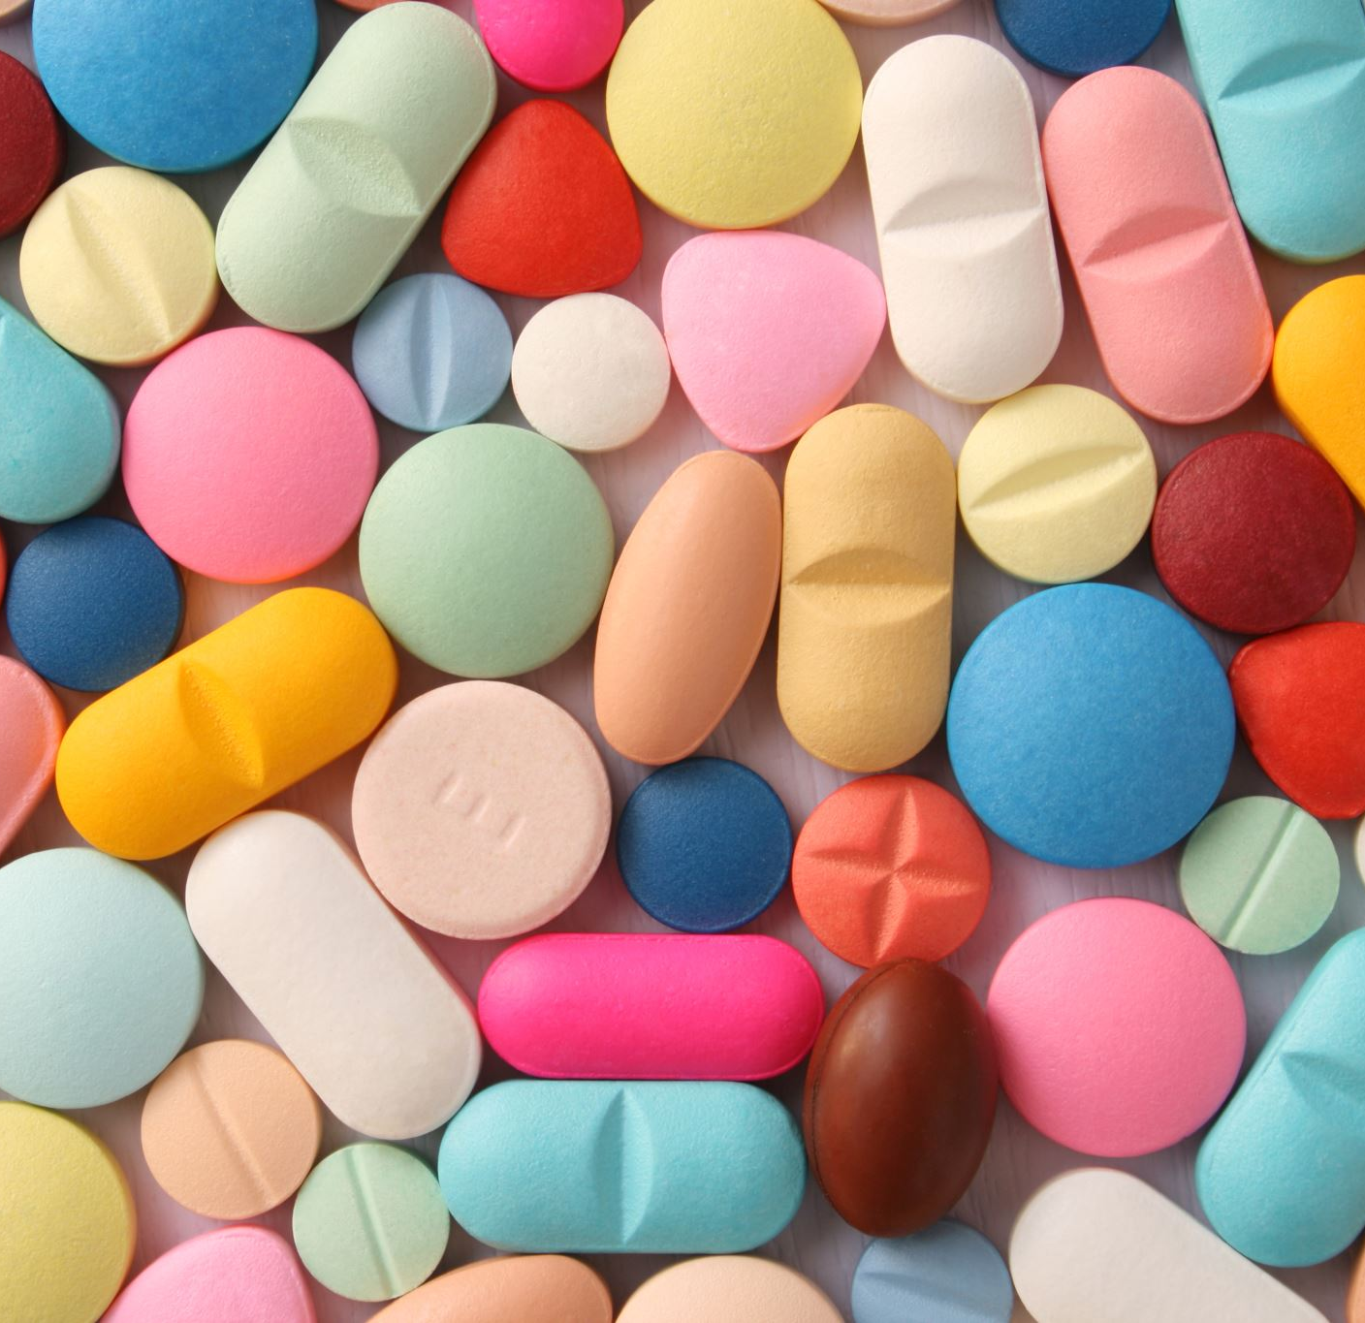
Predicting Drug-Induced Autoimmune Responses Prior to Clinical Trials
by Anthony Clark
Wentworth institute of technology
Capstone I
Professor Mehmet ergezer
^{April 14th, 2025}

Slide 2
Key Ideas
Drug-Induced Autoimmune Response
Immune system treats drug as external threat => immune response
Life-threatening, very costly
Not Immunoglobulin E (IgE)-mediated immune responses => More complicated
Physiochemical Dataset
Physiochemical features such as “atom connectivity”, “X-ray refraction at certain angle”, “number of valence electrons”, “hydroxyl groups in cumulative neg charge” are used to design drugs
These same features can be used to predict an autoimmune response
Predictivity/Interpretability Trade
Biochemical, physiological pathways are extremely complicated with a near unfathomable numbers of interactions and ancillary reactions.
Predictive power often sought over interpretability
Catch BEFORE clinical trials

Slide 3
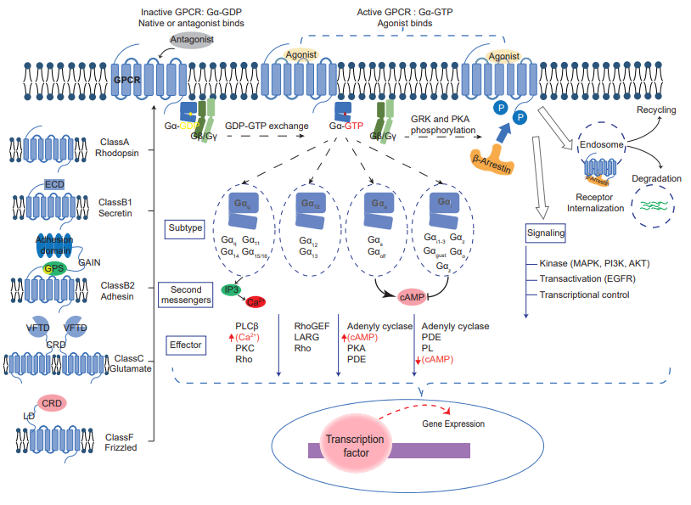
Illustration of Biochemical Complexity

Slide 4
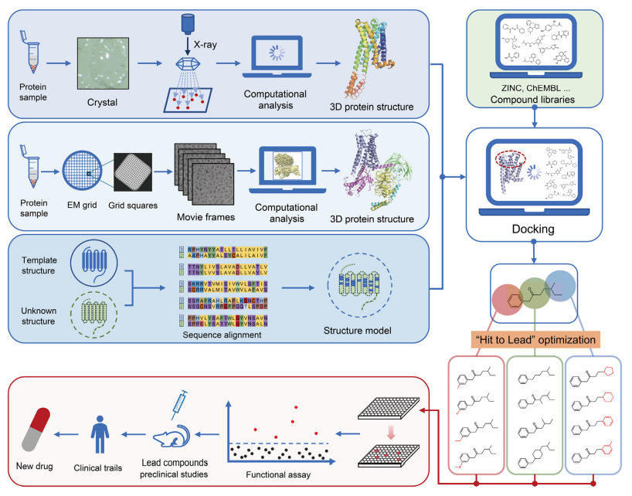
Drug Design Overview

Slide 5
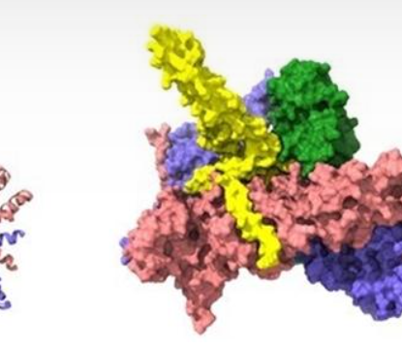
Dataset
-597 different drugs/molecules
-197 different features
-Binary target variable

Slide 6
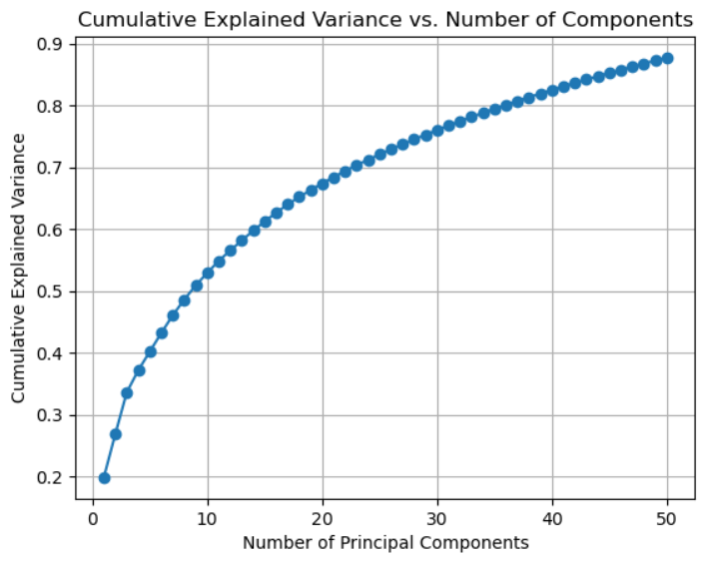
Preliminary PCA

Slide 7
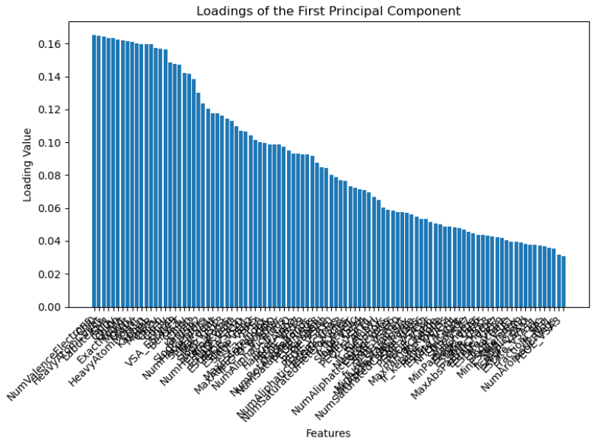
Preliminary PCA

Slide 8
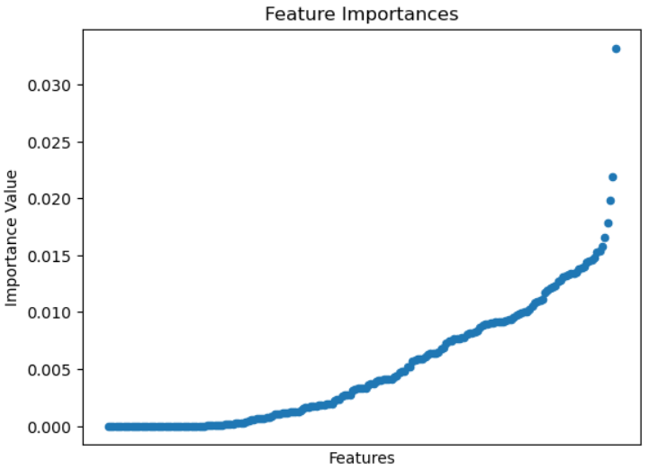
Preliminary Feature Importance (tuned Random Forests)

Slide 9
Preprocessing
Remove null, missing, “-inf” values
Remove values with single value
Feature modifications: standardization, normalization, polynomial, logarithm
Many variables heavily skewed
High correlation seen between several variables
Preliminary PCA and feature importances via random forests
Compare loadings with feature importances, find overlap

Slide 10
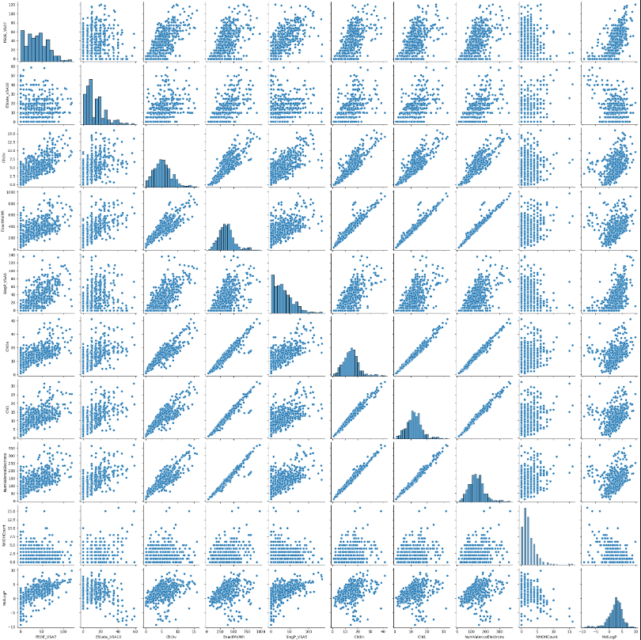
Correlation

Slide 11
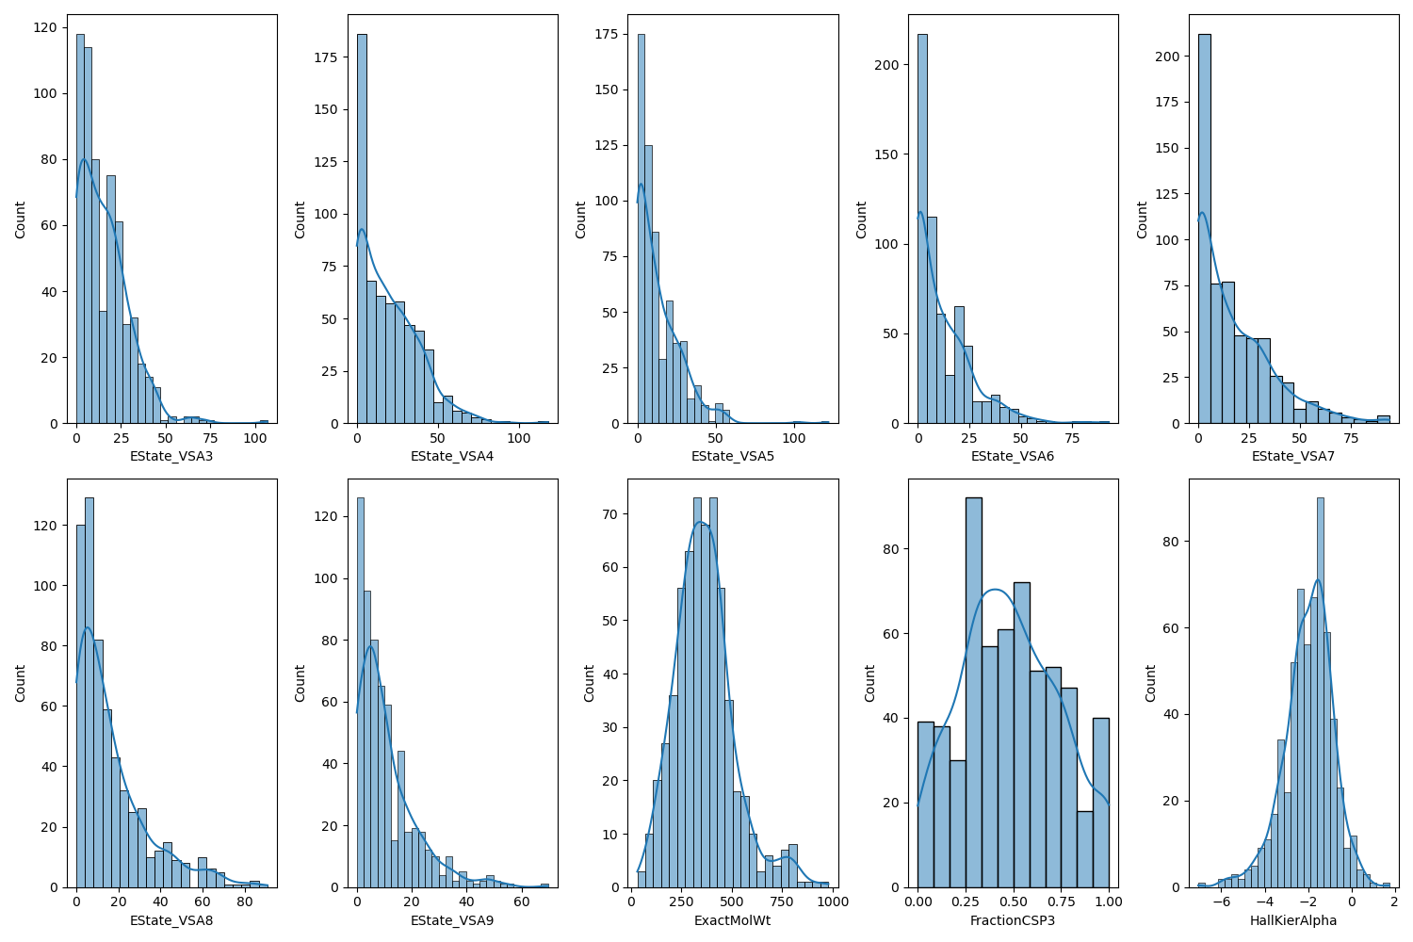
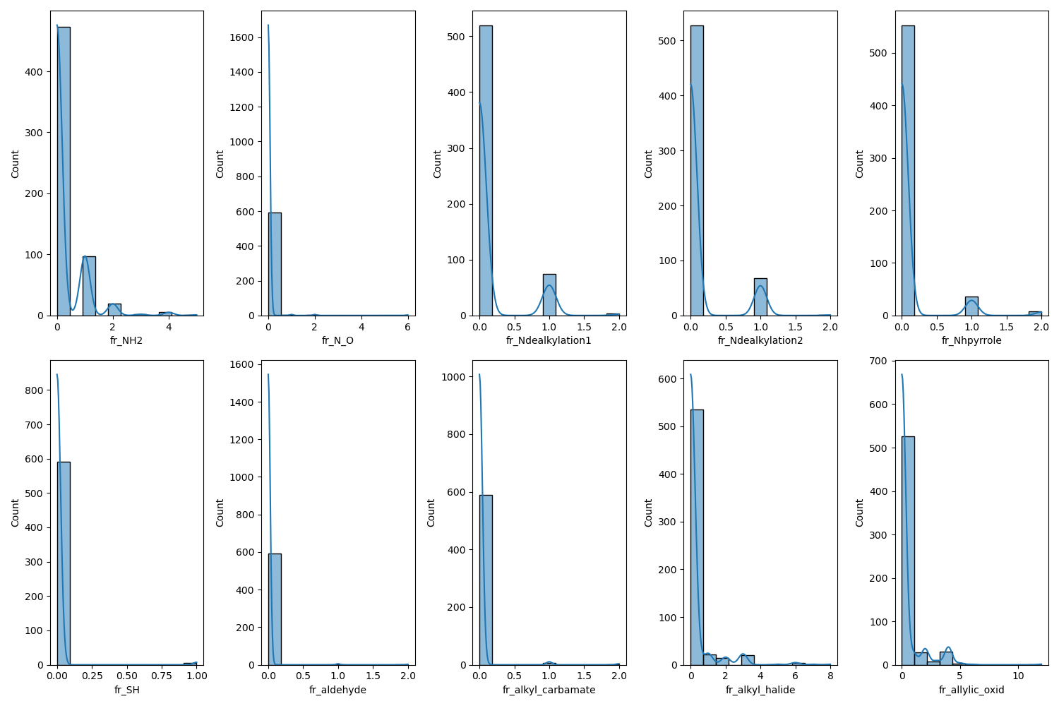
Skewed

Slide 12
Baseline Eval (SVM), Confusion Matrices
LINEAR | Actual Negative | Actual Positive
Actual Negative | 111 | 26
Actual Positive | 23 | 20
POLYNOMIAL | Actual Negative | Actual Positive
Actual Negative | 133 | 4
Actual Positive | 40 | 3
RBF | Actual Negative | Actual Positive
Actual Negative | 134 | 3
Actual Positive | 33 | 10
Sigmoid | Actual Negative | Actual Positive
Actual Negative | 134 | 3
Actual Positive | 38 | 5

Slide 13
Baseline Eval (SVM), Accuracy & Recall
Kernel | Accuracy | Recall
Linear | 0.73 | 0.46
Polynomial | 0.76 | 0.07
RBF | 0.80 | 0.23
Sigmoid | 0.77 | 0.12

Slide 14
Baseline Eval (Random Forests), Accuracy & Recall
Parameter | Value
Number of estimators | 100
Minimum Samples Split | 2
Minimum Samples Leaf | 2
Max Depth | 15
Bootstrap | False
Accuracy Score | Recall Score
0.82 | 0.37

Slide 15
Experiments: Scaling Features
Model | Unscaled Features | Standardized Features | Normalized Features | Log Applied
Random Forest | Accuracy: 0.82 Recall: 0.37 | Accuracy: 0.83 Recall: 0.35 | Accuracy: 0.82 Recall: 0.37 | Accuracy: 0.80 Recall: 0.35
Logistic Regression | Accuracy: 0.76 Recall: 0.00 | Accuracy: 0.75 Recall: 0.48 | Accuracy: 0.76 Recall: 0.19 | Accuracy: 0.78 Recall: 0.51
XGBoost | Accuracy: 0.80 Recall: 0.48 | Accuracy: 0.82 Recall: 0.53 | Accuracy: 0.80 Recall: 0.48 | Accuracy: 0.78 Recall: 0.52
Linear Discriminant Analysis | Accuracy: 0.72 Recall: 0.48 | Accuracy: 0.74 Recall: 0.28 | Accuracy: 0.72 Recall: 0.48 | Accuracy: 0.75 Recall: 0.44

Slide 16
Experiments: Adding Features
Model | Polynomial | Interaction | Derived-Domain | Unscaled (Reference)
Random Forest | Accuracy: 0.82 Recall: 0.47 | Accuracy: 0.82 Recall: 0.41 | Accuracy: 0.82 Recall: 0.39 | Accuracy: 0.82 Recall: 0.37
Logistic Regression | Accuracy: 0.75 Recall: 0.60 | Accuracy: 0.78 Recall: 0.52 | Accuracy: 0.71 Recall: 0.48 | Accuracy: 0.76 Recall: 0.00
XGBoost | Accuracy: 0.82 Recall: 0.48 | Accuracy: 0.80 Recall: 0.53 | Accuracy: 0.81 Recall: 0.56 | Accuracy: 0.80 Recall: 0.48
Linear Discriminant Analysis | Accuracy: 0.70 Recall: 0.62 | Accuracy: 0.73 Recall: 0.39 | Accuracy: 0.72 Recall: 0.39 | Accuracy: 0.72 Recall: 0.48

Slide 17
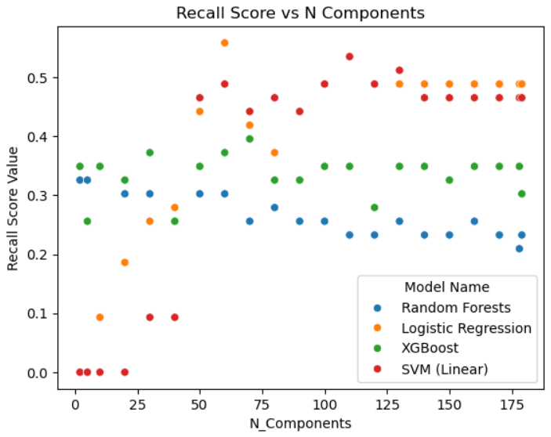
Experiments: Feature Transformations

Slide 18
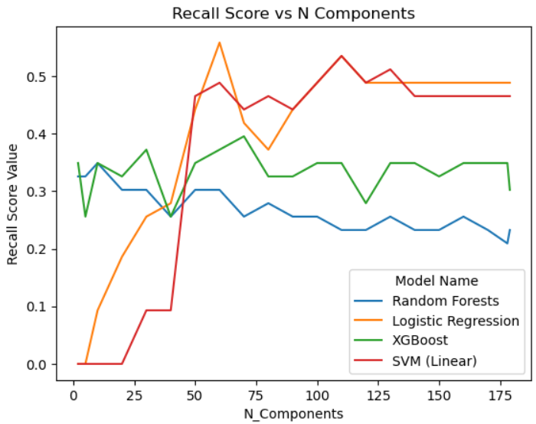
Experiments: Feature Transformations (line plot)

Slide 19
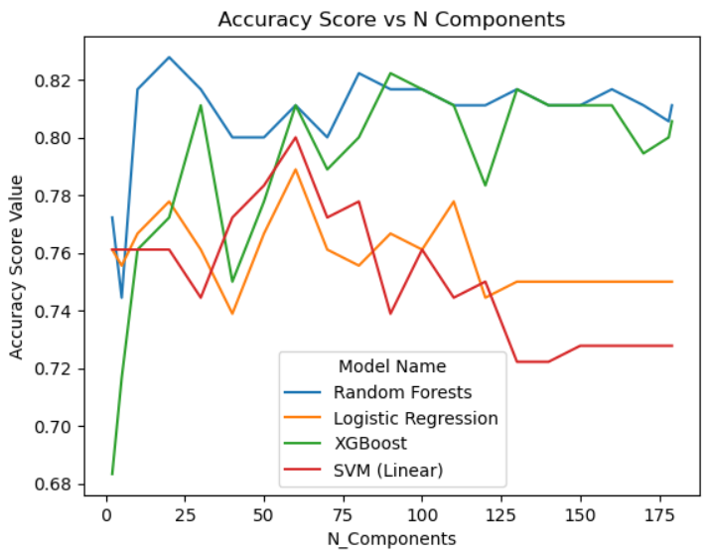
Experiments: Feature Transformations (line plot)

Slide 20
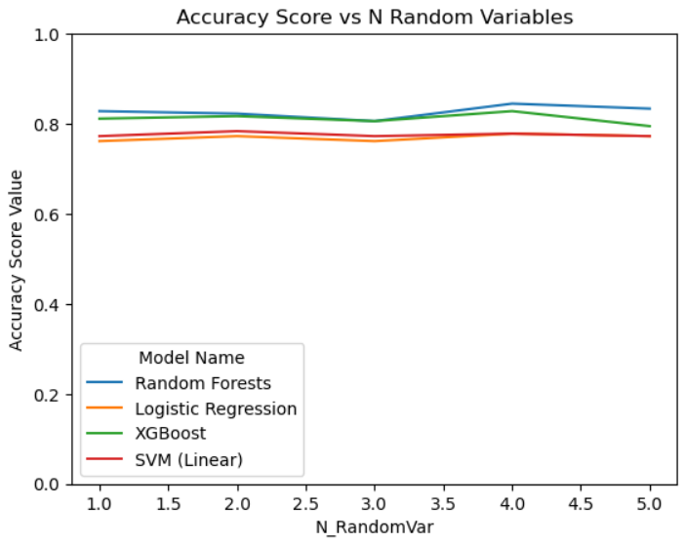
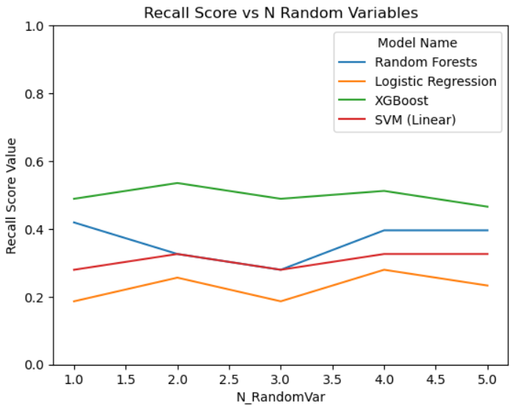
Experiments: Noise Introduction

Slide 21
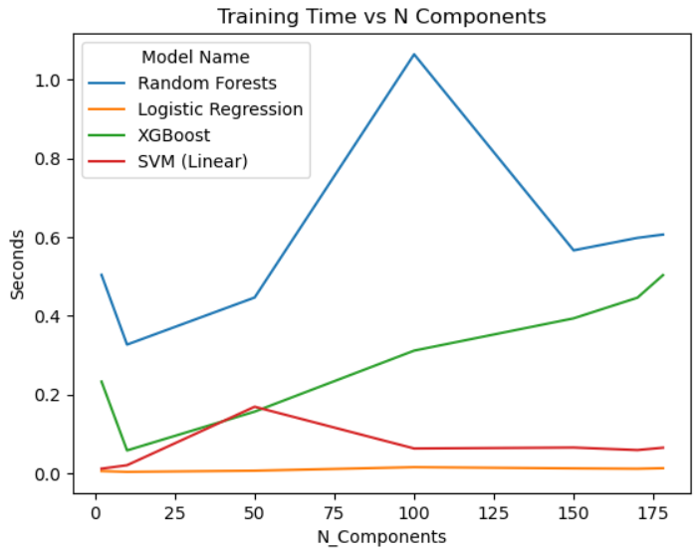
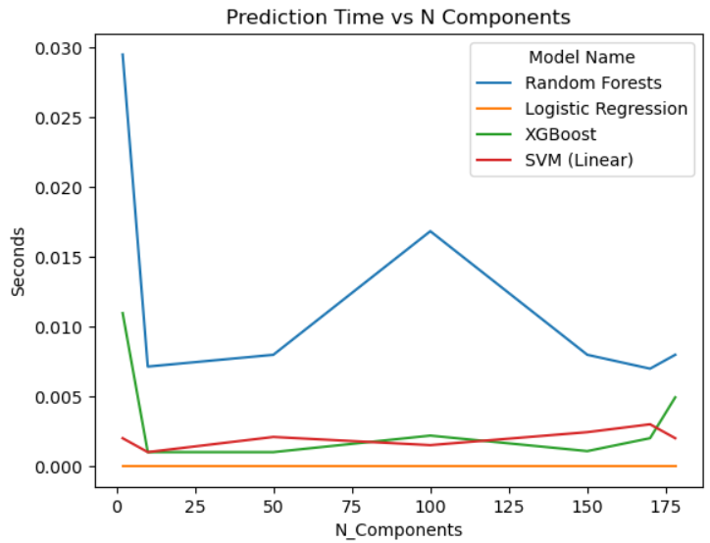
Experiments: Model Efficiency

Slide 22
Experiments: Model Efficiency

Slide 23
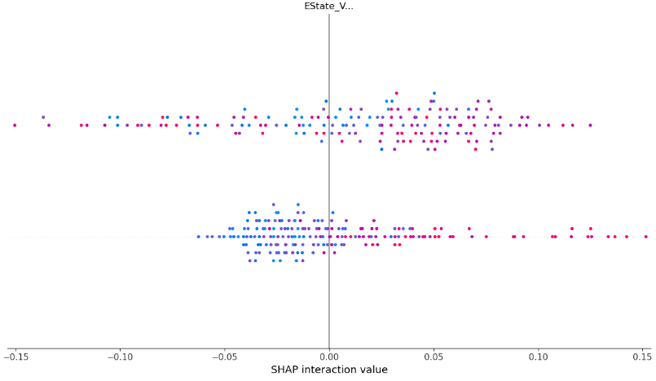
Model Interpretation (Difficulty)

Slide 24
Model Recommendation
Maximize recall without having accuracy dip below 0.75 (baseline)
Logistic polynomial and logistic PCA number of components = 60 had the highest recall scores (0.60 – 0.65) with accuracy rates above 0.75.
Keep in mind that logistic unscaled had a recall score of 0.0 (no true positives found).
SVM had a similarly high recall score around PCA number of components = 60 with a higher accuracy rate. Recall still lower than logistic regression.
XGBoost with ‘Interactions’ and ‘Domain-Derived’ features had a recall score of 0.60 with an accuracy above 0.81
Linear Discriminant analysis and xgboost are more consistent with unscaled recall scores of about 0.50.
Random Forests consistent, but relatively mid recall scores

Slide 25
Future Work
In real drug design, dataset would be thousands of rows and maybe hundreds-of-thousands of features
Domain-knowledge, exploration, feature grouping
Voting/Meta-Learner
Non-linear kernel PCA
More complicated pipeline, maybe use neural net
Leveraging more transformations, dimensionality reduction techniques

