Slide 1

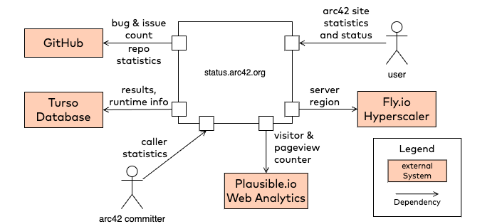
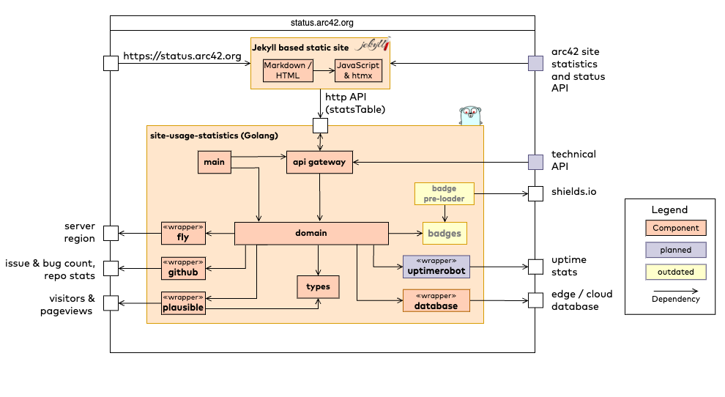
https://status.arc42.org
Jan. 2024
Aggregate usage data for visitors, pageviews, issues and bugs of all arc42 websites. Docu showcase.
show detailed statistics for all arc42 websites: Visitors, pageviews and totals
show issues/bug counters
store statistics in database
static site generator (Jekyll, Github pages) for main site
use plausible.io to collect usage data
use fly.io for deployment
use Golang to wrap statistics service
Markdown + plain HTML
Golang with packages
net/http, http/template
zerolog
htmx to perform DOM manipulation at runtime
fly.io for deployment
turso.tech as database
arc42 comitters
users of arc42 website(s)
web developers
accurate results
simple visualization
relevant numbers at a glance
Components / Modules
unknown user expectation

Slide 2
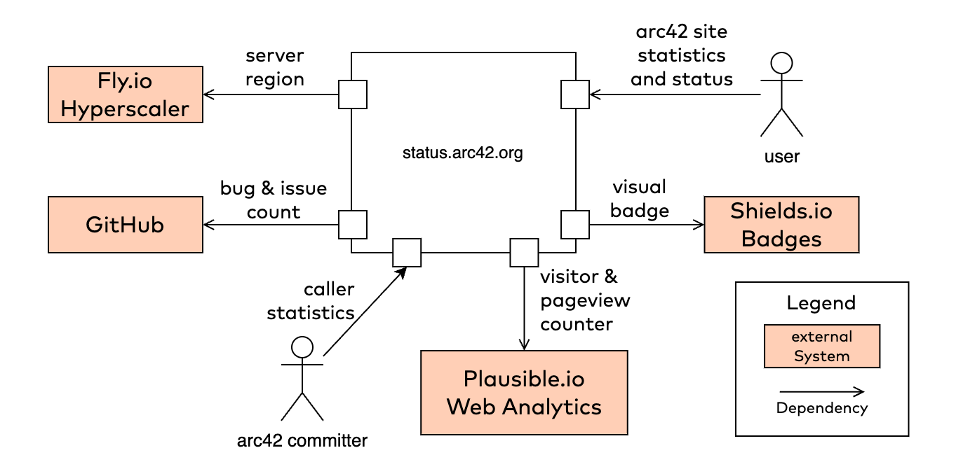
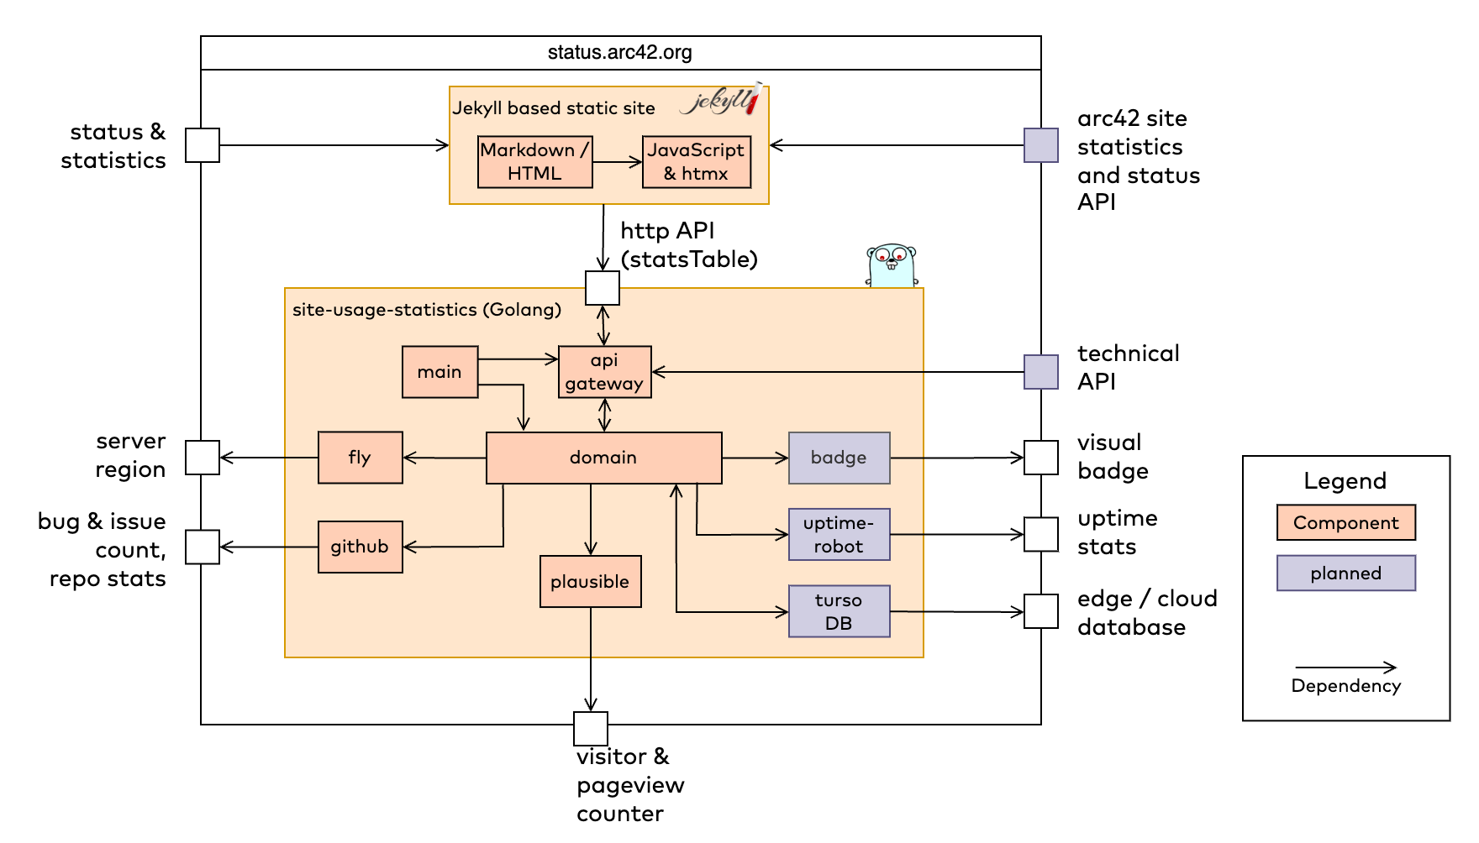
https://status.arc42.org
Dez. 2023
Aggregate usage data for visitors, pageviews, issues and bugs of all arc42 websites.
show detailed statistics for all arc42 websites: Visitors, pageviews and totals
show issues/bug counters
static site generator (Jekyll, Github pages) for main site
use plausible.io to collect usage data
use fly.io for deployment
use Golang to wrap statistics service
Markdown + plain HTML
Golang with packages
net/http, http/template
zerolog
htmx to perform DOM manipulation at runtime
fly.io for deployment
arc42 comitters
users of arc42 website(s)
web developers
deprecated
accurate results
simple visualization
relevant numbers at a glance
split in two different GitHub repos
Components / Modules
unknown user expectation

Slide 3
https://status.arc42.org
Nov. 2023
Show detailed aggregate statistics of visitors and pageviews of all arc42 websites.
show detailed statistics for all arc42 websites: Visitors, pageviews and totals
show issues/bug counters
static site generator (Jekyll, Github pages) for main site
use https:// plausible.io to collect usage data
use fly.io for deployment
use Golang to wrap statistics service
Markdown + plain HTML
Golang with packages
net/http, http/template
zerolog
htmx to perform DOM manipulation at runtime
fly.io for deployment
arc42 comitters
users of arc42 website(s)
web developers
deprecated
accurate results
simple visualization
all relevant data at a glance
just ONE slow request to create HTML table (>3500ms)
Components / Modules
unknown user expectation

