Slide 1

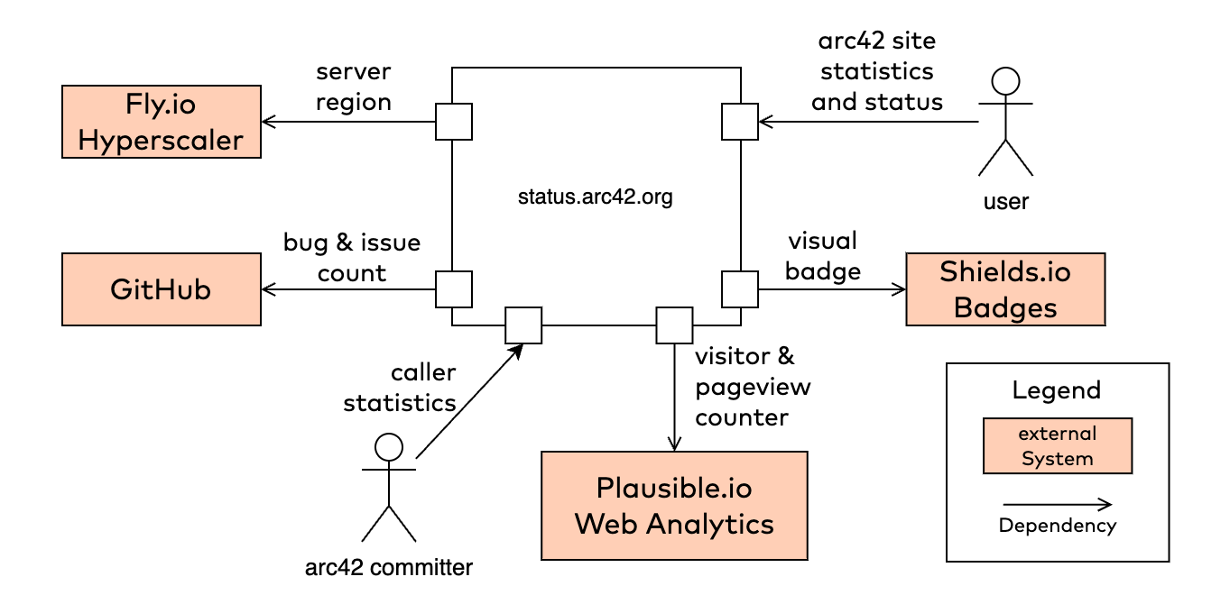
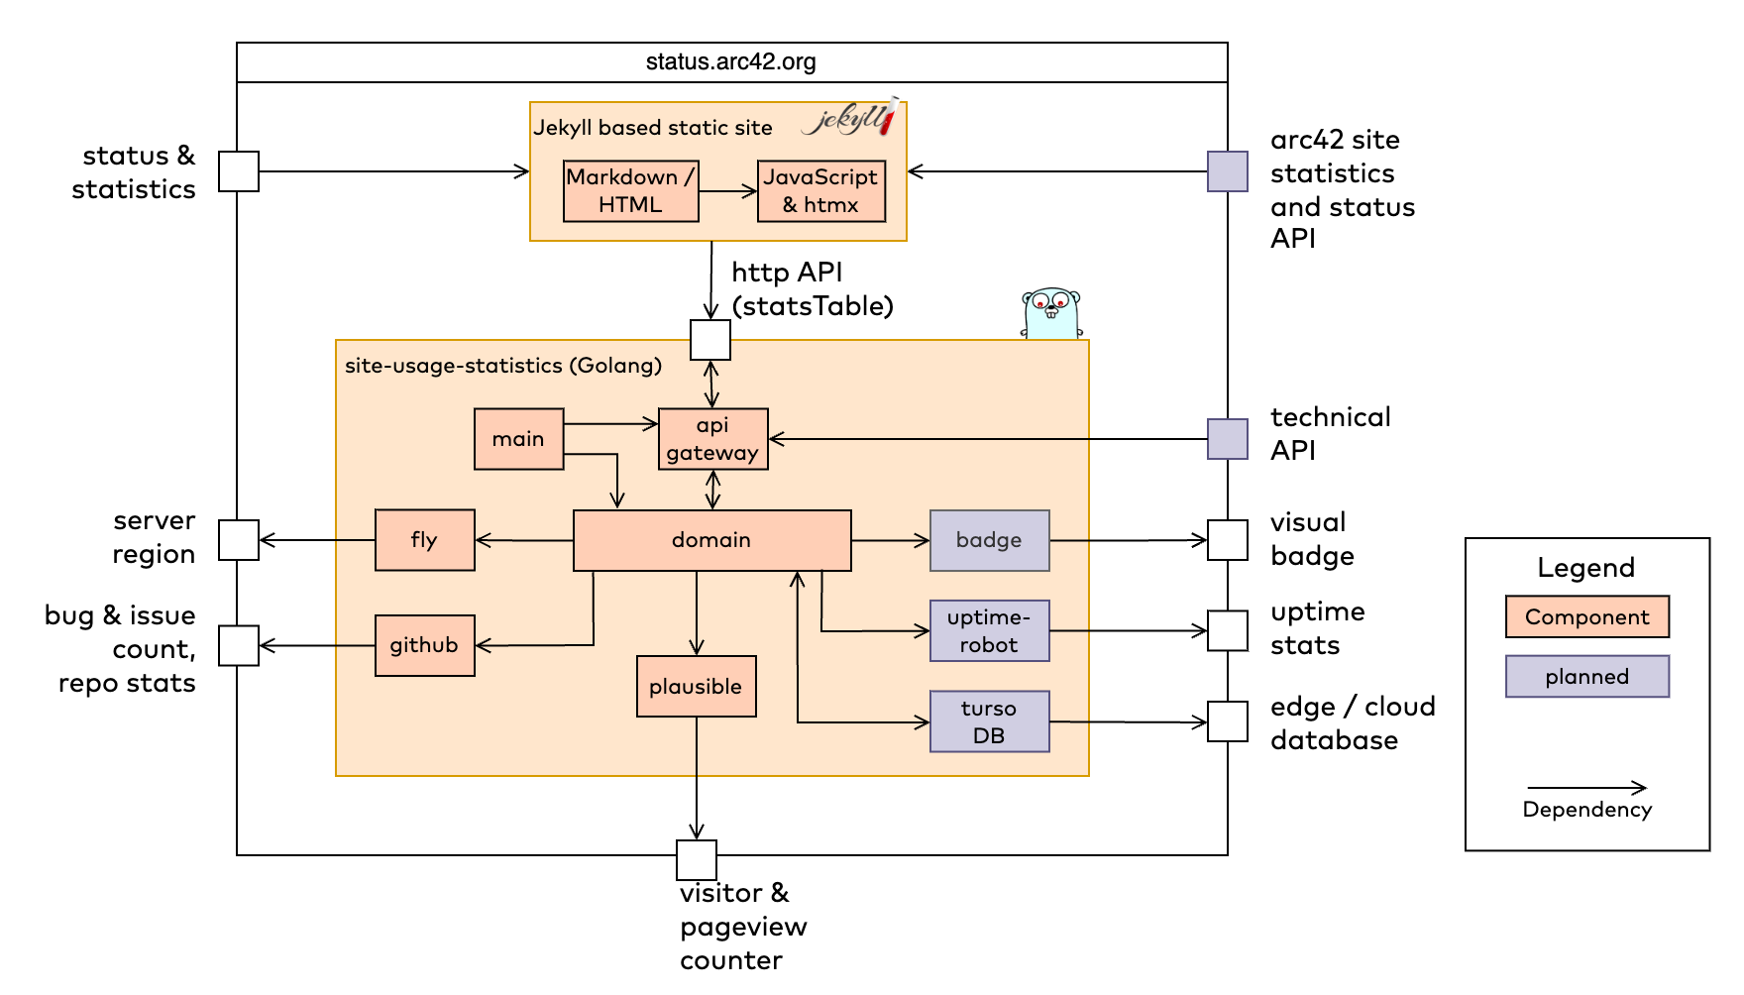
https://status.arc42.org
Dez. 2023
Aggregate usage data for visitors, pageviews, issues and bugs of all arc42 websites.
show detailed statistics for all arc42 websites: Visitors, pageviews and totals
show issues/bug counters
static site generator (Jekyll, Github pages) for main site
use plausible.io to collect usage data
use fly.io for deployment
use Golang to wrap statistics service
Markdown + plain HTML
Golang with packages
net/http, http/template
zerolog
htmx to perform DOM manipulation at runtime
fly.io for deployment
arc42 comitters
users of arc42 website(s)
web developers
accurate results
simple visualization
relevant numbers at a glance
split in two different GitHub repos
Components / Modules
unknown user expectation

Slide 2
https://status.arc42.org
Nov. 2023
Show detailed aggregate statistics of visitors and pageviews of all arc42 websites.
show detailed statistics for all arc42 websites: Visitors, pageviews and totals
show issues/bug counters
static site generator (Jekyll, Github pages) for main site
use https:// plausible.io to collect usage data
use fly.io for deployment
use Golang to wrap statistics service
Markdown + plain HTML
Golang with packages
net/http, http/template
zerolog
htmx to perform DOM manipulation at runtime
fly.io for deployment
arc42 comitters
users of arc42 website(s)
web developers
deprecated
accurate results
simple visualization
all relevant data at a glance
just ONE slow request to create HTML table (>3500ms)
Components / Modules
unknown user expectation

