Slide 1

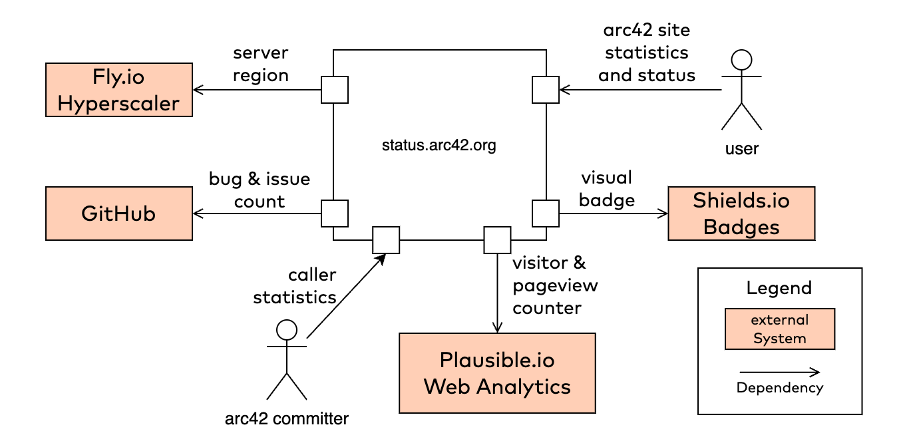
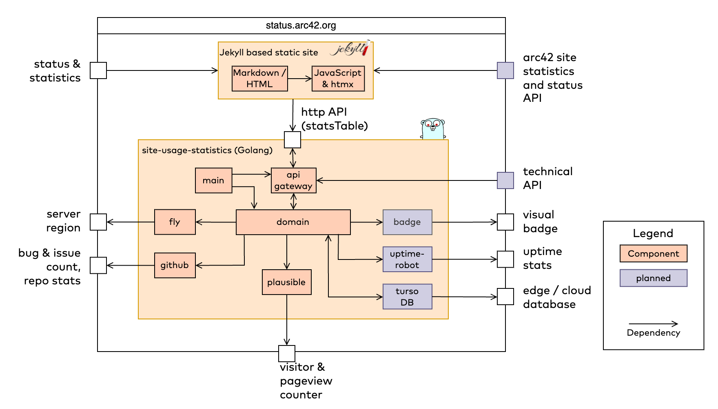
https://status.arc42.org
Nov. 2023
Show detailed aggregate statistics of visitors and pageviews of all arc42 websites.
show detailed statistics for every arc42 website (.de, .org, docs, faq, canvas, quality and status)
show issues/bug counters
static site generator (Jekyll, Github pages) for main site
use https:// plausible.io to collect usage data
use fly.io for deployment
use Golang to wrap statistics service
Markdown + plain HTML
Golang with packages
net/http, http/template
zerolog
htmx to perform DOM manipulation at runtime
fly.io for deployment
arc42 comitters
users of arc42 website(s)
web developers
accurate results
simple visualization
all relevant data at a glance
just ONE slow request to create HTML table (>3500ms)
Components / Modules
unknown user expectation

