Slide 1

Gun Violence IN America
By: Amanda Cantu, David Rojas, Jaime Hutton and Jodee Harris

Slide 2
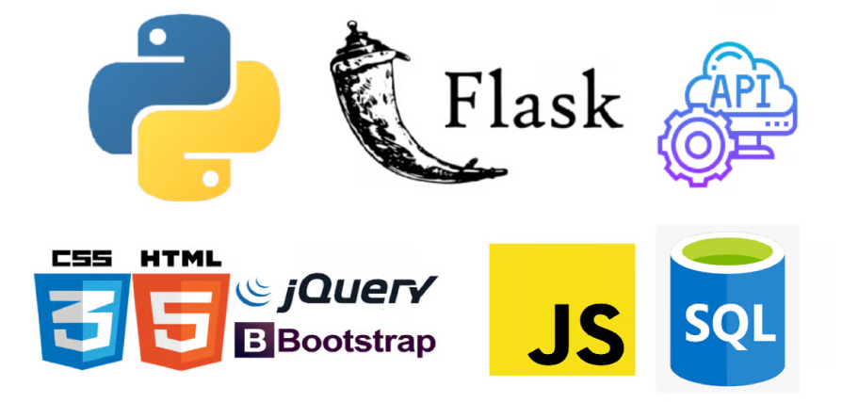
Contents
Purpose Statement
Database
HTML
Python Flask API
JavaScript GeoJson with Leaflet

Slide 3

Purpose
By creating a tool powered by a Python Flask API, HTML/CSS, JavaScript, and a Postgres database, the user can analyze the data of school shootings in the United States from 1999 to 2023. Considering the importance and reoccurrence of this issue, this tool is meant for public awareness.

Slide 4
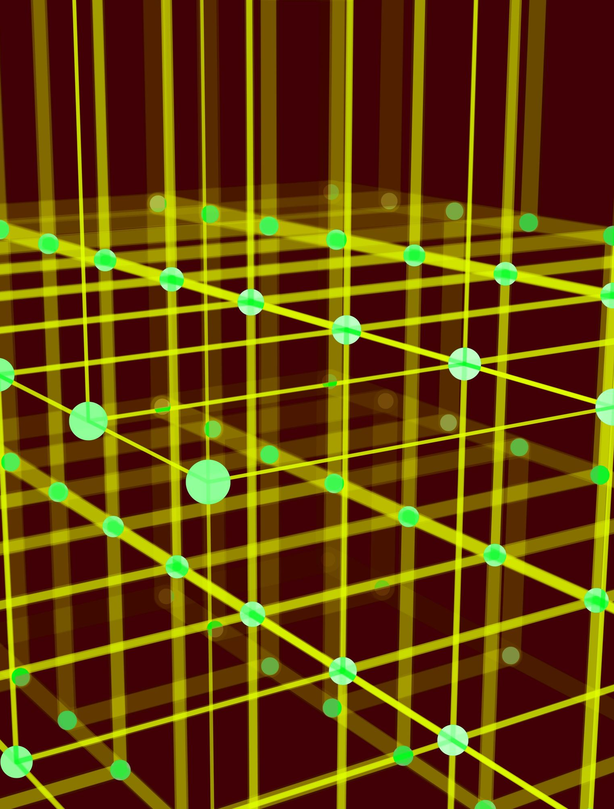
Database

Slide 5

HTML

Slide 6

Python Flask API

Slide 7

JavaScript GeoJson with Leaflet
Look in the slide notes below for topics to consider talking about
Notes:
Consider talking about:
Barrel
Projectile

Slide 8
Works cited
https://www.vectorstock.com/royalty-free-vector/simple-black-and-white-gun-vector-8614354 (Image- Slide 1)
https://www.upwork.com/services/product/development-it-python-flask-web-application-with-api-in-html-css-javascript-and-bootstrap-1467755780835794944 (Image- Slide 2)

