Slide 1
Data Challenge
Goal:
To estimate the number of X and Y chromosomes for each sample.
Data:
2 batch folders, each with 2 files:
1. Depth: average depth of each interval for each sample.
2. Interval_order: chromosome, start and end of the intervals in ‘Depth.csv’. The order of the rows in ‘Interval_order.csv’ file is the same as the order of the rows in ‘Depth.csv’ file in a given batch. Note that chromosomes X and Y are indexed as 23 and 24, respectively.

Slide 2
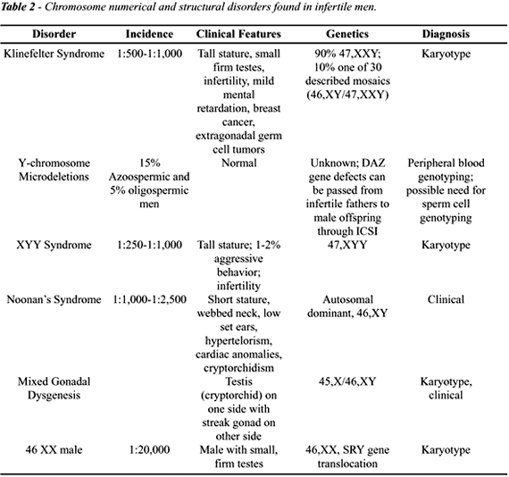
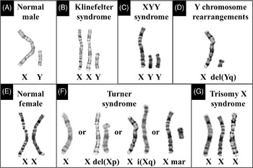
Background
Aneuploidy is defined as presence of an abnormal number of chromosomes in a cell. We perform this test as part of our fertility panel.
There are multiple X, Y chromosome aneulpoidy syndromes, some are associated with infertility.
https://www.cambridge.org
http://www.brazjurol.com.br/marco_2001/Nudell_105_119.htm

Slide 3
Methods
Here I used batch2 data as an example, same process for batch1. I combined several methods to give a final prediction. (Also see the code+report.Rmd markdown file)
Data visualization
PCA
Numeric predictor
A shiny app to further demonstrate regional losses on Y, which can be further explored with the shiny app.

Slide 4
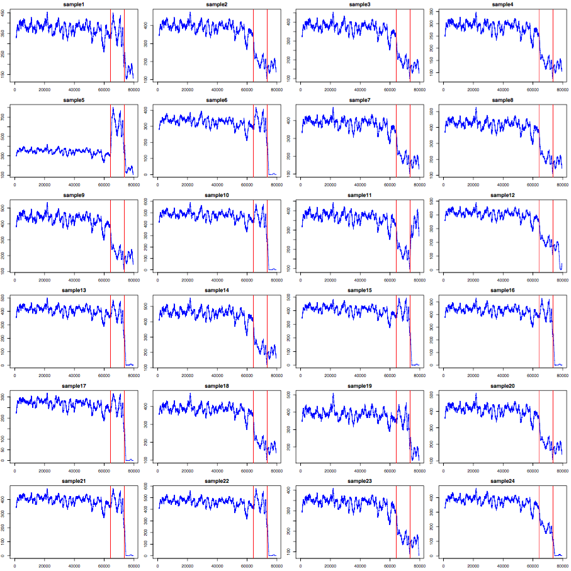
Results
Data visualization: chr 1-22 are diploidy, so XX genotype is expected to have similar read depth for X; and XY genotype is expected to have ½ read depth for X and Y each. Blue lines are moving average for depth. Red lines denote the regions for X, Y chromosomes.

Slide 5
Results
PCA: I used the top top 5000 intervals with highest variance. PC1and PC2 capture the most variance.
Together with previous visualization, we can roughly get copy number of X and Y
More X
X
XX
More Y
XY
2XY
X2Y

Slide 6
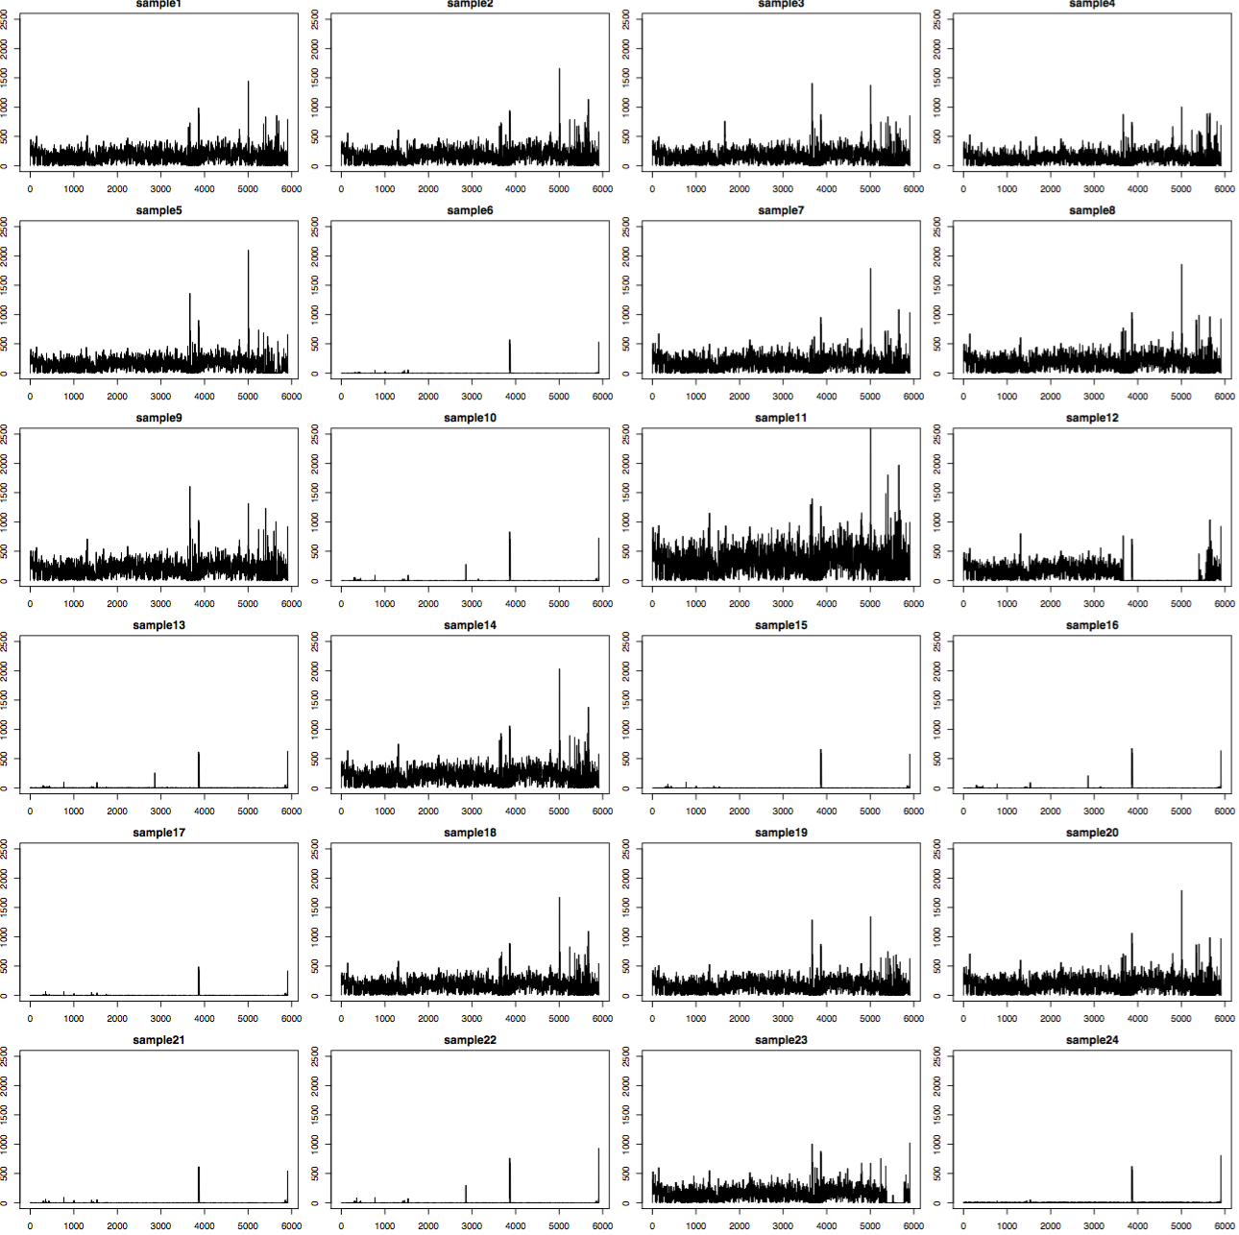
Results
Numeric predictor: I used mean(X-depth)/mean(chr1~22depth) to give a prediction. Not all prediction are close to integer, partially because some samples are with large loss
Together with visualization of Y to give a final prediction (Y- : with losses)

Slide 7
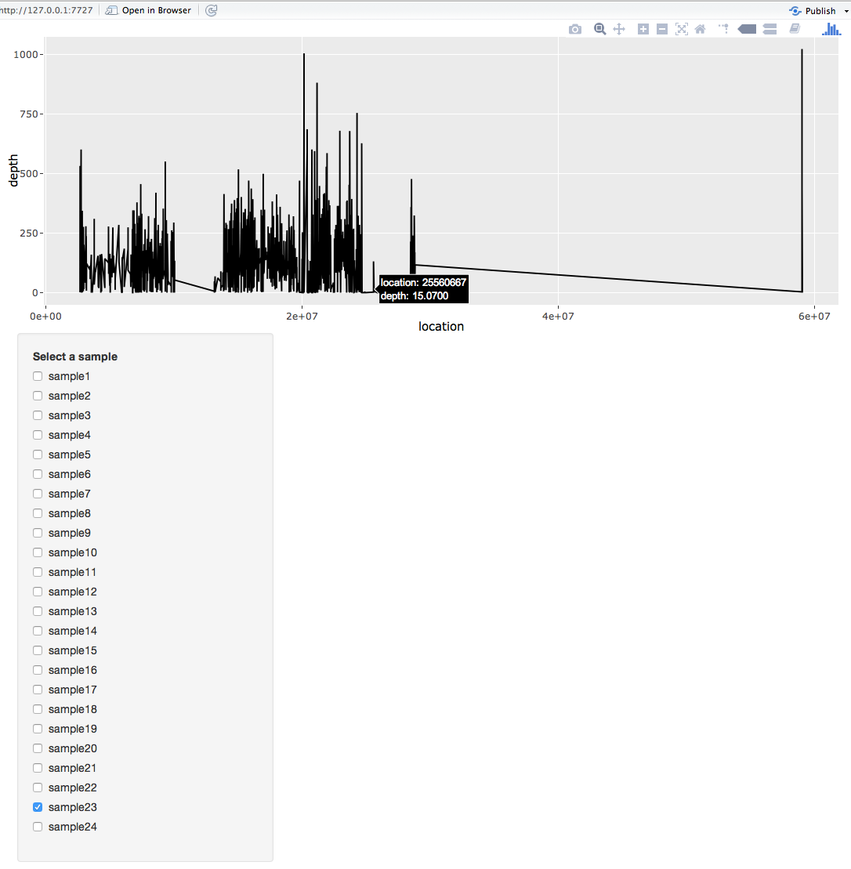
A shiny app
A shiny app was made to interactively visualize Y chromosome, one can locate exact regions with losses.

Slide 8
Results: batch1
For batch1 (sample 12, 15 and 17 actually have small pieces of Y)

Slide 9
Improvement
Given time, rather than taking X and Y chromosome as a whole, more complex method can be developed to take into account regional loss of Y so as to give more precise copy number prediction. It might also be helpful to remove the extreme values, log transfer depth, which is somewhat skewed, and perform normalization across samples.
Given bigger data sets, more sophisticated methods can be applied to get regional aneuploidy information.

