Slide 1

CROSSPLATFORM DEVELOPMENT WITH .NET
👨‍💻 Arcadio Garcia
🐤 arcadio_g_s
✉ arcadiog

Slide 2
Before we start…
What this talk IS NOT about:
Learning to code in C#
Learning to make console, Windows or Xamarin apps in depth
What this talk IS about:
Get a bird’s-eye view of:
What is .NET
What can be accomplished with it
Learn how to get started
Get inspiration

Slide 3
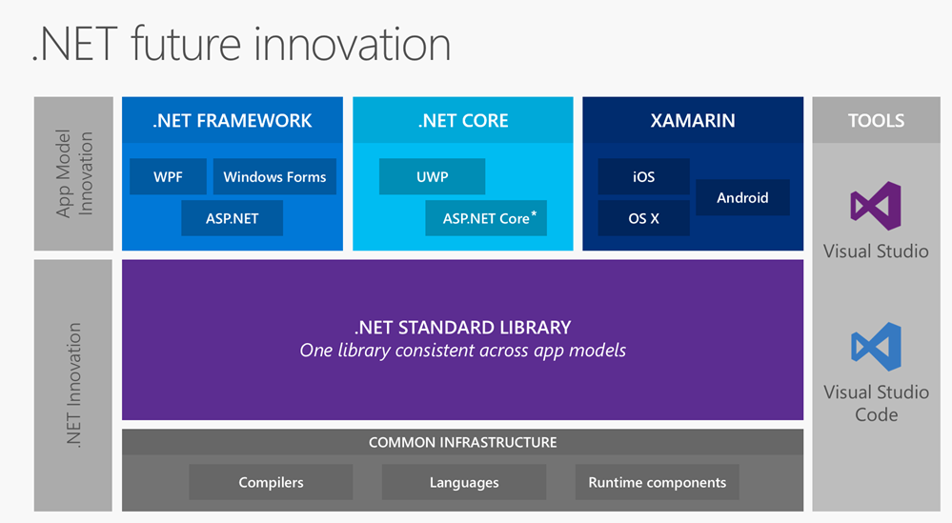
Some definitions
C#
.NET
.NET Standard
.NET Core

Slide 4
Demo time

Slide 5
Library (.NET Core)
.NET Core app
Windows
Linux
Windows app
Windows
Xamarin app
Android
iOS
Windows
Xbox
…
OSX

Slide 6
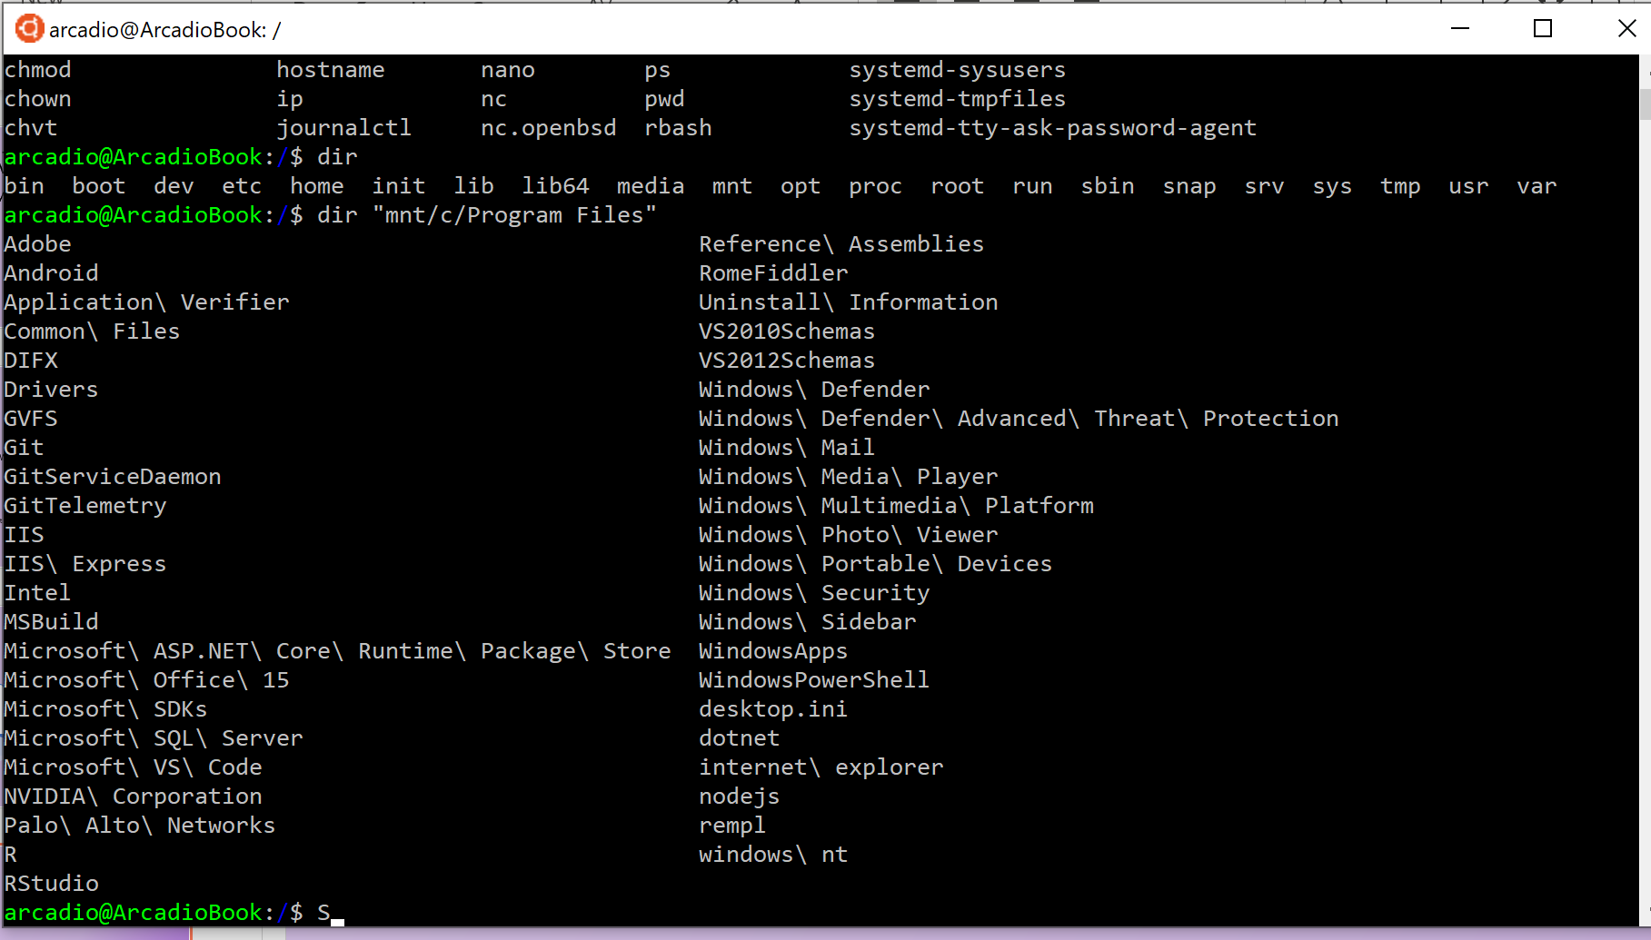
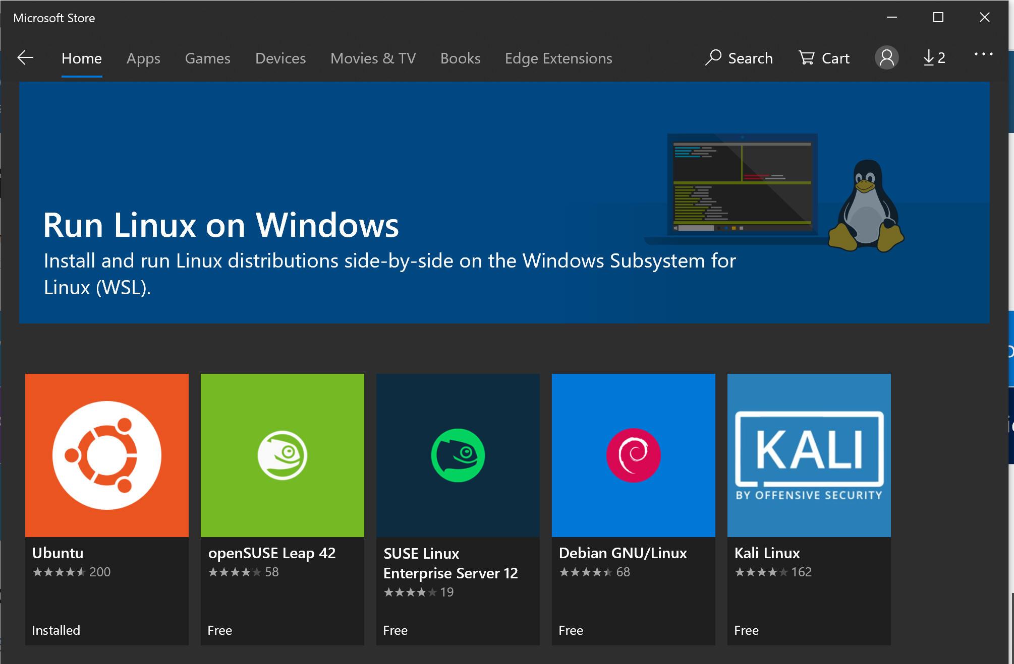
Windows Subsystem For Linux

Slide 7
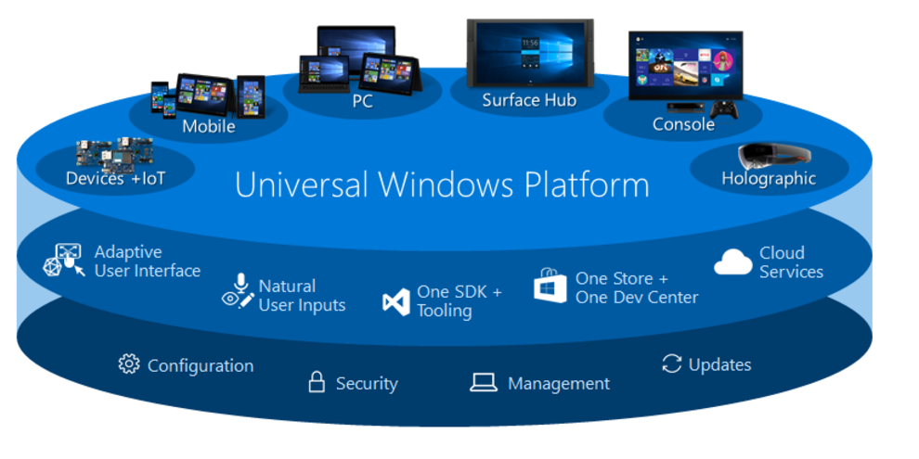
Universal Windows Platform

Slide 8
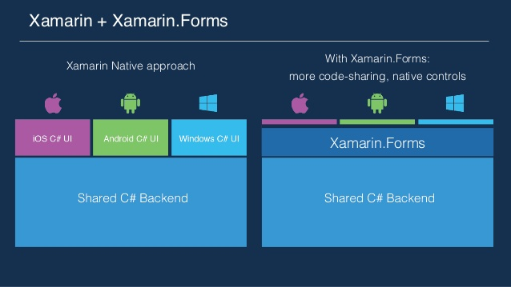
Xamarin

Slide 9
Some resources to get started
https://github.com/arcadiogarcia/DotNetStandardDemo
https://docs.microsoft.com
https://channel9.msdn.com/

