Slide 1


Explore EXPANDER Bootcamp – Q1 - 25
Team
Arcadio Garcia

Slide 2
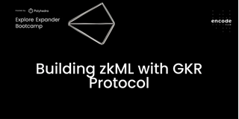
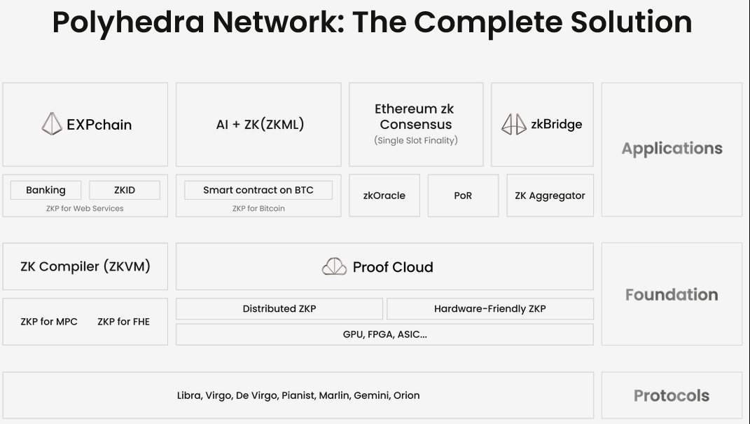
Bounty Track
Building zkML with GKR Protocol

Slide 3
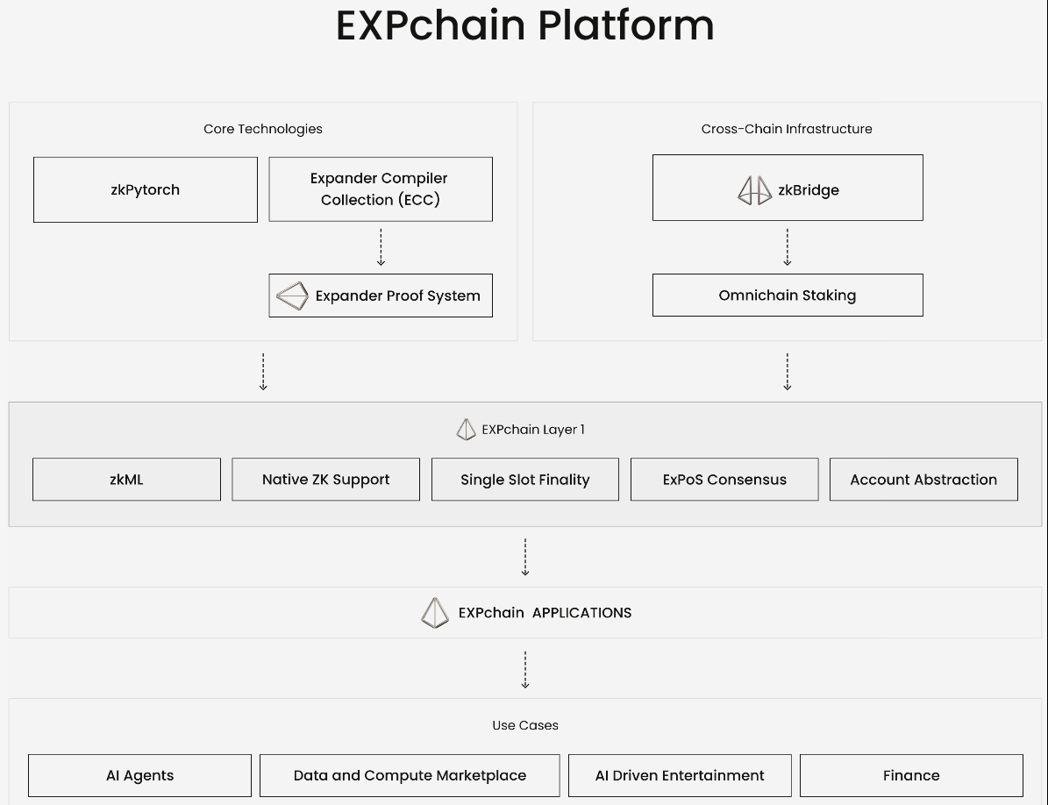
EXPchain Platform
https://expchain.ai/

Slide 4
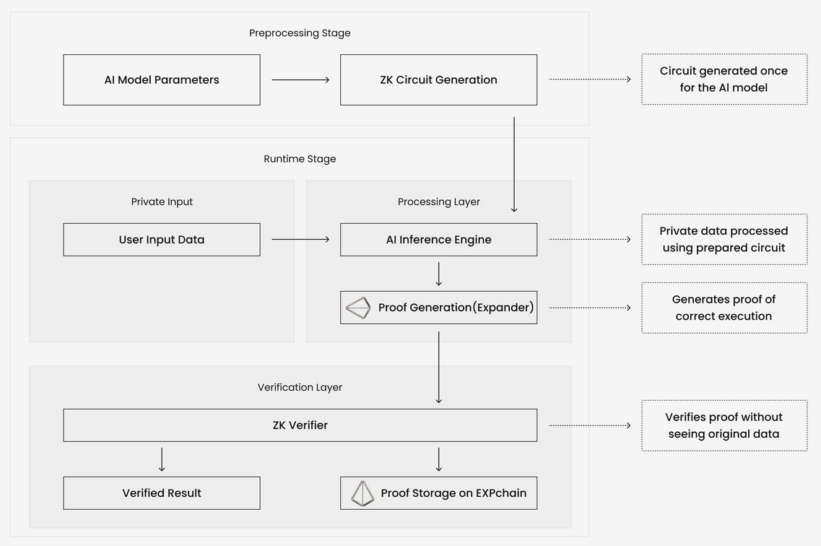
Technology Stack
Zero-Knowledge Machine Learning (zkML)
https://docs.polyhedra.network/litepaper/#3-technology-stack

Slide 5
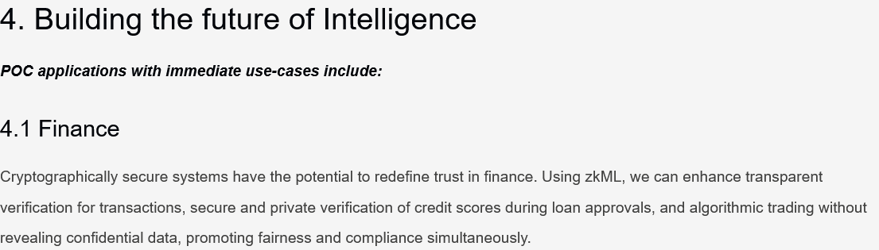
PoC – Proof of Concept >>> Summary / Purpose
Building zkML with GKR Protocol
https://docs.polyhedra.network/litepaper/#3-technology-stack
https://docs.polyhedra.network/litepaper/#3-technology-stack

Slide 6
Project Statement
Private Credit Score for Defi loans
SUMMARY
Defi loans necessitate substantial collateral. This project introduces private credit scoring, which allows for lower scoring requirements.
Simple Concept A:
A straightforward implementation would verify if a user has any scoring data to qualify for a loan with less than 100% collateral; otherwise, it would demand 110%.

Slide 7
Team tasks distribution

Slide 8
Process workflow
In a typical workflow:
Implement the circuit in our circuit frontend language RUST.
Use ExpanderCompilerCollection to compiler the circuit into layered circuit.
Use Expander prover to generate and verify proofs. You may also use integrated prover inside the compiler.

Slide 9
Process
Find an ML model (the simpler the better)
Export the ML model to ONNX
Generate a circuit with a proof a prediction
Use the circuit in ECC (can this be made compatible)
Smart contract to validate onchain
[optional] have a trading bot to validate the idea

Slide 11



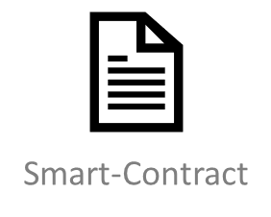
Verifier
Prover
Smart-Contract

