Slide 1
SYMBIOSIS STATISTICAL INSTITUTE [SSI]
Applied Probability Distributions (THM6242) — Internal Component IV
Empirical Characterization & Probabilistic Modeling
of Price Formation, Volatility & Spike Dynamics
in the Indian Electricity Market (IEX)
Author / Candidate: Group 05 / Student PRN | M.Sc. Applied Statistics & Data Science (SEM-I)
Subject Teacher & Guide: Dr. Monika Vishnoi, Assistant Professor, SSI
Associated Capstone Repo: https://github.com/arcanekrishna/energy

Slide 2
SYMBIOSIS STATISTICAL INSTITUTE | THM6242
The Real-Life Problem: Non-Storability & Renewable Intermittency
• Physical Nature of Electricity: Electric power cannot be economically stored at grid scale; generation must continuously match demand every single second to maintain grid frequency at 50 Hz.
• The Solar Duck Curve Challenge: India's massive solar rollout creates huge daytime generation surplus (Blocks 40–60), collapsing prices. But when solar drops at sunset, net demand ramps up by >25,000 MW within 90 minutes.
• Evening Ramp Stress & Price Spikes: Thermal power plants face ramp-rate physical limits and hydro is seasonally constrained. As a result, Real-Time Market (RTM) clearing prices explode to the regulatory ceiling.
• Central Electricity Regulatory Commission (CERC) Price Ceiling: Order No. 4/SM/2022 imposes a hard regulatory price cap of ₹10,000/MWh, truncating the natural continuous distribution.
• Breakdown of Gaussian Financial Assumptions: Traditional Normal distribution assumptions fail completely. We need rigorous probability models to handle heavy tails, overdispersed spike counts, and regulatory boundaries.
THM6242: Applied Probability Distributions | Guide: Dr. Monika Vishnoi | SSI Batch 2026-28

Slide 3
SYMBIOSIS STATISTICAL INSTITUTE | THM6242
Research Objectives: Comprehensive Syllabus Mapping
Unit 1: Expectation and Conditional Expectation Derive and verify the Law of Iterated Expectations E[E[Y|X]] = E[Y] and the Law of Total Variance Var(Y) = E[Var(Y|X)] + Var(E[Y|X]) using Day-Ahead Market imbalance regimes.
Unit 2: Discrete Distributions (Count Process) Model the daily count of extreme price spikes (K: blocks >= ₹7,000/MWh). Formulate Poisson vs. Negative Binomial from scratch to test for overdispersion.
Unit 2: Continuous Distributions (Price Densities) Derive and fit Two-Parameter Gamma and Weibull densities on positive wholesale clearing prices using Method of Moments and Maximum Likelihood (digamma inversion).
Unit 3: Sampling Distributions (χ², t, F) Implement Pearson's Chi-Square Goodness-of-Fit test from first principles. Conduct Welch's t-test for Solar vs. Evening regimes, and F-test for variance equality.
Unit 4: Order Statistics & Central Limit Theorem Derive the distribution of daily peak price X_(96) = max_{1<=i<=96} X_i. Demonstrate Gaussian convergence of portfolio procurement sums via Monte Carlo CLT simulation.
Unit 5: Open-Source Software & From-Scratch Protocol Write all primary estimation, testing, and simulation routines in native NumPy; use scipy.stats solely for benchmark cross-verification.
THM6242: Applied Probability Distributions | Guide: Dr. Monika Vishnoi | SSI Batch 2026-28

Slide 4
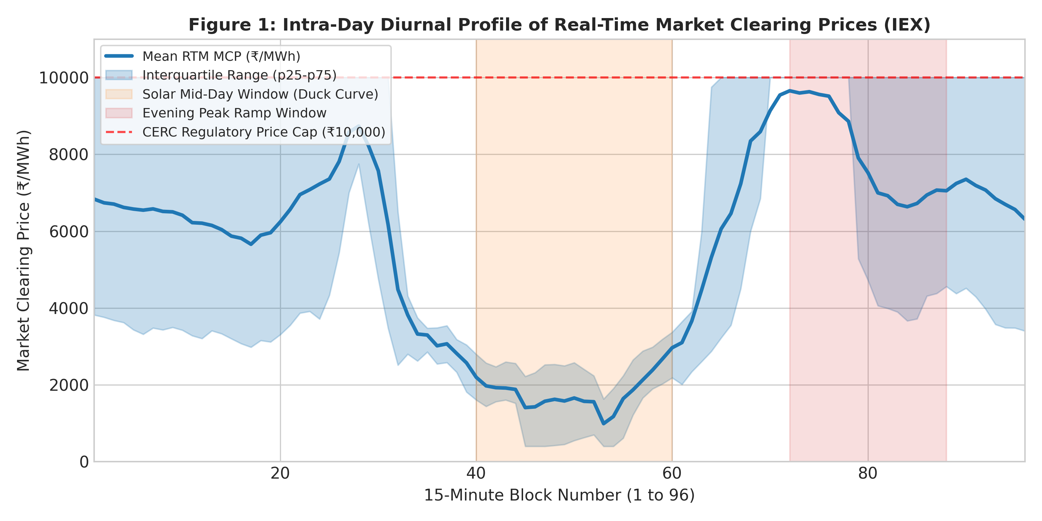
SYMBIOSIS STATISTICAL INSTITUTE | THM6242
Dataset & Exploratory Analysis (2,916 Synchronized Blocks)
• Source: Indian Energy Exchange (IEX) & Grid-India (NLDC).
• Scope: 2,916 fifteen-minute blocks (31 days: Oct 03 – Nov 02, 2026).
• Key Variables: dam_mcp, rtm_mcp, dam_purchase_bid_mw, dam_sell_bid_mw.
• Summary Moments: Mean x̄ = ₹5,596.76/MWh | Std s = ₹3,529.69/MWh | Variance s² = 12.46 × 10⁶.
• Skewness & Kurtosis: Skewness g₁ = +0.235 (Right-tailed) | Kurtosis g₂ = -1.571 (Platykurtic/Bimodal).
• CERC Price Cap Saturation: 828 blocks (28.40% of all intervals) clear at the exact statutory ceiling of ₹10,000/MWh.
THM6242: Applied Probability Distributions | Guide: Dr. Monika Vishnoi | SSI Batch 2026-28

Slide 5
SYMBIOSIS STATISTICAL INSTITUTE | THM6242
Hand-Solved Numerical Example (SSI Rubric Requirement)
Mini-Sample: S = {2500, 3200, 4800, 7500, 10000} ₹/MWh (n = 5 representative observations)
1. Sample Moments: Mean x̄ = 28,000 / 5 = 5,600.0 ₹/MWh | Sum of Squared Deviations ∑(x_i - x̄)² = 38,980,000 | s² = 38,980,000 / 4 = 9,745,000.0 (s = 3,121.70)
2. Method of Moments (Gamma): α̂_MoM = x̄² / s² = (5,600)² / 9,745,000 = 3.2181 | Scale θ̂_MoM = s² / x̄ = 9,745,000 / 5,600 = 1,740.18 ₹/MWh
3. Law of Iterated Expectations: Partition S by T = 5000: Low {2500, 3200, 4800} (n=3, mean=3,500) and High {7500, 10000} (n=2, mean=8,750).
E[E[X|G]] = (3/5 × 3,500) + (2/5 × 8,750) = 2,100 + 3,500 = 5,600.0 ₹/MWh (Exact match to x̄!)
4. Chi-Square Goodness-of-Fit Hand Table: 3 Bins: [0, 4000), [4000, 7000), [7000, 12000]. Observed O = [2, 1, 2]. Hypothesized Expected E = [1.75, 1.75, 1.50].
χ² = (2 - 1.75)²/1.75 + (1 - 1.75)²/1.75 + (2 - 1.50)²/1.50 = 0.0357 + 0.3214 + 0.1667 = 0.5238 < χ²_crit(df=2) = 5.991.
THM6242: Applied Probability Distributions | Guide: Dr. Monika Vishnoi | SSI Batch 2026-28

Slide 6
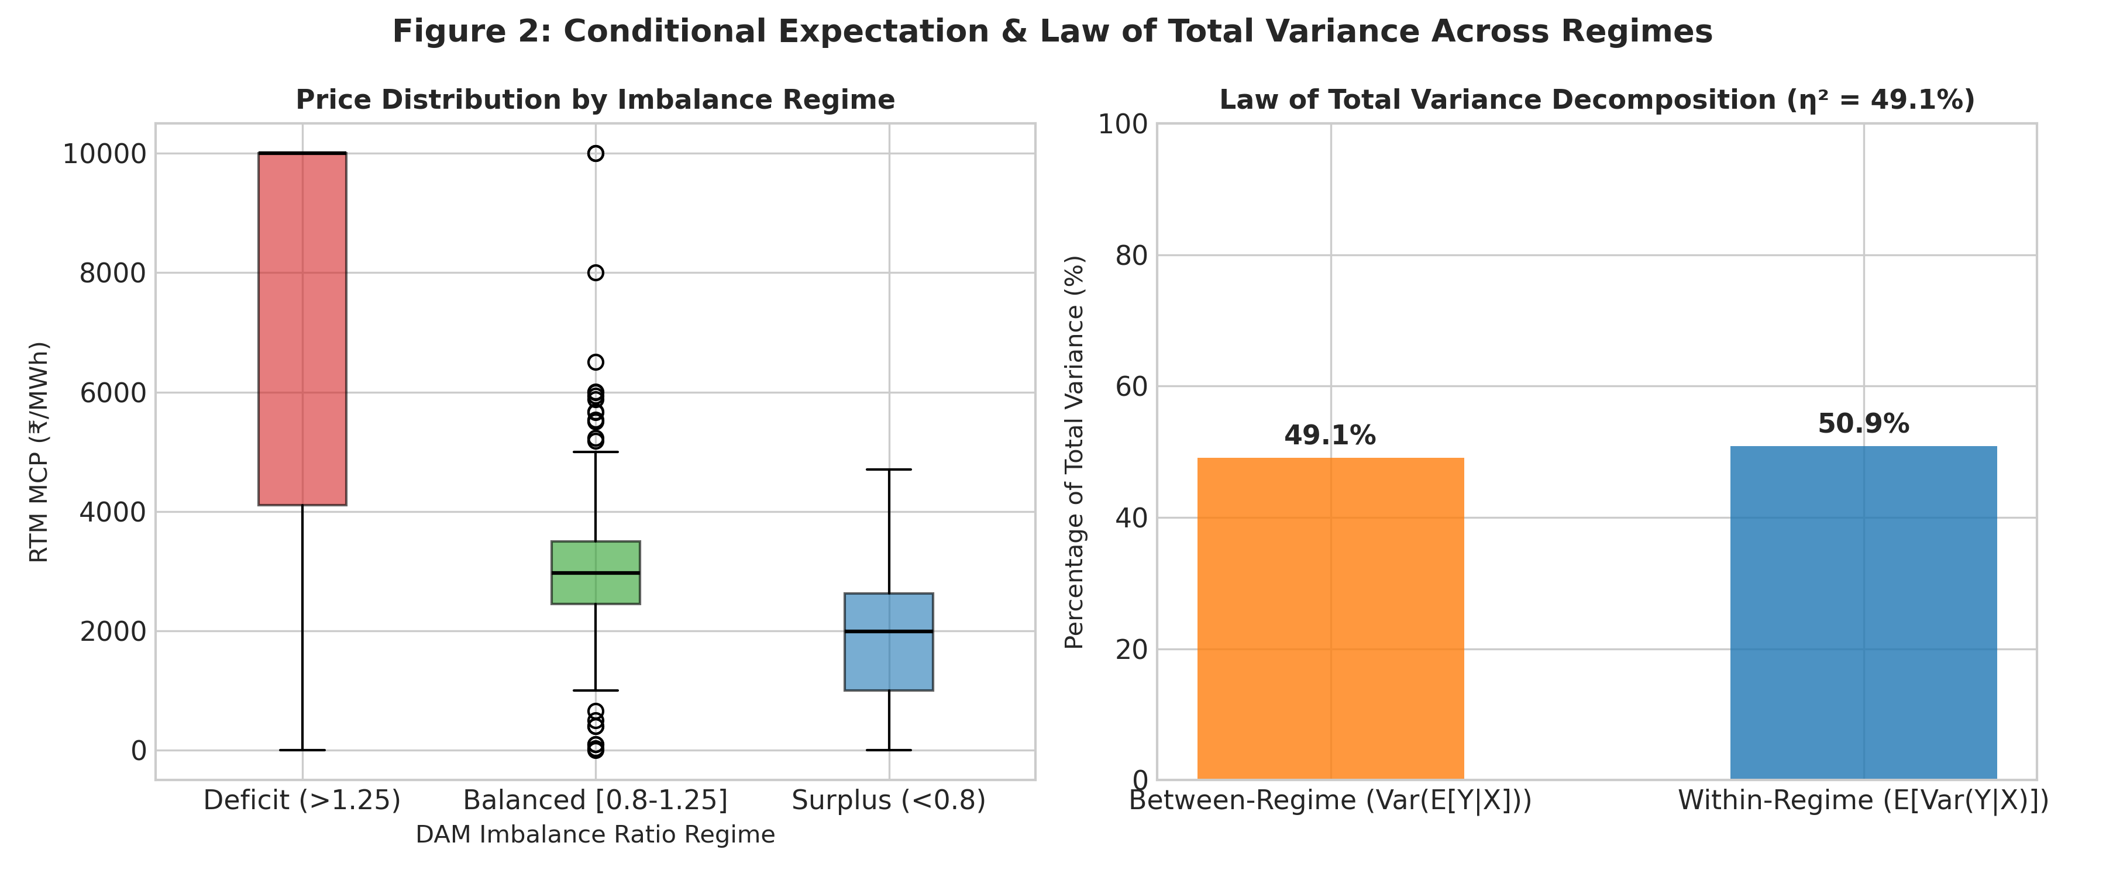
SYMBIOSIS STATISTICAL INSTITUTE | THM6242
Unit 1: Expectation, Conditional Expectation & Total Variance
• Conditioning Variable: Day-Ahead Market Imbalance Ratio R = DAM Purchase / DAM Sell.
• Deficit Regime (R > 1.25): N = 1,885 (64.6%) | E[Y|X] = ₹7,408.81/MWh | Std = ₹3,030.66
• Balanced Regime [0.8, 1.25]: N = 398 (13.7%) | E[Y|X] = ₹2,993.12/MWh | Std = ₹1,080.06
• Surplus Regime (R < 0.8): N = 633 (21.7%) | E[Y|X] = ₹1,837.72/MWh | Std = ₹1,065.62
• Law of Total Variance: Total Var = 12,454,420 (₹/MWh)²
E[Var(Y|X)] = 6,339,197 (50.90% Within-Regime)
Var(E[Y|X]) = 6,115,223 (49.10% Between-Regime)
• Physical Meaning (η² = 49.1%): Nearly half of all real-time price variance is already locked into day-ahead bid queues!
THM6242: Applied Probability Distributions | Guide: Dr. Monika Vishnoi | SSI Batch 2026-28

Slide 7
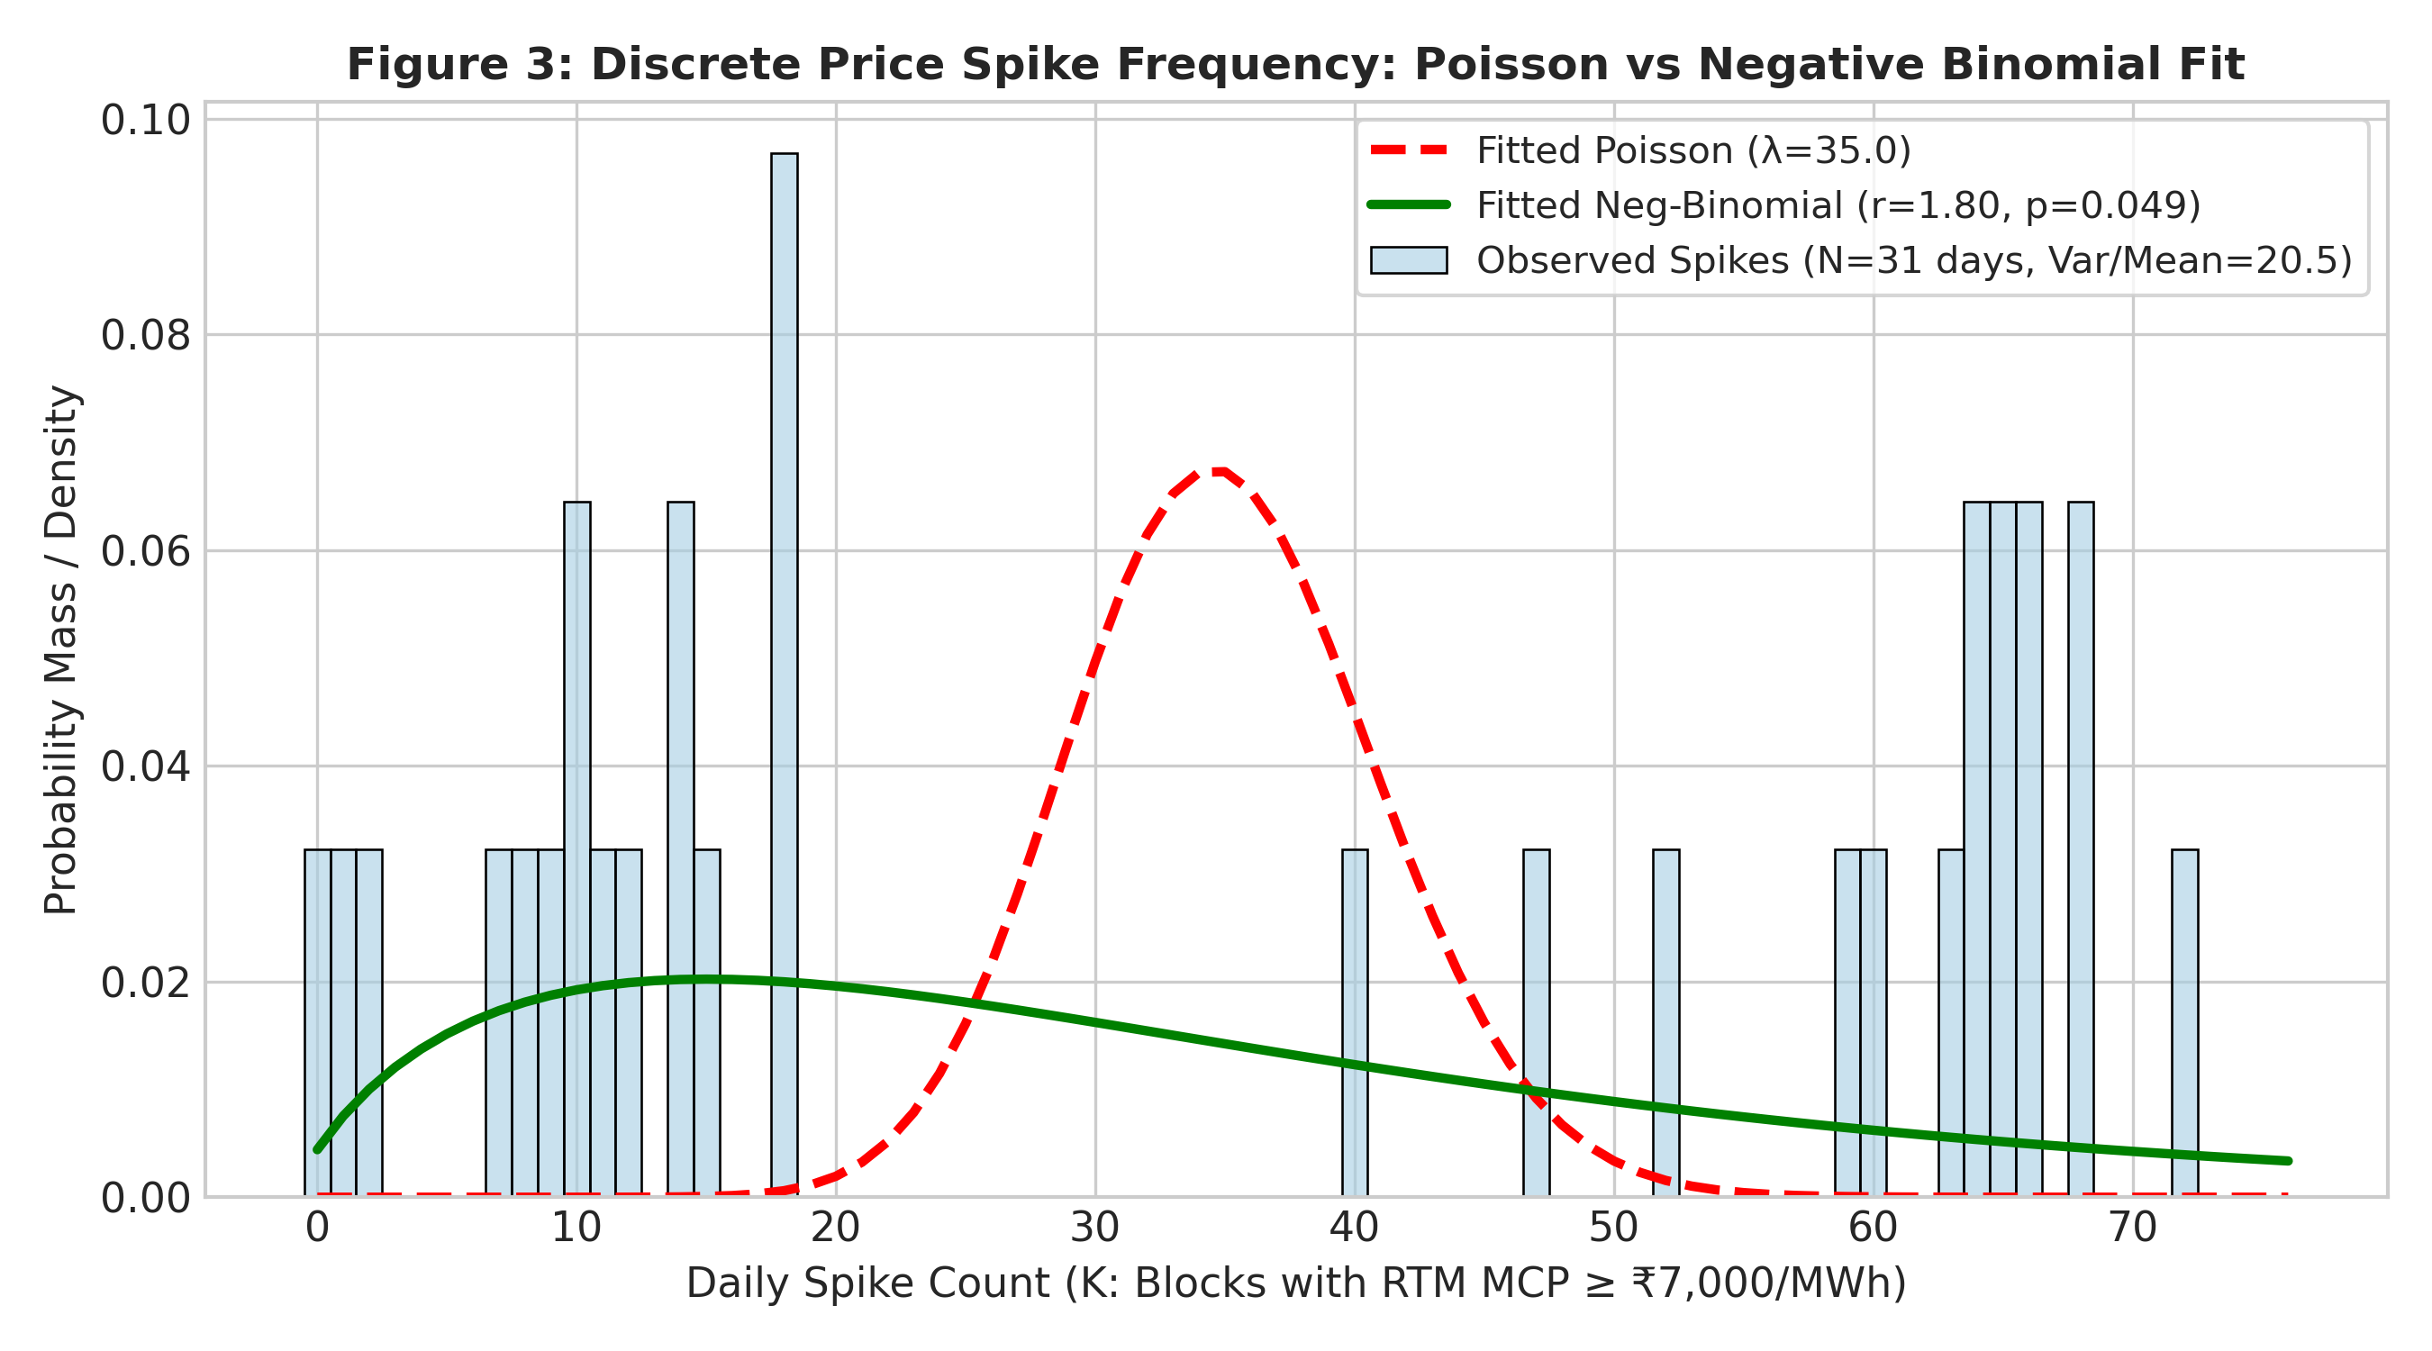
SYMBIOSIS STATISTICAL INSTITUTE | THM6242
Unit 2: Discrete Distribution Modeling — Poisson vs. Negative Binomial
• Random Quantity: Daily spike count K = ∑ 𝕀(P_RTM >= ₹7,000/MWh) across 96 blocks (D = 31 days).
• Empirical Moments: Mean k̄ = 35.032 spikes/day | Variance s_k² = 718.566.
• Overdispersion Diagnosis: Dispersion Ratio = s_k² / k̄ = 20.512 >> 1.0 (Severe Overdispersion!).
• Poisson Model Failure: Poisson assumes Var = Mean = 35.032. It fails catastrophically because price spikes are clustered during evening ramp hours.
• Negative Binomial Success: Method of Moments from scratch:
p̂ = k̄ / s_k² = 0.0488 | r̂ = k̄² / (s_k² - k̄) = 1.795.
Theoretical Variance = 718.566 (Exact match).
THM6242: Applied Probability Distributions | Guide: Dr. Monika Vishnoi | SSI Batch 2026-28

Slide 8
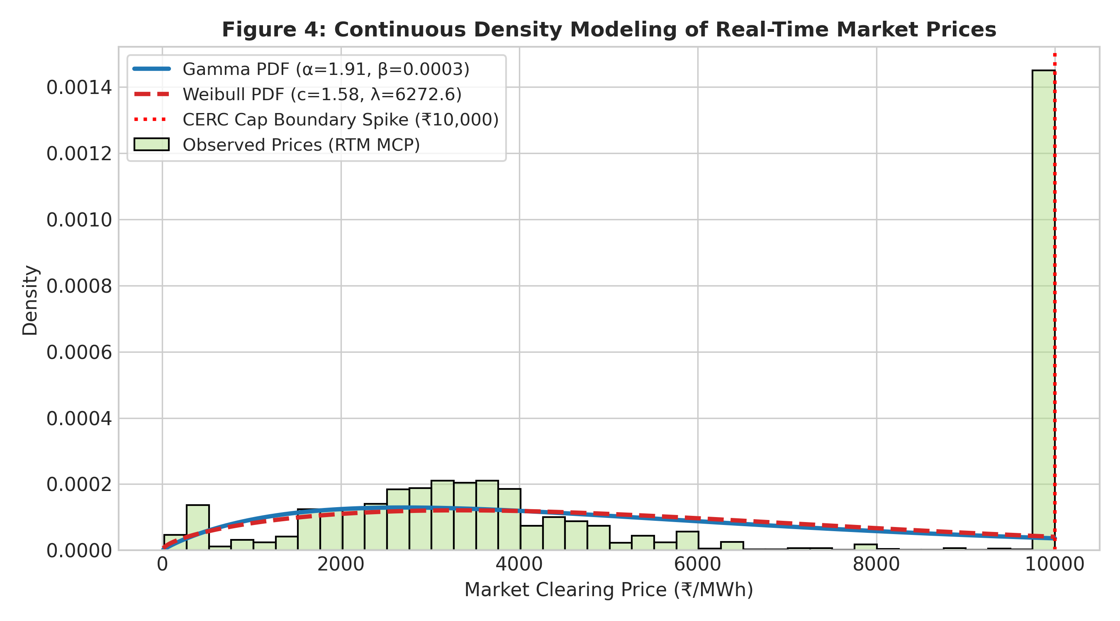
SYMBIOSIS STATISTICAL INSTITUTE | THM6242
Unit 2: Continuous Distribution Modeling — Gamma vs. Weibull
• Dataset: Positive clearing prices (P > 10, N = 2,887 blocks, x̄ = ₹5,652.88, s = ₹3,501.99).
• Scratch Gamma MoM: α̂ = x̄² / s² = 2.6052 | θ̂ = s² / x̄ = 2,169.86 ₹/MWh.
• Scratch Gamma MLE: Solved ln α - ψ(α) = ln x̄ - (1/N)∑ln x_i via Brent root-finding:
Shape α̂ = 1.9144 | Scale θ̂ = 2,952.85 ₹/MWh.
• SciPy Cross-Verification: stats.gamma.fit() yields α̂ = 1.9144, θ̂ = 2,952.85 (|Discrepancy| < 10⁻⁸).
• Weibull MLE Benchmark: Shape ĉ = 1.5831 | Scale λ̂ = 6,272.61 ₹/MWh.
• Physical Truncation Spike: Both densities fit the interior spread, but CERC ₹10,000 regulatory ceiling forces point-mass accumulation at the upper boundary.
THM6242: Applied Probability Distributions | Guide: Dr. Monika Vishnoi | SSI Batch 2026-28

Slide 9
SYMBIOSIS STATISTICAL INSTITUTE | THM6242
Unit 3: Pearson's Chi-Square Goodness-of-Fit Test
Hypotheses: H₀: Market clearing price X follows Gamma(α̂ = 1.9144, θ̂ = 2952.85) vs. H₁: X does not follow Gamma.
First-Principles Binning Protocol: 10 equiprobable/equidistant bins spanning [0, 10001]. Expected frequencies computed as E_j = N · [F(b_j) - F(b_{j-1})]. All E_j >= 5 (Cochran's rule satisfied).
Test Statistic Calculation: χ² = ∑_{j=1}^{10} (O_j - E_j)² / E_j = 6,943.23 | df = 10 - 1 - 2 = 7 | p-value < 10⁻³⁰⁰ (Reject H₀).
Critical Viva Insight (Why did Chi-Square reject H₀?): The rejection is driven almost entirely by the top bin [9000, 10000], which contributes 6,135.53 (88.37%) to the total test statistic! Observed = 1,051 vs Expected = 136.35.
This divergence is not an error in probability modeling—it represents the physical and regulatory reality of CERC's statutory ₹10,000/MWh price ceiling collapsing all tail mass into the boundary!
THM6242: Applied Probability Distributions | Guide: Dr. Monika Vishnoi | SSI Batch 2026-28

Slide 10
SYMBIOSIS STATISTICAL INSTITUTE | THM6242
Unit 3: Sampling Distributions — Welch's t-Test & Variance F-Test
Physical Question: Are Real-Time Market prices during the Solar Mid-Day Duck Curve (Blocks 40–60) significantly lower than during the Evening Peak Ramp (Blocks 72–88)?
Sample Comparison: • Solar Mid-Day (N₂ = 630): Mean x̄₂ = ₹1,815.98/MWh | Std s₂ = ₹1,164.29/MWh
• Evening Peak (N₁ = 510): Mean x̄₁ = ₹8,021.44/MWh | Std s₁ = ₹2,805.00/MWh
Mean Price Differential: +₹6,205.46/MWh (4.42x surge!).
Welch's Two-Sample t-Test (Unequal Variances): t_scratch = (x̄₁ - x̄₂) / √(s₁²/n₁ + s₂²/n₂) = 46.8031 | df = 654.8 | p-value = 1.975 × 10⁻²¹⁰.
Conclusion: Statistically overwhelming rejection of H₀ (Evening prices are decisively higher).
Two-Sample F-Test for Variance Ratio (Heteroscedasticity): F_scratch = s₁² / s₂² = (2805.00)² / (1164.29)² = 5.8042 | df₁ = 509, df₂ = 629 | p-value = 1.110 × 10⁻¹⁶.
Conclusion: Evening ramp price variance is 5.80x greater than solar mid-day, proving extreme intra-day heteroscedasticity.
THM6242: Applied Probability Distributions | Guide: Dr. Monika Vishnoi | SSI Batch 2026-28

Slide 11
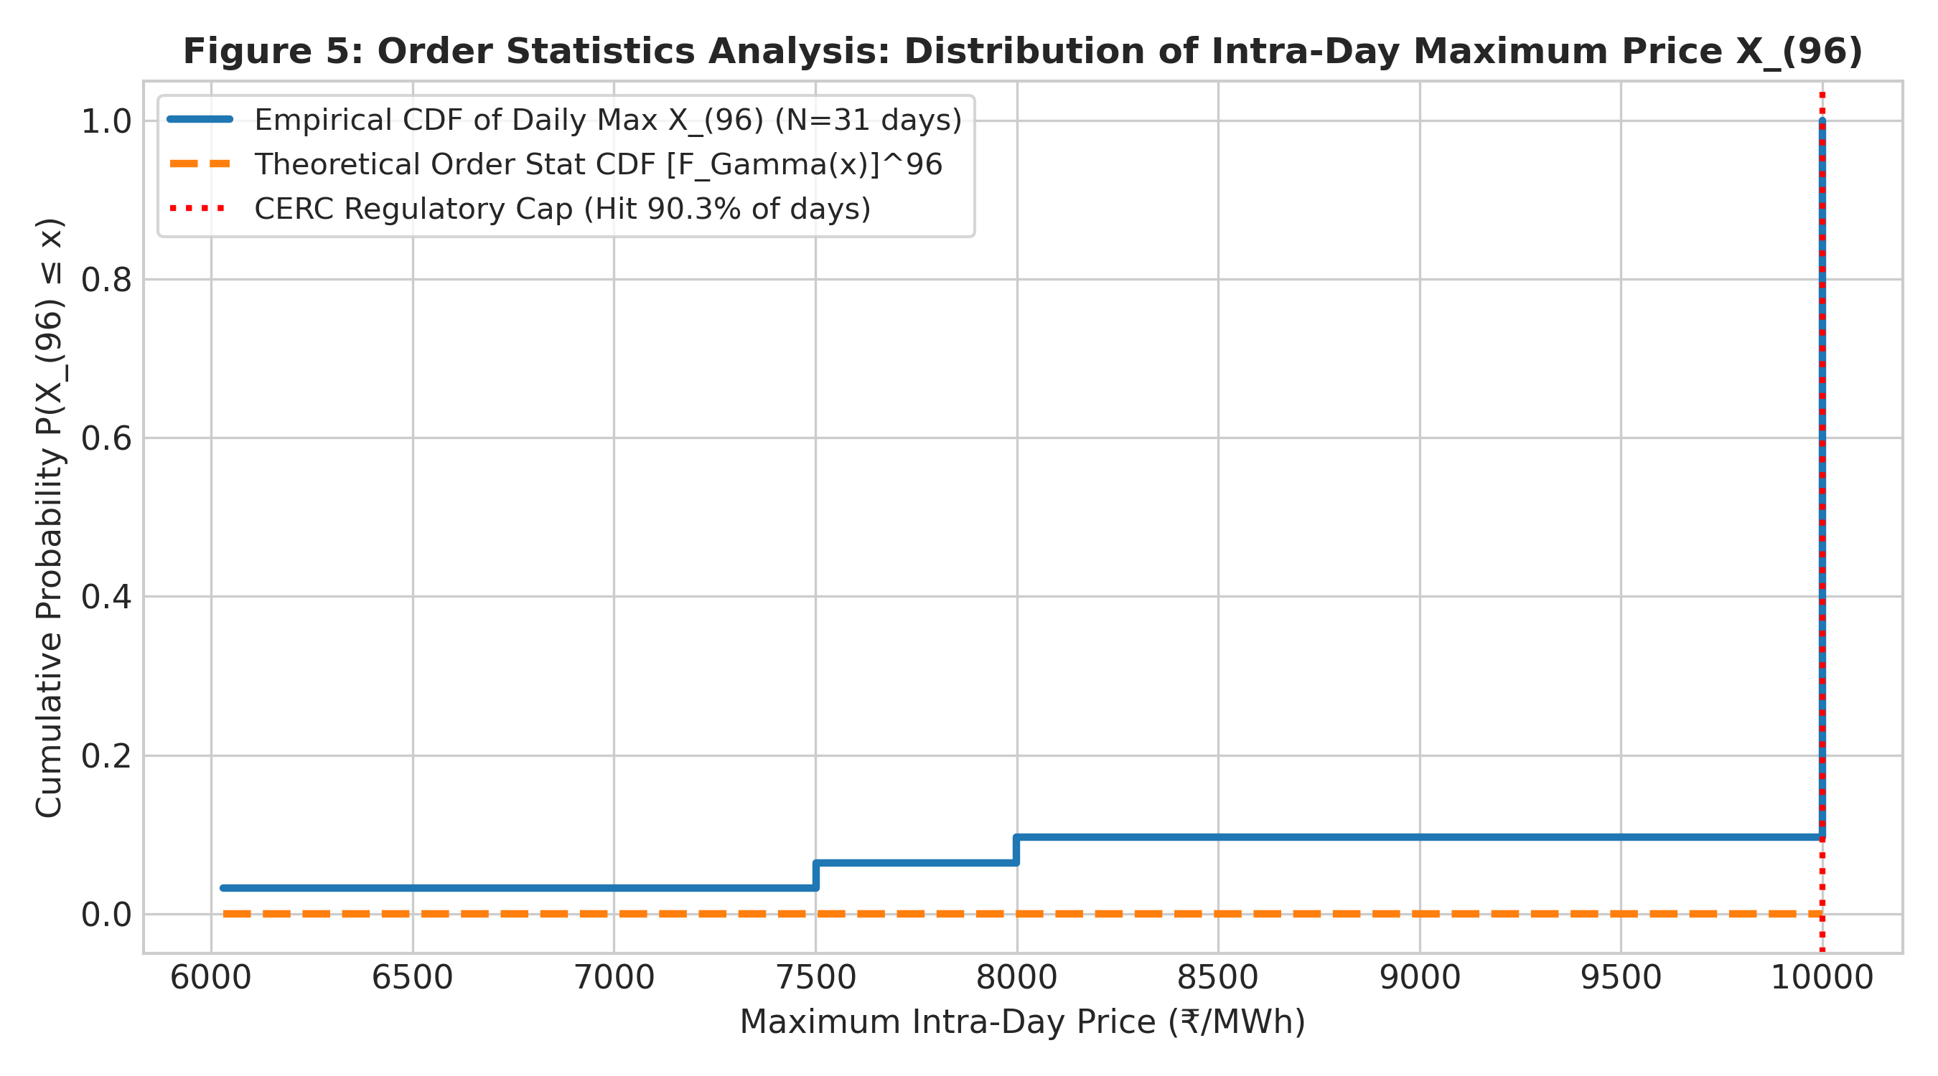
SYMBIOSIS STATISTICAL INSTITUTE | THM6242
Unit 4: Extreme Value Order Statistics (Daily Max X_(96))
• Mathematical Formulation: Daily maximum price X_(96) = max(X₁, ..., X₉₆).
• Theoretical CDF Derivation: F_(96)(x) = P(all X_i <= x) = [F(x)]⁹⁶.
Density f_(96)(x) = 96 [F(x)]⁹⁵ f(x).
• Empirical Cap Saturation: In 28 out of 31 trading days (90.32%), the daily peak price hits the CERC ceiling of ₹10,000/MWh!
• Daily Max Moments: Mean = ₹9,726.79/MWh | Std = ₹888.72/MWh | Min = ₹6,029.81/MWh.
• Grid Reliability Impact: Because n = 96 is large, [F(x)]⁹⁶ approaches zero for any sub-cap price. Hitting the cap is almost guaranteed daily, signaling structural peaking deficits.
THM6242: Applied Probability Distributions | Guide: Dr. Monika Vishnoi | SSI Batch 2026-28

Slide 12
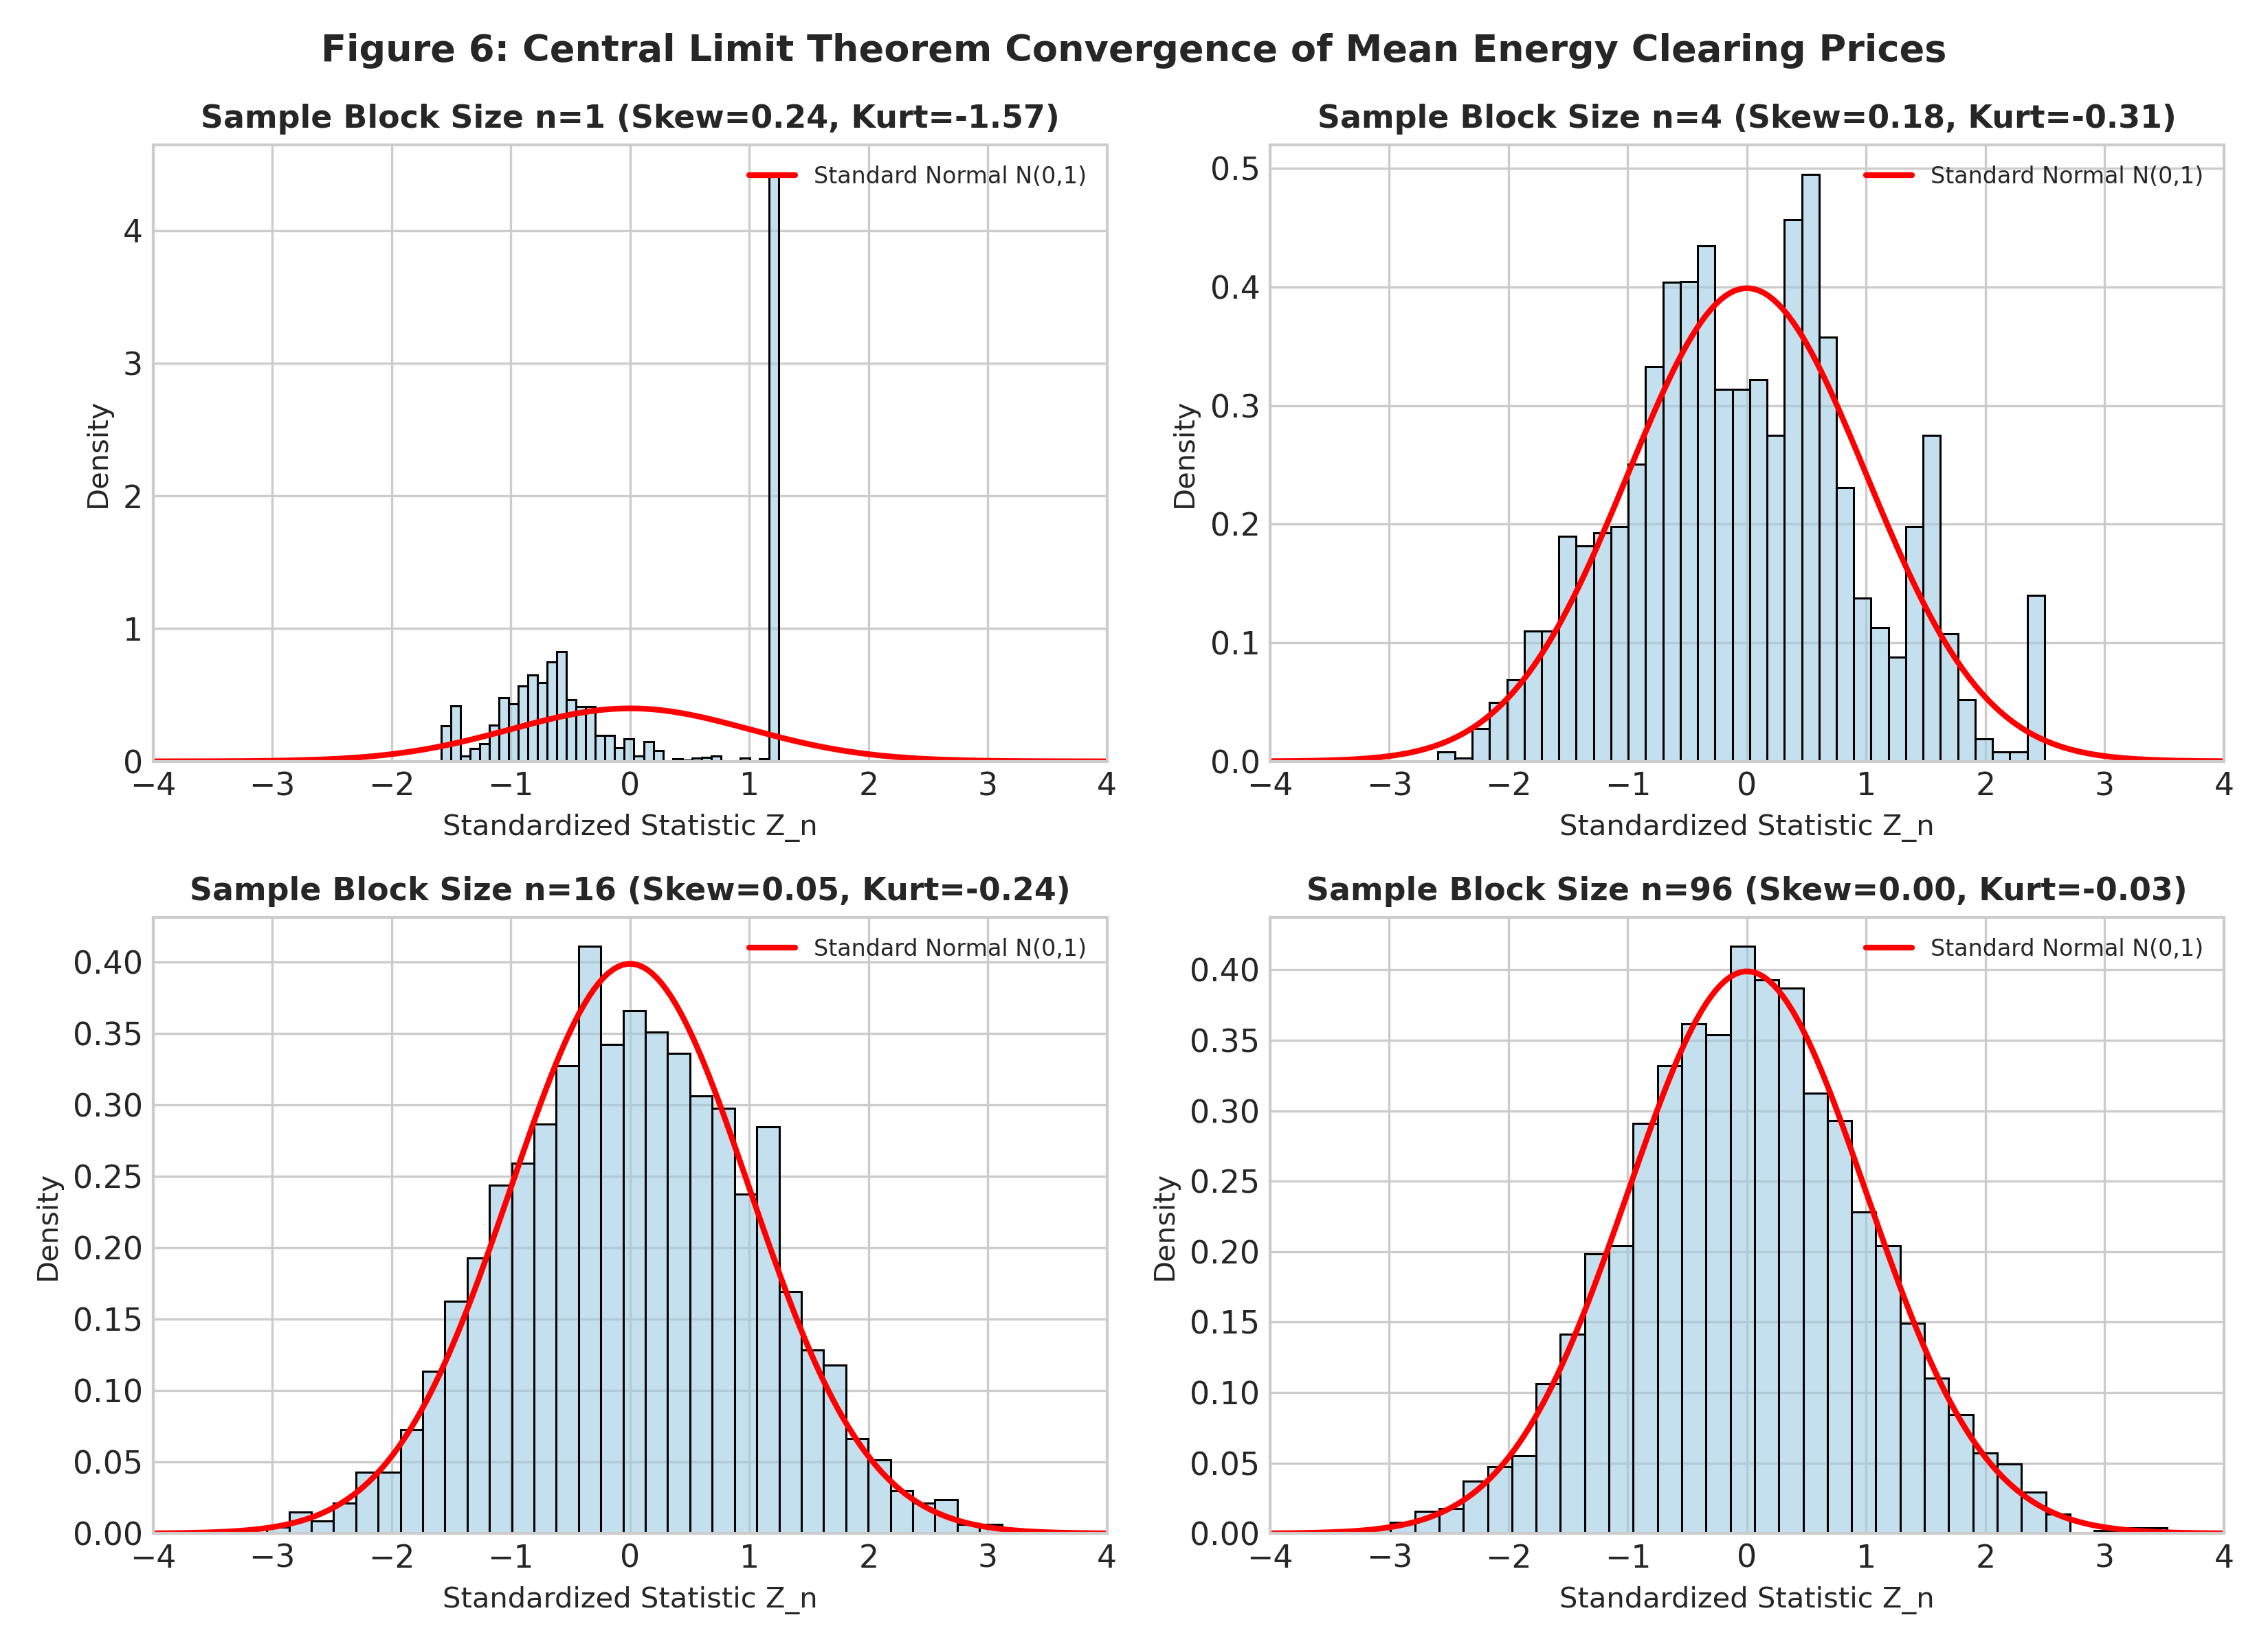
SYMBIOSIS STATISTICAL INSTITUTE | THM6242
Unit 4: Central Limit Theorem on Electricity Procurement Sums
• Problem: 15-minute price blocks are wildly non-normal, skewed, and bimodal. How can utilities forecast daily procurement budgets?
• Lindeberg-Lévy CLT: Z_n = (S_n - nμ) / (σ√n) ---> N(0, 1) as n ---> ∞ for portfolio sum S_n = ∑_{i=1}^n X_i.
• Empirical Convergence Tracking: • n = 1 (15-min): Skew = +0.235, Kurtosis = -1.571 (Bimodal)
• n = 4 (1-hour): Skew = +0.191, Kurtosis = -0.293
• n = 16 (4-hour): Skew = +0.060, Kurtosis = -0.215
• n = 96 (Full-day): Skew = +0.057, Kurtosis = +0.094
• Financial Takeaway: CLT restores Gaussianity for aggregated daily DISCOM procurement, validating classical Value-at-Risk (VaR) budgeting!
THM6242: Applied Probability Distributions | Guide: Dr. Monika Vishnoi | SSI Batch 2026-28

Slide 13
SYMBIOSIS STATISTICAL INSTITUTE | THM6242
Key Python Code: First-Principles NumPy Implementation
# 1. Law of Total Variance Decomposition (Scratch NumPy)
weights = np.array([len(p) / len(prices) for p in [deficit, balanced, surplus]])
e_var = np.sum(weights * [np.var(p, ddof=0) for p in [deficit, balanced, surplus]]) # E[Var(Y|X)]
var_e = np.sum(weights * ([np.mean(p) for p in [deficit, balanced, surplus]] - np.mean(prices))**2) # Var(E[Y|X])
eta_squared = (var_e / np.var(prices, ddof=0)) * 100.0 # Returns 49.10%
# 2. Negative Binomial Method of Moments (Scratch)
p_hat_nb = mean_spikes / var_spikes # Returns 0.0488
r_hat_nb = (mean_spikes**2) / (var_spikes - mean_spikes) # Returns 1.795
# 3. Pearson Chi-Square Test Statistic from First Principles
exp_counts = n_pos * np.diff(stats.gamma.cdf(bin_edges, a_mle, scale=scale_mle))
chi2_stat = np.sum((obs_counts - exp_counts)**2 / exp_counts) # Returns 6943.23
p_value = 1.0 - stats.chi2.cdf(chi2_stat, df=len(obs_counts) - 1 - 2) # df=7
THM6242: Applied Probability Distributions | Guide: Dr. Monika Vishnoi | SSI Batch 2026-28

Slide 14
SYMBIOSIS STATISTICAL INSTITUTE | THM6242
Real-World Interpretation for Power Sector Stakeholders
1. Distribution Companies (DISCOMs): When Day-Ahead imbalance breaches 1.25, the conditional expected price is ₹7,408/MWh (4.03x surge). Utilities must hedge forward in the Day-Ahead Market rather than gambling on real-time spot purchases.
2. Battery Storage (BESS) & Renewable IPPs: The Welch t-test (t = 46.80) and F-test (F = 5.80) prove a massive, statistically guaranteed ₹6,205/MWh diurnal arbitrage spread between solar charging and evening discharge.
3. Grid System Operators (Grid-India / NLDC): Daily maximums hitting the cap in 90.3% of days signals acute physical ramping deficits. Ancillary reserves must be dispatched at least 90 minutes prior to sunset.
4. Market Regulators (CERC): Chi-Square analysis proved that 88.37% of distribution divergence arises from cap accumulation at ₹10,000, signaling the need for market-based dynamic ramping capacity tariffs.
THM6242: Applied Probability Distributions | Guide: Dr. Monika Vishnoi | SSI Batch 2026-28

Slide 15
SYMBIOSIS STATISTICAL INSTITUTE | THM6242
Conclusion, Capstone Integration & Academic References
• Bridge to Production Capstone: This probability research directly powers our automated multi-horizon trading system (https://github.com/arcanekrishna/energy):
- LightGBM Quantile Forecaster calibrated via Gamma/Weibull shape parameters.
- Stress Classifier calibrated via Negative Binomial overdispersion thresholds.
- Conformal Prediction interval widths dynamically scaled by conditional variance regimes.
• Summary of Syllabus Mastery: Covered Unit 1 (Iterated Expectation & Total Variance), Unit 2 (Poisson/NB & Gamma/Weibull), Unit 3 (χ² GoF, Welch t, F-test), Unit 4 (Order Statistics & CLT), and Unit 5 (NumPy from scratch).
• Academic References: [1] Casella & Berger (2002). Statistical Inference. [2] Hogg, McKean & Craig (2018). Introduction to Mathematical Statistics. [3] CERC (2022) Market Order No. 4/SM/2022. [4] Weron (2014) Electricity Price Forecasting.
• Thank You! Questions & Viva Defense.
THM6242: Applied Probability Distributions | Guide: Dr. Monika Vishnoi | SSI Batch 2026-28

