Slide 1
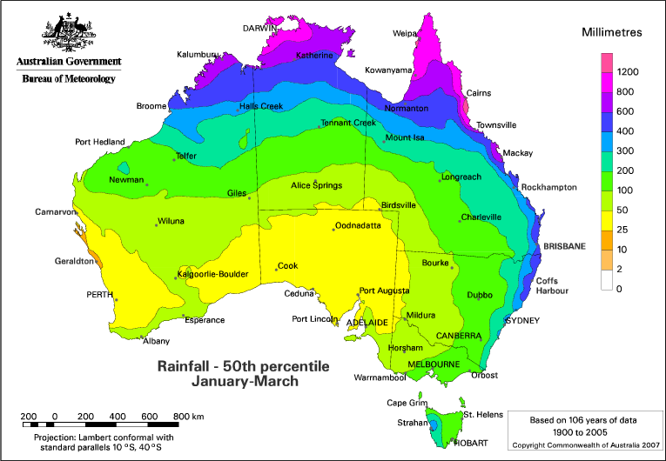
Predicting if it Rains Australia

Slide 2
The Data
Target:
Rain Tomorrow (Yes vs. No)
Input Data
Temperature
Wind (speed, direction)
Clouds, Sun
Location
Rain Today (Yes vs. No)

Slide 3
DATA
Feature Engineering
Build Model
Deploy!
Test
Model
Bad Results
Good Results

Slide 4
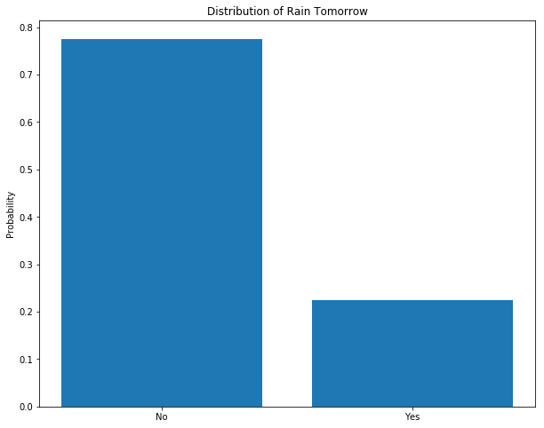
Problem: Imbalanced Target
Rains only 22% of the time
Predicting no rain everyday:
78% accurate!

Slide 5
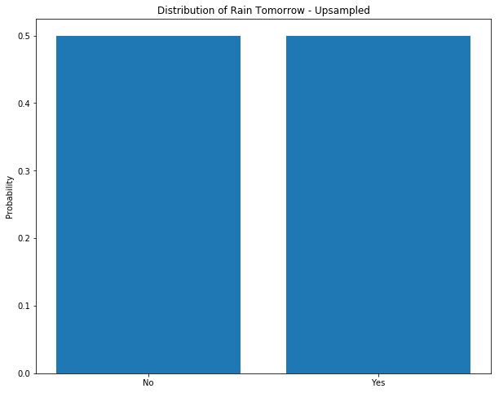
Solution: Upsampling
Create realistic synthetic data
Balance Target

Slide 6
Upsampling – Pros vs. Cons
Pros:
When it does rain, correct more often
Predict rain, actually Sun – Happy Surprise
Cons:
Model predicts rain too often
Unrealistic

Slide 7
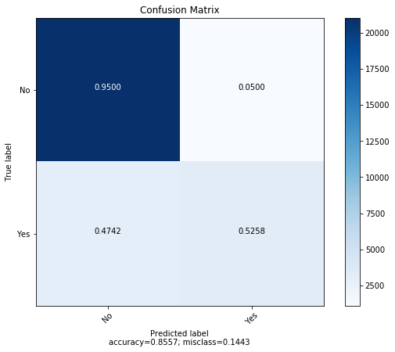
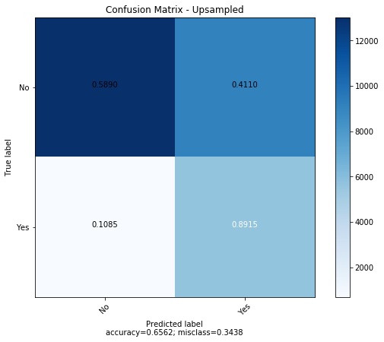
Solution: Build Two Models - Compare

Slide 8
Recommendations
Model Options:
Model 1 – Non-Upsampled:
Very Accurate
But, when it rains, only right half the time
Overall: Realistic

Slide 9
Recommendations
Model Options:
Model 2 – Upsampled:
Not very accurate
But, when it rains, right 90% of the time
Overall: Rain Focused

Slide 10
Recommendations
Model Choice:
Depends on Goals!
For Meteorology:
Choose Realistic Model
Correct more on average
If we care more about Rain:
Choose Rain Focused Model
Correct more when it rains

