Slide 1
Predicting House Price on Ames Dataset
Evaluating Linear and Bayesian Regression
Supervisor : Anirban Basu
Prepared By:-
Archit Vora (2015HT12480)

Slide 2
Data Description
80 features
23 Nominal
Hair color : Black, Brown
Agriculture, Commercial, Ordinal
23 Ordinal
Service satisfaction
Unsatisfied, neutral, satisfied
Bad, Good, Excellent
14 Discrete
20 Continuous
Example Features
Nearby Area
No of bedrooms
Parking Facility
Kitchen Quality
Swimming Pool
No of Floors

Slide 3
Filling Up Missing Values
Common
Encoding for Ordinal variables
Leveling for nominal variables
Specific
Replace with most frequent value for discrete and nominal
When no of missing values are less
Mostly the case with our data
Sometimes null value implies feature is not available
Basement area null gets replaced with zero
Inferring from related variables
When garage year is null, we say house is without garage
Allows us to infer garage area, no of cars, garage condition
Linear Regression : Predict Lot Frontage from lot area (after sqrt)
Improvements:
Creating Levels blindly : 288 features, 0.157122 rmse
After logically filling missing values : 263 features, 0.155965

Slide 4
Linear Regression

Slide 5
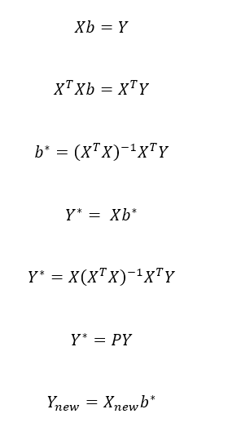
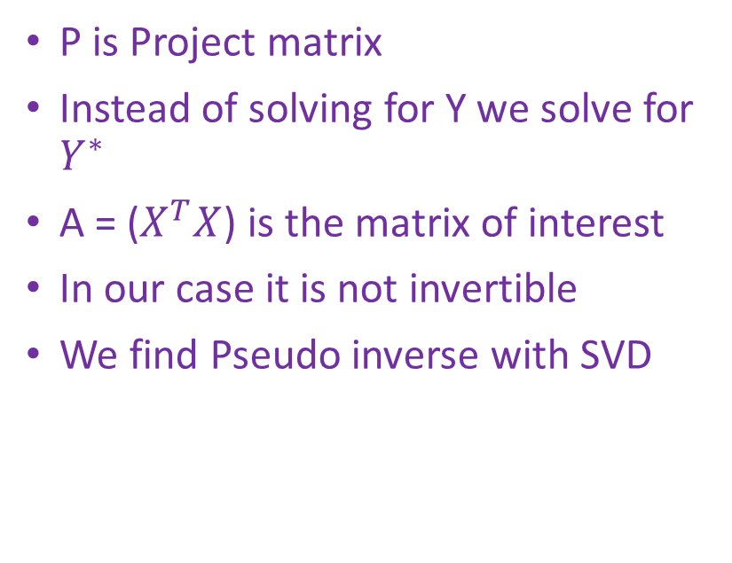
Linear Least Squares
P is Project matrix
Instead of solving for Y we solve for $Y^{∗}$
A = ($X^{T}X$) is the matrix of interest
In our case it is not invertible
We find Pseudo inverse with SVD

Slide 6
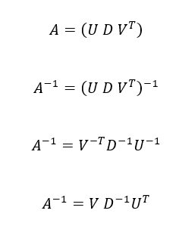
LLS with pseudo inverse
SVD is fast
U and V are orthogonal hence is transpose
D is diagonal, so inverse each of them
SVD allows pseudo inverse
Just inverse the non zero entries of D
Accuracy
0.16096

Slide 7
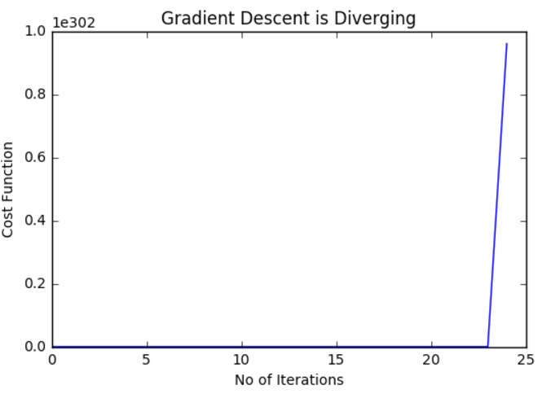
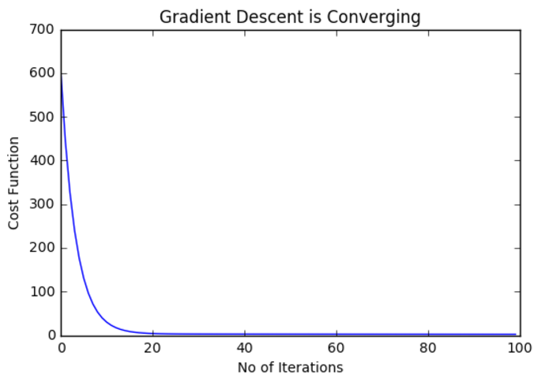
Gradient Descent
Importance of Normalizing
Iterations (step size 0.05)
100 – rmse 1.93
5k – rmse 0.48566
10k – rmse 0.38121
100k – rmse 0.18964

Slide 8

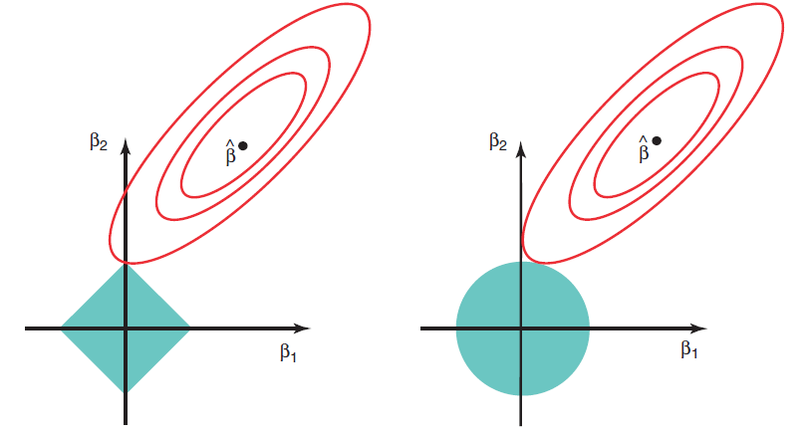

Shrinkage Intuition
Ridge
Lasso
Assumption
Two parameters
Without shrinkage entire plane is available

Slide 9
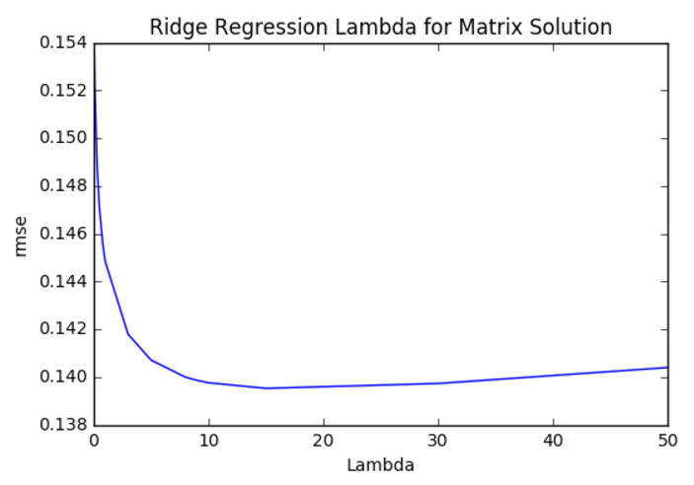
Ridge
Matrix Inverse
Unique inverse Exists
Accuracy - 0.1395
Matrix SVD
Accuracy - 0.13927
SAG
Accuracy - 0.230815
Tuning
Alpha = 15

Slide 10
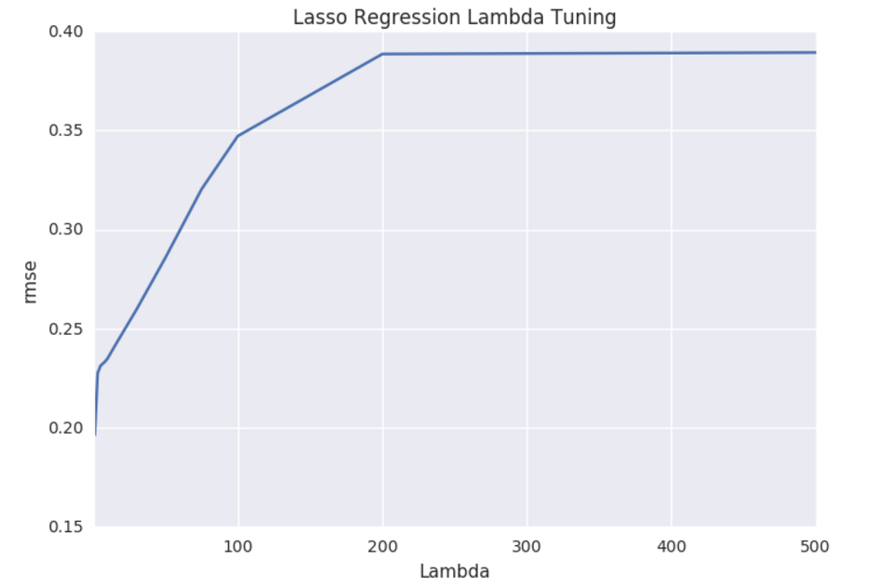
Lasso
Indicating not lo use Lasso
Generally used when we have too many features say in the range of 1000
Accuracy - 0.19638
Non zero coefficients – 13
Tuning
Alpha = 1

Slide 11
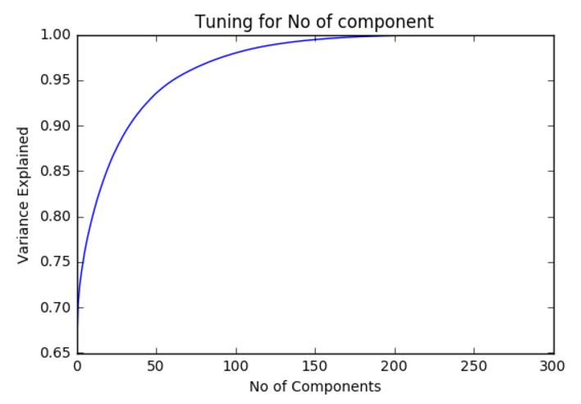



PCR
SVD
U reduced
First 100 component
Var explained = 0.9797
rmse 0.14949

Slide 12
Linear Regression - Summary
Baseline accuracy (average of training data)
0.399
Simple Least Square
LLS with Pseudo Inverse - rmse 0.16096
Gradient descent – step size 0.005 (Did not help), diverging
After Normalizing
Iter 1,00,000 rmse 0.18964
Iter 10, 000 rmse 0.38121
Iter 5000 rmse 0.48566
PCR
100 component
Rmse 0.14949
Ridge
Matrix - alpha 15, rmse 0.1395
Svd instead of finding inverse – 0.13927
Sag – 0.230815
Lasso
Alpha 1, rmse 0.19638, non zero 13

Slide 13
Bayesian Regression

Slide 14
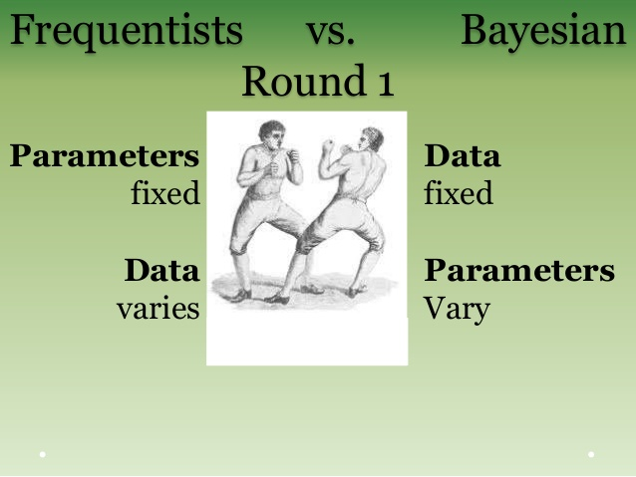
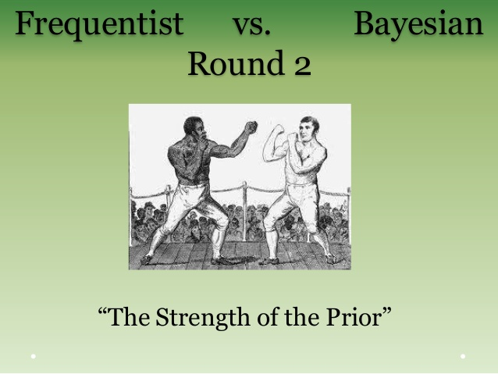
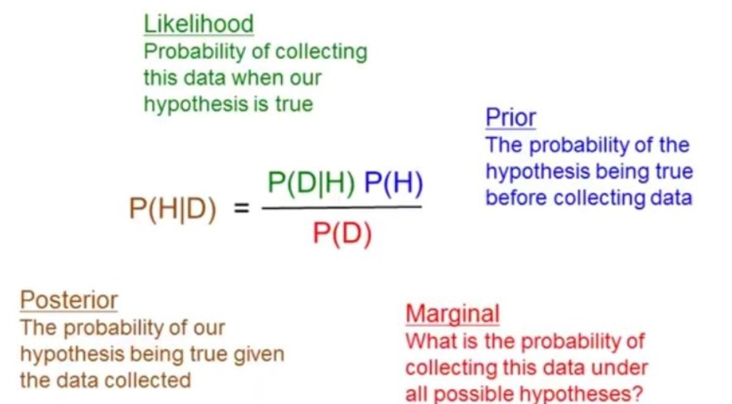
Bayes Theorem
Role of prior
Expert Advise
What is fixed ?
Data
Parameter
Denominator as complex multiple integration over parameters

Slide 15
Markov Chain Monte Carlo
Markov Chain
Next state depends only on current steps
Application
Hidden Markov models in speech recognition
Allows to draw independent samples
Monte Carlo
Simulation when simple mathematical equation is simple
Application
Uncertainty in market is random, predict sales
Solving complex Integration

Slide 16
MCMC Steps – Metropolis Hasting
muProposal = norm(muCurrent, StdDev).rvs()
likelihoodCurrent = norm(muCurrent, 1).pdf(data).prod()
likelihoodProposal = norm(muProposal, 1).pdf(data).prod()
priorCurrent = norm(muPriorMu, muPriorSd).pdf(muCurrent)
priorProposal = norm(muPriorMu, muPriorSd).pdf(muProposal)
probCurrent = likelihoodCurrent * priorCurrent
probProposal = likelihoodProposal * priorProposal
probAccept = probProposal / probCurrent
accept = np.random.rand() < probAccept
if (accept == True) then muCurrent = muProposal

Slide 17
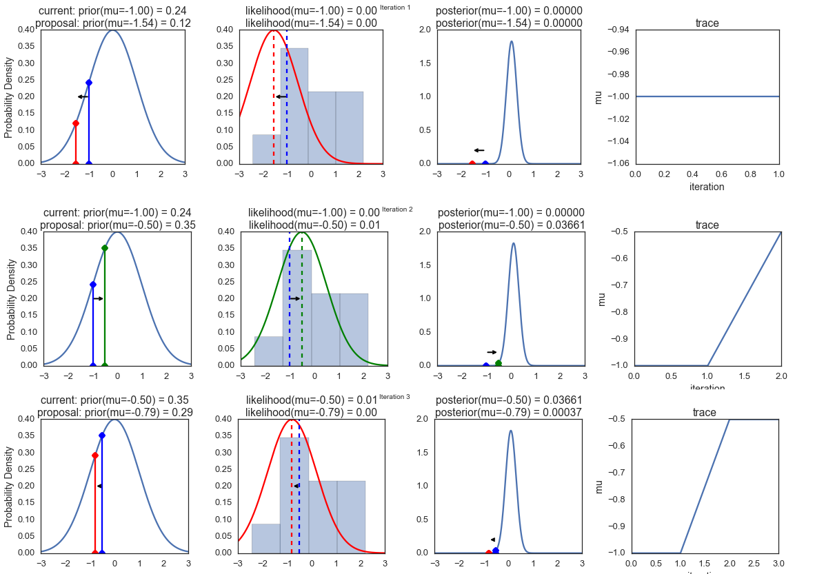
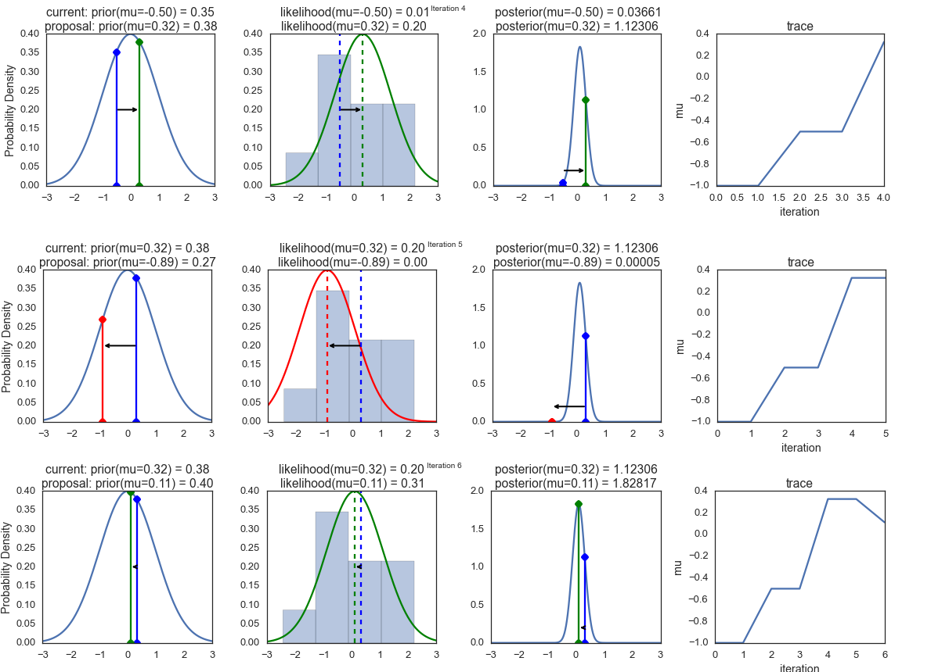
Visualization

Slide 18


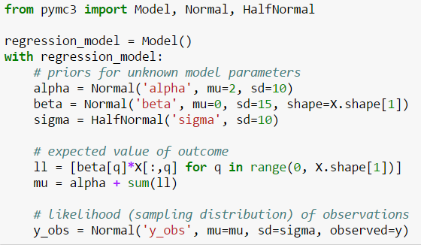
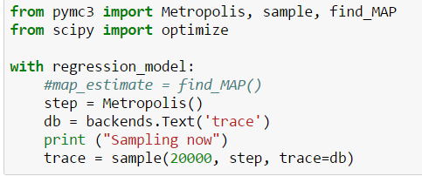
Pymc3 style
1. Model
2. Describe
3. Simulate
4. You get the trace

Slide 19
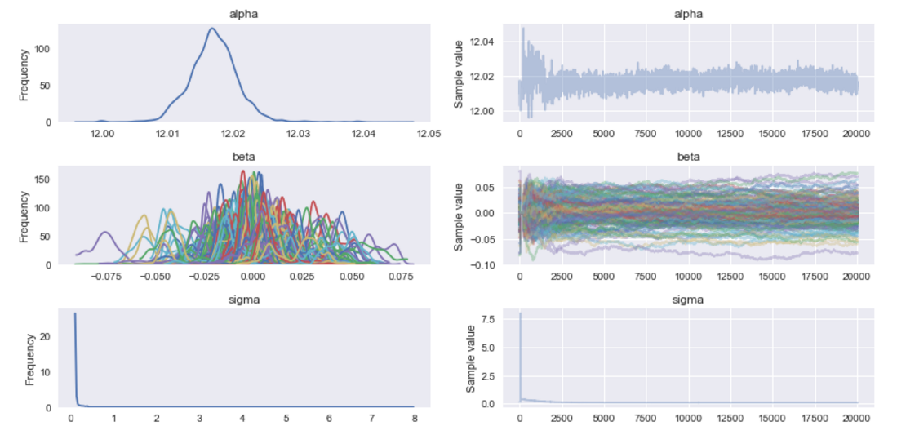
Trace

Slide 20
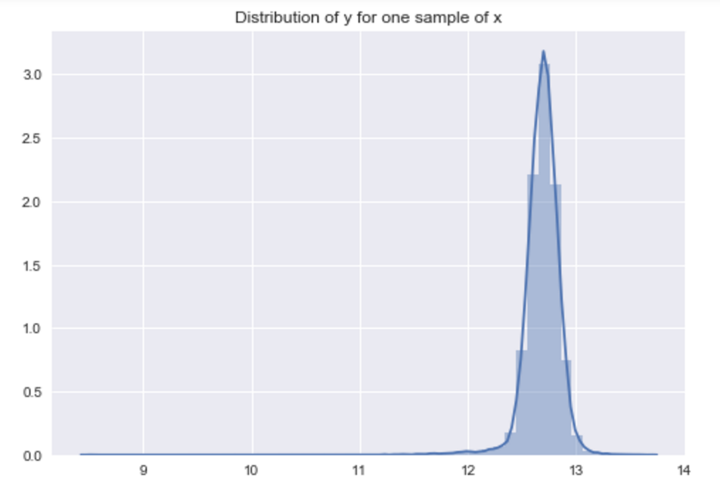
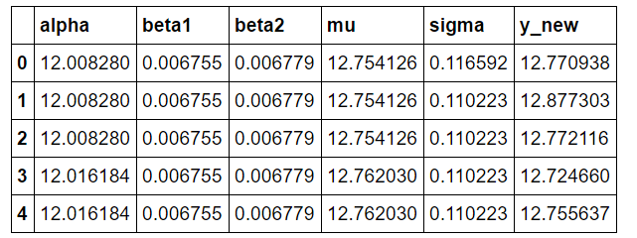
Predicting for new sample
Predict outcome for beta, alpha, sigma of each iteration
Draw random sample from given mu and sigma

Slide 21
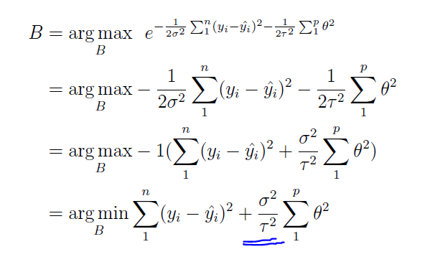
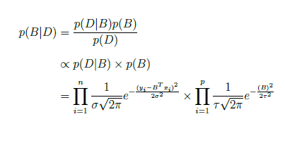
Ridge
Accuracy = 0.33020

Slide 22
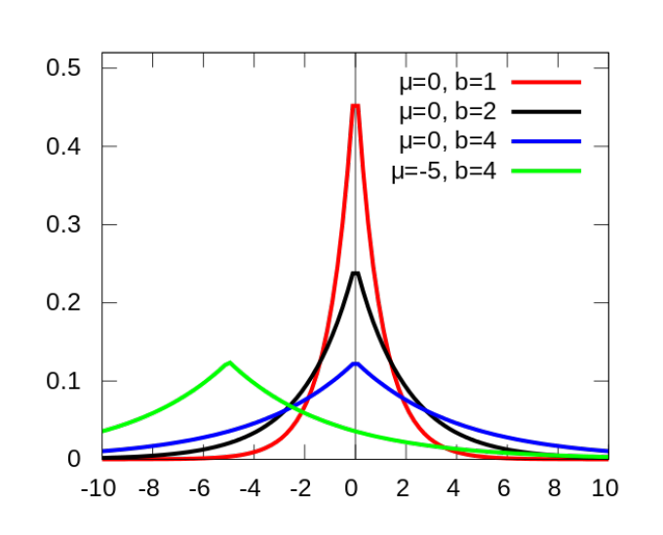
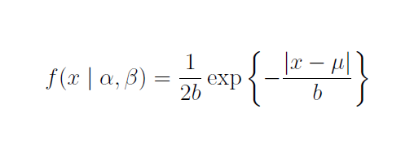
Lasso
Change Prior of parameter to strictly closer to zero distribution
Laplace Distribution
Accuracy : 0.25288

Slide 23
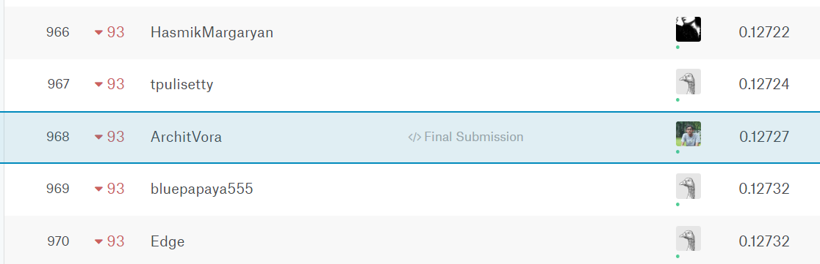
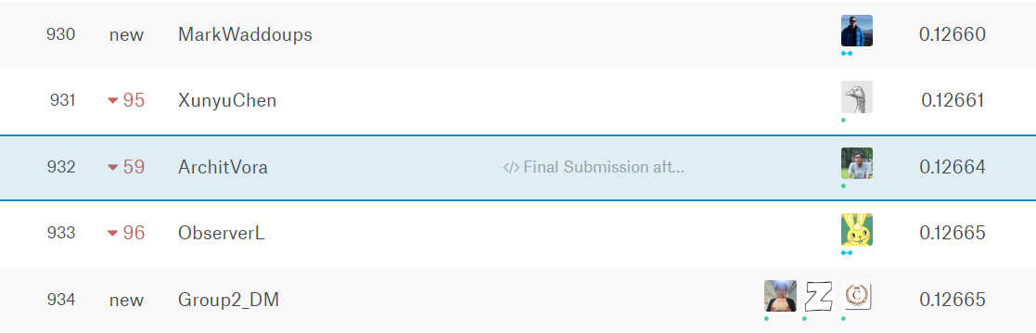
Some Kaggle Results
Without Missing Data Script
Accuracy – 0.12727
Rank - 968
With Missing Data Script
Accuracy – 0.12664
Rank - 932

Slide 24
Thank you !
BITS Wilp
Two years of amazing learning
Adobe for work life balance
My mentor Anirban Basu
Mathematics will carry along, subjective knowledge will not
Teachers, professors and seniors
I think I am luck enough
Parents and sisters
I think I am blessed

Slide 25


Questions and Suggestions !

