Slide 1
Android PHP from MySQL
Arc Chang
2016/08/17
Notes:
<number>

Slide 2
Outline
Introduction
Volley – Http Request Framework
Implement
Select
Insert
Update
Delete
Reference

Slide 4
Volley

Slide 5
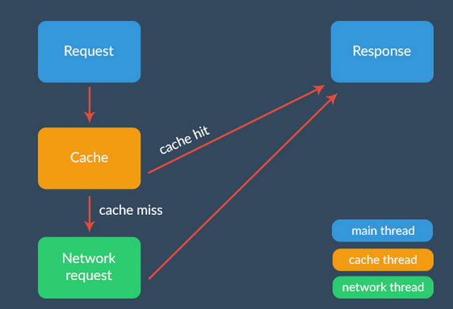
From：http://code.tutsplus.com/tutorials/an-introduction-to-volley--cms-23800

Slide 6
Reference
Image
http://stackoverflow.com/questions/13562429/how-many-ways-to-convert-bitmap-to-string-and-vice-versa

Slide 7

Thanks
Notes:
<number>
<number>

