Slide 1
Android PHP from MySQL
Arc Chang
2016/08/17

Slide 2
Outline
Introduction
Volley – Http Request Framework
Implement
Select
Insert
Update
Delete
Special case
Image
Array
Example
Reference

Slide 4
Volley

Slide 5
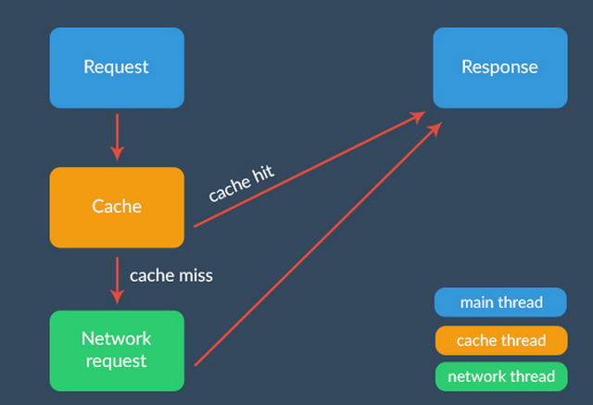
From：http://code.tutsplus.com/tutorials/an-introduction-to-volley--cms-23800

Slide 6
Implement

Slide 7
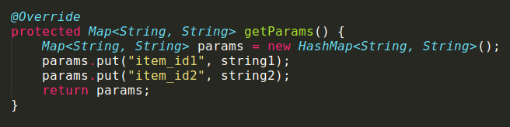
Special case
We can use JsonObjectRequest to upload JSON format data to our database
However, cause we need to connect the database through POST request
Volley provides getParams() method to implement
And the type is String only
Thus, we must change any type of data into “String”

Slide 8
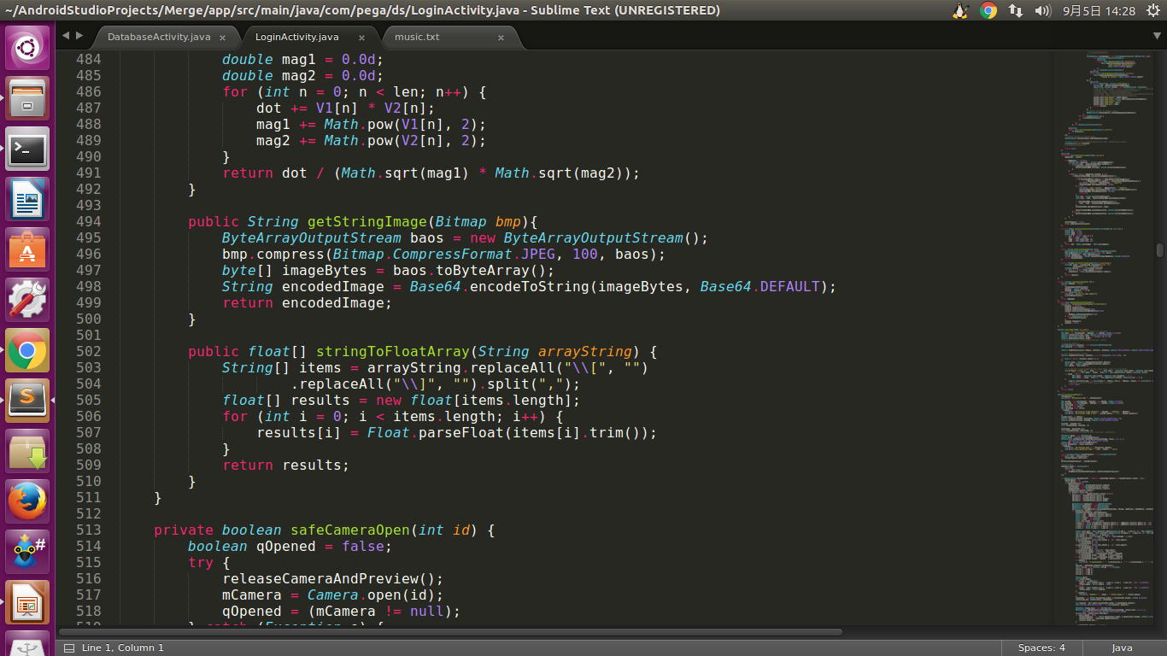
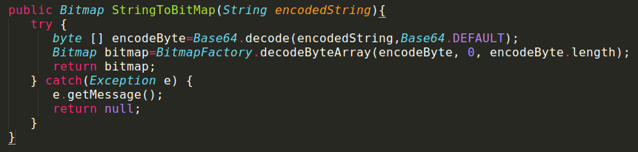
Special case – Image
For Bitmap to String
Compress bitmap first and then change into byte[ ]
Use Base64 to encode the byte[ ] to String
For String to Bitmap
vice versa

Slide 9
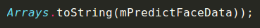
Special case – Array
For array to String
If float[] mPredictFaceData = {4.8, 5.2, 0, 6.5};
We will get String ans = [4.8, 5.2, 0, 6.5];
For String to array
Split the String first
Then use parse to change type of data one by one

Slide 10

Example
GO to my GitHub and git clone the folder
https://github.com/arcprince1236/Android_Volley_tutorial

Slide 11
Reference
Image
http://stackoverflow.com/questions/13562429/how-many-ways-to-convert-bitmap-to-string-and-vice-versa

Slide 12

Thanks

