Slide 1
GAMOS tutorial
Spectrometry
Exercises
Pedro Arce Dubois
CIEMAT
http://fismed.ciemat.es/GAMOS
Pedro Arce
Introducción a GEANT4

Slide 2

SPECTROMETRY simulation Exercises
Ex. 1: NaI simple detector
    Co60 radioactive decay
    Detector signals
Ex. 2: Marinelli detector
    Understanding time simulation
Ex. 3: Detector effects
Ex. 4: Extracting detailed information
    Optimising CPU
GAMOS Spectrometry tutorial
Pedro Arce

Slide 3
Exercise 1: NaI simple detector
A 3”×3” cylindrical NaI detector
Choose its base to be the plane z = 0 and its axis of symmetry along the positive z axis.
The crystal is encased in a 0.24-cm-thick aluminum cover^{(*)}
An aluminum slab with a thickness of 2 cm is located behind
(downstream) the crystal, to model the effect of the photocathode
and the photomultiplier tube.
⁽Usually, there is a reflector coating (e.g. Al₂O₃) between the crystal and the cover.
For simplicity, we have assumed that its material is equivalent to Al and considered it as part of the cover)
GAMOS Spectrometry tutorial
Pedro Arce

Slide 4


Exercise 1: NaI simple detector
2D view
3D view
Al (2.00)
NaI
(7.62 × 7.62)
z axis
x axis
Al (0.24)
GAMOS Spectrometry tutorial
Pedro Arce

Slide 5
Exercise 1a: Co60, as two single gammas
Co60: two gamma sources of energies 1173 keV and 1333 keV
  Place them at position (0,0,-5 cm)
Store detector signals (hits)
  Histogram their energy
GAMOS Spectrometry tutorial
Pedro Arce

Slide 6
Exercise 1b: Co60, as two single gammas
Same as exercise 1a
Gammas in cone illuminating the detector front face
GAMOS Spectrometry tutorial
Pedro Arce

Slide 7
Exercise 1c: Co60, as radioactive ion
Same geometry as exercise 1a
Use Co60 ion as particle source
Histogram of energy of particles created by radiocative decay, one histogram per each particle type
GAMOS Spectrometry tutorial
Pedro Arce

Slide 8
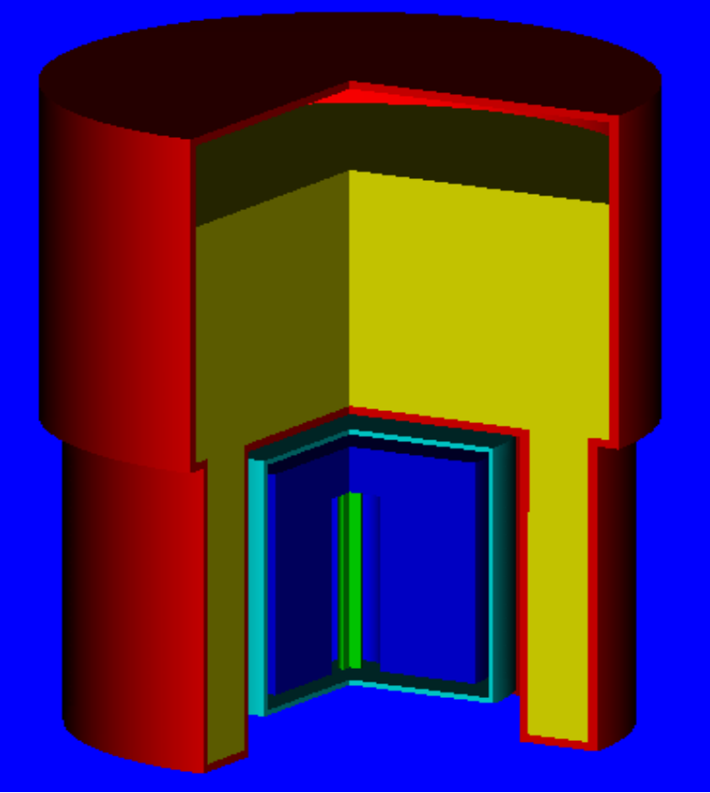
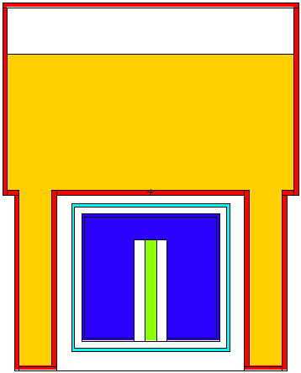
Exercise 2a: time of a radioactive decay
Geometry: Marinelli beaker
solución acuosa
Ge
Cu
Al
GAMOS Spectrometry tutorial
Pedro Arce

Slide 9
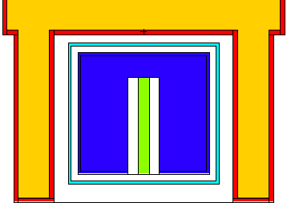
Exercise 2a: time of a radioactive decay
Geometry: Marinelli beaker
6.3
15.7
5.8
element | dimensions
Cristal Ge | R= 2.945 cm R_{int}= 0.7 cm h=5.43 cm
Dead layer | e=0.135 cm
Dedo Cu | R= 0.25 cm h=4.31 cm
Cubierta Al | e= 0.127 cm
Recipiente | e=0.2 cm
4
0.373
0.3
0.628
7.5
GAMOS Spectrometry tutorial
Pedro Arce

Slide 10
Exercise 2a: time of a radioactive decay
Co60 source randomly in water solution
Print in screen the time of each particle
Histogram the time of each particle
GAMOS Spectrometry tutorial
Pedro Arce

Slide 11
Exercise 2b: Co60 simulating a given activity
Same as exercise 2a
Simulate the Co60 ions with increasing time, corresponding to an activity of 0.1 Mbq
Print in screen the time of each particle
Histogram the time of each particle
GAMOS Spectrometry tutorial
Pedro Arce

Slide 12
Exercise 2c: Study activity chain with time
Use Si27, halflife 4.16 seconds
  Activity of 1kBq
  5000 events
Histogram the time of each particle
  Observe how the activity changes with time
GAMOS Spectrometry tutorial
Pedro Arce

Slide 13
Exercise 2d: multiple decay chain
Use Am241 -> Np237 -> Pa233 -> U233 -> Th229 -> ...
Activity of 1 MBq
10000 events
Histogram the log10(time) of each particle, one histogram per particle time
Observe the two groups of times
GAMOS Spectrometry tutorial
Pedro Arce

Slide 14
Exercise 2e: several isotopes together
Co57 activity 1 MBq
Cs137 activity 2 MBq
Cd109 activity 3 MBq
Histogram of the time of primary particles, one histogram per particle type
GAMOS Spectrometry tutorial
Pedro Arce

Slide 15
Exercise 3a: detector energy resolution
Co60 on NaI detector as in exercise 1
  Place source at position 0,0,-1 cm
  Activity 1 MBq
Smear the detector energy resolution with a gaussian of sigma 0.03
Histogram of the energy in the detector
GAMOS Spectrometry tutorial
Pedro Arce

Slide 16
Exercise 3b: detector measuring time
Same as exercise 3a
Add measuring time of 10 microsecond
Histogram of the energy in the detector
  Use reconstructed hits
GAMOS Spectrometry tutorial
Pedro Arce

Slide 17
Exercise 3c: detector dead time
Same as exercise 3b
Add dead time of 100 microsecond
Histogram of the energy in the detector
  Use reconstructed hits
GAMOS Spectrometry tutorial
Pedro Arce

Slide 18
Exercise 4a: extracting detailed information
Co60 in Marinelli beaker as in exercise 2
Histogram of energy of particles when entering Ge detector, by particle type
Histogram of energy of particles when exiting Ge detector, by particle type
Histogram of energy of particles when entering Ge detector, only if they have suffered before a Compton interaction
GAMOS Spectrometry tutorial
Pedro Arce

Slide 19
Exercise 4b: optimizing CPU
Same as exercise 4a
Kill electrons and anti neutrinos before they are transported
Compare detector signals with those of exercise 4a
GAMOS Spectrometry tutorial
Pedro Arce

