Slide 1
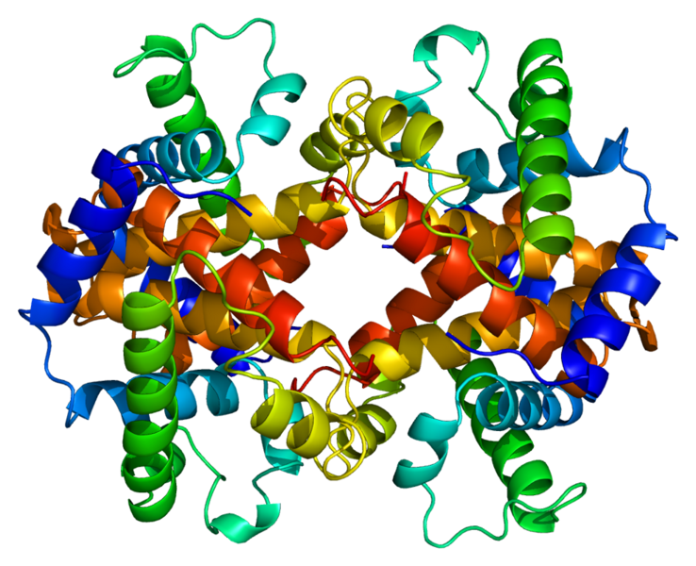
GSIGAASMEFCFDVFKELKVHHANENIFYCPIAIMSALAMVYLGAKDSTRTQINKVVRFD
KLPGFGDSIEAQCGTSVNVHSSLRDILNQITKPNDVYSFSLASRLYAEERYPILPEYLQC
VKELYRGGLEPINFQTAADQARELINSWVESQTNGIIRNVLQPSSVDSQTAMVLVNAIVF
KGLWEKAFKDEDTQAMPFRVTEQESKPVQMMYQIGLFRVASMASEKMKILELPFASGTMS
MLVLLPDEVSGLEQLESIINFEKLTEWTSSNVMEERKIKVYLPRMKMEEKYNLTSVLMAM
GITDVFSSSANLSGISSAESLKISQAVHAAHAEINEAGREVVGSAEAGVDAASVSEEFRA

