Slide 1


Slide 2
Data base

Slide 3
Spanner

Slide 4
DB A
DB A
DB A
DB A
DB A
DB A
DB A
Table 1
split 1
DB B
DB B
DB B
DB B
DB B
DB B
DB B
Table 2
split 2
Instance
DB C
DB C
DB C
DB C
DB C
DB C
DB C
Table 3
split 3
DB D
DB D
DB D
DB D
Table 4
split 4
DB E
DB E
DB E
DB E
Table 5
split 5

Slide 5
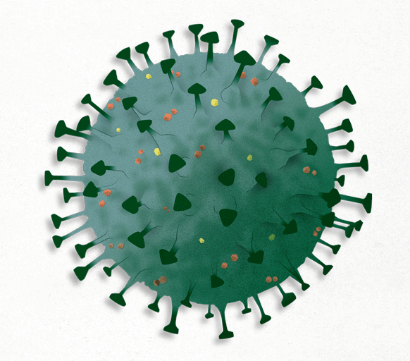

Slide 6

Concordance reads
Sample genome
Discordance reads
Split reads
SV detection
Lumpy/
Sniffles
Variant calling file
Alignment
SpeedSeq
SplitThreader
Rearrangements
Copy number
Copycat
Gene fusion
Concordance reads
Copy numbers
Reference genome

Slide 7
Concordance reads
Sample genome
Discordance reads
Split reads
SV detection
Lumpy/
Sniffles
Variant calling file
Alignment
SpeedSeq
SplitThreader
Rearrangements
Copy number
Copycat
Gene fusion
Concordance reads
Copy numbers
Reference genome

