Slide 1
A
C
G
A
C
G
T
T
T
1
2
3
1
2
3
1
2
3
1
2
3
4
5
6
7
8
9
2
4
6
5
7
9
8
10
12
+

Slide 2

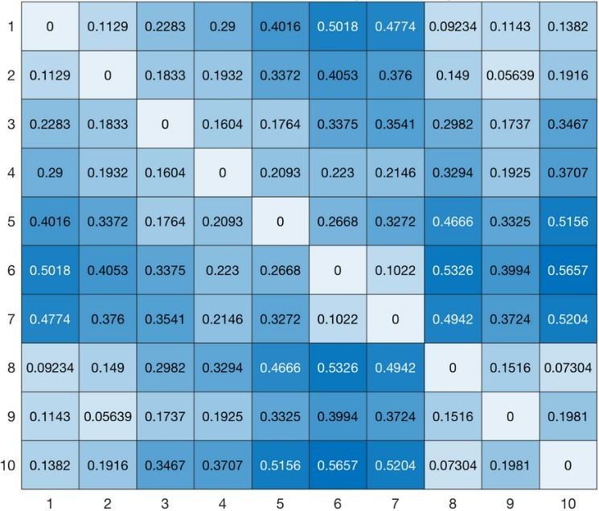
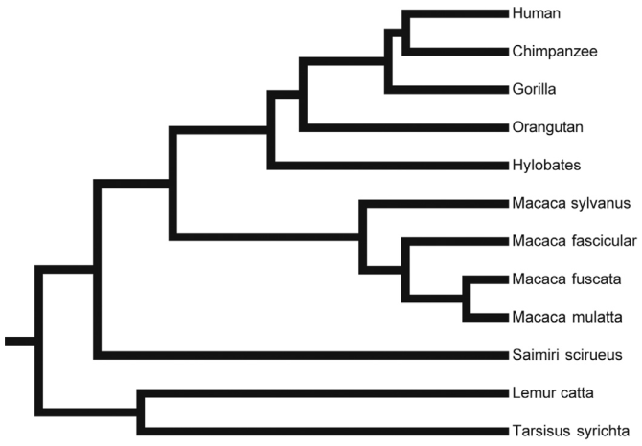
Similarity processing
Distance matrix
Feature vector
First-order statistics
GLCM
Phylogenetics trees
Graphical tree comparison
Distance between trees

