Slide 1
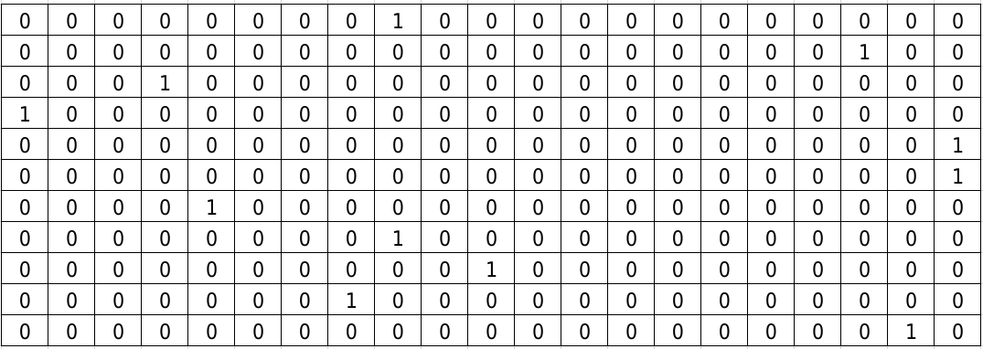
KVDAGKLHY
KVDAZZGKLHY
peptide
peptide after padding
one-hot encoding

Slide 2
MHC-peptide encoding
ESM-1b
ANN
MHC-peptide affinity
Peptide properties
ANN

Slide 3
MHC-peptide encoding (BERTMHC)
TAPE
(transformer)
ANN
MHC-peptide affinity
MHC-peptide encoding (APPM)
CNN

Slide 4
BERT
(transformer)
30 millions proteins
peptide-MHC-II dataset
TAPE
BERTMHC

Slide 5
peptide
MHC
KVDAGKLHY
LKVBDAGOKLHY...
Deep learning model
0/1

Slide 6
peptide
MHC
Concatenate - padding - tokenize
Concatenate - padding - tokenize
ESM-1b
ESM-1b
BiLSTM
pMHC binding / presentation prediction

