Slide 1
Optimization

Slide 2
Algorithm
Optimization with gradient descent is an iterative process of adjusting a function’s parameters to minimize an error function that is produced when a certain input is given to that function.
Steps:
Find an appropriate error function.
Analytically derive the partial derivative of that error function with respect to each parametrizable parameter in the function.
Create python functions for evaluating the expression, calculating the error, and computing the partial derivatives.
Pick a learning rate and loop through the process of evaluating the function, calculating the loss, computing the derivatives, and adjusting the parameters on the model.

Slide 3
Common Error Functions
MSE – Mean Squared Error
RMSE – Root of the MSE
MBE – Mean Bias Error – Mean Error keeping the sign (Positive errors cancel out with negative errors but it points out the sign of the bias)
MAE - Mean absolute error – Absolute value instead of squaring
MSLE – Mean Square Log Error
Cross Entropy loss AKA Hinge Loss – Used for classification
Log loss – the log of the cross entropy loss
SVM Loss – Used for classification, similar to Logistic Regression
Other: Kullback Leibler Divergence Loss – Huber Loss

Slide 4
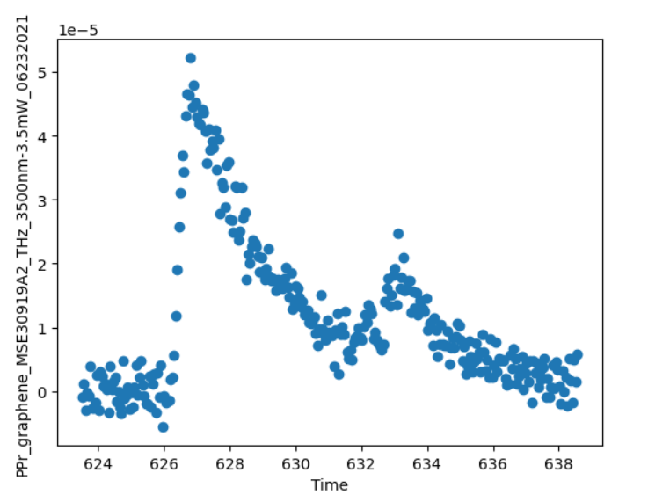
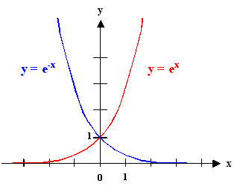
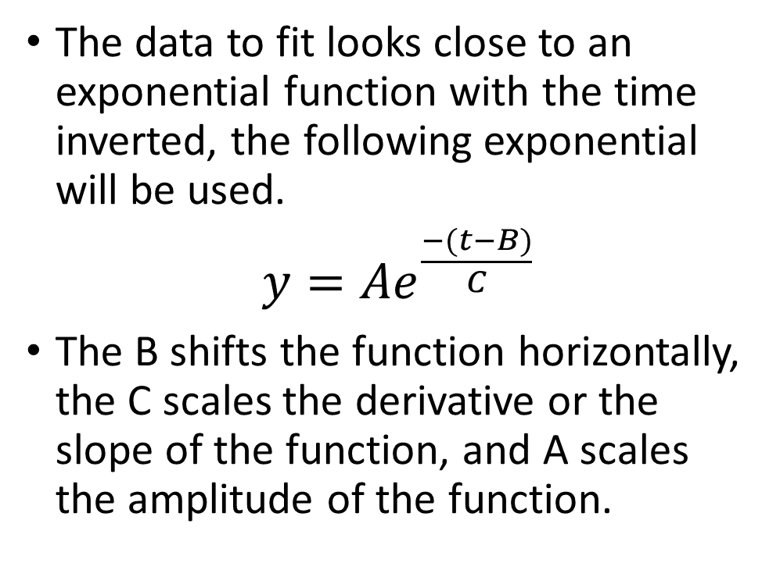
Function Used
The data to fit looks close to an exponential function with the time inverted, the following exponential will be used.
$y={Ae}^{\frac{−(t−B)}{C}}$
The B shifts the function horizontally, the C scales the derivative or the slope of the function, and A scales the amplitude of the function.

Slide 5
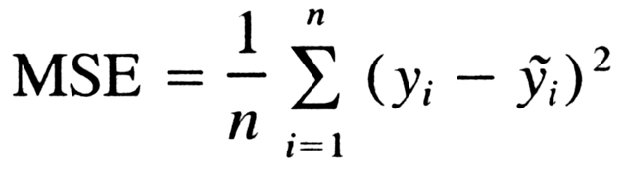
MSE
The Mean Squared error is the most common error metric, it is the average error squared. It is calculated by subtracting the theoretical value from every approximated value in the model, squaring the result and adding them up together to then divide by the amount of results. The squaring term is used to get rid of the negative errors and have a magnitude metric instead, the RMSE or root mean squared error can also be used to remove the scaling. The MAE uses absolute value instead of squaring, this causes it to punish outliers less as they wont scale so much as with the squared term. The MAE function’s derivative isn’t continuous and doesn’t exist at y_{i} = ỹ_{i.}

Slide 6


MSLE
The Mean Squared Logarithmic Error function depicts the relative or percentual difference between the predicted and theoretical value. In other words, the scales of the quantities don’t matter; only the ratios between them. This is useful if the model shouldn’t be penalized too much for predicting unscaled quantities. The function is the same as the mean squared error except 1 is added to each term (to prevent log of 0 which isn’t defined) and their natural logarithms are taken before their difference is computed.

Slide 7
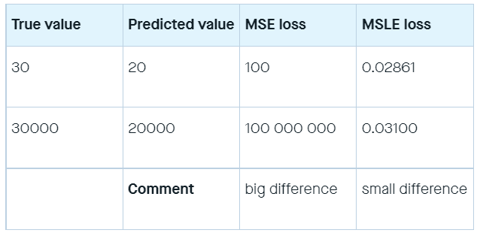
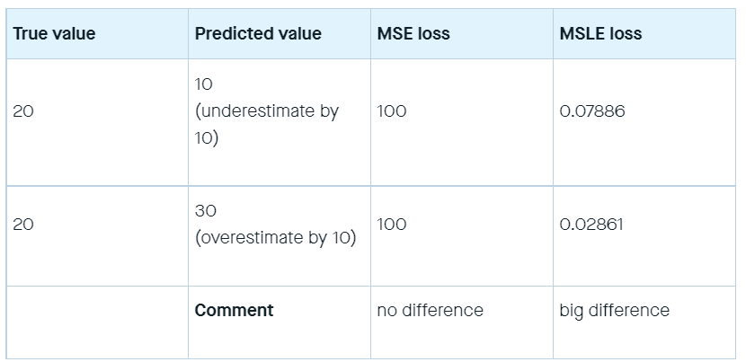
MSLE use
As seen in the top table, the MSLE punishes based on how different one value is relative to the other, and disregards the scale on which they are.
As seen on the bottom table, the error curve is asymmetric. Underestimations are punished more than overestimations.
MSLE should be used when doing regression on normally distributed data sets where the the range of the target value is large so large errors shouldn’t be significantly more penalized than small ones.

Slide 8
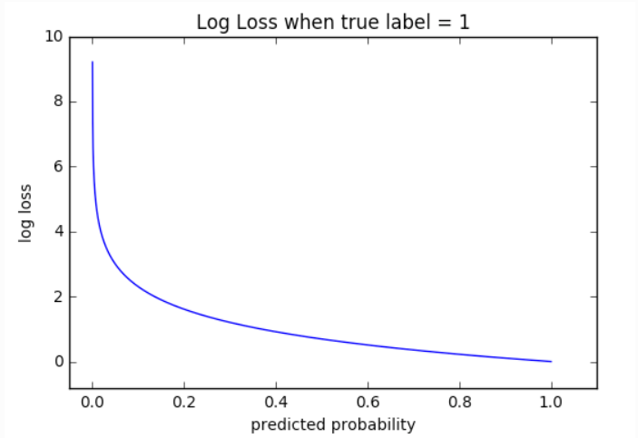
Cross Entropy Loss
Cross Entropy Loss is the most common error measurement for classification problems. Cross-entropy loss increases as the predicted probability diverges from the actual label. (theoretical value is y_{i})
When the actual label is 1 (y(i) = 1), second half of function disappears whereas in case actual label is 0 (y(i) = 0) first half is dropped off.
The function simply takes the log of the margin by which the prediction was wrong. An important aspect of this is that cross entropy loss penalizes heavily the predictions that are confident but wrong.

Slide 9
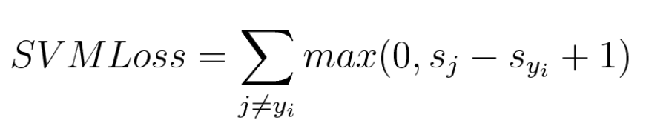
Hinge Loss (SVM)
Hinge loss is used in support vector machines for maximum margin classification (finds the largest margin of error) . Although not differentiable, it’s a convex function which makes it easy to work with usual convex optimizers used in machine learning domain. The function consists of the sum of every classifier, for which the maximum is computed between 0 and the difference between the classifier’s output and the real result plus one. This means that the sum elements will never be negative, so the sum

Slide 10
Training Loop
The loop consists of the following:
Compute a prediction using a function with an input vector consisting of the dataset provided.
Compute the error using another function with two input vectors which are the output of the prediction function and the theoretical values.
Compute each error partial derivative with a function that takes in the prediction and theoretical values plus the current values for the parameters A,B, and C. It loops through all the values of t computing each sum of the derivative of the error with respect to the different parameters.
Adjust the values of A, B and C by multiplying each -derivative times the learning rate and adding that to the current value.

Slide 11
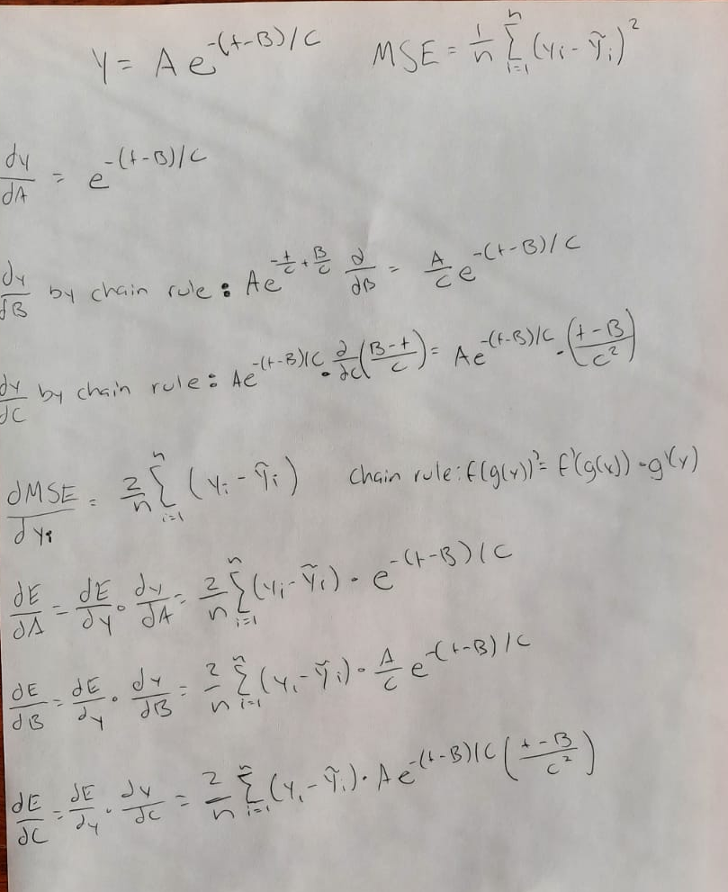
MSE Derivations

Slide 12
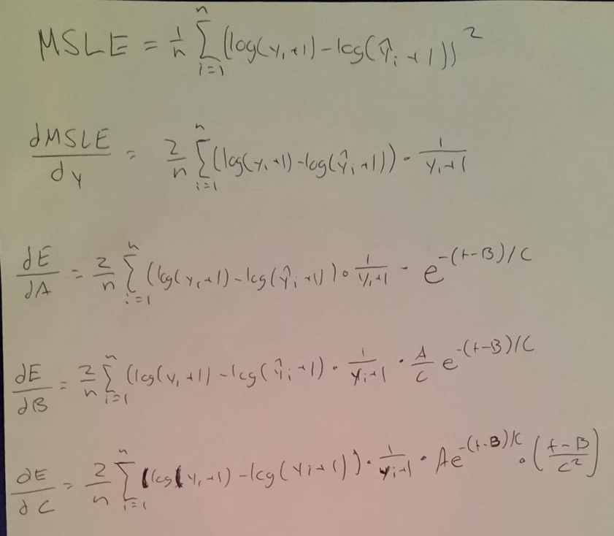
MSLE Derivations

Slide 13
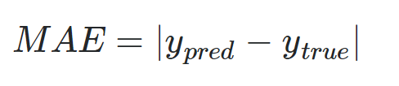
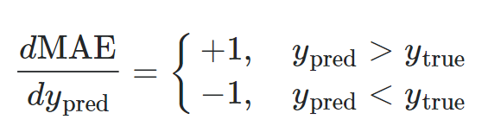
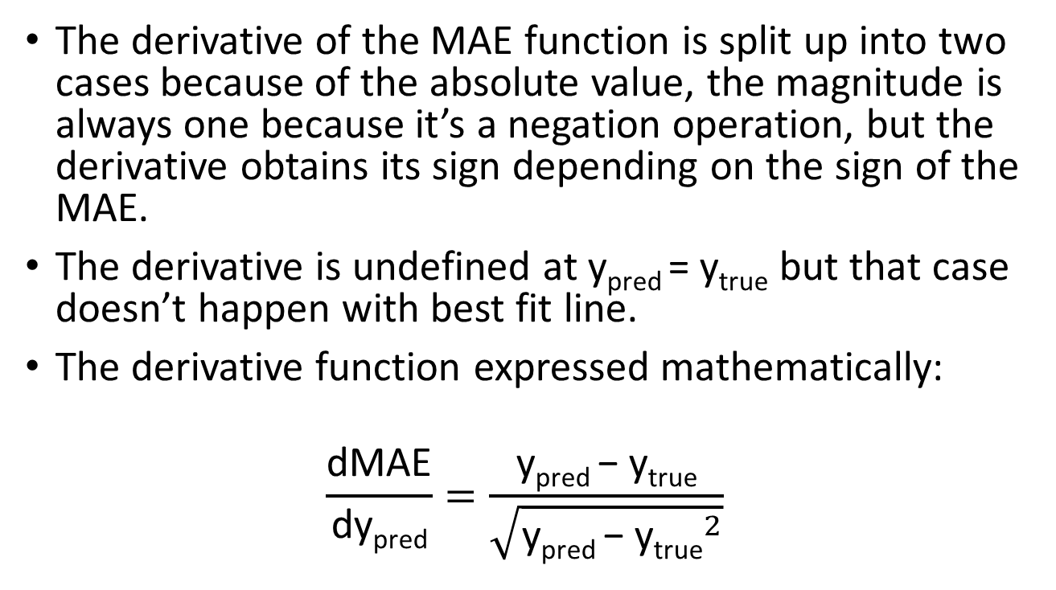
MAE algorithm
The derivative of the MAE function is split up into two cases because of the absolute value, the magnitude is always one because it’s a negation operation, but the derivative obtains its sign depending on the sign of the MAE.
The derivative is undefined at y_{pred} = y_{true} but that case doesn’t happen with best fit line.
The derivative function expressed mathematically:
$$\frac{\text{dMAE}}{\text{dy}\text{pred}}=\frac{\text{y}\text{pred} \text{−} \text{y}\text{true}}{\sqrt{{\text{y}\text{pred} \text{−} \text{y}\text{true}}^{2}}}$$

Slide 14
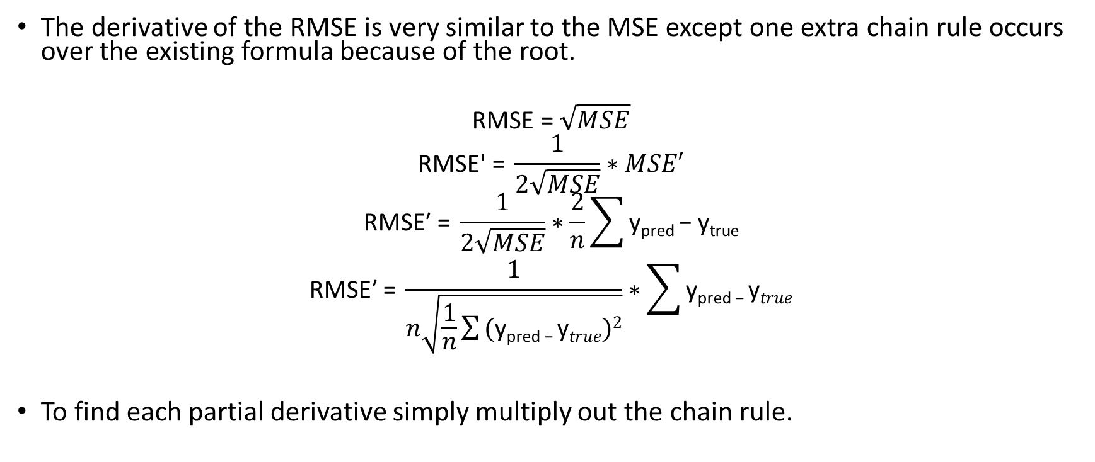
RMSE Derivation
The derivative of the RMSE is very similar to the MSE except one extra chain rule occurs over the existing formula because of the root.
$$\text{RMSE}\text{ = }\sqrt{MSE}$$
$$\text{RMSE}\text{′}\text{ = }\frac{1}{2\sqrt{MSE}}∗MSE′$$
$$\text{RMSE}\text{′}\text{ = }\frac{1}{2\sqrt{MSE}}∗\frac{2}{n}\sum{\text{y}\text{pred}\text{ − }\text{ytrue}}$$
$$\text{RMSE}\text{′}\text{ = }\frac{1}{n\sqrt{\frac{1}{n}\sum{\text{(}\text{y}\text{pred}\text{ − }\text{y}\text{t}rue)2}}}∗\sum{\text{y}\text{pred}\text{ − }\text{y}\text{t}rue}$$
To find each partial derivative simply multiply out the chain rule.

Slide 15
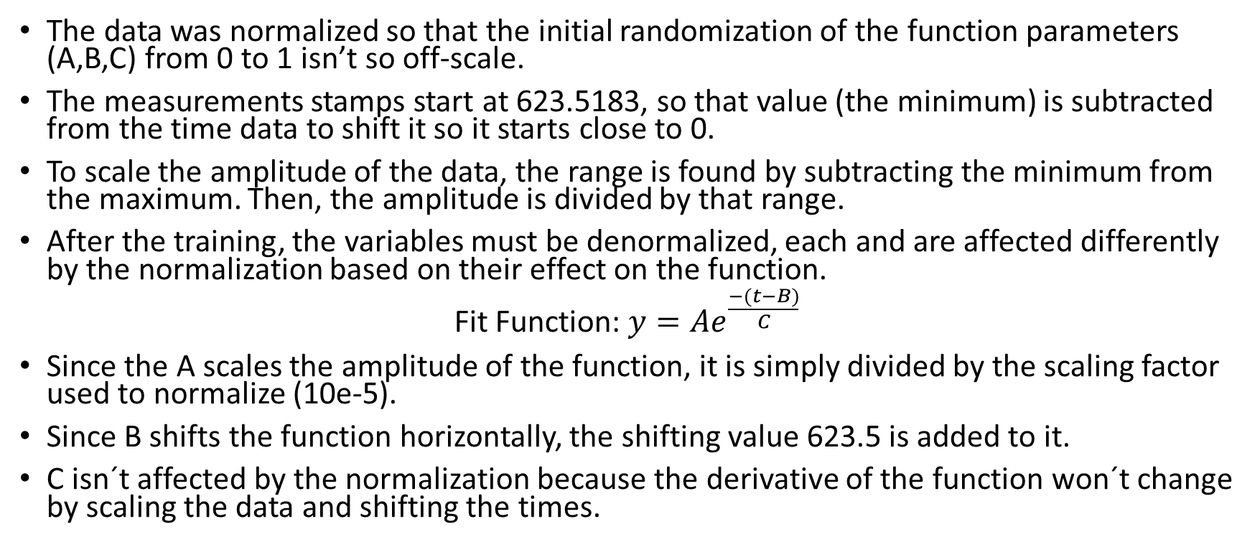
Normalization
The data was normalized so that the initial randomization of the function parameters (A,B,C) from 0 to 1 isn’t so off-scale.
The measurements stamps start at 623.5183, so that value (the minimum) is subtracted from the time data to shift it so it starts close to 0.
To scale the amplitude of the data, the range is found by subtracting the minimum from the maximum. Then, the amplitude is divided by that range.
After the training, the variables must be denormalized, each and are affected differently by the normalization based on their effect on the function.
Fit Function: $y={Ae}^{\frac{−(t−B)}{C}}$
Since the A scales the amplitude of the function, it is simply divided by the scaling factor used to normalize (10e-5).
Since B shifts the function horizontally, the shifting value 623.5 is added to it.
C isn´t affected by the normalization because the derivative of the function won´t change by scaling the data and shifting the times.

Slide 16

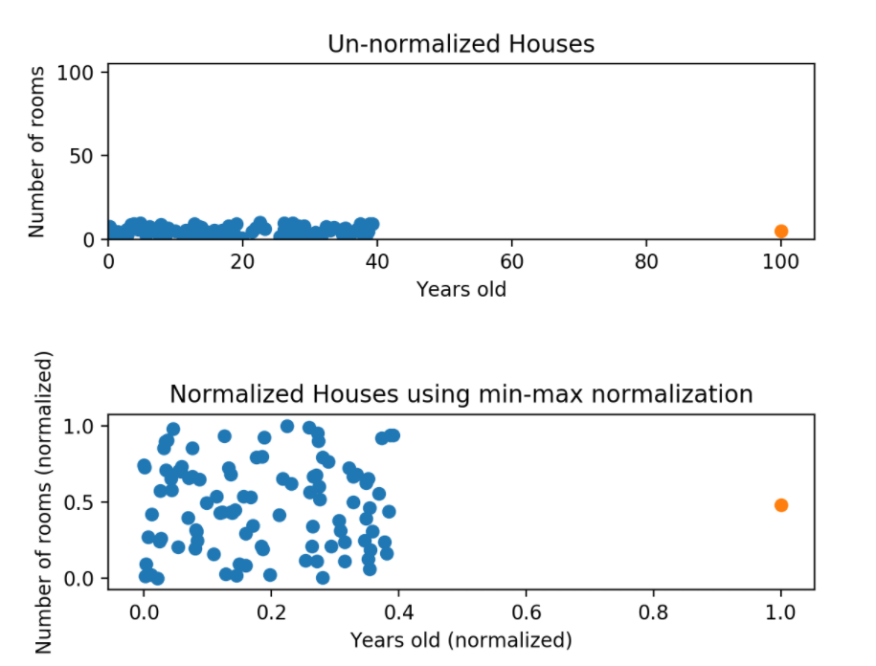
Min-Max
This normalization is used to scale all the values in the range of 0 to 1.
Min-max normalization has one significant downside: it does not handle outliers very well. For example, if you have 99 values between 0 and 40, and one value is 100, then the 99 values will all be transformed to a value between 0 and 0.4. That data is just as squished as before, the image on the right depicts this issue.

Slide 17

Min Max Implementation
Since the data is being flipped along the X axis, the normalization of the amplitude is added the minimum instead of subtracted, because the values are negative and we’re trying to make them closer to 0.
To denormalize, only the A and B parameters of the function are considered because the C function changes the derivative which isn’t altered by normalization. The B function shifts time so the inverse of the normalization applied to time is done to it. The A function scales the amplitude so the inverse of the values normalization is applied to it. First, the values are multiplied by the scaling factor and then the minimum value is added to them. In the case for A it is subtracted because the sign is inverted.

Slide 18

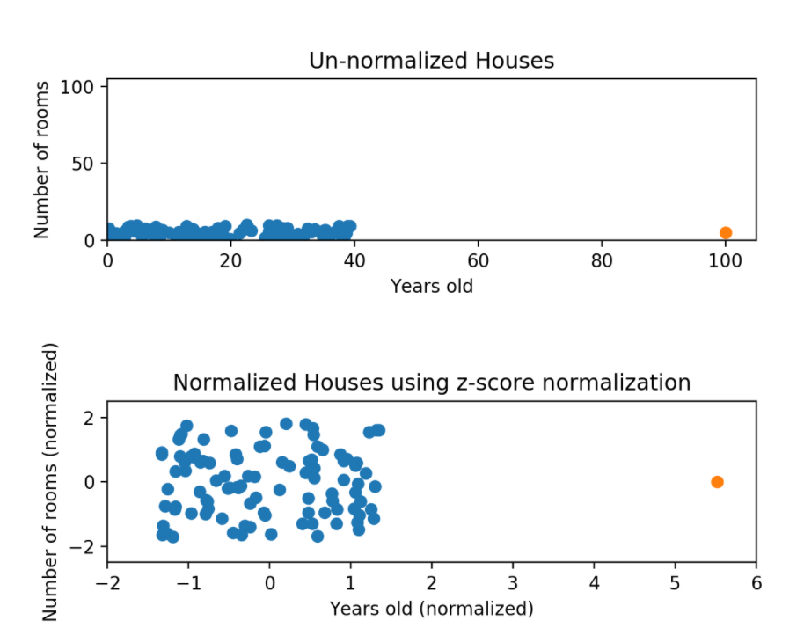
Z-Score Normalization
The Z-score normalization also deals with outliers by dividing the dataset by its standard deviation.
μ is the mean value of the feature and σ is the standard deviation
If a value is exactly equal to the mean of all the values of the feature, it will be normalized to 0. If it is below the mean, it will be a negative number, and if it is above the mean it will be a positive number. The size of those negative and positive numbers is determined by the standard deviation of the original feature. If the unnormalized data had a large standard deviation, the normalized values will be closer to 0.

Slide 19
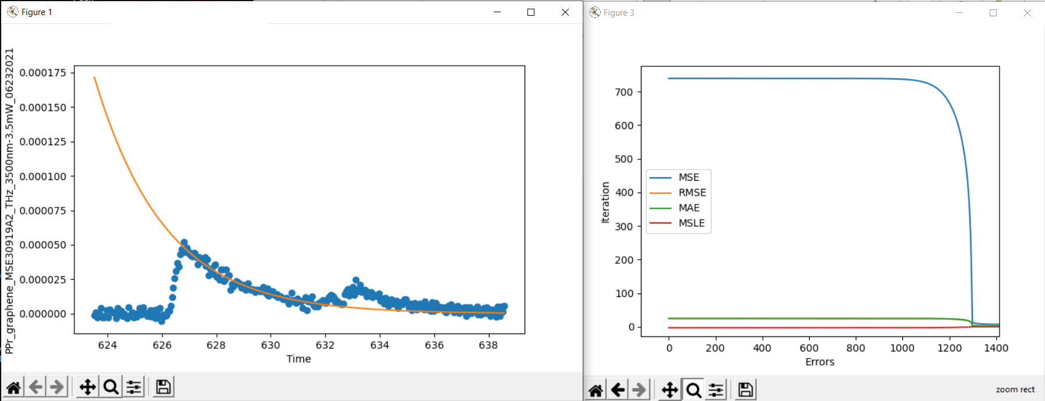
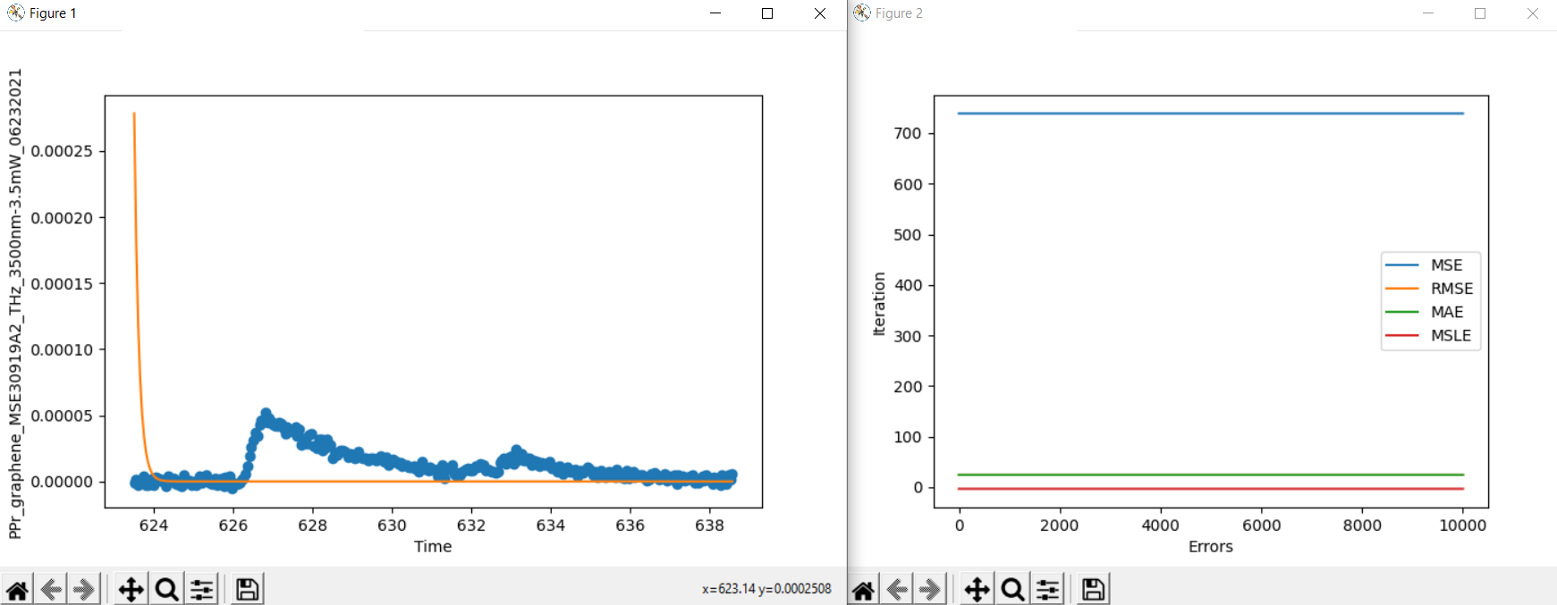
MSE Results
SUCCESS
The function converges to a minimum at about 1300 iterations.
All the error functions decrease exponentially except the MSLE, which decreases linearly because its in logarithmic scale.
The algorithm works most of the time but sometimes the errors remain constant and the fit function parameters seem to be random.
FAILURE

Slide 20
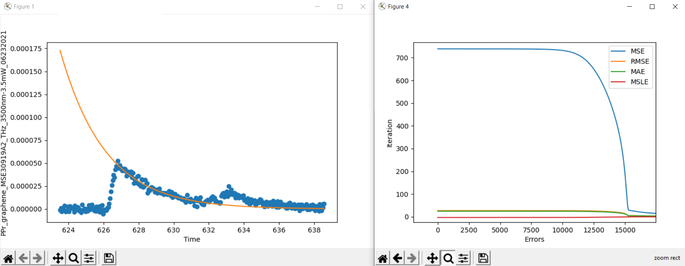
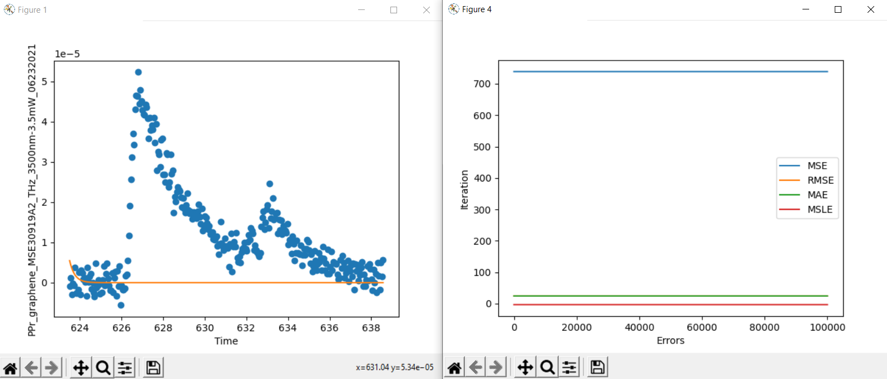
MSLE Results
SUCCESS
The function converges to a minimum at about 15500 iterations.
All the error functions decrease exponentially except the MSLE, which decreases linearly because its in logarithmic scale.
The algorithm works most of the time but sometimes the errors remain constant and the fit function parameters seem to be random.
FAILURE

Slide 21
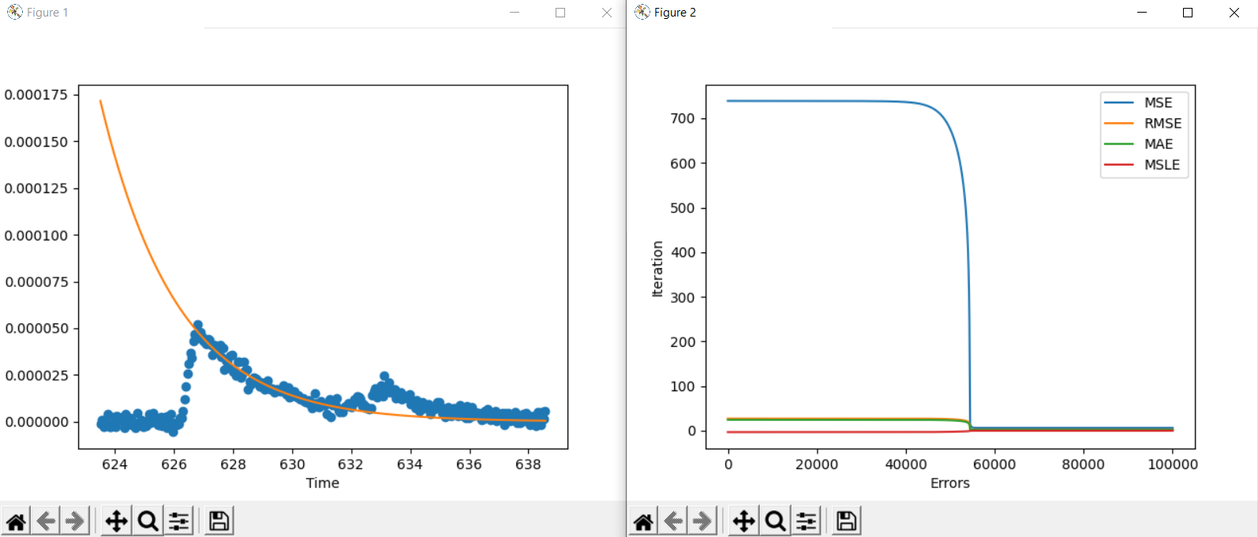
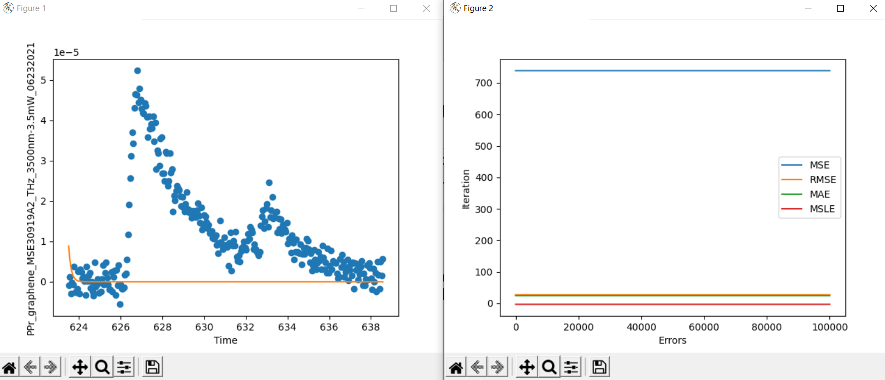
RMSE Results
SUCCESS
The function converges to a minimum at about 56,000 iterations.
All the error functions decrease exponentially except the MSLE, which decreases linearly because its in logarithmic scale.
The algorithm works most of the time but sometimes the errors remain constant and the fit function parameters seem to be random.
FAILURE

Slide 22
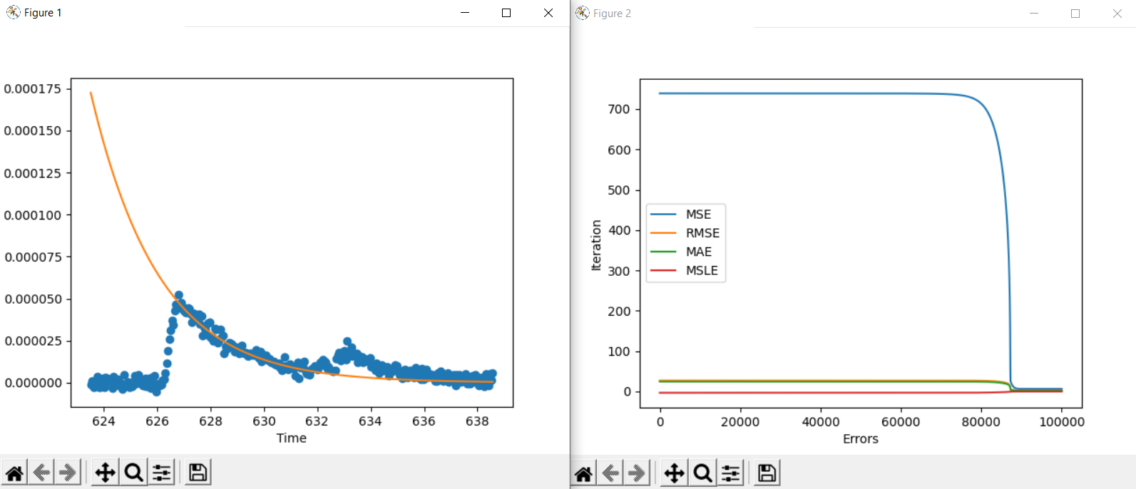

MAE Results
SUCCESS
The function converges to a minimum at about 88000 iterations.
All the error functions decrease exponentially except the MSLE, which decreases linearly because its in logarithmic scale.
The algorithm works most of the time but sometimes the errors remain constant and the fit function parameters seem to be random.
FAILURE

Slide 23
Fits Results Comparisons
MSE
MAE
MSLE
RMSE

Slide 24
Conclusions
The MSE function worked best out of them because it penalizes large errors a lot due to the square term, his very useful with line fitting because the parameters adapt faster due to the high derivative magnitudes, which are degree 1 but are scaled by the derivative of the square term.
The function converges at about 1300 iterations which is much faster than the rest, its followed by MSLE at 15,500 iterations. Next is RMSE at about 56,000 iterations and finally MAE at 88,000. There is a drastic difference between them. More tests must be done to determine if these test results are constant.
The error in all methods seems to remain constant until it reaches a point where it starts decreasing very fast, exponentially.

Slide 25
Error References
https://towardsdatascience.com/common-loss-functions-in-machine-learning-46af0ffc4d23
https://medium.com/analytics-vidhya/mae-mse-rmse-coefficient-of-determination-adjusted-r-squared-which-metric-is-better-cd0326a5697e
https://www.section.io/engineering-education/understanding-loss-functions-in-machine-learning/
https://peltarion.com/knowledge-center/documentation/modeling-view/build-an-ai-model/loss-functions/mean-squared-logarithmic-error-(msle)

