Slide 1
Where To Set Up Any Business
Coursera Capstone Assignment
Archit Narain.G

Slide 2
The Location Of A Business Is Important
The location is important as staff and customers depend on this factor and when there is a good customer and staff base from a good location, a business really grows and generates a large amount of profit.
Good Locations significantly boost a company’s long-term profit

Slide 3
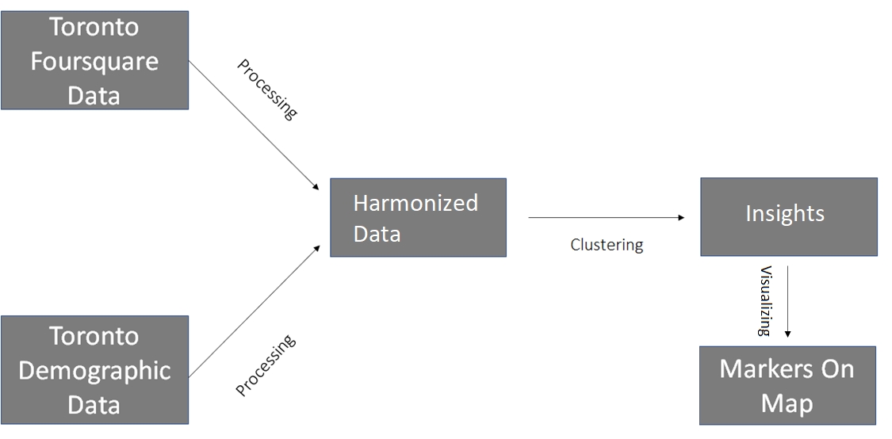
Solution Architecture

Slide 4

Data Used and How They Contribute
For this assignment I have used the following datasets:-
List of Postal Codes Of Canada (To get the postal code and latitudes and longitudes of the neighbourhoods)
Demographic data of Toronto Neighbourhoods (To get the population and average income of the neighbourhoods)
Foursquare data (To get the number of venues in each neighbourhoods)

Slide 5

The Best Neighbourhoods….
The best neighbourhoods were determined by the following factors :-
Income of the neighbourhood
Population of the neighbourhood
Number of Venues in the neighbourhood
If the neighbourhoods have a good income, population and many venues we consider them; else we simply ignore them.

Slide 6

Machine Learning Techniques Used
To determine the similarity between the best neighbourhoods, clustering is used to group the similar neighbourhoods together
This is considered advantageous as if a person would like to set up a business in one of the best neighbourhoods and is not able to, then we can provide them with another similar option

Slide 7
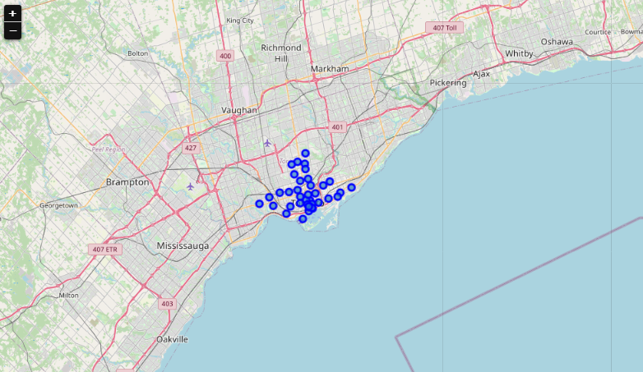
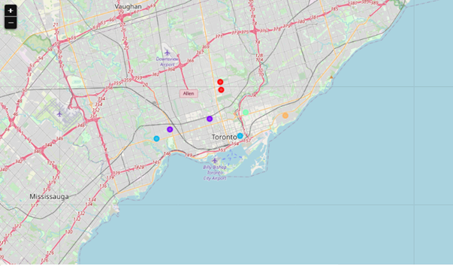
Neighbourhoods Best Neighbourhoods

Slide 8

Similarity
Swansea – Harbourfront
High Park – The Annex
Davisville – Davisville North
Riverdale & The Beaches – Not similar to any neighbourhood

Slide 9
Conclusion
Good Neighbourhoods to set up a business:-
Davisville (+ Davisville North)
High Park
The Beaches
Harbourfront
Swansea
The Annex
Riverdale

Slide 10
Thank You

