Slide 1
FPGAs and Bluespec:
Experiences and Practices
Eric S. Chung, James C. Hoe
{echung, jhoe}@ece.cmu.edu

Slide 2
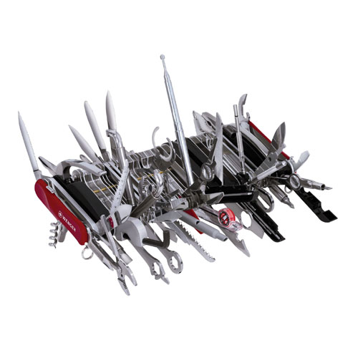
My learning experience w/ Bluespec
This talk:
  Share actual design experiences/pitfalls/problems/solutions
  Suggestions for Bluespec

Slide 3
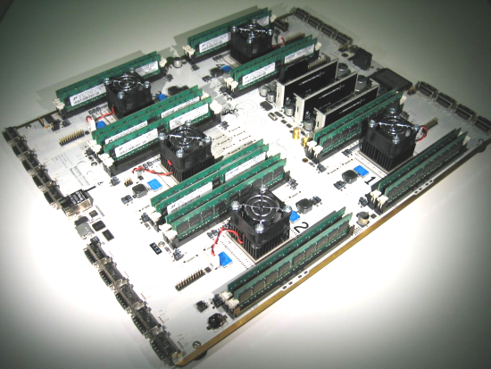
Why Bluespec?
Our project
  Multiprocessor UltraSPARC III architectural simulator using FPGAs
  Run full-system SPARC apps (e.g., Solaris, OLTP)
  Run-time instrumentation (e.g., CMP cache) 100x faster than SW
Berkeley Emulation Engine (BEE2)
5 Vertex-II Pro 70 FPGAs
SPARC
CPU
SPARC
CPU
CPU
SPARC
CPU
Memory
The role of Bluespec
  Retain flexibility & abstraction comparable to SW-based simulators
  Reduce design & verification time for FPGAs
August 13, 2007 Eric S. Chung / Bluespec Workshop

Slide 4
Completed design details
FPGA 1
Memory traces
FPGA 2
16-way interleaved
SPARC pipeline
16-way CMP
cache simulator
“Functional” trace generator
L1 I
L1 D
Memory controllers
Large multi-FPGA system built from scratch (4/07 – now):
  16 independent CPU contexts in a 64-bit UltraSPARC III pipeline
  Non-blocking caches and memory subsystem
  Multiple clock domains within/across multiple FPGA chips
  20k lines of Bluespec, pipeline runs up to 90 MHz @ IPC = 1

Slide 5
Summary of lessons learned
Lesson #1: Your Bluespec FPGA toolbox: black or white?
Lesson #2: Obsessive-Compulsive Synthesis Syndrome
Lesson #3: I’m compiling as fast as I can, Captain!
Lesson #4: Stress-free with Assertions
Lesson #5: Look Ma! No Waveforms!
Lesson #6: Have no fear, multi-clock is here
Lesson #7: Guilt-free Verilog

Slide 6
L1: Your FPGA toolbox: Black or White?
Two approaches to creating an FPGA Bluespec toolbox:
  Black – was given to me and just works, no area/timing intuition
  White – know exactly how many LUTs/FFs/BRAMs you’re getting
A cautionary tale:
  We initially used Standard Prelude prims extensively (e.g., FIFO)
Example 1
64-bit 16-entry FIFO from Bluespec Standard Prelude
Xilinx XST synthesis report:
1069 flip-flops
623 LUTs
Example 2
Same module redone using Xilinx distributed RAMs
Xilinx XST synthesis report:
21 flip-flops
163 LUTs

Slide 7

L2: Obsessive-Compulsive Synthesis Syndrome (OCSS)
Don’t wait until the end to synthesize your Bluespec!
  High-level abstraction makes it almost too easy to “program” HW
  Not easy to determine area/timing overheads after 20K lines
module mkFooBaz( FooBaz#(idx_t, data_t) )
provisos( Bits#(idx_t, idx_nt),
Bits#(data_t, data_nt) );
Vector#( idx_nt, Reg#(Bit#(data_nt)) ) array <- replicateM( mkReg(?) );
method Action write( idx_t idx, data_t din );
array[pack(idx)] <= pack(din);
endmethod
method data_t read( idx_t idx );
return unpack( array[pack(idx)] );
endmethod
endmodule
Quick tip (OCSS is good for you)
Make it effortless to go from *.bsv file → synthesis report
$> make mkClippy Clippy.bsv
$> compiling ./Clippy.bsv
…
$> Total number of 4-input LUTs used: 500,000
This is an array of N FF-based registers w/ an N-to-1 mux at read port. Is it obvious?

Slide 8
L3: I’m compiling as fast as I can, captain!
Problem: big designs w/ lots of rules take forever to compile
  E.g., compiling our SPARC design takes 30m on 2.93GHz Core 2 Duo
Workarounds:
  Incremental module compilation w/ (*synthesis*) pragmas
  ➔ very effective but forgoes passing interfaces into a module
  Lower scheduler’s effort & improve your rule/method predicates
Feedback for Bluespec
  a) “-prof” flag that gives timing feedback & suggests optimizations
  b) more documentation on what each compile stage does
  c) “-j 2” parallel compilation?

Slide 9
L4: Stress-free with Assertions
Assert and OVLAssert libraries (USE THEM)
  Our SPARC design has over 300 static + dynamic assertions
  Caught > 50% design bugs in simulation
Key difference from Verilog assertions:
  Assertion test expressions automatically include rule predicates
  Test expressions look VERY clean
Suggestions
  Synthesizable assertions for run-time debugging
  Assertions at rule-level?
  (e.g., if R1, R2 fire, then R3 eventually must fire)

Slide 10
L5: Look Ma! No Waveforms!
Interesting consequence of atomic rule-based semantics:
  $display() statements easily associated with atomic rule actions
  Majority of our debugging was done with traces only
  Very similar to SW debugging
Suggestions
  Support trace-based debugging more explicitly (gdb for Bluespec?)
  Controlled verbosity/severity of $display statements
  Context-sensitive $display

Slide 11
L6: Have no fear, Multi-clock is here
Multiple clock domains show up in large designs
  Sometimes start at freq < normal clock to speed up place & route
  But synchronization is generally tricky
Bluespec Clocks library to the rescue
  Contains many clock crossing primitives
  Most importantly, compiler statically catches illegal clock crossings
  TAKE advantage of this feature
(Anecdote) our system has 4 clock domains over 2 FPGAs
  With Bluespec, had no synchronization problems on FIRST try

Slide 12
L7: Guilt-free Verilog
Sometimes talking to Verilog is unavoidable
  Systems rarely come in a single HDL
  Learn how to import Verilog into Bluespec (import “BVI”)
  Understand what methods are and how they map to wires
Sometimes you feel like writing Verilog (and that’s okay!)
  Synthesis tools can be fickle
  Some behaviors better suited to synchronous FSMs
  (e.g., synchronous hand-shake to DDR2 controller)
  Solutions: write sequential FSM within 1 giant Bluespec rule
  OR write it in Verilog and wrap it into a Bluespec interface

Slide 13
Example: “Verilog-style” Bluespec
Wire#(Bool) en_clippy <- mkBypassWire();
rule clippy( True );
State_t nstate = Idle;
case( state )
Idle: nstate = En_clippy;
En_clippy: nstate = Idle;
default: dynamicAssert(False,…);
endcase
if( state == En_clippy )
en_clippy <= True;
endrule

Slide 14
Conclusion
Big thanks to Bluespec
Your feedback/comments are welcome!
echung@ece.cmu.edu
Learn more about our FPGA emulation efforts:
http://www.ece.cmu.edu/~simflex/protoflex.html

